Slide 1

An overview of Céu
(”A Safe and Reactive language
for Embedded Systems”)
Francisco Sant'Anna
santanna@chalmers.se
LabLua@PUC-Rio

Slide 2
Why I am here?
TODO

Slide 3
Concurrency Models
Asynchronous
  independent activities
  requires synchronization primitives (mutexes, monitors, channels, pipes)
Threads (Java, p-threads)
Processes (UNIX)
Actors (erlang)
Synchronous
  stepwise execution
  requires asynchronous (nonblocking) primitives
Event-driven (callbacks)
Finite state machines
TinyOS
Céu

Slide 4
Motivation
Asynchronous (threads)
  structured programming
  safety issues
  complex implementation
  parallel execution
Synchronous (callbacks)
  unstructured programming
  lock-free concurrency
  small footprint
  serial execution
VS
  structured programming
  lock-free concurrency
  small footprint
  parallel execution
?

Slide 5
Reactive “Hello World!”
loop do
await 1s;
_printf("Hello World!\n");
end

Slide 6
A simple specification
Increment a counter every second
Reset the counter on external request
Show the counter value whenever it changes

Slide 7
input int RESET; // external event
event int c = 0; // reactive variable
par do
loop do // 1st trail
await 1s;
emit c = c+1;
end
with
loop do // 2nd trail
c = await RESET;
emit c;
end
with
loop do // 3rd trail
await c;
_printf("c = %d\n", c);
end
end

Slide 8
Overview of Céu
Reactive
  environment in control: events
Imperative
  sequences, loops, assignments
Concurrent
  multiple lines of execution: trails
Synchronous
  trails synchronize at each external event
  trails are always awaiting
Deterministic (*)
  always yields the same outcome for a given timeline

Slide 9
par/and, par/or, par
loop do
par/and do
await A;
with
await 1s;
end
end
// SAMPLING (”at least”)
...

Slide 10
par/and, par/or, par
loop do
par/or do
await A;
with
await 1s;
end
end
// WATCHDOG (”at most”)
...

Slide 11
Two (possible) problems
Unbounded reaction
  Breaks the synchronous/reactive model
  All paths must either await or break
var int v=0;
await A;
loop do
v = v + 1;
end
await B;

Slide 12
Two (possible) problems
Non-determinism
input void A;
var int v=0;
par/and do
await A;
v = v+1;
with
await B;
v = v*2;
end
return v;
input void A;
var int v=0;
par/and do
await A;
v = v+1;
with
await A;
v = v*2;
end
return v;

Slide 13
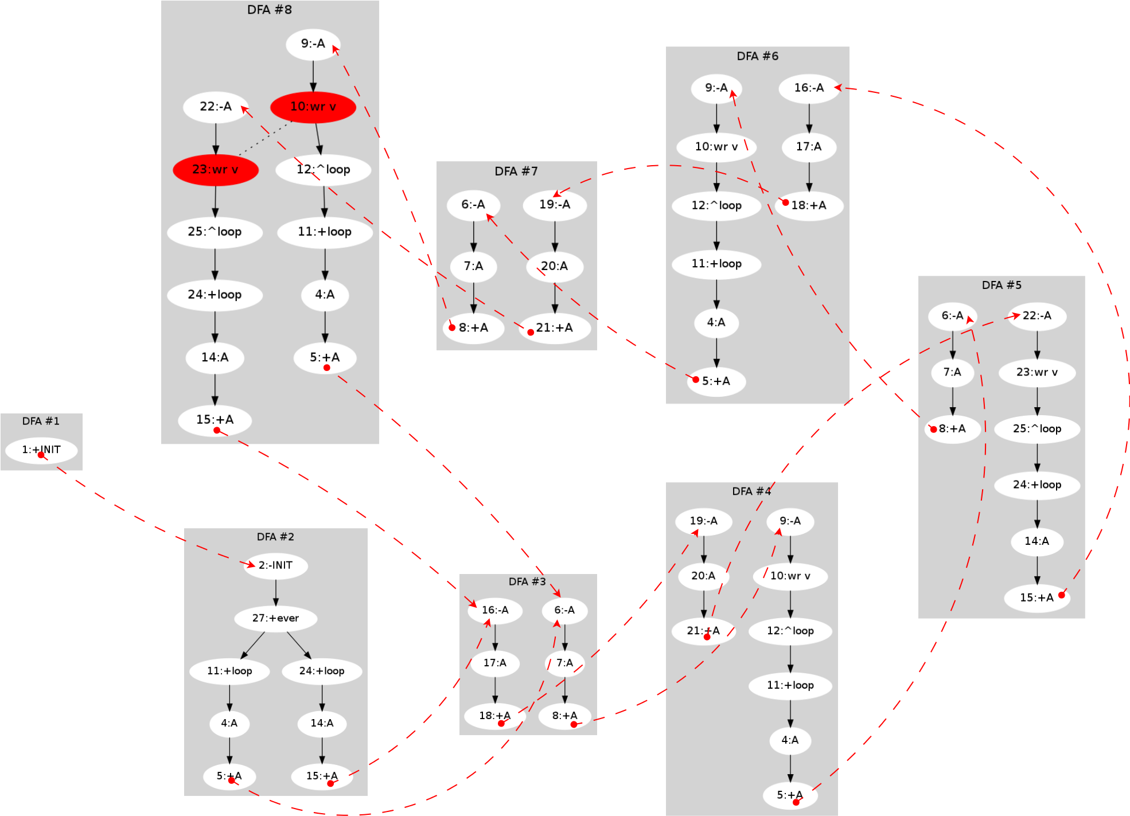
DFA conversion
input void A;
var int v;
par do
loop do
await A;
await A;
v = 1;
end
with
loop do
await A;
await A;
await A;
v = 2;
end
end
Exponential algorithm!

Slide 14
1st class Timers
Timers are very common in embedded apps
loop do
await 2min30s400ms;
... // do something
end
loop do
par/or do
// do something
with
await 500ms;
end
end

Slide 15
1st class Timers
1s + 1s = 2s (model and implementation (!))
loop do
await 10ms;
_printf(“1\n”);
await 1ms;
_printf(“2\n”);
end
15ms elapse
late = 5ms
late = 4ms
par/or do
loop do
await 10ms;
_printf(”1\n”);
await 1ms;
_printf(”2\n”);
end
with
await 15ms;
_printf(”3\n”);
end

Slide 16
1st class Timers
Temporal Analysis
var int v;
par/or do
loop do
await 10ms;
v = 1;
end
with
await 100ms;
v = 2;
end

Slide 17
Summary
Safety
  deterministic execution (exponential static analysis)
  lock-free concurrency (even w/o static analysis)
Expressiveness
  structured / parallel compositions
  1st-class timers
Small footprint
  ROM: 2 Kbytes
  RAM: 50 bytes

Slide 18
What is missing?
Object Oriented sub-system
Stacked execution for internal events
  exceptions, finalization blocks
Asynchronous blocks
  time-consuming computations
  simulation (deterministic & reproducible)
Output events
  communication between processes
Formal semantics
  operational semantics for control primitives

Slide 19
Céu + WSNs
Céu compiles to C
  easily ported to embedded platforms
    (e.g. Arduino,TinyOS)
TinyOS binding
  TOS events become input events in Céu
event message_t* Radio.receive(...) {...}
msg = await RADIO_RECEIVE;
  TOS commands become C functions in Céu
call Leds.set(7);
_Leds_set(7);

Slide 20
Blink (from TinyOS)
implementation {
event void Boot.booted() {
call T0.startPeriodic(250);
call T1.startPeriodic(500);
call T2.startPeriodic(1000);
}
event void T0.fired() {
call Leds.led0Toggle();
}
event void T1.fired() {
call Leds.led1Toggle();
}
event void T2.fired() {
call Leds.led2Toggle();
}
}
deterministic _Leds_led0Toggle
with _leds_led1Toggle,
_leds_led2Toggle;
deterministic _Leds_led1Toggle
with _leds_led2Toggle;
par do
loop do
await 250ms;
_Leds_led0Toggle();
end
with
loop do
await 500ms;
_Leds_led1Toggle();
end
with
loop do
await 1000ms;
_Leds_led2Toggle();
end
end

Slide 21
Demo:
Neighbors Discovery

Slide 22
Simulation
Important in cross-compiling platforms
Simulators
  Usually inaccurate
  Require additional knowledge
  Vary among platforms
Céu uses the own language for simulation
  input events: only source
  asynchronous blocks can emit input events

Slide 23
Simulation
par do
input int Start;
int v = await Start;
loop do
await 10min;
v = v + 1;
_printf(”v = %d\n”, v);
end
with
async do
emit Start=1;
emit 1h35min;
end
return 0;
end

Slide 24

An overview of Céu
(”A Safe and Reactive language
for Embedded Systems”)
www.ceu-lang.org
Thanks!

