Slide 1

A semantics for Céu
www.ceu-lang.org

Slide 2
Peculiarities of Céu
Synchronous model
  trails synchronize at each external event
  events are broadcast
Internal events
  ”stacked” execution
Determinism & unbounded execution
  handled in separate

Slide 3
Formal semantics
Describes a reaction chain
  reaction to a single external event
  Big-step rules
    match emits vs awaits at once
  Small-step rules
    advance unblocked trails
Full execution
  queue to hold incoming external events

Slide 4
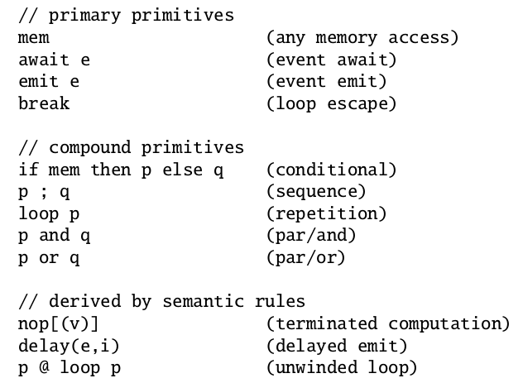
Syntax

Slide 5

Small-steps (1)
Associated with priority i
* No rules for nop, break, await, delay

Slide 6
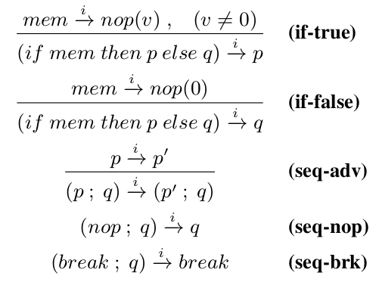
Small-steps (2)

Slide 7
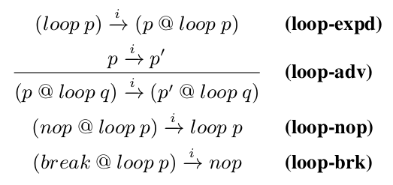
Small-steps (3)

Slide 8
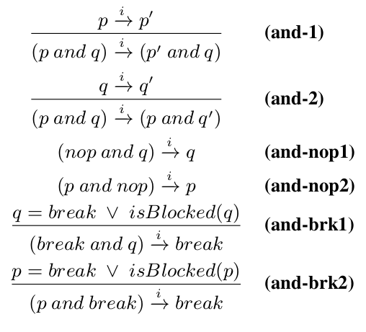
Small-steps (4)

Slide 9
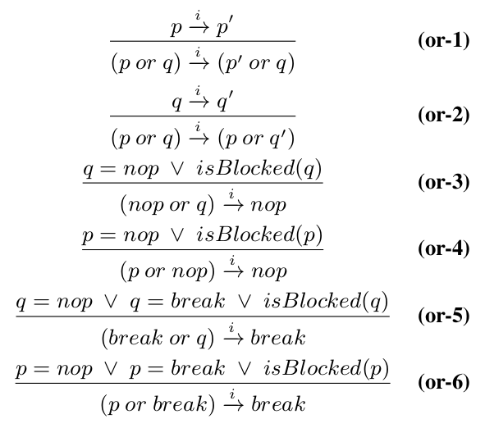
Small-steps (5)

Slide 10
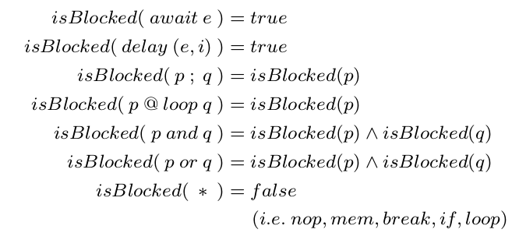
isBlocked(p)

Slide 11
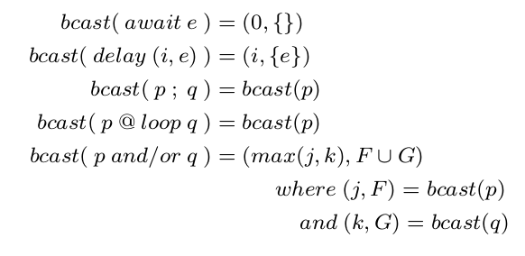
Big-steps (1)
Associated with priority tuple (i,E)
  initially, (i,E)=(0,{})
  then, (i,E)=bcast(p)

Slide 12
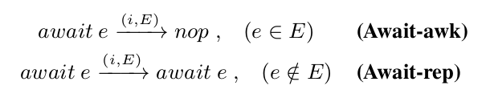
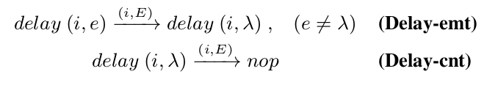
Big-steps (2)

Slide 13
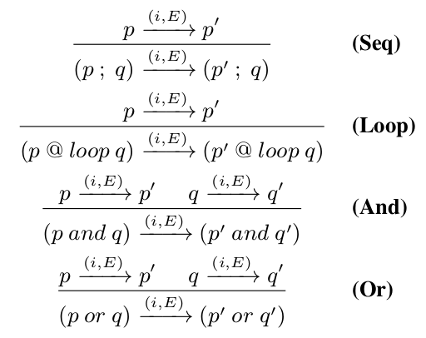
Big-steps (3)

Slide 14


A reaction chain
Terminating conditions:
  p'' = nop
  bcast = (0,{})

Slide 15
FIM

Slide 16
nothing (nothing)
mem (memory access)
await e (event await -- int/ext)
emit e (event emit -- int)
p ; q (sequence)
if mem then p else q (conditional)
loop p (loop)
break (break loop)
p or q (parallel/or)
p and q (parallel/and)

Slide 17
input int Restart;
event void e;
int v = 0;
par do
loop do // 1st trail
await 1s;
v = v + 1;
emit e;
end
with
loop do // 3rd trail
v = await Restart;
emit e;
end
with
loop do // 2nd trail
await e;
_printf("v = %d\n", v);
end
end

Slide 18
Reaction chain

Slide 19
Reaction chain
external
event

Slide 20
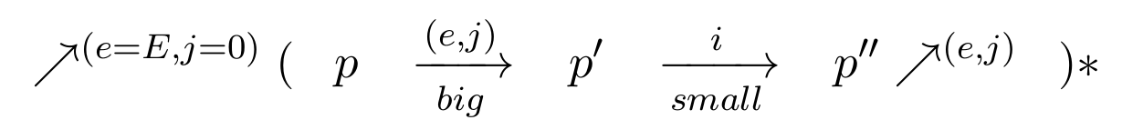
Reaction chain
external
event
small step
(other stmts)
big-step
(eliminate all
awaiting at once;
unwind loops)
internal emit
i = 0
repeat to completion

Slide 21
Example 1
p = (await A ; await A)
(0,{A})
p' = await A

Slide 22
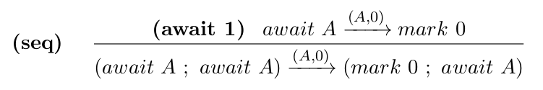
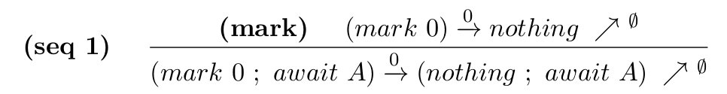
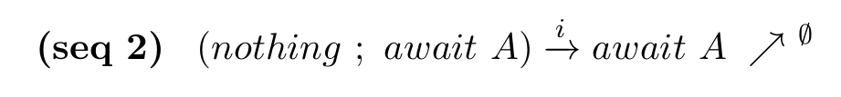
p = (await A ; await A)
big(0,{A})
p' = (mark 0 ; await A)
small(0)
big(-,-)
small(0)
0

Slide 23
Example 2
p = loop
if mem then
break
else
await A
Reaction 1: (0, {#})
Reaction 2: (0, {A})

Slide 24


p = loop
if mem then
break
else
await A
big (0,#)
p' = (if mem(v) then break else await A)
@ loop (if …)
small(0)
small(0)

Slide 25
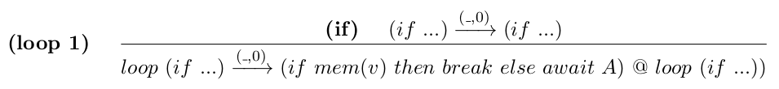
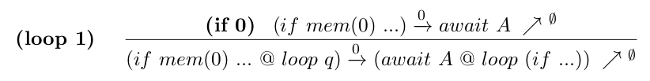
p = loop
if mem then
break
else
await A
big(_,0)
p' = (if mem(v) then break else await A)
@ loop (if …)
i = 0
small(0)

Slide 26
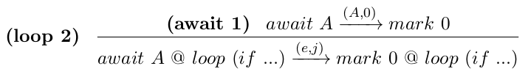

p = await A
@ loop (if …)
big(A,0)
p' = mark 0 @ loop (if ...)
small(0)
small(0)

Slide 27
Levels of priority
par/or do
await a;
v = 1;
with
await A;
emit a;
v = 2;
with
await A;
v = 3;
end
par/or do
await a;
v = 1; (+2)
with
await A;
emit a;
v = 2; (+1)
with
await A;
v = 3; (-)
end

Slide 28
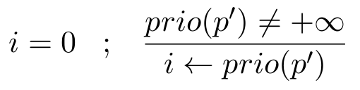
Reaction chain
external
event
small step
(other stmts)
big-step
(eliminate all
awaiting at once)
internal emit
repeat to completion

Slide 29
Example 3
par/or do
await a; // 2
emit b; // 3
v = 1; // no
with
await b; // 4
v = 2; // yes
with
await A;
emit a; // 1
v = 3; // no
end
p = (await a ; emit b ; mem(1))
or
( await b ; mem(2)
or
(await A ; emit a; mem(3)) )

Slide 30
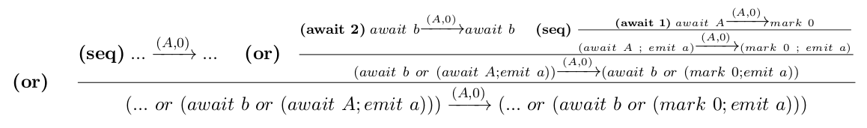
p = (await a ; emit b)
or
( await b
or
(await A ; emit a) )
big(A,0)
(await a ; emit b) or
(await b or (mark 0; emit a))

Slide 31
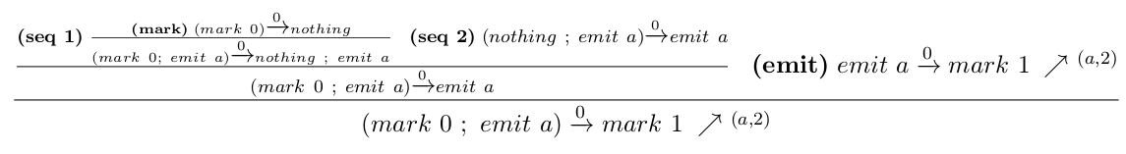
(await a ; emit b) or
(await b or (mark 0; emit a))
small*(0)
(await a ; emit b) or (await b or mark 1)
big(a,2)
(mark 2 ; emit b) or (await b or mark 1)
(await 1)
small(2)
(mark 3) or (await b or mark 1) (b,4)
big(b,4)
(mark 3) or (mark 4 or mark 1)
(or 4), (or 3)
small(4)
small(4)
nothing

Slide 32
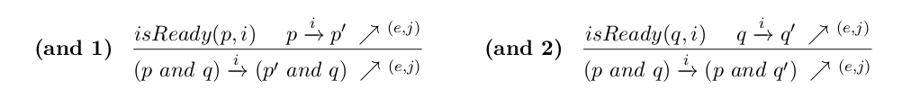
Nondeterminism
mem and mem

Slide 33
Unbounded execution
loop mem

