Slide 1
Céu: A low-level imperative
reactive language

Slide 2
Overview
Reactive
  environment in control: events
Concurrent
  multiple lines of execution: trails
Deterministic
  always yields the same outcome for a given timeline
Synchronous
  trails synchronize at each event
Imperative
  sequences, loops, assignments

Slide 3
Céu -> NCL (vs C)
Modeling
  temporal & spacial
Security
  cycles, bounded execution, no malloc, determinism
Performance
  generates C, single threaded
Test & Simulation
  uses the same language, uses the own program

Slide 4
Examples
( ~Key ~> Print )*
(~Step; ~>Jump)* || ~Lap

Slide 5
Execution Model
Time: discrete sequence of external input events
  sequence: only one event reacts at a time
  discrete: a reaction executes in bounded time
Program starts in one trail from the 1st expression.
Active trails execute without interruption. (Reaction Chain)
Check termination.
Await next event and repeat Step 2.

Slide 6
Example
(~Tick => v)* || (~End ; v)
Timeline:
2 ~> Tick
3 ~> Tick
~> End

Slide 7
Temporal Analysis
Bounded execution
  Loops: ~A ; (1)*
  Operators: 1 -> op
Determinism
  1=>v && 2=>v
  1 || 2
  (1^ && 2^)*

Slide 8
Céu -> DFA
DFA
  State: what to execute and what to await
  Transition: events
Detects:
  concurrent access to variables or events
  concurrent split/or termination
  concurrent loop escape
  unreachable expressions
  whether a program can terminate or not

Slide 9
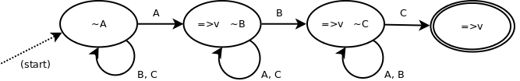
DFA example 1
~A=>v ; ~B=>v ; ~C=>v

Slide 10
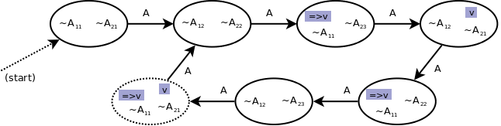
DFA example 2
(~A ; ~A ; 1=>v)* && (~A ; ~A ; ~A ; v)*

Slide 11
Internal events
Communication mechanism among trails
(~a ~> Print)* || (~Key ~> a)*
internal events <=> variables : reactive variables
Stack based execution policy:
( 0=>v ; ~Start ;
1~>a ; v->inc=>v -- expr.1
&&
~a~>b ; v->inc=>v -- expr.2
&&
~b~>c ; v->inc=>v ) -- expr.3

Slide 12
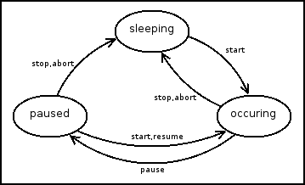
NCL State Machine
(~s._sleeping ;
(~s.start ~> s._occurring)
)*
||
(~s._occurring ;
( ~s.stop ~> s._sleeping
|| ~s.pause ~> s._paused )
)*
||
(~s._paused ;
( ~s.stop ~> s._sleeping
|| ~s.start ~> s._occurring )
)*

Slide 13
Link
link(s1.stop, s2.start)
(~s1.stop ~> s2.start)*

Slide 14
NCL Players
( (~r.x || ~r.y || ~r.w || ~r.h) ;
SDL_Rect(r.rect, r.x, r.y, r.w, r.h)
)*
||
( ~r.draw ;
(r.vis ? (screen, r.rect, r.clr)->SDL_FillRect)
)*

Slide 15
NCL Media
s
||
r
||
(~s._occurring => r.vis)*
||
((~s._sleeping || ~s._paused)->inv => r.vis)*

