Slide 1





Céu: A Synchronous and Reactive Language for Constrained
Embedded Systems
Francisco Sant'Anna

Slide 2

Background
LabLua:
  PUC-Rio
  Research in languages
  The home of Lua
My research:
  Reactive languages
  MSc.: LuaGravity
    reactive extensions to Lua
  (ongoing) PhD. : Céu
    a low-level reactive language “from scratch”
LabLua
PUC-Rio

Slide 3
Lua
Where is it used?
  everywhere (ranked 22th)
    after C, Java, Python, JavaScript, PHP, …
    before Fortran, Haskell, Erlang, Smalltalk, ...
  niche in games
Why?
  it's an extension scripting language
  “speaks” nicely with C

Slide 4

Some games...

Slide 5

Some games...

Slide 6

Some games...

Slide 7

Some games...

Slide 8

Some games...

Slide 9

Céu: A Synchronous and Reactive Language for Constrained
Embedded Systems
www.ceu-lang.org

Slide 10
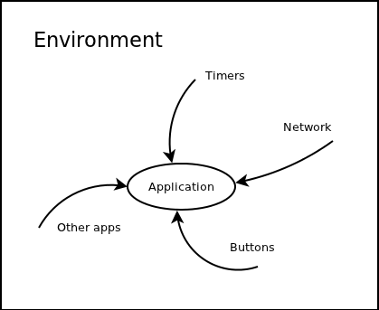
Reactive?
  environment in control
  real-time requirements
Synchronous?
  one event at a time
  safe concurrency
  imposes some restrictions
Constrained?
  Sensor networks
    32 Kb ROM
    4 Kb RAM

Slide 11
Key features of Céu
await statement
  (vs callbacks)
parallel compositions
  (vs threads)
safe shared-memory concurrency
  (vs mutexes & locks)
first-class timers
  (vs callbacks)
internal event-based communication
  (vs global state)

Slide 12
How does Céu look like?
“Run forever: read sensor and broadcast readings every 10 min.
Force new read/broadcast on external request.”
loop do
.
_sensorRequest();
int v = await SENSOR_READ;
.
_radioBroadcast(&v);
await RADIO_SENT;
.
.
.
.
.
.
end
loop do
.
_sensorRequest();
int v = await SENSOR_READ;
par/and do
_radioBroadcast(&v);
await RADIO_SENT;
with
await 10min;
end
.
.
.
end
loop do
par/or do
_sensorRequest();
int v = await SENSOR_READ;
par/and do
_radioBroadcast(&v);
await RADIO_SENT;
with
await 10min;
end
with
await RESTART;
end
end

Slide 13
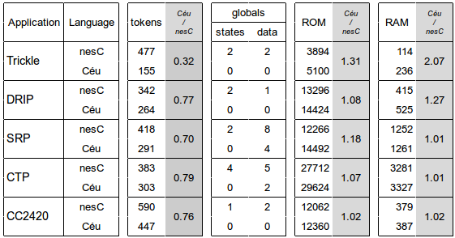
- 20-70% reduction
in code complexity
- no state variables
- less globals
- reasonable
footprint
Evaluation

