Slide 1
Safe and High-level Programming for Embedded Systems
Francisco Sant'Anna
Orientadores:
Roberto Ierusalimschy
Noemi Rodriguez

Slide 2
Embedded Systems
Hardware + Software
  development in conjunction
Reactive systems
  interaction with the environment
(sensors & actuators)
Development in C
  ”bare metal”
  RTOS: preemptive/cooperative multithreading

Slide 3
Synchronous Alternatives
Discrete time / External tick
Control/Imperative style:
  Esterel
Dataflow/Declarative style:
  Signal, Lustre
Developed in the early 80's
Today:
  Esterel Studio
  SCADE

Slide 4
Esterel
module ABRO:
input A, B, R;
output O;
loop
[ await A || await B ];
emit O
each R
end module

Slide 5
Lustre
node Count (evt, reset: bool)
returns (count: int);
let
count =
if (true -> reset) then
0
else
if evt then pre(count) + 1
else pre(count)
tel

Slide 6
Central idea
Embedded systems development can benefit from a new programming
language paradigm that unifies both control and dataflow reactive synchronous styles, while preserving typical C features that programmers are familiar with, namely shared memory concurrency.

Slide 7
Proposed model
Least common denominator
  control + dataflow + shared memory
  control-based kernel
    similar to Esterel
  introduce shared memory
    derive dataflow
Safety warranties
  unbounded execution, concurrent var access
No dynamic support
  memory allocation, dynamic loading

Slide 8
Control example
input void A, B, R;
output void O;
loop do
par/or do
par/and do
await A;
with
await B;
end
emit O;
with
await R;
end
end

Slide 9
Dataflow example
event void evt, reset;
event int count;
int v = 0;
loop do
par/or do
await reset;
v = 0; // !!!
with
await evt;
v = v + 1; // !!!
end
emit count(v);
end

Slide 10
Safety warranties
Bounded execution
  preserves the synchronous model
await A;
loop do
v = v + 1;
end
await B;

Slide 11
Safety warranties
Determinism
  usually desired
input void A;
int v;
par/and do
await A;
v = 1;
with
await A;
v = 2;
end
return v;
input void A;
int v;
par/and do
await A;
v = 1;
with
await A;
await A;
v = 2;
end
return v;

Slide 12
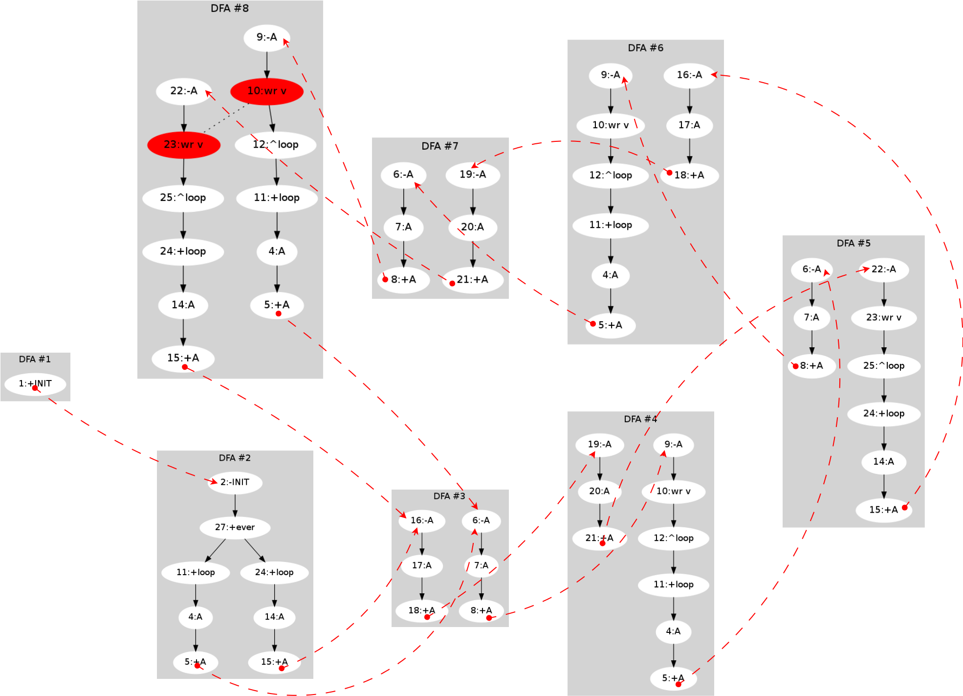
DFA convertion
input void A;
int v;
par do
loop do
await A;
await A;
v = 1;
end
with
loop do
await A;
await A;
await A;
v = 2;
end
end

Slide 13
Implementation
Céu Programming Language
  http://www.ceu-lang.org/
Bindings:
  TinyOS (OS for WSN)
  Arduino
Footprint:
  2 Kbytes/ROM
  50 bytes/RAM

Slide 14
From here...
Precise description
  operational semantics
New platforms
  even more constrained (e.g. PIC)
Application scenarios
  WSNs
  quantitative & qualitative analysis

Slide 15
1st class Timers
”Wall-clock” time is very common in reactive apps
  samplings, watchdogs, etc
loop do
await 1h2m3s4ms5us;
... // do something
end
loop do
par/or do
// do something
with
await 500ms;
end
end

Slide 16
1st class Wall-clock
1s + 1s = 2s (!!!) (model and implementation)
await 10ms;
v = 1;
await 1ms;
v = 2;
15ms elapses
dt = 5ms
dt = 4ms
Temporal Analysis
par/or do
loop do
await 10ms;
v = 1;
end
with
await 100ms;
v = 2;
end

