Slide 1

Céu: A Reactive language for Wireless Sensor Networks
Francisco Sant'Anna
Advisors:
Roberto Ierusalimschy
Noemi Rodriguez
LabLua
PUC-Rio

Slide 2
Overview of Céu
Reactive
  environment in control: events
Imperative
  sequences, loops, assignments
Concurrent
  multiple lines of execution: trails
Synchronous
  trails synchronize at each external event
Deterministic
  always yields the same outcome for a given timeline

Slide 3
Céu and TinyOS
Céu is implemented on top of nesC/TinyOS
  TinyOS events -> Céu external input events
    Radio.receive -> Radio_recv
  TinyOS commands -> Céu external output events
    Leds.set -> Leds_set

Slide 4
”Sum” Example
0 => acc;
(
( (~Radio_recv,acc)->add ~> acc )*
||
( ~acc ~> Leds_set )*
)

Slide 5
Synchronous Execution
Time: discrete sequence of external input events
  sequence: only one event reacts at a time
  discrete: a reaction executes in bounded time
Await next event and awake awaiting trails.
Active trails execute without interruption. (Reaction Chain)
Goto 1.

Slide 6
Temporal Analysis
Bounded execution
  Loops:
    (1)* (~A||v)* (v?1:~A)*
    (~A)* (~A&&v)* (~A?1:0)*
  Operations: (1,2) -> add
Determinism
  1=>v && 2=>v (vs: ~A=>v && ~B=>v)
  1~>A && 2~>B
  (1 || 2) => v
  (1^ && 2^)* => v

Slide 7
Céu -> DFA
Céu programs are converted to DFAs
Céu is static
Detects:
  concurrent access to variables or events
  concurrent par/or termination
  concurrent loop escape
  unreachable expressions

Slide 8
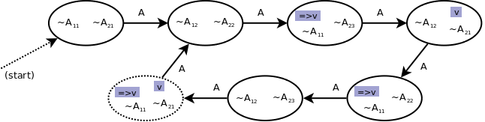
DFA example
(~A ; ~A ; 1=>v)*
||
(~A ; ~A ; ~A ; v)*

Slide 9
Examples

Slide 10
Blink
(
( ~250ms ; ~>Leds_led0Toggle )*
||
( ~500ms ; ~>Leds_led1Toggle )*
||
( ~1000ms ; ~>Leds_led2Toggle )*
)

Slide 11
Radio - Init
(
~1s
||
( ~>Radio_start => radio_err ?
~> radio_err
:
( ~Radio_startDone => radio_err ?
~> radio_err
:
0∧
)
) ;
~~
)*

Slide 12
Radio - Using
(
RADIO_START() -- copy init
||
(~radio_err ; ~>Leds_led0Toggle)*
) ;
... -- use the radio

Slide 13
System Development
System-level development
  Low-level, efficiency
Event-driven (e.g. nesC)
Multithreaded
  Cooperative (e.g. Protothreads)
  Preemptive (e.g. MantisOS)

Slide 14
Evaluation Aspects
Memory usage
Safety
  Deterministic & bounded execution
Expressiveness
Responsiveness
Energy Consumption

Slide 15
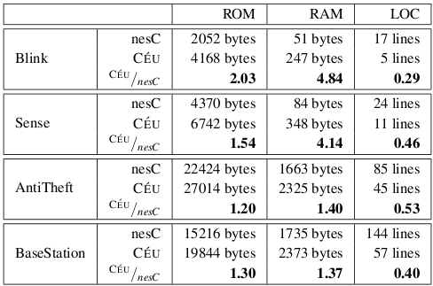
Memory & Expr.

Slide 16
Conclusion
Cons
  Purely static
Pros
  Static analysis
  Data & Control reactive styles

Slide 17
Thanks!

Slide 18
Async. Execution
(
@{
0 => sum ;
1 => i ;
(
(sum,i)->add => sum ;
(i,100)->eq ? sum∧ : i->inc=>i ;
)*
}
||
~10ms ;
0 ;
) ~> Leds_set ;

Slide 19
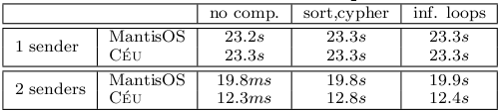
Responsiveness

Slide 20
Example
(~Tick => v)* || (~End ; v)
Timeline:
2 ~> Tick
3 ~> Tick
~> End

Slide 21
Internal Events
(~a -> dec ~> b)*
||
(~b -> inc ~> a)*

Slide 22
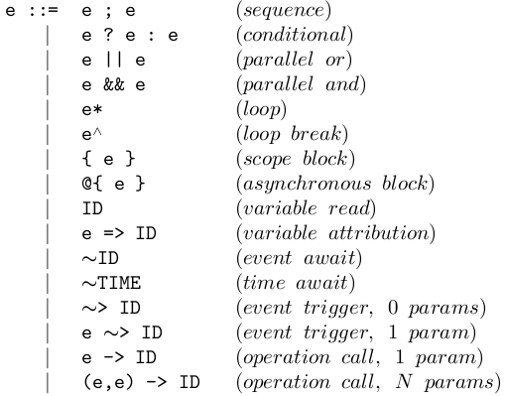
Syntax

