Slide 1
DONE
( github.com/fsantanna/tinyos-exps )

Slide 2
Evaluation
Trickle
Drip
CTP Routing
CC2420 Receive

Slide 3
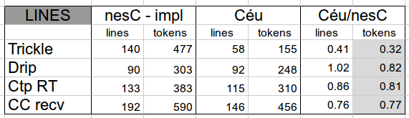
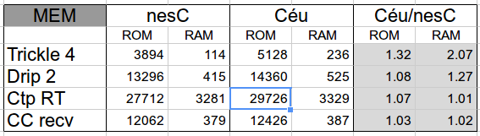
Tokens / ROM / RAM

Slide 4
Performance
CC2420 driver uses interrupts (async events)
  (with fine grained atomic sections)
Async execution breaks Céu assumptions
But...
  ”premature optimization is the root of all evil”
  ”scheduling is easy when the resource is almost always idle” (vs RTOS)

Slide 5
Performance
async event void InterruptFIFOP.fired () {
atomic {
ceu_go_event(IN_CC_RECV_FIFOP, NULL);
}
}
async event void RXFIFO.readDone (...) {
atomic {
cc_recv_readdone_t t = { rx_buf, rx_len, error };
ceu_go_event(IN_CC_RECV_READDONE, &t);
}
}

Slide 6
Performance
A mote receives 800 x 20-bytes messages
While performing two periodic activities
nesC
  receives and activities preempt each other
  maximum concurrency
Céu
  receives and activities run to completion

Slide 7
Performance
Parameters:
  receive rate: 100ms
  act-1 rate: 75ms for 1ms (1k instr ?)
  act-2 rate: 180ms for 3ms (3k instr ?)
nesC
  messages = 800
  act-1 + act-2 = 1140
Céu
  the same

Slide 8
Performance
Parameters:
  receive rate: 100ms
  act-1 rate: 45ms for 1ms
  act-2 rate: 90ms for 3ms
nesC
  messages = 800
  act-1 + act-2 = 1297
Céu
  messages = 800
  act-1 + act-2 = 1294 (-0.3%)

Slide 9
Performance
Parameters:
  receive rate: 50ms
  act-1 rate: 45ms for 1ms
  act-2 rate: 90ms for 3ms
nesC
  messages = 766
  act-1 + act-2 = 2244
Céu
  messages = 751 (-2.0%)
  act-1 + act-2 = 2239 (-0.3%)

Slide 10
References
Safety
  Efficient Memory Safety for TinyOS
Languages
  Protothreads: Simplifying Event-Driven …
  Virgil: Objects on the Head of a Pin
  Threads2Events: An Automatic Code …
General
  Experiences from a Decade of TinyOS Dev.

Slide 11
TODO
Enumerate Céu features used on each example
Rewrite (simpler) static analysis
  safety
  improve ROM
More porting
  rewrite SRP (exploring OO)
More references
Paper outline

Slide 12
Schedule
40 days left for SENSYS deadline
  6th April
Next 7 days
  rewrite the static analysis
  rewrite SRP
  enumerate Céu features
13-15th March SAAB-Brazil (Stockolm)
  need to write a poster

