Slide 1


Structured Synchronous Programming with Céu
(mixing control with data flow)
Francisco Sant'Anna
www.ceu-lang.org

Slide 2
“Hello world!” in Céu

Slide 3
“Hello world!” in Céu
Blinking a LED
  on ↔ off every 500ms

Slide 4
“Hello world!” in Céu
Blinking a LED
  on ↔ off every 500ms
loop do
await 500ms;
_leds_toggle();
end

Slide 5
“Hello world!” in Céu
Blinking a LED
  on ↔ off every 500ms
  stop after “press”
loop do
await 500ms;
_leds_toggle();
end

Slide 6
“Hello world!” in Céu
Blinking a LED
  on ↔ off every 500ms
  stop after “press”
par/or do
loop do
await 500ms;
_leds_toggle();
end
with
await PRESS;
end
loop do
await 500ms;
_leds_toggle();
end

Slide 7
“Hello world!” in Céu
Blinking a LED
  on ↔ off every 500ms
  stop after “press”
par/or do
loop do
await 500ms;
_leds_toggle();
end
with
await PRESS;
end
loop do
await 500ms;
_leds_toggle();
end
Lines of execution
=
Trails (in Céu)

Slide 8
“Hello world!” in Céu
Blinking a LED
  on ↔ off every 500ms
  stop after “press”
  restart after 2s
par/or do
loop do
await 500ms;
_leds_toggle();
end
with
await PRESS;
end
loop do
await 500ms;
_leds_toggle();
end
Lines of execution
=
Trails (in Céu)

Slide 9
“Hello world!” in Céu
Blinking a LED
  on ↔ off every 500ms
  stop after “press”
  restart after 2s
par/or do
loop do
await 500ms;
_leds_toggle();
end
with
await PRESS;
end
loop do
par/or do
loop do
await 500ms;
_leds_toggle();
end
with
await PRESS;
end
await 2s;
end
loop do
await 500ms;
_leds_toggle();
end
Lines of execution
=
Trails (in Céu)

Slide 10
“Hello world!” in Céu
Blinking a LED
  on ↔ off every 500ms
  stop after “press”
  restart after 2s
Compositions
  seq, loop, par (trails)
    At any level of depth
par/or do
loop do
await 500ms;
_leds_toggle();
end
with
await PRESS;
end
loop do
par/or do
loop do
await 500ms;
_leds_toggle();
end
with
await PRESS;
end
await 2s;
end
loop do
await 500ms;
_leds_toggle();
end
Lines of execution
=
Trails (in Céu)

Slide 11
“Hello world!” in Céu
Blinking a LED
  on ↔ off every 500ms
  stop after “press”
  restart after 2s
Compositions
  seq, loop, par (trails)
    At any level of depth
  state variables / communication
par/or do
loop do
await 500ms;
_leds_toggle();
end
with
await PRESS;
end
loop do
par/or do
loop do
await 500ms;
_leds_toggle();
end
with
await PRESS;
end
await 2s;
end
loop do
await 500ms;
_leds_toggle();
end
Lines of execution
=
Trails (in Céu)

Slide 12
“Hello world!” in Céu
Blinking a LED
  on ↔ off every 500ms
  stop after “press”
  restart after 2s
Compositions
  seq, loop, par (trails)
    At any level of depth
  state variables / communication
loop do
par/or do
loop do
await 500ms;
_leds_toggle();
end
with
await PRESS;
end
await 2s;
end

Slide 13
“Hello world!” in Céu
Where is my data?
Blinking a LED
  on ↔ off every 500ms
  stop after “press”
  restart after 2s
Compositions
  seq, loop, par (trails)
    At any level of depth
  state variables / communication
loop do
par/or do
loop do
await 500ms;
_leds_toggle();
end
with
await PRESS;
end
await 2s;
end

Slide 14
Mixing data & control flow

Slide 15
Mixing data & control flow
Controlling the ball inside the screen
  click mouse to start
  ball moves in one direction with an acceleration
  click mouse to turn clockwise (single-button controller)

Slide 16
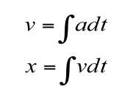
Mixing data & control flow
Controlling the ball inside the screen
  click mouse to start
  ball moves in one direction with an acceleration
  click mouse to turn clockwise (single-button controller)
Data flow:
  position is the integral of velocity
  velocity is the integral of acceleration

Slide 17
Mixing data & control flow
Controlling the ball inside the screen
  click mouse to start
  ball moves in one direction with an acceleration
  click mouse to turn clockwise (single-button controller)
Data flow:
  position is the integral of velocity
  velocity is the integral of acceleration

Slide 18
Mixing data & control flow
Controlling the ball inside the screen
  click mouse to start
  ball moves in one direction with an acceleration
  click mouse to turn clockwise (single-button controller)
Data flow:
  position is the integral of velocity
  velocity is the integral of acceleration
Control flow:
  abrupt changes in the clicks (non-continuous functions)
  discontinuity suggests state (e.g., isRunning, currentDirection)

Slide 19
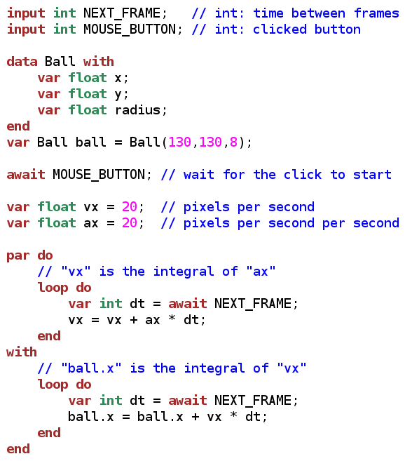
Moving the ball

Slide 20
Moving the ball

Slide 21
Moving the ball

Slide 22
Moving the ball

Slide 23
Moving the ball

Slide 24
Moving the ball

Slide 25
Moving the ball

Slide 26
Moving the ball

Slide 27
Moving the ball

Slide 28
Moving the ball

Slide 29
Moving the ball

Slide 30
Moving the ball
Lengthy, low level...

Slide 31
Moving the ball
Lengthy, low level...
  simple data dependency pattern
    1 par + 2 loop
  relies on mutation
    scheduling follows lexical order

Slide 32
Moving the ball
Lengthy, low level...
  simple data dependency pattern
    1 par + 2 loop
  relies on mutation
    scheduling follows lexical order
Abstractions

Slide 33
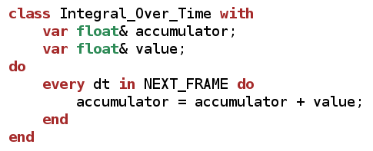
Moving the ball
Lengthy, low level...
  simple data dependency pattern
    1 par + 2 loop
  relies on mutation
    scheduling follows lexical order
Abstractions

Slide 34
Moving the ball
Lengthy, low level...
  simple data dependency pattern
    1 par + 2 loop
  relies on mutation
    scheduling follows lexical order
Abstractions

Slide 35
Moving the ball
Lengthy, low level...
  simple data dependency pattern
    1 par + 2 loop
  relies on mutation
    scheduling follows lexical order
Abstractions

Slide 36
Moving the ball
Lengthy, low level...
  simple data dependency pattern
    1 par + 2 loop
  relies on mutation
    scheduling follows lexical order
Abstractions
  Interface (fields + methods)

Slide 37
Moving the ball
Lengthy, low level...
  simple data dependency pattern
    1 par + 2 loop
  relies on mutation
    scheduling follows lexical order
Abstractions
  Interface (fields + methods)

Slide 38
Moving the ball
Lengthy, low level...
  simple data dependency pattern
    1 par + 2 loop
  relies on mutation
    scheduling follows lexical order
Abstractions
  Interface (fields + methods)

Slide 39
Moving the ball
Lengthy, low level...
  simple data dependency pattern
    1 par + 2 loop
  relies on mutation
    scheduling follows lexical order
Abstractions
  Interface (fields + methods)

Slide 40
Moving the ball
Lengthy, low level...
  simple data dependency pattern
    1 par + 2 loop
  relies on mutation
    scheduling follows lexical order
Abstractions
  Interface (fields + methods)

Slide 41
Moving the ball
Lengthy, low level...
  simple data dependency pattern
    1 par + 2 loop
  relies on mutation
    scheduling follows lexical order
Abstractions
  Interface (fields + methods)

Slide 42
Moving the ball
Lengthy, low level...
  simple data dependency pattern
    1 par + 2 loop
  relies on mutation
    scheduling follows lexical order
Abstractions
  Interface (fields + methods)
  Body (any code in Céu)

Slide 43
Moving the ball
Lengthy, low level...
  simple data dependency pattern
    1 par + 2 loop
  relies on mutation
    scheduling follows lexical order
Abstractions
  Interface (fields + methods)
  Body (any code in Céu)

Slide 44
Moving the ball
Lengthy, low level...
  simple data dependency pattern
    1 par + 2 loop
  relies on mutation
    scheduling follows lexical order
Abstractions
  Interface (fields + methods)
  Body (any code in Céu)
  Organisms ~ Simula Objects

Slide 45
Moving the ball
Lengthy, low level...
  simple data dependency pattern
    1 par + 2 loop
  relies on mutation
    scheduling follows lexical order
Abstractions
  Interface (fields + methods)
  Body (any code in Céu)
  Organisms ~ Simula Objects
Organisms react directly
to the environment

Slide 46
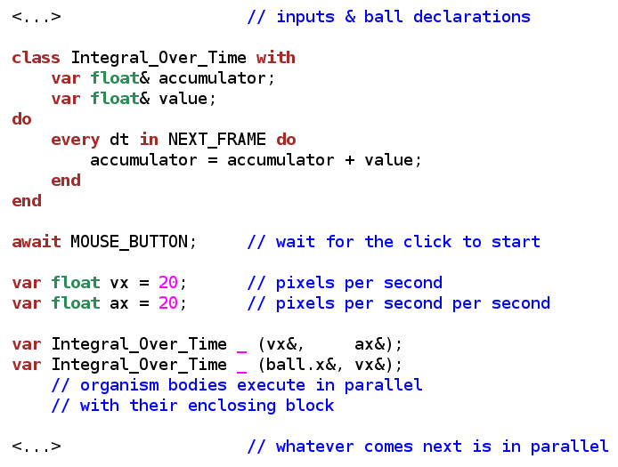
Moving the ball

Slide 47
Moving the ball

Slide 48
Moving the ball

Slide 49
Moving the ball

Slide 50
Moving the ball

Slide 51
Moving the ball
anonymous
instances

Slide 52
Moving the ball
Organisms
  body executes in parallel with the block
anonymous
instances

Slide 53
Moving the ball
Organisms
  body executes in parallel with the block
anonymous
instances

Slide 54
Moving the ball
Organisms
  body executes in parallel with the block
anonymous
instances

Slide 55
Moving the ball
Organisms
  body executes in parallel with the block
anonymous
instances

Slide 56
Moving the ball
Organisms
  body executes in parallel with the block
anonymous
instances

Slide 57

Moving the ball
Organisms
  body executes in parallel with the block
anonymous
instances

Slide 58
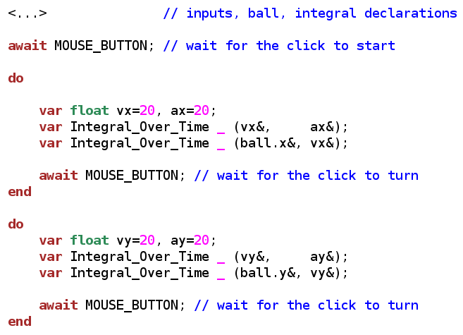
Making the turn

Slide 59
Making the turn

Slide 60
Making the turn

Slide 61
Making the turn

Slide 62
Making the turn

Slide 63
Making the turn
Doesn't work as expected
  previous dependencies still active

Slide 64
Making the turn
Doesn't work as expected
  previous dependencies still active

Slide 65
Making the turn
Doesn't work as expected
  previous dependencies still active

Slide 66
Making the turn
Doesn't work as expected
  previous dependencies still active
Lexical scope for organisms
  data reclaimed, body aborted

Slide 67
Making the turn
Doesn't work as expected
  previous dependencies still active
Lexical scope for organisms
  data reclaimed, body aborted

Slide 68
Making the turn
Doesn't work as expected
  previous dependencies still active
Lexical scope for organisms
  data reclaimed, body aborted

Slide 69
Making the turn
Doesn't work as expected
  previous dependencies still active
Lexical scope for organisms
  data reclaimed, body aborted
Mixing data and control flow
  automatic data updates
  no explicit state machines
  structured code with lexical scope

Slide 70
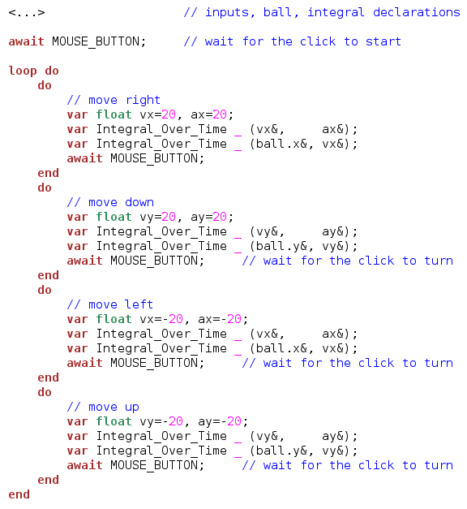
Closing the loop

Slide 71
Closing the loop

Slide 72
Closing the loop

Slide 73
Closing the loop

Slide 74
Closing the loop

Slide 75
Closing the loop
Lenghty code...

Slide 76
Closing the loop
Lenghty code...
  ... but regular

Slide 77
Closing the loop
Lenghty code...
  ... but regular

Slide 78
Closing the loop
Lenghty code...
  ... but regular

Slide 79
Closing the loop
Lenghty code...
  ... but regular

Slide 80
Closing the loop
Lenghty code...
  ... but regular

Slide 81
Closing the loop
Lenghty code...
  ... but regular
  “abstractable” with another class

Slide 82
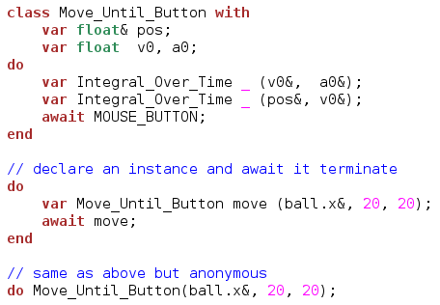
Closing the loop
Lenghty code...
  ... but regular
  “abstractable” with another class

Slide 83
Closing the loop
Lenghty code...
  ... but regular
  “abstractable” with another class

Slide 84
Closing the loop
Lenghty code...
  ... but regular
  “abstractable” with another class

Slide 85
Closing the loop
Lenghty code...
  ... but regular
  “abstractable” with another class

Slide 86
Closing the loop
Lenghty code...
  ... but regular
  “abstractable” with another class

Slide 87
Closing the loop
Lenghty code...
  ... but regular
  “abstractable” with another class

Slide 88
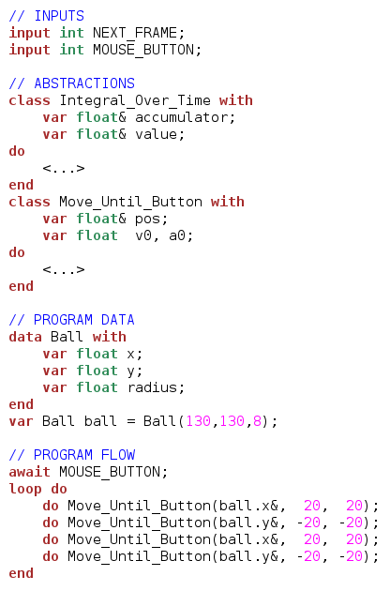
Closing the loop

Slide 89
Closing the loop

Slide 90
Closing the loop

Slide 91
Closing the loop
Structured, sequential, and with encapsulated data flow.

Slide 92
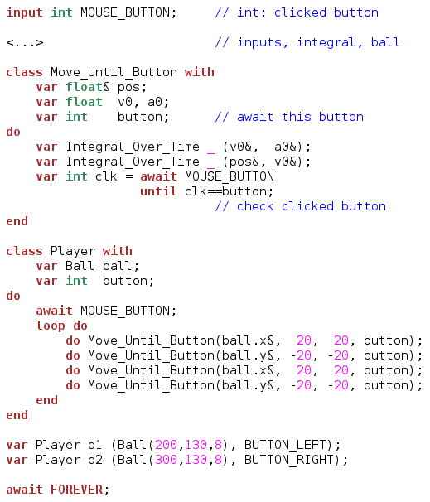
More abstractions
(two players)

Slide 93
More abstractions
(two players)

Slide 94
More abstractions
(two players)

Slide 95
More abstractions
(two players)

Slide 96
More abstractions
(two players)

Slide 97
More abstractions
(two players)

Slide 98
More abstractions
(two players)

Slide 99
More abstractions
(two players)

Slide 100
More abstractions
(two players)

Slide 101
More abstractions
(two players)

Slide 102
More abstractions
(two players)

Slide 103
Pull/Push data flow

Slide 104
Pull/Push data flow
source
value
computed
value

Slide 105
Pull/Push data flow
Pull approach
  read values continuously
  good for periodic/fast streams
source
value
pull
computed
value

Slide 106

Pull/Push data flow
Pull approach
  read values continuously
  good for periodic/fast streams
source
value
pull
computed
value

Slide 107
Pull/Push data flow
Pull approach
  read values continuously
  good for periodic/fast streams
source
value
pull
computed
value

Slide 108
Pull/Push data flow
Pull approach
  read values continuously
  good for periodic/fast streams
source
value
pull
computed
value

Slide 109
Pull/Push data flow
Pull approach
  read values continuously
  good for periodic/fast streams
source
value
pull
computed
value

Slide 110
Pull/Push data flow
Pull approach
  read values continuously
  good for periodic/fast streams
Push approach
  notify changes on values
  good for slow/occasional streams
  other advantages
    efficiency
    encapsulation
    decoupling
source
value
push
pull
computed
value

Slide 111
Push example
2-player game
  food increases ball radius
  constraint: sum of radius (p1+p2) is constant
  restarts when any radius reaches 0

Slide 112
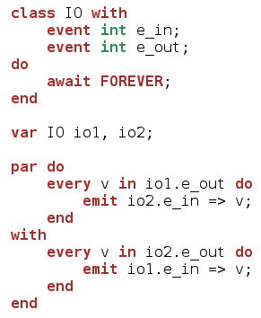
Push example
2-player game
  food increases ball radius
  constraint: sum of radius (p1+p2) is constant
  restarts when any radius reaches 0

Slide 113
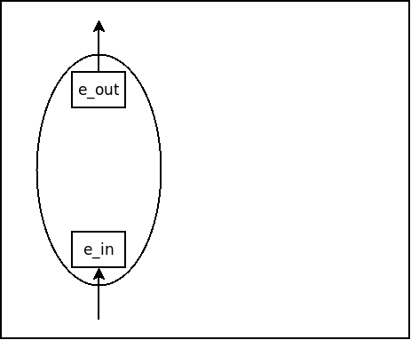
Push example
2-player game
  food increases ball radius
  constraint: sum of radius (p1+p2) is constant
  restarts when any radius reaches 0

Slide 114
Push example
2-player game
  food increases ball radius
  constraint: sum of radius (p1+p2) is constant
  restarts when any radius reaches 0

Slide 115
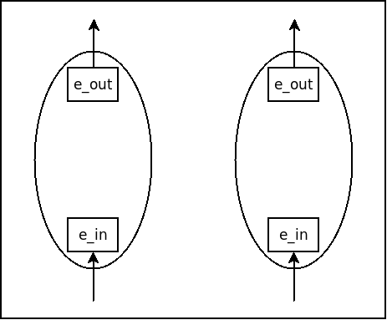
Push example
2-player game
  food increases ball radius
  constraint: sum of radius (p1+p2) is constant
  restarts when any radius reaches 0

Slide 116
Push example
2-player game
  food increases ball radius
  constraint: sum of radius (p1+p2) is constant
  restarts when any radius reaches 0

Slide 117
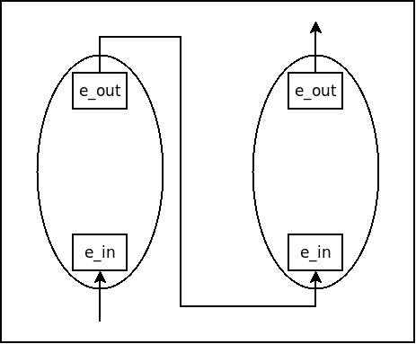
Push example
2-player game
  food increases ball radius
  constraint: sum of radius (p1+p2) is constant
  restarts when any radius reaches 0

Slide 118
Push example
2-player game
  food increases ball radius
  constraint: sum of radius (p1+p2) is constant
  restarts when any radius reaches 0

Slide 119
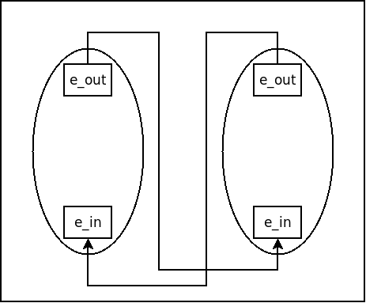
Push example
2-player game
  food increases ball radius
  constraint: sum of radius (p1+p2) is constant
  restarts when any radius reaches 0

Slide 120
Push example
2-player game
  food increases ball radius
  constraint: sum of radius (p1+p2) is constant
  restarts when any radius reaches 0

Slide 121
Push example
2-player game
  food increases ball radius
  constraint: sum of radius (p1+p2) is constant
  restarts when any radius reaches 0
?
?

Slide 122
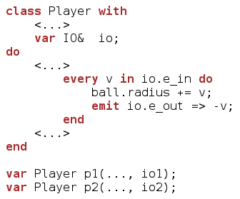
Push example
2-player game
  food increases ball radius
  constraint: sum of radius (p1+p2) is constant
  restarts when any radius reaches 0
?
?

Slide 123
Push example
2-player game
  food increases ball radius
  constraint: sum of radius (p1+p2) is constant
  restarts when any radius reaches 0
?
?

Slide 124
Push example
2-player game
  food increases ball radius
  constraint: sum of radius (p1+p2) is constant
  restarts when any radius reaches 0
?
?

Slide 125
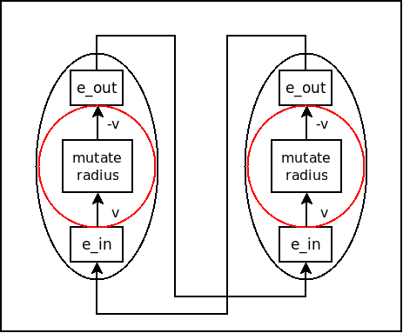
Push example
2-player game
  food increases ball radius
  constraint: sum of radius (p1+p2) is constant
  restarts when any radius reaches 0

Slide 126
Push example
2-player game
  food increases ball radius
  constraint: sum of radius (p1+p2) is constant
  restarts when any radius reaches 0
Initial stimulus from
collision with food

Slide 127
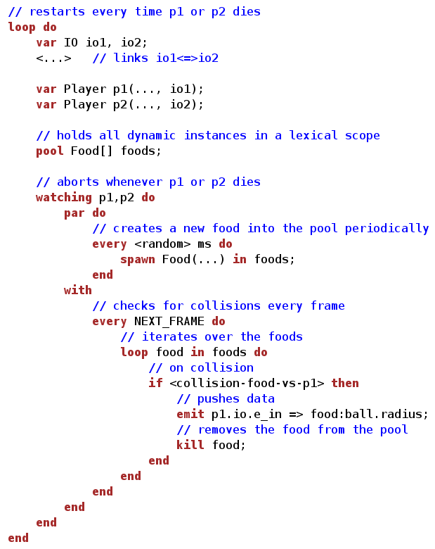

Slide 137
(same code for player 2)

Slide 138
(same code for player 2)

Slide 139
(same code for player 2)

Slide 140
(same code for player 2)

Slide 141
(same code for player 2)

Slide 142
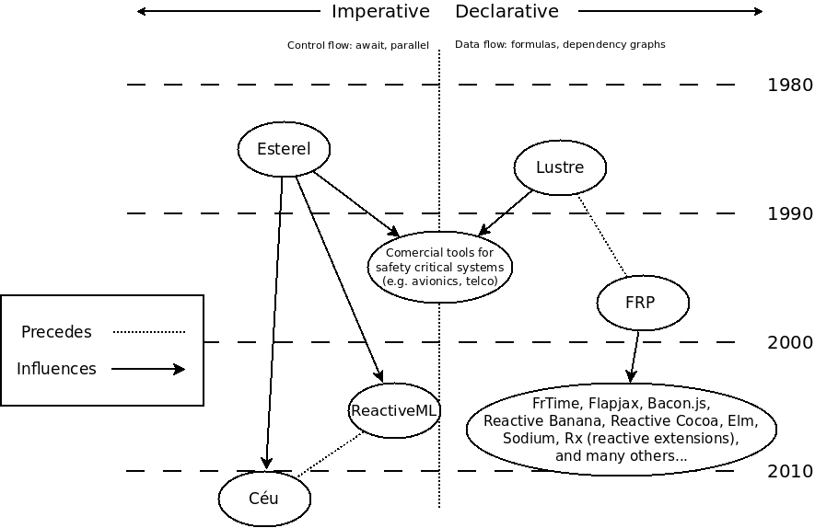
Synchronous/Reactive Languages

Slide 143
Synchronous/Reactive Languages
Original
Synchronous/Reactive
Languages

Slide 144
Synchronous/Reactive Languages
Original
Synchronous/Reactive
Languages
Can we reconcile control with
data-oriented programming?

Slide 145
Design guidelines / Tradeoffs in Céu

Slide 146
Design guidelines / Tradeoffs in Céu
Structured programming
(vs data streams/signals + functional combinators)

Slide 147
Design guidelines / Tradeoffs in Céu
Structured programming
Side effects everywhere
(vs data streams/signals + functional combinators)
(vs purity / immutable data)

Slide 148
Design guidelines / Tradeoffs in Céu
Structured programming
Side effects everywhere
Sequential/Deterministic semantics (real parallelism relies on asynchronous primitives)
(vs data streams/signals + functional combinators)
(vs purity / immutable data)
(vs potential parallelism) (feasible in real-time reactive apps?)

Slide 149
Design guidelines / Tradeoffs in Céu
Structured programming
Side effects everywhere
Sequential/Deterministic semantics (real parallelism relies on asynchronous primitives)
Static memory management (lexical scope + safe abortion)
(vs data streams/signals + functional combinators)
(vs purity / immutable data)
(vs potential parallelism) (feasible in real-time reactive apps?)
(vs garbage collection)

Slide 150
Design guidelines / Tradeoffs in Céu
Structured programming
Side effects everywhere
Sequential/Deterministic semantics (real parallelism relies on asynchronous primitives)
Static memory management (lexical scope + safe abortion)
Bounded memory and execution time
(vs data streams/signals + functional combinators)
(vs purity / immutable data)
(vs potential parallelism) (feasible in real-time reactive apps?)
(vs garbage collection)
(vs hidden costs)

Slide 151
Design guidelines / Tradeoffs in Céu
Structured programming
Side effects everywhere
Sequential/Deterministic semantics (real parallelism relies on asynchronous primitives)
Static memory management (lexical scope + safe abortion)
Bounded memory and execution time
Data flow
  explicit loops with side effects
(vs data streams/signals + functional combinators)
(vs purity / immutable data)
(vs potential parallelism) (feasible in real-time reactive apps?)
(vs garbage collection)
(vs hidden costs)
Control flow
  explicit state machines (fold combinator)

Slide 152
Summary

Slide 153
Summary
From “Structured Programming” to “Structured Synchronous/Reactive Programming”

Slide 154
Summary
From “Structured Programming” to “Structured Synchronous/Reactive Programming”
Data-oriented and Control-oriented programming are useful and complementary
  declarative / imperative dichotomy (since the '80s)

Slide 155
Summary
From “Structured Programming” to “Structured Synchronous/Reactive Programming”
Data-oriented and Control-oriented programming are useful and complementary
  declarative / imperative dichotomy (since the '80s)
Let's not give up on imperative programming!

Slide 156
Summary
From “Structured Programming” to “Structured Synchronous/Reactive Programming”
Data-oriented and Control-oriented programming are useful and complementary
  declarative / imperative dichotomy (since the '80s)
Let's not give up on imperative programming!
  Side effects can be tamed:
    avoid control variables
    use deep nesting of scopes
    rely on deterministic semantics

Slide 157


Structured Synchronous Programming with Céu
(mixing control with data flow)
Francisco Sant'Anna
francisco.santanna@gmail.com
@fsantanna_puc
(I'll tweet the slides here!)
www.ceu-lang.org

