Slide 1
pico-Céu:
A minimalist, visual,and interactive
programming environment
focused on education.
Francisco Sant'Anna
francisco@ime.uerj.br
https://github.com/fsantanna/pico-ceu

Slide 2
“Hello World!”
emit GRAPHICS_DRAW_PIXEL(0,0);
emit GRAPHICS_DRAW_PIXEL(0,0);
await KEY_PRESS;
emit GRAPHICS_DRAW_PIXEL(1,1);
emit GRAPHICS_DRAW_PIXEL(0,0);
await 1s;
emit GRAPHICS_DRAW_PIXEL(1,1);
await 1s;
emit GRAPHICS_DRAW_PIXEL(2,2);
await 1s;
emit GRAPHICS_DRAW_PIXEL(3,3);

Slide 3
Goals
Concrete problems
  avoid abstract/mathematical problems
    fibonacci, primes, gdc, sort
  seek visual and playful applications
    focus on input/output, time
    propose modifications that require maths
Project oriented
  portfolio building, creativity
  individualization
    no best/single/correct solution
    make exams optional and reduces plagiarism
Multiple target audiences
  computer science, engineering, visual arts, schools, kids

Slide 4
Approach
Straightforward graphics
  immediate feedback
  pixel-level manipulation and visualization
Simple development cycle
  minimalist API
  easy installation and execution
Explicit I/O operations
  await for input
  emit for output
Structured synchronous programming model
  sequential execution, no callbacks
  logical parallelism, deterministic concurrency

Slide 5
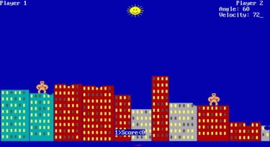
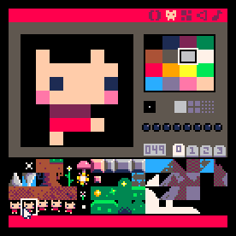
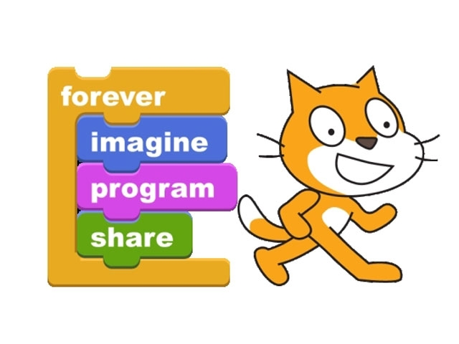
Inspirations
Basic
  simple/immediate graphics API
pico8
  8-bit “fantasy console”
  focused, minimalist
Scratch
  “constructionist learning”
  “creative computing”

Slide 6
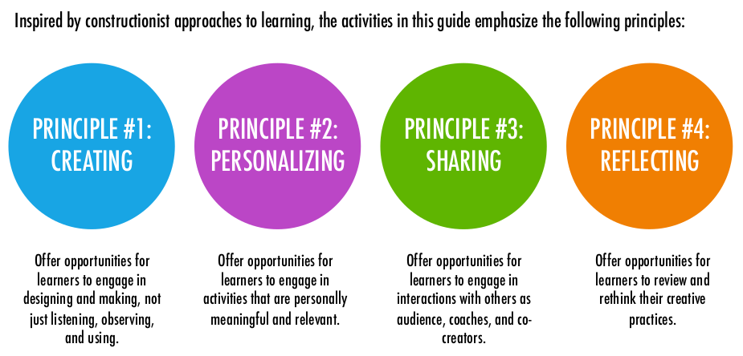
Creative Computing / Scratch

Slide 7
Input & Output
var integer x ⟵ 0;
var integer y ⟵ 0;
emit GRAPHICS_DRAW_PIXEL(x,y);
loop do
var integer key ⟵ await KEY_PRESS;
if key = KEY_LEFT then
x ⟵ x - 1;
else/if key = KEY_RIGHT then
x ⟵ x + 1;
else/if key = KEY_DOWN then
y ⟵ y - 1;
else/if key = KEY_UP then
y ⟵ y + 1;
end
emit GRAPHICS_DRAW_PIXEL(x,y);
end

Slide 8

var integer x ⟵ 25;
var integer y ⟵ 25;
emit GRAPHICS_DRAW_PIXEL(x,y);
loop do
var integer key ⟵ await KEY_PRESS;
if key = KEY_LEFT then
x ⟵ x - 1;
else/if key = <...> then
<...>
end
emit GRAPHICS_DRAW_PIXEL(x,y);
end
Escrita
x ⟵
y ⟵
Leitura
x
y

Slide 9
Exercises / Projects
Add a new feature
  erase the moving trail
  use different colors
  draw other geometric shapes (circles, figures)
  write text
Explore the API

Slide 10

Concurrency
Drawing an X on the screen:

Slide 11
Concurrency
par do
var integer p1;
loop p1 in [-25 -> 25] do
emit GRAPHICS_DRAW_PIXEL(p1,p1);
await 100ms;
end
with
var integer p2 = 0;
loop p2 in [-25 -> 25] do
emit GRAPHICS_DRAW_PIXEL(p2,-p2);
await 100ms;
end
end
var integer p;
loop p in [-25 -> 25] do
emit GRAPHICS_DRAW_PIXEL(p,p);
emit GRAPHICS_DRAW_PIXEL(p,-p);
await 100ms;
end

Slide 12
Concurrency and Parallelism
Early approach to the theme
What means “at the same time”?
  to the application user
  to the application programmer
  to the computer
  experience, specification, implementation
  concurrency, logical parallelism, real parallelism

Slide 13
Moving two pixels
Independent movement
Calls for logical parallelism
Calls for abstractions

Slide 14
par do
var integer x1 = 1;
var integer y1 = 1;
emit GRAPHICS_DRAW_PIXEL(x1,y1);
loop do
var integer key = await KEY_PRESS;
if key == KEY_LEFT then
x1 = x1 - 1;
else/if <...> then
<...>
end
emit GRAPHICS_DRAW_PIXEL(x1,y1);
end
with
var integer x2 = -1;
var integer y2 = -1;
emit GRAPHICS_DRAW_PIXEL(x2,y2);
loop do
var integer key = await KEY_PRESS;
if key == KEY_a then
x2 = x2 - 1;
else/if <...> then
<...>
end
emit GRAPHICS_DRAW_PIXEL(x2,y2);
end
end
var integer x1 = 1;
var integer y1 = 1;
emit GRAPHICS_DRAW_PIXEL(x1,y1);
var integer x2 = -1;
var integer y2 = -1;
emit GRAPHICS_DRAW_PIXEL(x2,y2);
loop do
var integer key = await KEY_PRESS;
if key == KEY_LEFT then
x1 = x1 - 1;
else/if <...> then
<...>
end
emit GRAPHICS_DRAW_PIXEL(x1,y1);
if key == KEY_a then
x2 = x2 - 1;
else/if <...> then
<...>
end
emit GRAPHICS_DRAW_PIXEL(x2,y2);
end

Slide 15
Exercises / Projects
Create a simple game or application
  how to track the moving trails?
  how to detect collisions?

Slide 16
Structured/Imperative Programming
Input and Output
Assignment
Control Flow
  Sequence
  Choice
  Repetition
  Parallelism (logical)
Abstractions
  Code
  Data

Slide 17
Abstractions: Code
par do
var integer x1 = 1;
var integer y1 = 1;
emit GRAPHICS_DRAW_PIXEL(x1,y1);
loop do
var integer key = await KEY_PRESS;
if key == KEY_LEFT then
x1 = x1 - 1;
else/if <...> then
<...>
end
emit GRAPHICS_DRAW_PIXEL(x1,y1);
end
with
var integer x2 = -1;
var integer y2 = -1;
emit GRAPHICS_DRAW_PIXEL(x2,y2);
loop do
var integer key = await KEY_PRESS;
if key == KEY_a then
x2 = x2 - 1;
else/if <...> then
<...>
end
emit GRAPHICS_DRAW_PIXEL(x2,y2);
end
end
code Pix (var integer x, y,
var integer key_left, key_right,
key_up, key_down)
-> FOREVER
do
emit GRAPHICS_DRAW_PIXEL(x,y);
loop do
var integer key = await KEY_PRESS;
if key == key_left then
x = x - 1;
else/if <...> then
<...>
end
emit GRAPHICS_DRAW_PIXEL(x,y);
end
end
par do
await Pix(1,1,
KEY_LEFT,KEY_RIGHT,
KEY_UP,KEY_DOWN);
with
await Pix(-1,-1,
KEY_a,KEY_d,
KEY_w,KEY_s);
end

Slide 18
Abstractions: Data
data Posicao with
var integer x;
var integer y;
end
data Controle with
var integer left;
var integer right;
var integer up;
var integer down;
end
par do
await Pix( Posicao( 1, 1),
Controle(KEY_LEFT,KEY_RIGHT,KEY_UP,KEY_DOWN) );
with
await Pix( Posicao(-1,-1),
Controle(KEY_a,KEY_d,KEY_w,KEY_s) );
end

Slide 19
Network
API for unreliable broadcast
  uses UDP
par do
var integer n;
var byte&& buf;
every (n,buf) in NET_RECEIVE do
emit GRAPHICS_WRITE("recv: “);
emit GRAPHICS_WRITELN(buf);
end
with
loop do
await 1s;
emit NET_SEND(4, "ola");
emit NET_SEND(6, "mundo");
end
end

Slide 20
Other Subjects
Classical Problems
  backtracking
  dinning philosophers
  shortest path
    traveling salesman
  two generals
    three-way handshake
“Physical computing”
  Arduino, RPi
Céu is “scalable”
  sufficiently general purpose and integrates with C
  other domains (SDL, Arduino, libuv, multimedia, WSNs, ...)

Slide 21
Arduino
Even more concrete environment
input onoff PIN_02;
output onoff PIN_13;
emit PIN_13(on);
loop do
var onoff v = await PIN_02;
emit PIN_13(v);
end

Slide 22
TODO
Documentação em Português
Linguagem em Português?
Debugger

