Slide 1
DONE
( github.com/fsantanna/tinyos-exps )

Slide 2
Evaluation
Trickle
Drip
CTP Routing
CC2420 Receive

Slide 3
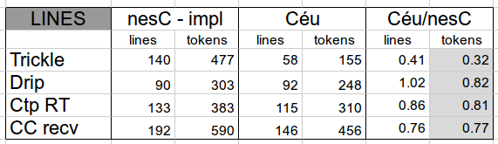
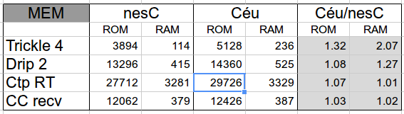
Tokens / ROM / RAM

Slide 4
Performance
CC2420 driver uses interrupts (async events)
  (with fine grained atomic sections)
Async execution breaks Céu assumptions
But...
  ”premature optimization is the root of all evil”
  ”scheduling is easy when the resource is almost always idle” (vs RTOS)

Slide 5
Performance
async event void InterruptFIFOP.fired () {
atomic {
ceu_go_event(IN_CC_RECV_FIFOP, NULL);
}
}
async event void RXFIFO.readDone (...) {
atomic {
cc_recv_readdone_t t = { rx_buf, rx_len, error };
ceu_go_event(IN_CC_RECV_READDONE, &t);
}
}

Slide 6
Performance
A mote receives 800 x 20-bytes messages
While performing two periodic activities
nesC
  receives and activities preempt each other
  maximum concurrency
Céu
  receives and activities run to completion

Slide 7
Performance
Parameters:
  receive rate: 100ms
  act-1 rate: 75ms for 1ms (1k instr ?)
  act-2 rate: 180ms for 3ms (3k instr ?)
nesC
  messages = 800
  act-1 + act-2 = 1140
Céu
  the same

Slide 8
Performance
Parameters:
  receive rate: 100ms
  act-1 rate: 45ms for 1ms
  act-2 rate: 90ms for 3ms
nesC
  messages = 800
  act-1 + act-2 = 1297
Céu
  messages = 800
  act-1 + act-2 = 1294 (-0.3%)

Slide 9
Performance
Parameters:
  receive rate: 50ms
  act-1 rate: 45ms for 1ms
  act-2 rate: 90ms for 3ms
nesC
  messages = 766
  act-1 + act-2 = 2244
Céu
  messages = 751 (-2.0%)
  act-1 + act-2 = 2239 (-0.3%)

Slide 10
References
Safety
  Efficient Memory Safety for TinyOS
Languages
  Protothreads: Simplifying Event-Driven …
  Virgil: Objects on the Head of a Pin
  Threads2Events: An Automatic Code …
General
  Experiences from a Decade of TinyOS Dev.

Slide 11
TODO
Enumerate Céu features used on each example
Rewrite (simpler) static analysis
  safety
  improve ROM
More porting
  rewrite SRP (exploring OO)
More references
Paper outline

Slide 12
Schedule
40 days left for SENSYS deadline
  6th April
Next 7 days
  rewrite the static analysis
  rewrite SRP
  enumerate Céu features
13-15th March SAAB-Brazil (Stockolm)
  need to write a poster

Slide 13
Paper Outline
Introduction 2 col
Overview 2 col
Design of Céu 9 col
  feature => example from ports
Evaluation 8 col
Related work 2 col
Conclusion 1 col
Bibliography 2 col

Slide 14
Introduction (3 cols)
Background
  WSN, reactive nature, languages/OSes
Benchmark
  nesC
    minimization and prevention
  protothreads
    expressiveness
Contributions
  design that embraces safety/expressiveness *together* (one is not possible w/o the other)

Slide 15
Design of Céu (11 cols)
2 dimensions: expressiveness / safety
Features
  parallel compositions
  shared-memory / C integration
  locals / finalizers
  timers
  internal events
  objects
  (asynchronous)
Implementation (reuse trails & locals // listeners // objs)

Slide 16
Evaluation (9 cols)
Trickle, DRIP, SRP, CTP, CC2420
Expressivenes
  number of tokens
  explicit states, global variables
  used features
Safety
  finalization, no tight loops, deterministic accs
Minimization
  RAM, ROM, Interrupts experiment

Slide 17
Related work (2 cols)
nesC
Protothreads
Ocram
Esterel

Slide 18
Conclusion (1 col)

Slide 19
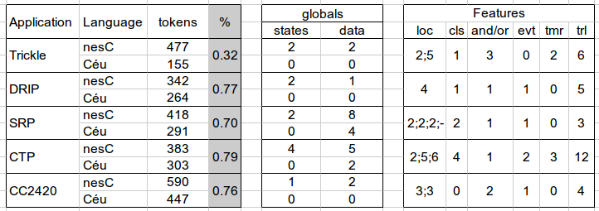

Slide 20
Finalization
par do
loop do
par/or do // STOP
loop do
par/or do // RESET
par/and do // depth=6
var _message_t msg; // goes out of scope
send(&msg);
await SENDDONE;
end
ERR : line 183 : call requires `finalize´

Slide 21
Finalization
par do
loop do
par/or do
loop do
par/or do
par/and do
var _message_t msg;
send(&msg) finalize with
cancel(&msg);
end;
await SENDDONE;
end

Slide 22
Finalization
nesC code base:
  349 AMSend.send()
  49 AMSend.cancel()
no safety problems
  buffers are global, but
    waste of radio
    decrease in perofmance
    message pools (?)

Slide 23
nesC
States / Globals
Trickle
Drip
SRP
CTP
CC2420
2 states, 2 globals
2 states, 1 globals
2 states, 8 globals
4 states, 5 globals
1 states, 2 globals

Slide 24
Céu
States / Globals
Trickle
Drip
SRP
CTP
CC2420
0 states, 2 locals (2,5)
0 states, 1 locals (4)
0 states, 4 globals, 3 locals (2,2,2)
0 states, 2 globals, 3 locals (2,5,6)
0 states, 0 globals, 2 locals (3,3)

Slide 25
Features per port
Trickle
Drip
SRP
CTP
CC2420
1 cls, 3 or, 2 tmr, 6 trl (xN)
1 cls, 1 or, 1 evt, 5 trl(xN)
2 cls, 1 or, 1 evt, 3 trl(xC/F)
4 or, 1 and, 3 tmr, 2 evt, 12 trl
2 or, 1 evt, 4 trl

