Slide 1


Structured Synchronous Programming with Céu
(a data-oriented perspective)
Francisco Sant'Anna
www.ceu-lang.org

Slide 2
Recursive data structures
Interpreter for a simple Logo turtle
  move N pixels
  rotate N degrees
  sequence, repetition
Program as an abstract syntax tree (AST)
  sequence and repetition are recursive

Slide 3
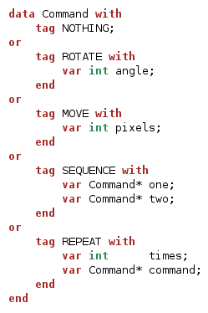
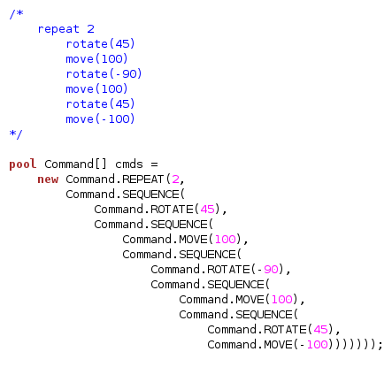
Recursive data structures

Slide 4
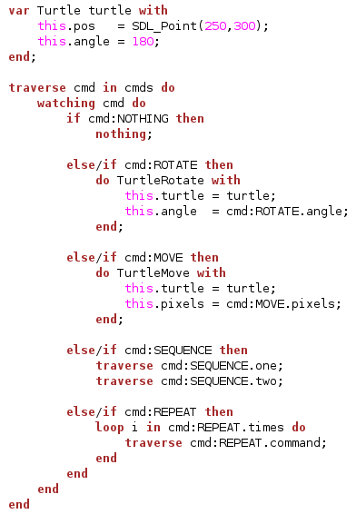
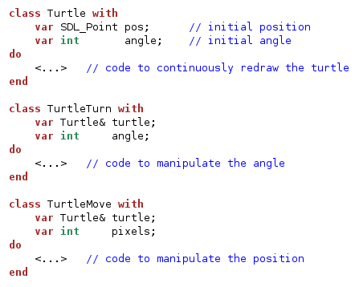

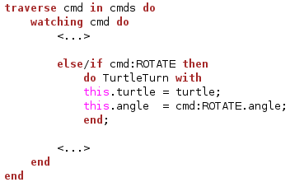
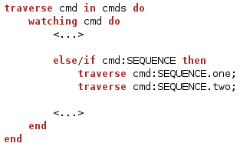
Structured Recursive Loops

Slide 5
A more powerful Turtle
Interpreter for a powerful Logo turtle
  move N pixels per second
  rotate N degrees per second
  await N milliseconds
  sequence, repetition, par/or

Slide 6
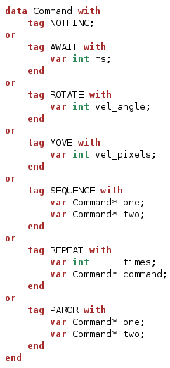
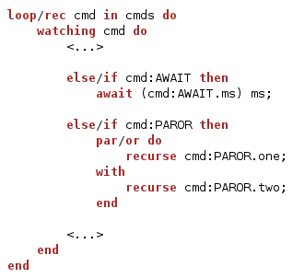
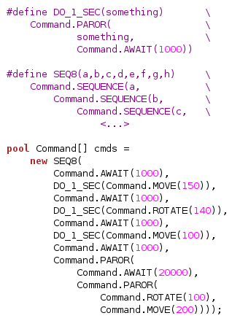
A more powerful Turtle

Slide 7


Structured Synchronous Programming with Céu
(a data-oriented perspective)
Francisco Sant'Anna
francisco.santanna@gmail.com
@fsantanna_puc
(I'll tweet the slides here!)
www.ceu-lang.org

