Slide 1


Structured Synchronous Programming with Céu
(mixing control with data flow)
Francisco Sant'Anna
www.ceu-lang.org

Slide 2
“Hello world!” in Céu
Where is my data?
Blinking a LED
  on ↔ off every 500ms
  stop after “press”
  restart after 2s
Compositions
  seq, loop, par (trails)
    At any level of depth
  state variables / communication
par/or do
loop do
await 500ms;
_leds_toggle();
end
with
await PRESS;
end
loop do
par/or do
loop do
await 500ms;
_leds_toggle();
end
with
await PRESS;
end
await 2s;
end
loop do
await 500ms;
_leds_toggle();
end
Lines of execution
=
Trails (in Céu)

Slide 3
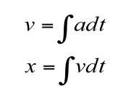
Mixing data & control flow
Controlling the ball inside the screen
  click mouse to start
  ball moves in one direction with an acceleration
  click mouse to turn clockwise (single-button controller)
Data flow:
  position is the integral of velocity
  velocity is the integral of acceleration
Control flow:
  abrupt changes in the clicks (non-continuous functions)
  discontinuity suggests state (e.g., isRunning, currentDirection)

Slide 4
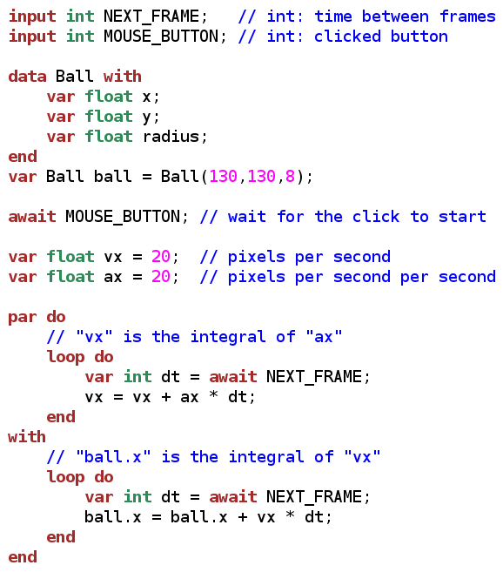
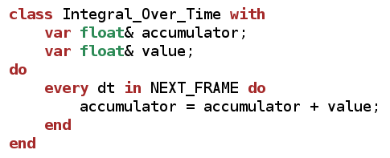
Moving the ball
Lengthy, low level...
  simple data dependency pattern
    1 par + 2 loop
  relies on mutation
    scheduling follows lexical order
Abstractions
  Interface (fields + methods)
  Body (any code in Céu)
  Organisms ~ Simula Objects
Organisms react directly
to the environment

Slide 5
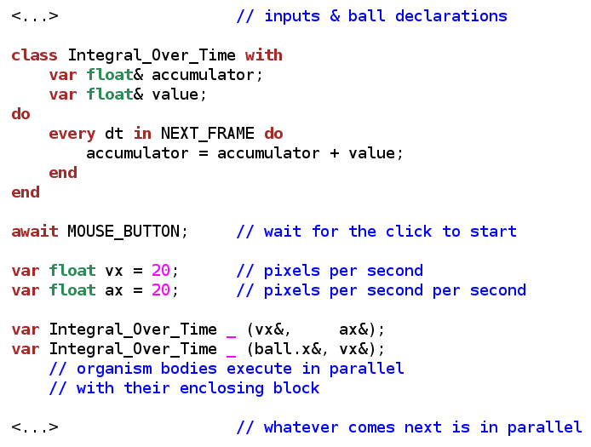

Moving the ball
Organisms
  body executes in parallel with the block
anonymous
instances

Slide 6
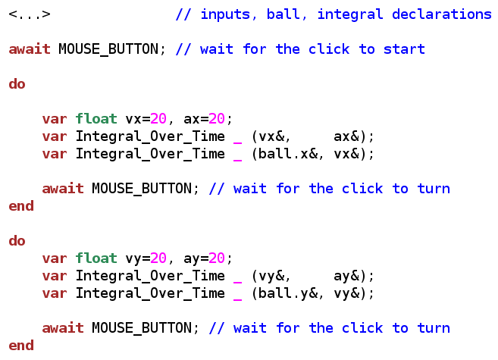
Making the turn
Doesn't work as expected
  previous dependencies still active
Lexical scope for organisms
  data reclaimed, body aborted
Mixing data and control flow
  automatic data updates
  no explicit state machines
  structured code with lexical scope

Slide 7
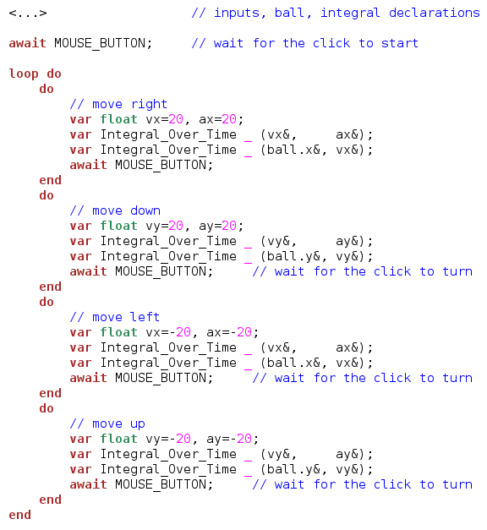
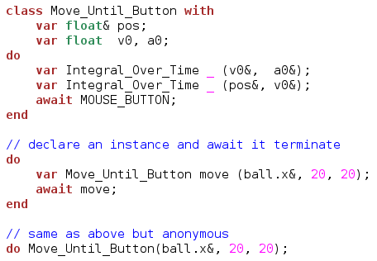
Closing the loop
Lenghty code...
  ... but regular
  “abstractable” with another class

Slide 8
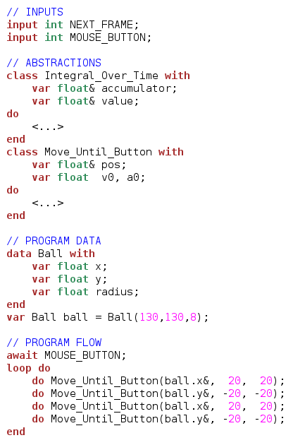
Closing the loop
Structured, sequential, and with encapsulated data flow.

Slide 9
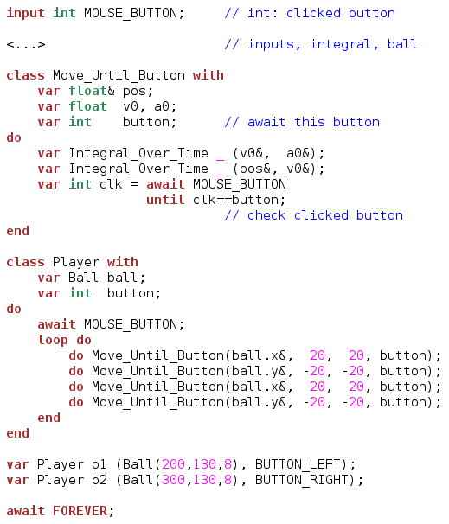
More abstractions
(two players)

Slide 10
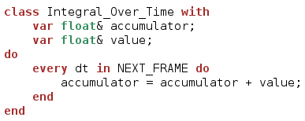

Push/Pull data flow
Pull strategy
  values are read continuously
  good for fast/periodic streams
Push strategy
  values are notified only on changes
  good for slow/occasional streams
  other reasons:
    efficiency
    encapsulation
    decoupling

Slide 11
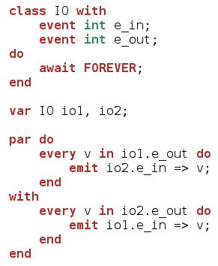
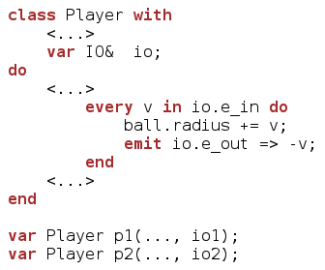
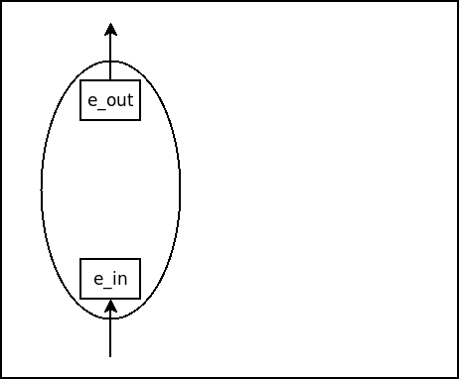
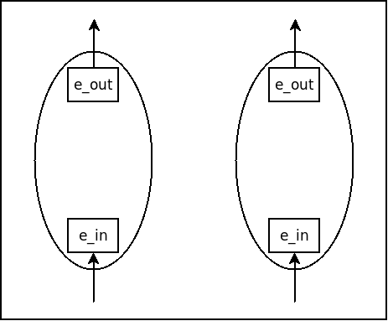
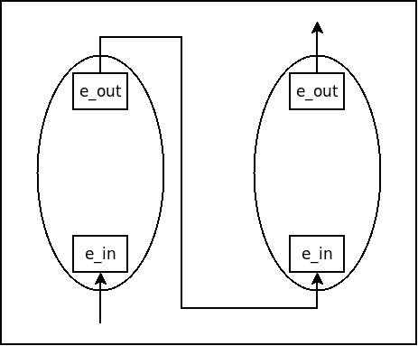
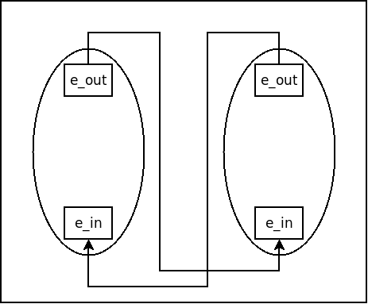
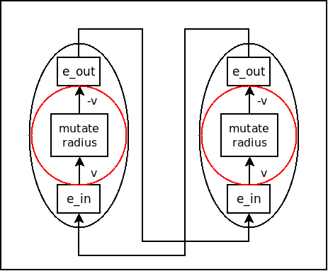
Push example
2-player game
  food increases ball radius
  constraint: sum of radius (p1+p2) is constant
  restarts when any radius reaches 0
?
?
Initial stimulus from
collision with food

Slide 12
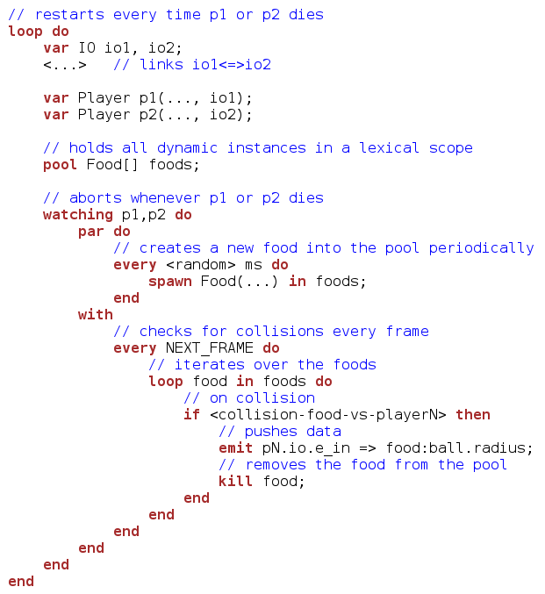
(2x player 1/2)

Slide 13
Design guidelines / Tradeoffs in Céu
Structured programming
Side effects everywhere
Sequential/Deterministic semantics (real parallelism relies on asynchronous primitives)
Static memory management (lexical scope + safe abortion)
Bounded memory and execution time
Data flow
  explicit loops with side effects
(vs data streams/signals + functional combinators)
(vs purity / immutable data)
(vs potential parallelism) (feasible in real-time reactive apps?)
(vs garbage collection)
(vs hidden costs)
Control flow
  explicit state machines (fold combinator)

Slide 14
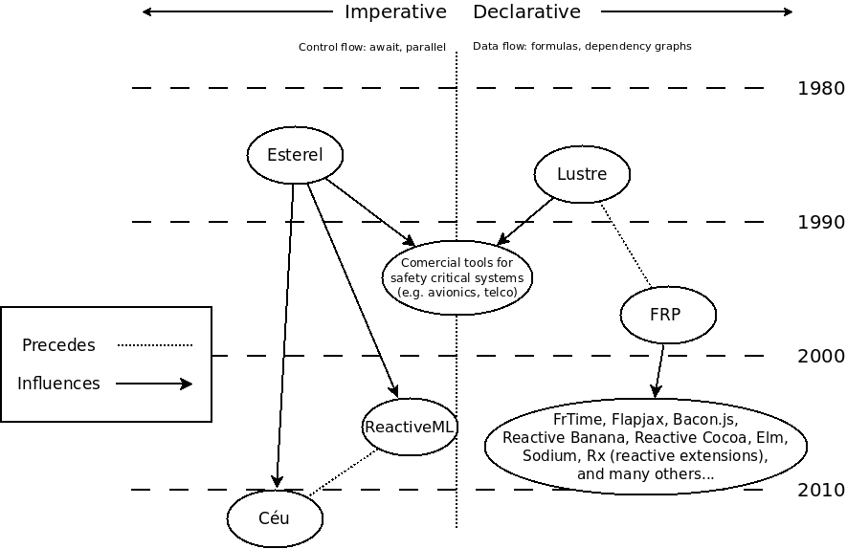
Synchronous/Reactive Languages
Original
Synchronous/Reactive
Languages
Can we reconcile control with
data-oriented programming?

Slide 15
Summary
From “Structured Programming” to “Structured Synchronous/Reactive Programming”
Data-oriented and Control-oriented programming are useful and complementary
  declarative / imperative dichotomy (since the '80s)
Let's not give up on imperative programming!
  Side effects can be tamed:
    avoid control variables
    use deep nesting of scopes
    rely on deterministic semantics

Slide 16


Structured Synchronous Programming with Céu
(mixing control with data flow)
Francisco Sant'Anna
francisco.santanna@gmail.com
@fsantanna_puc
(I'll tweet the slides here!)
www.ceu-lang.org

