Slide 1
Advanced Control Reactivity
for Embedded Systems
(with Céu)
Authors:
Francisco Sant'Anna
Roberto Ierusalimschy
Noemi Rodriguez
PUC-Rio, Brasil
Workshop on Reactivity,
Events and Modularity
REM'13 – Indianapolis

Slide 2
Céu

Slide 3
Céu
Synchronous
  Esterel-based language
Reactive
  guided by the environment (events)
Concurrent
  safety aspects
Efficient
  embedded platforms

Slide 4
Céu
Synchronous
  Esterel-based language
Reactive
  guided by the environment (events)
Concurrent
  safety aspects
Efficient
  embedded platforms

Slide 5
Céu
Synchronous
  Esterel-based language
Reactive
  guided by the environment (events)
Concurrent
  safety aspects
Efficient
  embedded platforms

Slide 6
Céu
Synchronous
  Esterel-based language
Reactive
  guided by the environment (events)
Concurrent
  safety aspects
Efficient
  embedded platforms

Slide 7
Synchronous styles

Slide 8
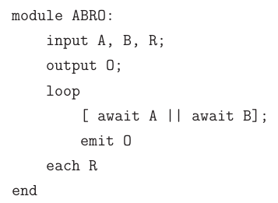
Synchronous styles
Control / Imperative
  control-flow primitives
  Esterel, Céu
Data / Declarative
  graphs of values
  Lustre / FRP

Slide 9
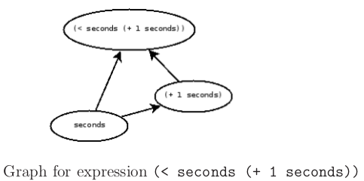
Synchronous styles
Control / Imperative
  control-flow primitives
  Esterel, Céu
Data / Declarative
  graphs of values
  Lustre / FRP

Slide 10
Céu: Peculiarities

Slide 11
Céu: Peculiarities
Deterministic (internal) execution semantics
  safe shared-memory concurrency
Hierarchical abortion for lines of execution
  dataflow programming
Stack-based execution for internal events
  limited coroutines, exception handling
(Highly constrained platforms: 32Kb-ROM, 4Kb-RAM)

Slide 12
Céu: Peculiarities
Deterministic (internal) execution semantics
  safe shared-memory concurrency
Hierarchical abortion for lines of execution
  dataflow programming
Stack-based execution for internal events
  limited coroutines, exception handling
(Highly constrained platforms: 32Kb-ROM, 4Kb-RAM)

Slide 13
Céu: Peculiarities
Deterministic (internal) execution semantics
  safe shared-memory concurrency
Hierarchical abortion for lines of execution
  dataflow programming
Stack-based execution for internal events
  limited coroutines, exception handling
(Highly constrained platforms: 32Kb-ROM, 4Kb-RAM)

Slide 14
Céu: Peculiarities
Deterministic (internal) execution semantics
  safe shared-memory concurrency
Hierarchical abortion for lines of execution
  dataflow programming
Stack-based execution for internal events
  limited coroutines, exception handling
(Highly constrained platforms: 32Kb-ROM, 4Kb-RAM)

Slide 15
Hello world!
Emit an output O as soon as two inputs A and B have occurred. Reset this behavior each time the input R occurs.

Slide 16
Hello world!
Emit an output O as soon as two inputs A and B have occurred. Reset this behavior each time the input R occurs.
// Esterel
loop
abort
[
await A
||
await B
];
emit O;
when R
end
// Céu
loop do
par/or do
par/and do
await A
with
await B
end
emit O;
with
await R;
end
end

Slide 17
Hello world!
Emit an output O as soon as two inputs A and B have occurred. Reset this behavior each time the input R occurs.
// Esterel
loop
abort
[
await A
||
await B
];
emit O;
when R
end
// Céu
loop do
par/or do
par/and do
await A
with
await B
end
emit O;
with
await R;
end
end

Slide 18
1. Deterministic execution

Slide 19
1. Deterministic execution
// Esterel
[
call f1();
||
call f2();
];
// Céu
par/and do
_f1();
with
_f2();
end

Slide 20
1. Deterministic execution
// Esterel
[
call f1();
||
call f2();
];
// Céu
par/and do
_f1();
with
_f2();
end
“if there is no control dependency, the execution order is unspecified and it would be an error to rely on it”
precludes sharing memory

Slide 21
1. Deterministic execution
// Esterel
[
call f1();
||
call f2();
];
// Céu
par/and do
_f1();
with
_f2();
end
“if there is no control dependency, the execution order is unspecified and it would be an error to rely on it”
precludes sharing memory

Slide 22
1. Deterministic execution
// Esterel
[
call f1();
||
call f2();
];
// Céu
par/and do
_f1();
with
_f2();
end
“if there is no control dependency, the execution order is unspecified and it would be an error to rely on it”
precludes sharing memory
“they are scheduled in the order they appear in the program source code”
Arbitrary, but
  enables sharing memory
  support for priority scheme
  no parallelism anyways

Slide 23
1. Deterministic execution
// Esterel
[
call f1();
||
call f2();
];
// Céu
par/and do
_f1();
with
_f2();
end
“if there is no control dependency, the execution order is unspecified and it would be an error to rely on it”
precludes sharing memory
“they are scheduled in the order they appear in the program source code”
Arbitrary, but
  enables sharing memory
  support for priority scheme
  no parallelism anyways

Slide 24
2. Hierarchical abortion

Slide 25
2. Hierarchical abortion
// Esterel
abort
await A;
call f();
when A;

Slide 26
2. Hierarchical abortion
// Esterel
abort
await A;
call f();
when A;
Strong abortion (default)
Weak abortion

Slide 27
2. Hierarchical abortion
// Esterel
abort
await A;
call f();
when A;
// Céu
par/or do
await A;
with
await A;
_f();
end
Strong abortion (default)
Weak abortion

Slide 28
2. Hierarchical abortion
// Esterel
abort
await A;
call f();
when A;
// Céu
par/or do
await A;
with
await A;
_f();
end
// Céu
par/hor do
await A;
_g();
with
await A;
_f();
end
Strong abortion (default)
Weak abortion
Hierarchical abortion

Slide 29
3. Internal events
// Esterel
input A; // external
signal B; // internal
[[
await A;
emit B;
call f(2);
||
await B;
call f(1);
]]

Slide 30
3. Internal events
// Esterel
input A; // external
signal B; // internal
[[
await A;
emit B;
call f(2);
||
await B;
call f(1);
]]
No control dependency between f(1) and f(2)

Slide 31
3. Internal events
// Esterel
input A; // external
signal B; // internal
[[
await A;
emit B;
call f(2);
||
await B;
call f(1);
]]
// Céu
input void A; // external
signal void b; // internal
par/and do
await A;
emit b;
_f(2);
with
await b;
_f(1);
end
No control dependency between f(1) and f(2)

Slide 32
3. Internal events
// Esterel
input A; // external
signal B; // internal
[[
await A;
emit B;
call f(2);
||
await B;
call f(1);
]]
// Céu
input void A; // external
signal void b; // internal
par/and do
await A;
emit b;
_f(2);
with
await b;
_f(1);
end
No control dependency between f(1) and f(2)
Stacked execution:
  await A → emit b → push
  await b → f(1)
  pop → f(2)

Slide 33
3. Internal events
// Esterel
input A; // external
signal B; // internal
[[
await A;
emit B;
call f(2);
||
await B;
call f(1);
]]
// Céu
input void A; // external
signal void b; // internal
par/and do
await A;
emit b;
_f(2);
with
await b;
_f(1);
end
No control dependency between f(1) and f(2)
Stacked execution:
  await A → emit b → push
  await b → f(1)
  pop → f(2)

Slide 34
3. Internal events
// Esterel
input A; // external
signal B; // internal
[[
await A;
emit B;
call f(2);
||
await B;
call f(1);
]]
// Céu
input void A; // external
signal void b; // internal
par/and do
await A;
emit b;
_f(2);
with
await b;
_f(1);
end
No control dependency between f(1) and f(2)
Stacked execution:
  await A → emit b → push
  await b → f(1)
  pop → f(2)

Slide 35
3. Internal events
// Esterel
input A; // external
signal B; // internal
[[
await A;
emit B;
call f(2);
||
await B;
call f(1);
]]
// Céu
input void A; // external
signal void b; // internal
par/and do
await A;
emit b;
_f(2);
with
await b;
_f(1);
end
No control dependency between f(1) and f(2)
Stacked execution:
  await A → emit b → push
  await b → f(1)
  pop → f(2)

Slide 36
3. Internal events

Slide 37
3. Internal events
event int* inc; // subroutine `inc'
par/or do
loop do // definition
var int* p = await inc;
*p = *p + 1; // body
end
with
var int v = 1;
await A;
emit inc => &v; // call `inc'
_assert(v==2); // after return
end

Slide 38
3. Internal events
Limited subroutines
  no recursion
  bounded memory
  bounded execution
Also coroutines
  body can await
event int* inc; // subroutine `inc'
par/or do
loop do // definition
var int* p = await inc;
*p = *p + 1; // body
end
with
var int v = 1;
await A;
emit inc => &v; // call `inc'
_assert(v==2); // after return
end

Slide 39
3. Internal events
Limited subroutines
  no recursion
  bounded memory
  bounded execution
Also coroutines
  body can await
event int* inc; // subroutine `inc'
par/or do
loop do // definition
var int* p = await inc;
*p = *p + 1; // body
end
with
var int v = 1;
await A;
emit inc => &v; // call `inc'
_assert(v==2); // after return
end

Slide 40
3. Internal events
Limited subroutines
  no recursion
  bounded memory
  bounded execution
Also coroutines
  body can await
event int* inc; // subroutine `inc'
par/or do
loop do // definition
var int* p = await inc;
*p = *p + 1; // body
end
with
var int v = 1;
await A;
emit inc => &v; // call `inc'
_assert(v==2); // after return
end

Slide 41
3. Internal events
Limited subroutines
  no recursion
  bounded memory
  bounded execution
Also coroutines
  body can await
event int* inc; // subroutine `inc'
par/or do
loop do // definition
var int* p = await inc;
*p = *p + 1; // body
end
with
var int v = 1;
await A;
emit inc => &v; // call `inc'
_assert(v==2); // after return
end

Slide 42
Putting it all together

Slide 43
Putting it all together
Exception handling
  shared memory, internal events
Dataflow programming
  shared memory, internal events, hierarchical compositions

Slide 44
Putting it all together
Exception handling
  shared memory, internal events
Dataflow programming
  shared memory, internal events, hierarchical compositions

Slide 45
Exception handling
An external entity periodically writes to a file and notifies the program the number of available characters.

Slide 46
Exception handling
An external entity periodically writes to a file and notifies the program the number of available characters.
// DECLARATIONS
input int ENTRY;
var _FILE* f = <...>;
var char[10] buf;
event int read;
event void excpt;
// NORMAL FLOW
loop do
var int n = await ENTRY;
emit read => n;
_printf("line: %s\n", buf);
end

Slide 47
Exception handling
An external entity periodically writes to a file and notifies the program the number of available characters.
<...> // DECLARATIONS
par/or do
<...> // NORMAL FLOW
with
loop do // READ SUBROUTINE
var int n = await read;
if _read(f,buf,n) != n then
emit excpt;
end
end
end
// DECLARATIONS
input int ENTRY;
var _FILE* f = <...>;
var char[10] buf;
event int read;
event void excpt;
// NORMAL FLOW
loop do
var int n = await ENTRY;
emit read => n;
_printf("line: %s\n", buf);
end

Slide 48
Exception handling
An external entity periodically writes to a file and notifies the program the number of available characters.
<...> // DECLARATIONS
par/or do
<...> // NORMAL FLOW
with
loop do // READ SUBROUTINE
var int n = await read;
if _read(f,buf,n) != n then
emit excpt;
end
end
end
// DECLARATIONS
input int ENTRY;
var _FILE* f = <...>;
var char[10] buf;
event int read;
event void excpt;
// NORMAL FLOW
loop do
var int n = await ENTRY;
emit read => n;
_printf("line: %s\n", buf);
end
<...> // DECLARATIONS
par/or do
await excpt;
with
<...> // NORMAL FLOW
with
<...> // READ SUBROUTINE
end

Slide 49
Exception handling
// DECLARATIONS
input int ENTRY;
var _FILE* f = <...>;
var char[10] buf;
event int read;
event void excpt;
par/or do
// EXCEPTION HANDLER
await excpt;
with
// NORMAL FLOW
loop do
var int n = await ENTRY;
emit read => n;
_printf("line: %s\n", buf);
end
with
// READ SUBROUTINE
loop do
var int n = await read;
if _read(f,buf,n) != n then
emit excpt;
end
end
end

Slide 50
Exception handling
// DECLARATIONS
input int ENTRY;
var _FILE* f = <...>;
var char[10] buf;
event int read;
event void excpt;
par/or do
// EXCEPTION HANDLER
await excpt;
with
// NORMAL FLOW
loop do
var int n = await ENTRY;
emit read => n;
_printf("line: %s\n", buf);
end
with
// READ SUBROUTINE
loop do
var int n = await read;
if _read(f,buf,n) != n then
emit excpt;
end
end
end
Normal flow invokes the read operation and pauses. [norm]
Read operation awakes, throws an exception, and pauses. [norm, read]
Exception handler awakes and terminates the par/or, aborting the read call, the normal behavior, and terminating the program. [ ]

Slide 51
Exception handling
// DECLARATIONS
input int ENTRY;
var _FILE* f = <...>;
var char[10] buf;
event int read;
event void excpt;
par/or do
// EXCEPTION HANDLER
await excpt;
with
// NORMAL FLOW
loop do
var int n = await ENTRY;
emit read => n;
_printf("line: %s\n", buf);
end
with
// READ SUBROUTINE
loop do
var int n = await read;
if _read(f,buf,n) != n then
emit excpt;
end
end
end
Normal flow invokes the read operation and pauses. [norm]
Read operation awakes, throws an exception, and pauses. [norm, read]
Exception handler awakes and terminates the par/or, aborting the read call, the normal behavior, and terminating the program. [ ]

Slide 52
Exception handling
// DECLARATIONS
input int ENTRY;
var _FILE* f = <...>;
var char[10] buf;
event int read;
event void excpt;
par/or do
// EXCEPTION HANDLER
await excpt;
with
// NORMAL FLOW
loop do
var int n = await ENTRY;
emit read => n;
_printf("line: %s\n", buf);
end
with
// READ SUBROUTINE
loop do
var int n = await read;
if _read(f,buf,n) != n then
emit excpt;
end
end
end
Normal flow invokes the read operation and pauses. [norm]
Read operation awakes, throws an exception, and pauses. [norm, read]
Exception handler awakes and terminates the par/or, aborting the read call, the normal behavior, and terminating the program. [ ]

Slide 53
Exception handling
// DECLARATIONS
input int ENTRY;
var _FILE* f = <...>;
var char[10] buf;
event int read;
event void excpt;
par/or do
// EXCEPTION HANDLER
loop do
await excpt;
buf = <...>;
end
with
// NORMAL FLOW
loop do
var int n = await ENTRY;
emit read => n;
_printf("line: %s\n", buf);
end
with
// READ SUBROUTINE
loop do
var int n = await read;
if _read(f,buf,n) != n then
emit excpt;
end
end
end

Slide 54
Exception handling
// DECLARATIONS
input int ENTRY;
var _FILE* f = <...>;
var char[10] buf;
event int read;
event void excpt;
par/or do
// EXCEPTION HANDLER
loop do
await excpt;
buf = <...>;
end
with
// NORMAL FLOW
loop do
var int n = await ENTRY;
emit read => n;
_printf("line: %s\n", buf);
end
with
// READ SUBROUTINE
loop do
var int n = await read;
if _read(f,buf,n) != n then
emit excpt;
end
end
end

Slide 55
Exception handling
// DECLARATIONS
input int ENTRY;
var _FILE* f = <...>;
var char[10] buf;
event int read;
event void excpt;
par/or do
// EXCEPTION HANDLER
loop do
await excpt;
buf = <...>;
end
with
// NORMAL FLOW
loop do
var int n = await ENTRY;
emit read => n;
_printf("line: %s\n", buf);
end
with
// READ SUBROUTINE
loop do
var int n = await read;
if _read(f,buf,n) != n then
emit excpt;
end
end
end
Normal flow invokes the read operation and pauses. [norm]
Read operation awakes, throws an exception, and pauses. [norm, read]
Exception handler awakes, assigns a default string to buf, and awaits the next exception. [norm, read]
Read subroutine resumes and awaits the next call. [norm]
Read call resumes and uses buf normally, as if no exceptions had occurred. [ ]

Slide 56
Exception handling
// DECLARATIONS
input int ENTRY;
var _FILE* f = <...>;
var char[10] buf;
event int read;
event void excpt;
par/or do
// EXCEPTION HANDLER
loop do
await excpt;
buf = <...>;
end
with
// NORMAL FLOW
loop do
var int n = await ENTRY;
emit read => n;
_printf("line: %s\n", buf);
end
with
// READ SUBROUTINE
loop do
var int n = await read;
if _read(f,buf,n) != n then
emit excpt;
end
end
end
Normal flow invokes the read operation and pauses. [norm]
Read operation awakes, throws an exception, and pauses. [norm, read]
Exception handler awakes, assigns a default string to buf, and awaits the next exception. [norm, read]
Read subroutine resumes and awaits the next call. [norm]
Read call resumes and uses buf normally, as if no exceptions had occurred. [ ]

Slide 57
Exception handling
// DECLARATIONS
input int ENTRY;
var _FILE* f = <...>;
var char[10] buf;
event int read;
event void excpt;
par/or do
// EXCEPTION HANDLER
loop do
await excpt;
buf = <...>;
end
with
// NORMAL FLOW
loop do
var int n = await ENTRY;
emit read => n;
_printf("line: %s\n", buf);
end
with
// READ SUBROUTINE
loop do
var int n = await read;
if _read(f,buf,n) != n then
emit excpt;
end
end
end
Normal flow invokes the read operation and pauses. [norm]
Read operation awakes, throws an exception, and pauses. [norm, read]
Exception handler awakes, assigns a default string to buf, and awaits the next exception. [norm, read]
Read subroutine resumes and awaits the next call. [norm]
Read call resumes and uses buf normally, as if no exceptions had occurred. [ ]

Slide 58
Exception handling
// DECLARATIONS
input int ENTRY;
var _FILE* f = <...>;
var char[10] buf;
event int read;
event void excpt;
par/or do
// EXCEPTION HANDLER
loop do
await excpt;
buf = <...>;
end
with
// NORMAL FLOW
loop do
var int n = await ENTRY;
emit read => n;
_printf("line: %s\n", buf);
end
with
// READ SUBROUTINE
loop do
var int n = await read;
if _read(f,buf,n) != n then
emit excpt;
end
end
end
Normal flow invokes the read operation and pauses. [norm]
Read operation awakes, throws an exception, and pauses. [norm, read]
Exception handler awakes, assigns a default string to buf, and awaits the next exception. [norm, read]
Read subroutine resumes and awaits the next call. [norm]
Read call resumes and uses buf normally, as if no exceptions had occurred. [ ]

Slide 59
Exception handling
// DECLARATIONS
input int ENTRY;
var _FILE* f = <...>;
var char[10] buf;
event int read;
event void excpt;
par/or do
// EXCEPTION HANDLER
loop do
await excpt;
buf = <...>;
end
with
// NORMAL FLOW
loop do
var int n = await ENTRY;
emit read => n;
_printf("line: %s\n", buf);
end
with
// READ SUBROUTINE
loop do
var int n = await read;
if _read(f,buf,n) != n then
emit excpt;
end
end
end
Normal flow invokes the read operation and pauses. [norm]
Read operation awakes, throws an exception, and pauses. [norm, read]
Exception handler awakes, assigns a default string to buf, and awaits the next exception. [norm, read]
Read subroutine resumes and awaits the next call. [norm]
Read call resumes and uses buf normally, as if no exceptions had occurred. [ ]

Slide 60
Dataflow programming

Slide 61
Dataflow programming
Data dependency
  variable + internal event → reactive variable
  (state + signaling)
Issues:
  Glitches (par/hor)
  Cycles (stacked execution)

Slide 62
Dataflow programming
Data dependency
  variable + internal event → reactive variable
  (state + signaling)
Issues:
  Glitches (par/hor)
  Cycles (stacked execution)

Slide 63
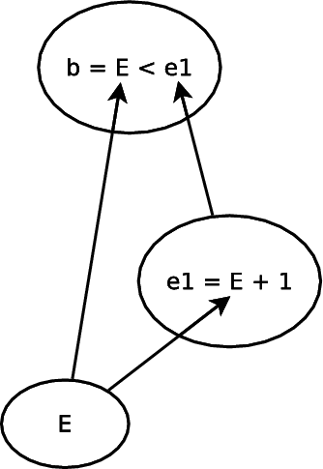
Dataflow programming
Data dependency
  variable + internal event → reactive variable
  (state + signaling)
Issues:
  Glitches (par/hor)
  Cycles (stacked execution)

Slide 64
Dataflow programming
Data dependency
  variable + internal event → reactive variable
  (state + signaling)
Issues:
  Glitches (par/hor)
  Cycles (stacked execution)
input int E;
event int b, e1;
par/or do
// b = E < E + 1
loop do
var int v1=0,v2=1;
par/hor do
v1 = await E;
with
v2 = await e1;
end
emit b => v1 < v2;
end
with
// e1 = E + 1
loop do
var int v = await E;
emit e1 => v + 1;
end
end

Slide 65
Dataflow programming
Data dependency
  variable + internal event → reactive variable
  (state + signaling)
Issues:
  Glitches (par/hor)
  Cycles (stacked execution)

Slide 66
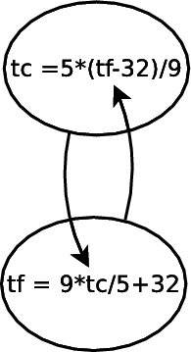
Dataflow programming
Data dependency
  variable + internal event → reactive variable
  (state + signaling)
Issues:
  Glitches (par/hor)
  Cycles (stacked execution)

Slide 67
Dataflow programming
Data dependency
  variable + internal event → reactive variable
  (state + signaling)
Issues:
  Glitches (par/hor)
  Cycles (stacked execution)
event int tc, tf;
par/or do
loop do
var int v = await tc;
emit tf => (9 * v / 5 + 32);
end
with
loop do
var int v = await tf;
emit tc => (5 * (v-32) / 9);
end
with
<...>
emit tc => 0;
end

Slide 68
Conclusion

Slide 69
Conclusion
A comprehensive and resource efficient design
Contributions:
  Safe shared-memory concurrency
  Hierarchical abortion
  Stacked internal events
Formal semantics (skipped)

Slide 70
Conclusion
A comprehensive and resource efficient design
Contributions:
  Safe shared-memory concurrency
  Hierarchical abortion
  Stacked internal events
Formal semantics (skipped)

Slide 71
Conclusion
A comprehensive and resource efficient design
Contributions:
  Safe shared-memory concurrency
  Hierarchical abortion
  Stacked internal events
Formal semantics (skipped)

Slide 72
Advanced Control Reactivity
for Embedded Systems
(with Céu)
Authors:
Francisco Sant'Anna
Roberto Ierusalimschy
Noemi Rodriguez
PUC-Rio, Brasil
Workshop on Reactivity,
Events and Modularity
REM'13 – Indianapolis

Slide 73
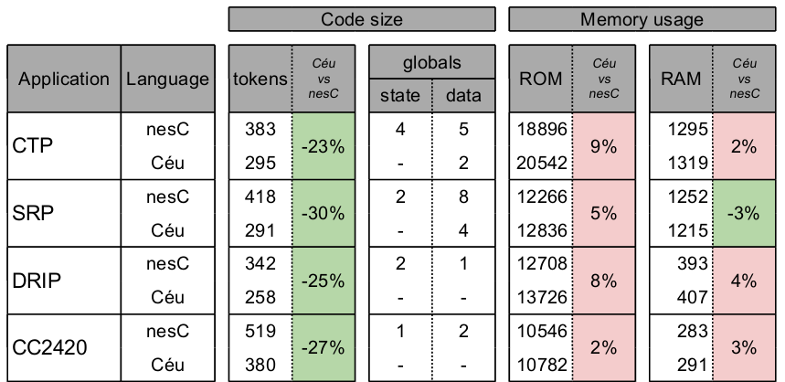
Code size & Memory usage

Slide 74
Code size & Memory usage
no control globals
globals → locals

Slide 75
Safety
Time-bounded reactions
No concurrency in variables
No concurrency in C calls
Finalization for blocks going out of scope
Auto-adjustment for timers in sequence
Synchronization for timers in parallel

Slide 76
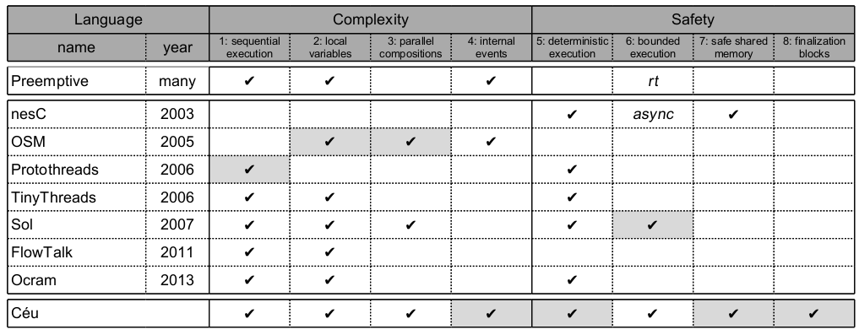
Related work

