Slide 1
Advanced Control Reactivity
for Embedded Systems
(with Céu)
Authors:
Francisco Sant'Anna
Roberto Ierusalimschy
Noemi Rodriguez
PUC-Rio, Brasil
Workshop on Reactivity,
Events and Modularity
REM'13 – Indianapolis

Slide 2
Hello world!
Emit an output O as soon as two inputs A and B have occurred. Reset this behavior each time the input R occurs.
// Céu
loop do
par/or do
par/and do
await A;
with
await B;
end
emit O;
with
await R;
end
end
// Esterel
loop
abort
[
await A
||
await B
];
emit O;
when R
end
// Céu
par/and do
await A;
with
await B;
end
emit O;
// Céu
par/or do
par/and do
await A;
with
await B;
end
emit O;
with
await R;
end

Slide 3
Céu
Deterministic (internal) execution semantics
  safe shared-memory concurrency
Hierarchical abortion for lines of execution
  dataflow programming
Stack-based execution for internal events
  limited coroutines, exception handling

Slide 4
1. Deterministic execution
// Esterel
[
call f1();
||
call f2();
];
// Céu
par/and do
_f1();
with
_f2();
end
“no control dependency: the execution order is unspecified”
precludes sharing memory
“trails are scheduled in the order they appear in the program source code”
Arbitrary, but
  enables sharing memory
  support for priority scheme
  no parallelism anyways

Slide 5
2. Hierarchical abortion
// Esterel
abort
await A;
call f();
when A;
// Céu
par/or do
await A;
with
await A;
_f();
end
// Céu
par/hor do
await A;
_g();
with
await A;
_f();
end
Strong abortion (default)
Weak abortion
Hierarchical abortion

Slide 6
3. Internal events
// Céu
input void A; // external
event void b; // internal
par/and do
await A;
emit b;
_f(2);
with
await b;
_f(1);
end
Stacked execution:
  await A → emit b → push
  await b → f(1)
  pop → f(2)

Slide 7
3. Internal events
Limited subroutines
  no recursion
  bounded memory
  bounded execution
Also coroutines
  body can await
event int* inc; // subroutine `inc'
loop do
var int* p = await inc;
*p = *p + 1; // body
end
event int* inc; // subroutine `inc'
par/or do
loop do
var int* p = await inc;
*p = *p + 1; // body
end
with
var int v = 1;
await A;
emit inc => &v; // call `inc'
_assert(v==2); // after return
end

Slide 8
Putting it all together
Exception handling
  shared memory, internal events
Dataflow programming
  shared memory, internal events, hierarchical compositions

Slide 9
Exception handling
An external entity periodically writes to a file and notifies the program the number of available characters.
<...> // DECLARATIONS
par/or do
<...> // NORMAL FLOW
with
loop do // READ SUBROUTINE
var int n = await read;
if _read(f,buf,n) != n then
emit excpt;
end
end
end
// NORMAL FLOW
loop do
var int n = await ENTRY;
emit read => n;
_printf("line: %s\n", buf);
end
// DECLARATIONS
input int ENTRY;
var _FILE* f = <...>;
var char[10] buf;
event int read;
event void excpt;
// NORMAL FLOW
loop do
var int n = await ENTRY;
emit read => n;
_printf("line: %s\n", buf);
end
<...> // DECLARATIONS
par/or do
await excpt;
with
<...> // NORMAL FLOW
with
<...> // READ SUBROUTINE
end

Slide 10
Exception handling
// DECLARATIONS
input int ENTRY;
var _FILE* f = <...>;
var char[10] buf;
event int read;
event void excpt;
par/or do
// EXCEPTION HANDLER
await excpt;
with
// NORMAL FLOW
loop do
var int n = await ENTRY;
emit read => n;
_printf("line: %s\n", buf);
end
with
// READ SUBROUTINE
loop do
var int n = await read;
if _read(f,buf,n) != n then
emit excpt;
end
end
end
Normal flow invokes the read operation and pauses. [norm]
Read operation awakes, throws an exception, and pauses. [norm, read]
Exception handler awakes and terminates the par/or, aborting the read call, the normal behavior, and terminating the program. [ ]

Slide 11
Exception handling
// DECLARATIONS
input int ENTRY;
var _FILE* f = <...>;
var char[10] buf;
event int read;
event void excpt;
par/or do
// EXCEPTION HANDLER
loop do
await excpt;
buf = <...>; // default
end
with
// NORMAL FLOW
loop do
var int n = await ENTRY;
emit read => n;
_printf("line: %s\n", buf);
end
with
// READ SUBROUTINE
loop do
var int n = await read;
if _read(f,buf,n) != n then
emit excpt;
end
end
end
Normal flow invokes the read operation and pauses. [norm]
Read operation awakes, throws an exception, and pauses. [norm, read]
Exception handler awakes, assigns a default string to buf, and awaits the next exception. [norm, read]
Read subroutine resumes and awaits the next call. [norm]
Normal flow resumes and uses buf normally, as if no exceptions had occurred. [ ]

Slide 12
Dataflow programming
Declarative reactivity (vs imperative)
Lustre (Esterel's cousin), FRP
Describe data dependency (vs control)
  c = a + b
Implicit flow / graph traversal
Issues:
  Cycles & Glitches
c
a
b

Slide 13
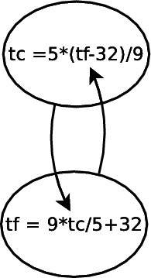
Dataflow programming
In Céu:
  variable + internal event → (state + signaling)
Cycles: stacked execution
event int tc, tf;
par/or do
loop do
var int v = await tc;
emit tf => (9 * v / 5 + 32);
end
with
loop do
var int v = await tf;
emit tc => (5 * (v-32) / 9);
end
with
<...>
emit tc => 0;
end

Slide 14
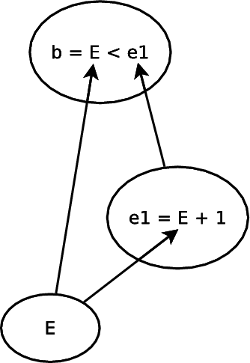
Dataflow programming
In Céu:
  variable + internal event → reactive variable
  (state + signaling)
Glitches: par/hor
input int E;
event int b, e1;
par do
// b = E < E + 1
loop do
var int v1=0,v2=1;
par/hor do
v1 = await E;
with
v2 = await e1;
end
emit b => v1 < v2;
end
with
// e1 = E + 1
loop do
var int v = await E;
emit e1 => v + 1;
end
end
E < E+1

Slide 15
Conclusion
A comprehensive and resource efficient design
  SenSys'13: Safe System-level Concurrency on Resource-Constrained Nodes
  Hierarchical abortion
  Stacked internal events
  Reconciling control & data reactivity
  Too low level?
Formal semantics (skipped)

Slide 16

Advanced Control Reactivity
for Embedded Systems
(with Céu)
www.ceu-lang.org
Authors:
Francisco Sant'Anna
Roberto Ierusalimschy
Noemi Rodriguez
PUC-Rio, Brasil
Workshop on Reactivity,
Events and Modularity
REM'13 – Indianapolis

