Slide 1
Safe System-level Concurrency on Resource-Constrained Nodes
(with Céu)
Authors:
Francisco Sant'Anna
Roberto Ierusalimschy
Noemi Rodriguez
PUC-Rio, Brazil
Olaf Landsiedel
Philippas Tsigas
Chalmers, Sweden
Conference on Embedded
Networked Sensor Systems
ACM SenSys'13 – Rome

Slide 2
“Hello world!”
Blinking LEDs
  on ↔ off every 500ms
  stop after 5s
  repeat after 2s
Compositions
  par, seq, loop
  avoid state vars
  static inference
par/or do
loop do
await 500ms;
_leds_toggle();
end
with
await 5s;
end
loop do
par/or do
loop do
await 500ms;
_leds_toggle();
end
with
await 5s;
end
await 2s;
end
loop do
await 500ms;
_leds_toggle();
end

Slide 3
The design of Céu
Synchronous execution model:
  Reactions do not overlap (based on Esterel)
    Pros: safety, resource efficiency
    Cons: heavy (async) computations
Contributions (safety aspects):
  Shared-memory concurrency
  Internal events
  Integration with C
  Local scopes & Finalization
  First-class timers

Slide 4
1. Shared-memory concurrency
var int x=1;
par/and do
await A;
x = x + 1;
with
await B;
x = x * 2;
end
var int x=1;
par/and do
await A;
x = x + 1;
with
await A;
x = x * 2;
end
Compile-time race detection

Slide 5
3. Integration with C
Well-marked syntax (“_”)
par do
_f(_inc(10));
with
_g();
end
pure _inc();
safe _f() with _g();
par do
_f(_inc(10));
with
_g();
end
Compile-time race detection
pure and safe annotations

Slide 6
4. Local scopes & Finalization
loop do
await 1s;
var _message_t msg;
<...> // prepare msg
_send_request(&msg);
await SEND_ACK;
end
local pointer

Slide 7
4. Local scopes & Finalization
par/or do
loop do
await 1s;
var _message_t msg;
<...> // prepare msg
_send_request(&msg);
await SEND_ACK;
end
with
await STOP;
end
var int x = 1;
Compile-time error

Slide 8
4. Local scopes & Finalization
par/or do
loop do
await 10ms;
var _message_t msg;
<...> // prepare msg
finalize
_send_request(&msg);
with
_send_cancel(&msg);
end
await SEND_ACK;
end
with
await STOP;
end
var int x = 1;

Slide 9
5. First-class timers
Very common in WSNs
  sampling, timeouts
await supports time (i.e. ms, min)
  it also compensates system delays
par/or do
await 10ms;
<...> // no awaits
await 1ms;
v = 1;
with
await 12ms;
v = 2;
end
await 2ms;
v = 1;
await 1ms;
v = 2;
3ms elapse
late = 1ms
late = 0ms
11 < 12 (always!)

Slide 10
Evaluation
Source code size
  number of tokens, data/state variables
Memory usage
  ROM, RAM
Responsiveness
  time-consuming C calls (e.g. encryption)
Comparison to nesC
  WSNs protocols, radio driver

Slide 11
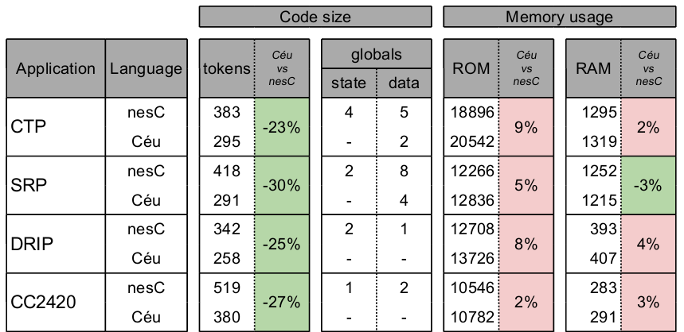
Code size & Memory usage
no control globals
globals → locals

Slide 12
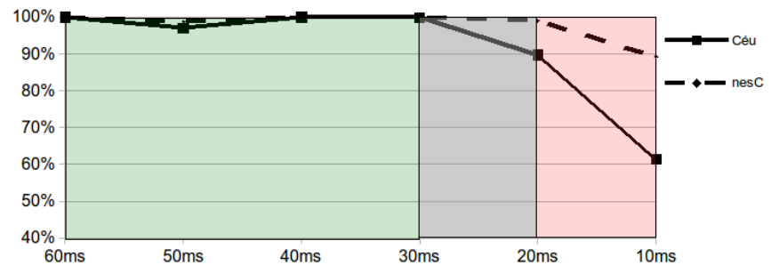
Responsiveness
10 sending nodes → 1 receiving node
60-10 ms / msg
8ms operation in sequence w/ every msg

Slide 13
Conclusion
A comprehensive and resource-efficient design
A set of compile-time guarantees
  time/memory bounded reactions
  race-free shared variables
  race-free native calls
  finalization for locals
  auto-adjustment for timers in sequence
  synchronization for timers in parallel

Slide 14

Safe System-level Concurrency on Resource-Constrained Nodes
www.ceu-lang.org

Slide 15
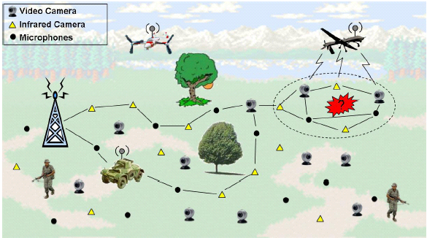
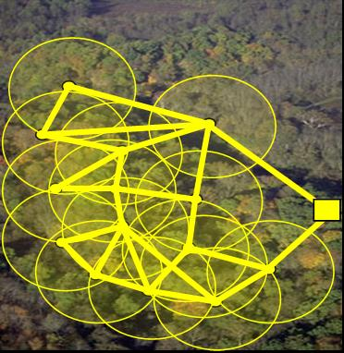
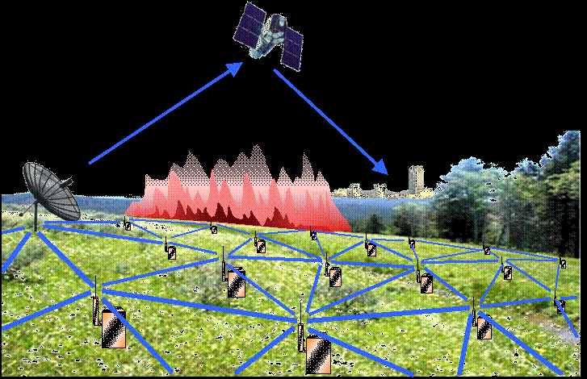
Wireless Sensor Networks

Slide 16
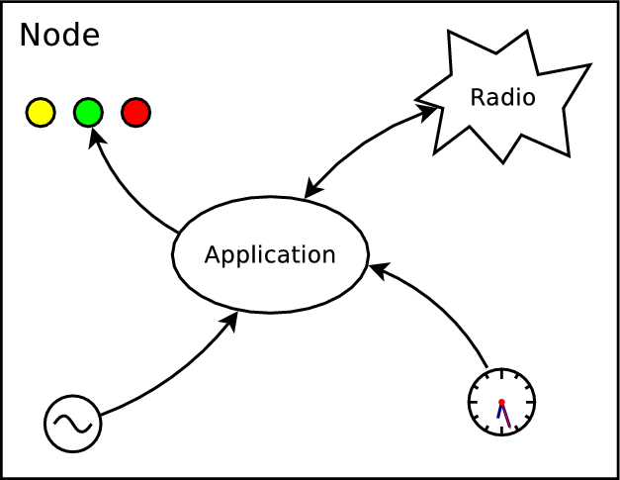
Wireless Sensor Networks
Reactive
  guided by the environment
Concurrent
  safety aspects
Constrained
  32K ROM
  4K RAM

Slide 17
Programming models in WSNs
Event-driven programming
  TinyOS/nesC, Contiki/C
Multi-threading
  Protothreads, TinyThreads, OCRAM
Synchronous languages
  Sol, OSM, Céu

Slide 18
Programming models in WSNs
Event-driven programming
Multi-threading
Synchronous
(Céu)
low level
high level
- unstructred code
- manual memory
management
- multiple threads
- unrestricted shared
memory
- composable threads
- safety analysis

Slide 19
Overview of Céu
Reactive
  environment in control: events
Imperative
  sequences, loops, assignments
Concurrent
  multiple lines of execution: trails
Synchronous
  trails synchronize at each external event
Deterministic
  trails execute in a specific order

Slide 20
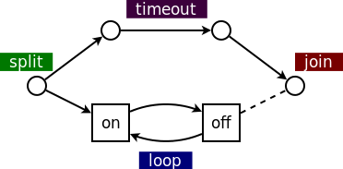
Blinking a LED
  sequential: on=2s, off=1s
  parallel: 1-minute timeout
// nesC: event-driven
event void Boot.booted () {
call T1.start(0);
call T2.start(60000);
}
event void T1.fired() {
static int on = 0;
if (on) {
call Leds.led0Off();
call T1.start(1000);
} else {
call Leds.led0On();
call T1.start(2000);
}
on = !on
}
event void T2.fired() {
call T1.cancel();
call Leds.led0Off();
<...> // continue
}
// Protothreads: multi-threaded
int main() {
PT_INIT(&blink);
timer_set(&timeout,60000);
while (
PT_SCHEDULE(blink()) &&
!timer_expired(timeout)
);
leds_off(LEDS_RED);
<...> // continue
}
PT_THREAD blink() {
while (1) {
leds_on(LEDS_RED);
timer_set(&timer,2000);
PT_WAIT(expired(&timer));
leds_off(LEDS_RED);
timer_set(&timer,1000);
PT_WAIT(expired(&timer));
}
}
// Céu: synchronous
par/or do
loop do
_Leds_led0On();
await 2s;
_Leds_led0Off();
await 1s;
end
with
await 1min;
end
_Leds_led0Off();
<...> // continue

Slide 21
Synchronous execution
Program is idle.
On any external event, awaiting trails awake.
Active trails execute, until they await or terminate.
Goto step 1.
Reactions to external events never overlap
The synchronous hypothesis:
“reactions run infinitely faster in
comparison to the rate of events”

Slide 22

1. Synchronous execution
par/and do
<...> // 1
await A;
<...> // 3
with
<...> // 2
await B;
<...> // 4
end
<...> are trail segments that do not await (e.g. assignments, system calls)
Reactions to external events never overlap
The synchronous hypothesis:
“reactions run infinitely faster in
comparison to the rate of events”

Slide 23
Synchronous execution
Parallel compositions
Sampling and Timeout patterns
loop do
par/and do
<...>
with
await 100ms;
end
end
loop do
par/or do
<...>
with
await 100ms;
end
end

Slide 24
Synchronous execution
Céu enforces bounded execution
Limitation: time-consuming operations
loop do
if <cond> then
break;
end
end
loop do
if <cond> then
break;
else
await A;
end
end

Slide 25
2. Internal events
(vs external events)
Emitted by the program
  (vs environment)
Multiple can be active at the same time
  (vs single)
Stack-based execution policy
  (vs queue)

Slide 26
2. Internal events
Stack-based execution policy
  (vs queue)
Advanced control mechanisms
  (e.g. subroutines, exceptions)
Bounded memory & execution
  no recursion
event int* inc;
// define subroutine
loop do
var int* p = await inc;
*p = *p + 1;
end
event int* inc;
par do
// define subroutine
loop do
var int* p = await inc;
*p = *p + 1;
end
with
// use subroutine
<...>
var int v = 1;
emit inc => &v;
_assert(v == 2);
end

Slide 27
3. Integration with C
Well-marked syntax (“_”)
  “C hat” (unsafe execution)
  no bounded-execution analysis
  what about side effects in parallel trails?
native _assert(), _inc(), _I;
_assert(_inc(_I));
native do
#include <assert.h>
int I = 0;
int inc (int i) {
return I+i;
}
end

Slide 28
Local scopes
blocks in parallel: sum memory
blocks in sequence: reusue memory
par/and do
var int a;
<...>
with
var int b;
<...>
end
var int c;
<...>

Slide 29
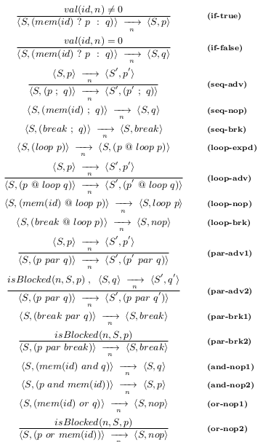
Formalization
Small-step operational semantics
Control aspects of the language
  parallel compositions,
  stack-based events, finalization
Mapping: formal → concrete

Slide 30
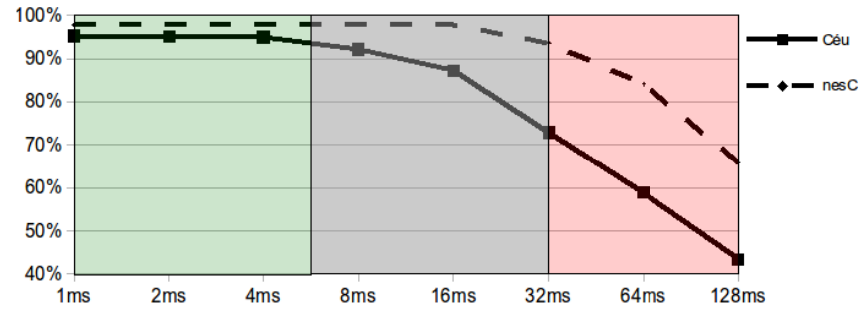
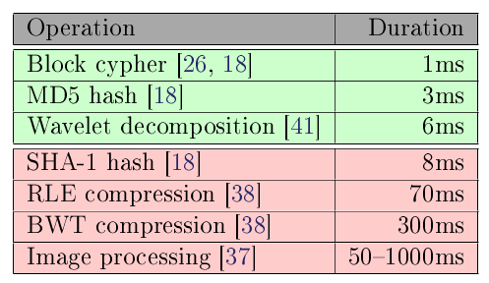
Responsiveness
10 sending nodes
  20-bytes msgs, 200ms/msg
1 receiving node
  50msg/s
  1-128ms operation (every 150ms)

Slide 31
Safety
Time-bounded reactions
No concurrency in variables
No concurrency in C calls
Finalization for blocks going out of scope
Auto-adjustment for timers in sequence
Synchronization for timers in parallel

Slide 32
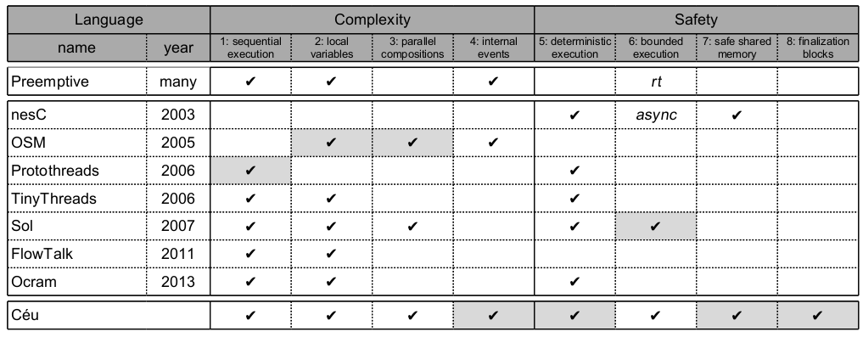
Related work

Slide 33
Demo applications
  explore the programming style of Céu
Semantics of Céu
  control aspects
    determinism, stacked internal events
Implementation of Céu
  parsing, temporal analysis, code generation

