Slide 1


Structured Synchronous Reactive Programming with Céu
Authors
Francisco Sant'Anna
Roberto Ierusalimschy
Noemi Rodriguez
LabLua – PUC-Rio
www.lua.inf.puc-rio.br
www.ceu-lang.org

Slide 2
TODO
Reactive, actors, synchronous, etc
  pegar artigo do Berry e Pnueli
Exemplos de Signal,Lustre,Fran,Elm

Slide 3



Céu goals
Céu non-goals
Front-end applications
  GUIs, Games, interactive apps
  Desktops → Arduino (4K RAM)
Ruled by the environment
  Immediate/real-time feedback
  Global consensus
Logical reasoning
  Concurrency w/ Determinism
Back-end infrastructure
  High-performance servers
  Clusters, Cloud computing
Independent sessions/actors
  Latency in communication
  Distribution
The C10K problem
  Concurrency w/ Parallelism

Slide 4
“Hello world!” in Céu
par means
await in parallel
(not execute in parallel)
Blinking a LED
  on ↔ off every 500ms
  stop after “press”
  restart after 2s
Compositions
  seq, loop, par (trails)
    At any level of depth
  state variables / communication
par/or do
loop do
await 500ms;
_leds_toggle();
end
with
await PRESS;
end
loop do
par/or do
loop do
await 500ms;
_leds_toggle();
end
with
await PRESS;
end
await 2s;
end
loop do
await 500ms;
_leds_toggle();
end
Lines of execution
=
Trails (in Céu)

Slide 5
From “Structured Programming”
To “Structured Reactive Programming”
Control Structures
  Sequences, Loops, Conditionals
Blocks, Scopes, Locals
  Automatic memory management
Subroutines
  Abstraction mechanism
What about reactivity?
  Environment event → Short-lived callback
  No more loops, scopes, etc.
  Breaks structured programming
    “Callbacks as our Generations' goto” [Miguel de Icaza]
The await statement
  Imperative-reactive nature
Compositions
  Control structures + parallels
Synchronous execution model
  Time ~ Sequence of events
Esterel did this back in the '80s
What about abstractions and modularization?

Slide 6
Two Blinking LEDs
par do
with
end
loop do
par/or do
every 500ms do
_leds_toggle(1);
end
with
var int bt = await PRESS
until bt==1;
end
await 2s;
end
loop do
par/or do
loop do
await 500ms;
_leds_toggle();
end
with
await PRESS;
end
await 2s;
end
The need for abstractions!
loop do
par/or do
every 500ms do
_leds_toggle(2);
end
with
var int bt = await PRESS
until bt==2;
end
await 2s;
end

Slide 7
The O.O. way
Use the observer pattern
  Create a Blink class
  Create two instances
  Add instances as listeners for timers and button events
  Explicit references
  No loops and parallel compositions (short-lived methods)
This has been considered
imperative reactive programming
(even though Esterel has been around for ~30 years)
Memory (heap) management:
  Memory leaks
  Dangling pointers
  Garbage collection
We want something as simple as locals with automatic management!

Slide 8
Céu Organisms
Organism ~ (Object + Trails)
class Blink do
var int led;
var int but;
with
loop do
par/or do
every 500ms do
_leds_toggle(this.led);
end
with
var int bt =
await PRESS
until bt==this.but;
end
await 2s;
end
end
class <ID> with
<interface>
// properties
// methods
do
<body>
// Céu code
end
Organisms react directly to
the environment

Slide 9
Two Blinking LEDs
class Blink with
<interface>
do
<body>
end
var Blink b1 with
this.led = 1;
this.but = 1;
end;
var Blink b2 with
this.led = 2;
this.but = 2;
end;
await FOREVER;
normal declaration
+
constructor
+
body execution in parallel

Slide 10
n-Blinking LEDs
class Blink with
<...>
end
var int i = 1;
var Blink[6] bs with
this.led = i;
this.but = i;
i = i + 1;
end;
await FOREVER;
x6

Slide 11
[led-07]
(scopes)
Lexical Scope
class Blink with
<...>
end
loop do
var int i = 1;
var Blink[6] bs with
this.led = i;
this.but = i;
i = i + 1;
end;
var int bt = await PRESS
until bt==0;
end
organisms have
lexical scope
organism out of scope:
data reclaimed and body aborted
Organisms preserve data+control state across reactions
Organisms management is as simple as for locals

Slide 12
Structured, Reactive, Abstract.
But we still have a static semantics!

Slide 13
n-Blinking LEDs with
Lexical Scope
loop do
par/or do
par do
<body-1>
with
...
with
<body-n>
end
with
var int bt =
await PRESS
until bt==0;
end
end
par do
<body-1>
with
...
with
<body-k>
end
loop do
par/or do
loop do
await 500ms;
_leds_toggle(i);
end
with
await i-PRESS;
end
await 2s;
end

Slide 14
Another Example
class Bird with
var Pos pos; // position
var int speed; // px/secs
do
par do
<code-to-move>
with
<code-to-redraw>
end
end
Reaction to the environment is abstracted inside the body
var Bird b1 with
this.pos.y = 100;
this.speed = 100;
end;
var Bird b2 with
this.pos.y = 300;
this.speed = 200;
end;
await FOREVER;
On instantiation, only the interface matters

Slide 15
Dynamic Instantiation
class Bird with
<...>
end
every 1s do
spawn Bird with
this.pos.y = 20 + _rand()%HEIGHT;
this.speed = 100 + _rand()%100;
end;
end
spawn dynamically allocates
an anonymous organism

Slide 16
Natural Termination
class Bird with
<...>
do
par/or do
<...>
with
<await-limit-of-screen>
end
end
every 1s do
spawn Bird with
this.pos.y = 20 + _rand()%HEIGHT;
this.speed = 100 + _rand()%100;
end;
end
these trails are aborted
this trail terminates
the whole body terminates
(natural termination)
natural termination
automatically reclaims
dynamic organisms
from memory
no need for a
free primitive or
garbage collection
spawned organisms
are anonymous

Slide 17
Memory Pools with Lexical Scope
class Bird with
<...>
end
pool Bird[] birds;
every 1s do
spawn Bird in birds with
this.pos.y = 20 + _rand()%HEIGHT;
this.speed = 100 + _rand()%100;
end;
end

Slide 18
Memory Pools with Lexical Scope
class Bird with
<...>
end
loop do
par/or do
pool Birds[] birds;
every 1s do
spawn Bird in birds with
this.pos.y = 20 + _rand()%HEIGHT;
this.speed = 100 + _rand()%100;
end;
end
with
await SDL_MOUSEBUTTON;
end
end
pool out of scope:
data and body of
all organisms reclaimed
pools also have
lexical scope
heap allocation with
automatic memory management
(vs. garbage collection)

Slide 19
Pointers
Pointers to organisms are sometimes required:
  Static: `&´ operator
  var T t;
  <use &t>
  Dynamic: pool iterators
  pool T ts;
  loop (T*)t in ts do
  <use t>
  end
All pointers are temporary references

Slide 20
Pool Iterator (for collision detection)
class Bird with
<...>
event void collided;
do
par/or do
<animate>
with
await this.collided;
with
every SDL_REDRAW do
<redraw>
end
end
end
par do
<bird creation>
with
every SDL_FRAME do
loop (Bird*)b1 in birds do
loop (Bird*)b2 in birds do
if <&b1->r vs &b2->r> then
emit b1->collided;
emit b2->collided;
end
end
end
end
end
Interfaces support
internal events
Await to abort the body
For every frame
Iterate over the birds
Emits on collision
detection

Slide 21
Pointers to organisms
Alive (valid) within a whole reaction
Dead (invalid) across reactions
Pointers can be tracked across reactions
var T* ptr = <...>;
ptr->x = 1;
await 1s;
_printf(”x = %d\n”, ptr->x);
possibly a
dangling pointer
var T* ptr = <...>;
ptr->x = 1;
watching ptr do
await 1s;
_printf(”x = %d\n”, ptr->x);
end
par/or do
await ptr._killed;
with
<...>
end

Slide 22
Reference Watching
class Bird with
<...>
end
par do
<bird creation>
with
loop do
var _SDL_MouseEvent* mse = await SDL_MOUSEBUTTON;
var Bird* ptr = null;
loop (Bird*)b in birds do
if <mse vs &b->r> then
ptr = b;
break;
end
end
if ptr != null then
watching ptr do
every SDL_REDRAW do
_SDL_DrawLine(WIDTH/2,HEIGHT,
ptr->pos.x,ptr->pos.y);
end
end
end
end
end
Iterator that
checks if a bird
was clicked
Watches the bird
while drawing
a line

Slide 23
Interfaces
interface IBird with
var Pos pos; // position
var int speed; // px/secs
end
class Bird1 with
interface IBird;
do
<...>
end
class Bird2 with
interface IBird;
do
<...>
end

Slide 24
Composition over Inheritance
class MoveSin with
var IBird& bird;
var Pos to;
event void ok;
do
every FRAME do
<...> // move in a senoid
// break when in “to”
end
emit this.ok;
end
class Bird1 with
interface IBird;
do
<...>
do
var MoveSin mv with
this.bird = outer;
this.to = <...>;
end;
await mv.ok;
end
<...>
end
do MoveSin with
this.bird = outer;
this.to = <...>;
end;

Slide 25
par/or
Céu in one feature
par: lexical composition of activites
  static reasoning, static memory
  synchronous execution
or: orthogonal abortion
  safe/consistent termination
  no need for garbage collection
permeates all aspects of the language
  organism expansion, reference watching, finalization

Slide 26
Summary
SP -> SSRP
  sequences, loops, conditionals -> await+parallels+abortion
  routines -> organisms
  static/dynamic instances -> lexical scope
Issues in dynamic allocation:
  Memory leaks: lexical scope and body termination
  Dangling pointers: controlled references
  Garbage collection: lexical scope and body termination

Slide 27
Structured Synchronous Reactive Programming with Céu
Authors
Francisco Sant'Anna
Roberto Ierusalimschy
Noemi Rodriguez
LabLua – PUC-Rio
www.lua.inf.puc-rio.br
www.ceu-lang.org

Slide 28
Extra
Slides

Slide 29

Reactive/RT applications

Slide 30
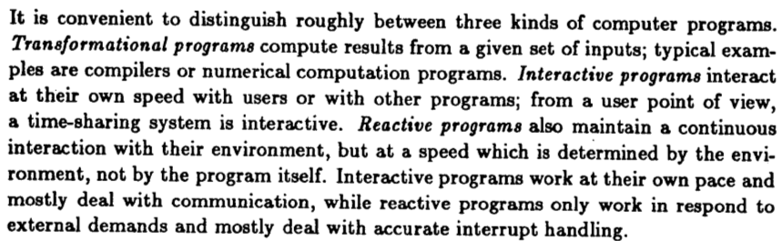
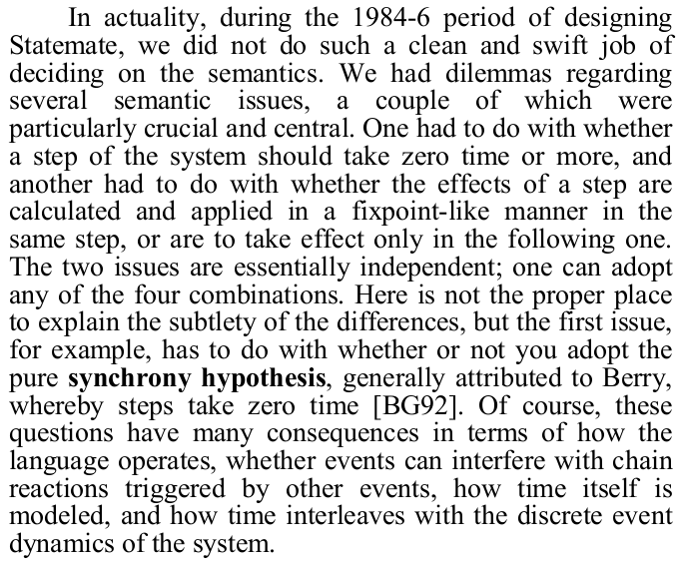
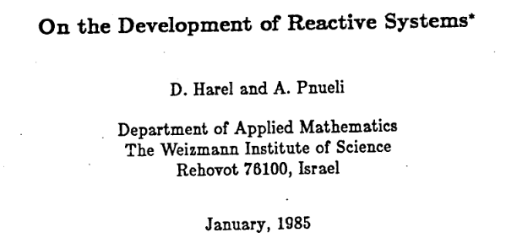
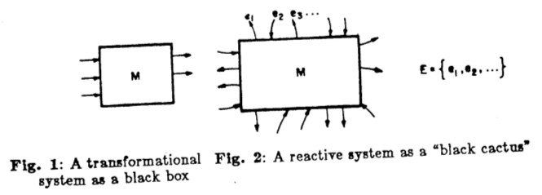
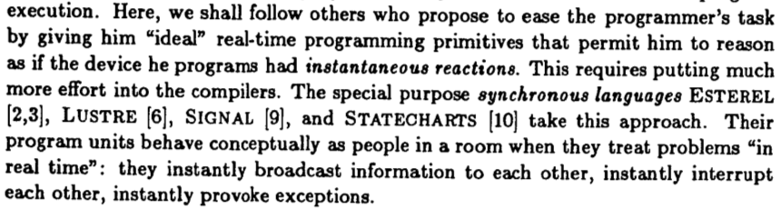
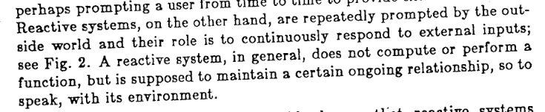

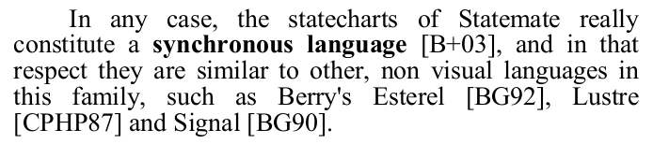
“Reactive” (terminology)
[1985] “On the development of reactive systems”, David Harel et. al.
[1987] “Statecharts: A Visual Formalism for Complex Systems”, David Harel
[2007-HOPL] "Statecharts in the Making: A Personal Account", David Harel
[1989] “Real time programming: Special purpose or general purpose languages”, Gérard Berry

Slide 31
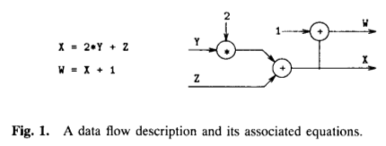
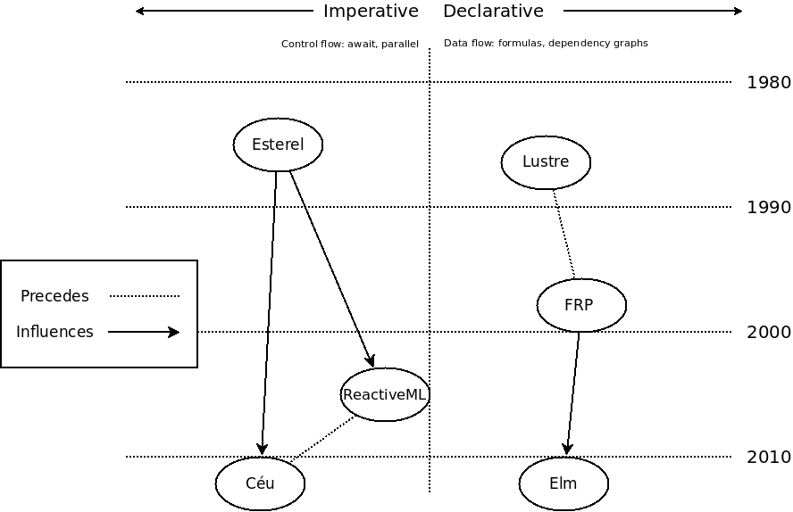
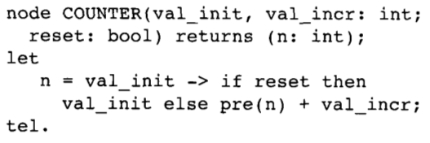
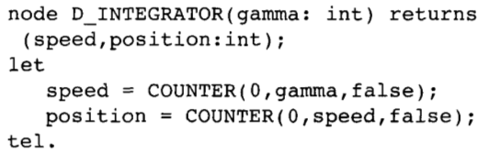
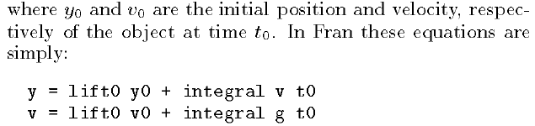
Reactive languages
discrete

Slide 32

Synchronous execution
Game Loop (i.e., input → logic → redraw → *)
Arduino Loop (i.e., input → logic → output → *)
Observer Pattern (i.e., input → observers → output → *)
Digital Circuits (i.e., input → propagation → output → *)

Slide 33

Execution model
Programs starts in the “boot reaction” in a single trail.
Trails execute until they await or terminate. This step is known as “reaction chain” and always executes in bounded time.
An input event occurrence awakes all trails awaiting that event. Repeat “step 2”.
par/and do
<...> // 1
await A;
<...> // 3
with
<...> // 2
await B;
<...> // 4
end
<...> are trail segments that do not await
(e.g. atrbuições, chamadas de função)

Slide 34
Execution model
Synchronous hypothesis: “Reactions execute infinitely faster in comparison to the input rate.”
In theory: a program does not take time on “step 2” and is always idle on “step 3”.
In practice: if an event occurs while a reaction takes place, the event is enqueued for the next reaction.
Reactions to events never overlap.
When multiple trails are active (i.e., awoken from the same event), they execute in the order they appear in the source code.

Slide 35
Bounded execution
Céu ensures bounded execution
  All loops must await or break
Limitation: long computations
loop do
if <cond> then
break;
end
end
loop do
if <cond> then
break;
else
await A;
end
end

Slide 36
Shared memory
var int x=1;
par/and do
await A;
x = x + 1;
with
await B;
x = x * 2;
end
_printf(“%d\n”, x);
var int x=1;
par/and do
await A;
x = x + 1;
with
await A;
x = x * 2;
end
_printf(“%d\n”, x);
Static analysis
  ceu --safety 0 # allows both
  ceu --safety 1 # allows LEFT, refuses RIGHT
  ceu --safety 2 # refuses both

Slide 37
Orthogonal abortion
Synchronous execution model
In between reactions to events, the whole system is idle.
par/or do
// trail-1
// locals-1
// resources-1
with
// trail-2
// locals-2
// resources-2
end
// locals-cont

Slide 38
Organism transformation
par/or do
loop do
await 500ms;
_toggle(11);
end
with
loop do
await 1s;
_toggle(12);
end
with
await 1min;
end
class Blink with
var int pin;
var int dt;
do
loop do
await (this.dt)ms;
_toggle(this.pin);
end
end
do
var Blink b1 with
this.pin = 11;
this.dt = 500;
end;
var Blink b2 with
this.pin = 12;
this.dt = 1000;
end;
await 1min;
end
struct _Blink with
var int pin;
var int dt;
end;
do
var _Blink b1, b2;
par/or do
// body of b1
b1.pin = 11;
b1.dt = 500;
loop do
await (b1.dt)ms;
_toggle(b1.pin);
end
await FOREVER;
with
// body of b2
b2.pin = 12;
b2.dt = 1000;
loop do
await (b2.dt)ms;
_toggle(b2.pin);
end
await FOREVER;
with
await 1min;
end
end

Slide 39
C integration
Well-marked syntax (“_”)
  “C hat” (unsafe execution)
  No “bounded” analysis
  What about side effects?
native do
#include <assert.h>
int I = 0;
int inc (int i) {
return i+1;
}
end
_assert(_inc(_I));

Slide 40
C integration
pure and safe annotations
par do
_f(_inc(10));
with
_g();
end
pure _inc();
safe _f() with _g();
par do
_f(_inc(10));
with
_g();
end

Slide 41
Resources
Internal
  Céu -> C
External
  C -> Céu
par/or do
var _message_t msg;
<...> // prepare msg
_send_request(&msg);
await SEND_ACK;
with
<...>
end
par/or do
var _FILE* f = _fopen(...);
_fwrite(..., f);
await 1s;
_fwrite(..., f);
await 1s;
_fclose(f);
with
<...>
end
local memory
to
external pointer
external memory
to
local pointer
May terminate
May terminate
line 5 : call to "_send_request" requires `finalize´
line 2 : attribution requires `finalize´

Slide 42
Resources
Internal
  Céu -> C
External
  C -> Céu
par/or do
var _message_t msg;
<...> // prepare msg
finalize
_send_request(&msg);
with
_send_cancel(&msg);
end
await SEND_ACK;
with
<...>
end
par/or do
var _FILE&? f;
finalize
f = _fopen(...);
with
_fclose(&f);
end
_fwrite(..., &f);
await 1s;
_fwrite(..., &f);
await 1s;
_fclose(&f);
with
<...>
end

Slide 43
Resources
Internal
  Céu -> C
External
  C -> Céu
par/or do
var _message_t msg;
<...> // prepare msg
finalize
_send_request(&msg);
with
_send_cancel(&msg);
end
await SEND_ACK;
with
<...>
end
par/or do
var _FILE&? f;
finalize
f = _fopen(...);
with
_fclose(&f);
end
_fwrite(..., &f);
await 1s;
_fwrite(..., &f);
await 1s;
_fclose(&f);
with
<...>
end

Slide 44
1st class Timers
Very common in reactive applications
  sampling, timeouts
await supports time (i.e., ms, min)
  … and compensates system delays
par/or do
await 10ms;
<...> // no awaits
await 1ms;
v = 1;
with
await 12ms;
v = 2;
end
await 2ms;
v = 1;
await 1ms;
v = 2;
5ms elapse
late = 3ms
late = 2ms

Slide 45
(Related) Esterel
Fundamental differences
  A single external event defines a reaction
    safe shared-memory concurrency
  Stack-based execution for internal events
Other differences
  Finalization for resources
  First-class timers
  Organisms

Slide 46
(Related) Simula
Similar syntactic structure
  Interface + Body
Different execution models
  Cooperative vs Synchronous/Reactive/Independent
Compositions
  Single body vs Parallel compositions
Memory management (reasoning)
  Heap vs Lexical scope

