Slide 1


Time Traveling in Céu
LabLua – PUC-Rio
www.lua.inf.puc-rio.br
www.ceu-lang.org

Slide 2
Time traveling
Allows programs to go back and forth in time during execution.
Why?
  Debug & Analysis
    Reproduce execution, control speed, pause/resume
  Tests & Simulation
    Simulate the future (input generation)
  Features & 1st-class use
    Undo, time manipulation

Slide 3
1. Debug & Analysis
Reproduce execution, control speed, pause/resume
Demo (tm)
Bret Victor's “Inventing by Principle” (cut-inventing)
Elm's “Time travel debugger” (Mario.elm)
Requires some form of “hot swapping”

Slide 4
2. Test & Simulation
Simulate the future (input generation)
Demo (ui, 10min)
Fast, random, adjustable
Automatic tests for interactive applications

Slide 5
3. Feature & 1st-class use
Undo (cut-om-undo)
  functional immutable data structures
Time manipulation ()
  imperative code, record the world
Demo (tm)

Slide 6
Feasibility in Céu
The good:
  Synchronous execution model
    Time: sequence of external input events
    Reproducible execution
  Static memory
    No heap (pools for dynamic allocation)
    Simple snapshots (single memcpy)
The bad:
  native calls with side effects (e.g. printf)
  heap allocation in many applications

Slide 7
Time machine in Céu
Environment, Host (time machine), and Guest (original application)
  Guest is unaware of the host
Operations
  play forward (replay)
  seek
  play backwards
  generate future
Approaches:
  Record inputs
  Record snapshots

Slide 8
Time machine in Céu
Each input X has a corresponding X' for host use
  control the time machine from Céu itself
Normal execution (timemachine=off)
  host receives all X/X' inputs
    recording all X inputs
    recording snapshots of the memory
  guest receives all X inputs
Controlled execution (timemachine=on)
  host receives all X' inputs
  guest
    receives “simulated” X inputs from host
    has the memory changed from snapshots

Slide 9
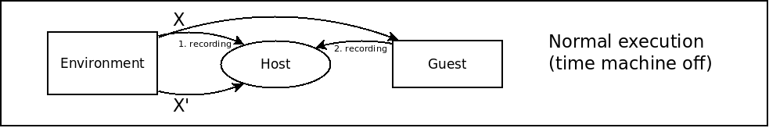
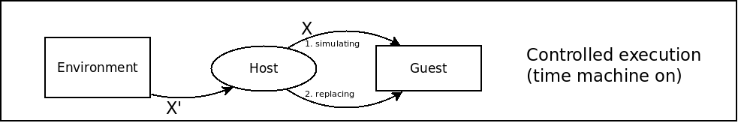
Time machine in Céu

Slide 10
Host implementation
event void go_on, go_off;
event int go_seek, go_back, go_fwd;
class Guest with
do
#include "guest.ceu"
end
var Guest guest;
// contiguous static memory
<save-guest-state-0>
par do
loop do
watching go_on do
<...> // record inputs/snapshots
end
<restore-guest-state-0>
watching go_off do
<...> // restore inputs/snapshots
end
end
with
<react to X'-inputs and
control-time-with-go_*>
end
par do
every vi in Xi do
<put-(Xi+vi)-in-vec>
end
with
<...>
end
--------------------------------
await go_forward;
loop (Xi,vi) in vec do
async do
emit Xi => vi;
end
if Xi==DT then
_delay(vi/speed);
end
end
every (x)ms do
<save-snapshot-in-vec>
end
--------------------------------
await go_forward;
loop i in vec do
<restore-snapshot>
_delay(x/speed);
end

Slide 11
Input simulation
Space analysis:
  state-0 + sum(|Xi| + 2bytes)
    “KeyboardEvent”: 40 bytes
    10e/s --> 36000e/h
    state-0 (18K) + 1.5M/h

Slide 12
Input simulation
t0
t1
t2
t3
t4
tn
Time:
  play forward
    replay: no impact
    fast forward: CPU capacity
  seek(t): “linear” (replay up to t)
  play backwards: “quadratic”
  Demo: (evts)
tk
tk-1
tk-2
tk-3

Slide 13
Snapshots
Space analysis:
  state-0 + ...
    diffs_t: (8 + 8*n) bytes
    50diffs/s --> 400b/s --> 1.5M/h
    state-0 (18K) + 300M/h
typedef struct {
u32 offset;
u8 from;
u8 to;
} diff_t;
typedef struct {
u16 prv;
u16 n;
u32 time;
diff_t vec[0];
} diffs_t;
<guest-state-0>
<guest-state-1>
...
<guest-state-N>
<guest-state-0>
{
prv=0, n=2, time=20,
vec = { {10,20,30},
{40,50,11} }
}
{
prv=K, n=5, time=40,
vec = { ...,
... }
}

Slide 14
Snapshots
Time:
  play forward: faster than simulation
  seek(t): “linear” (replay up to t)
  play backwards: same as forward
  Demo: (diffs)
<guest-state-0>
{
prv=0, n=2, time=20,
vec = { {10,20,30},
{40,50,11} }
}
{
prv=K, n=5, time=40,
vec = { ...,
... }
}

Slide 15
Next steps
Detect “time-unfriendly” boundaries
  force manual handling
High order (E -> E' -> E'' -> ...)
Hot swapping (tcc?)
Debugger
  simulation
Serialization (related)
  Pointers offsets

