Slide 1



Céu for Embedded Systems
Francisco Sant'Anna
LabLua – PUC-Rio
www.lua.inf.puc-rio.br
www.ceu-lang.org

Slide 2
What is Céu?
Alternative to C for embedded systems
  more safety
  more expressiveness
Embedded?
  the application is embedded in an environment and has to react to events from it in real time
Based on Esterel (a French language born in the '80s)
Céu in keywords
  synchronous, imperative, reactive, concurrent, deterministic
Céu means “sky” in Portuguese (Lua means “moon”)

Slide 3




Embedded/Reactive/Real time

Slide 4
“Hello world!” in Céu
Blinking a LED
  on ↔ off every 500ms
  stop after “press”
  restart after 2s
Compositions
  seq, loop, par (trails)
    At any level of depth
  state variables / communication
  static inference
par/or do
loop do
await 500ms;
_leds_toggle();
end
with
await PRESS;
end
loop do
par/or do
loop do
await 500ms;
_leds_toggle();
end
with
await PRESS;
end
await 2s;
end
loop do
await 500ms;
_leds_toggle();
end
Lines of execution
=
Trails (in Céu)

Slide 5
Why Céu (vs C)
Safety
  safe resource management
    leaked/dangling pointers
  finite bounds in programs
    unbounded memory
    unbounded execution
Expressiveness (reasoning)
  events (emit, await)
  concurrency (par, par/and, par/or)
  static memory management (no garbage collection)

Slide 6
Overview of Céu
Reactive
  environment in control: events
Imperative
  sequences, loops, assignments
Concurrent
  multiple lines of execution: trails
Synchronous
  trails synchronize at each external event
  trails are always awaiting
Deterministic
  always yields the same outcome for a given timeline

Slide 7
Features
Bounded Execution
Parallel Compositions
Shared-memory Concurrency
Interaction with C
Resource Management (Internal and External)
Timers

Slide 8
1. Bounded Execution
Céu enforces bounded execution
  All loops have to await or terminate
Limitation: time-consuming operations
loop do
if <cond> then
break;
end
end
loop do
if <cond> then
break;
else
await A;
end
end

Slide 9
2. par/and, par/or
loop do
par/and do
await A;
with
await 1s;
end
end
// PERIODIC (”at least”)
loop do
par/or do
await A;
with
await 1s;
end
end
// TIMEOUT (”at most”)
...
...

Slide 10
3. Shared-Memory
Concurrency
var int x=1;
par/and do
await A;
x = x + 1;
with
await B;
x = x * 2;
End
_printf(“%d\n”, x);
var int x=1;
par/and do
await A;
x = x + 1;
with
await A;
x = x * 2;
End
_printf(“%d\n”, x);
Static Analysis
  ceu --safety 0 # allows BOTH
  ceu --safety 1 # allows LEFT, refuses RIGHT
  ceu --safety 2 # refuses BOTH

Slide 11
4. Interaction with C
Special syntax (“_”)
  “C hat” (unsafe execution)
  No analysis for bounded execution
  What about side effects?
native do
#include <assert.h>
int I = 0;
int inc (int i) {
return i+1;
}
end
_assert(_inc(_I));

Slide 12
4. Interaction with C
pure and safe annotations
par do
_f(_inc(10));
with
_g();
end
pure _inc();
safe _f() with _g();
par do
_f(_inc(10));
with
_g();
end

Slide 13
5. Resource Management
Internal
  Céu -> C
External
  C -> Céu
par/or do
var _message_t msg;
<...> // prepare msg
_send_request(&msg);
await SEND_ACK;
with
<...>
end
par/or do
var _FILE* f = _fopen(...);
_fwrite(..., f);
await 1s;
_fwrite(..., f);
await 1s;
_fclose(f);
with
<...>
end
local memory
to
external pointer
external memory
to
local pointer
May terminate
May terminate
line 5 : call to "_send_request" requires `finalize´
line 2 : attribution requires `finalize´

Slide 14
5. Resource Management
Internos
  Céu -> C
Externos
  C -> Céu
par/or do
var _message_t msg;
<...> // prepare msg
finalize
_send_request(&msg);
with
_send_cancel(&msg);
end
await SEND_ACK;
with
<...>
end
par/or do
var _FILE&? f;
finalize
f = _fopen(...);
with
_fclose(&f);
end
_fwrite(..., &f);
await 1s;
_fwrite(..., &f);
await 1s;
_fclose(&f);
with
<...>
end

Slide 15
6. Timers
Very common in embedded systems
  sampling, timeouts
await supports time (i.e., ms, min)
  … and compensates delays
par/or do
await 10ms;
<...> // no awaits
await 1ms;
v = 1;
with
await 12ms;
v = 2;
end
await 2ms;
v = 1;
await 1ms;
v = 2;
5ms elapse
late = 3ms
late = 2ms

Slide 16
8. Others
Internal Events
Abstractions
Asynchronous Execution

Slide 17
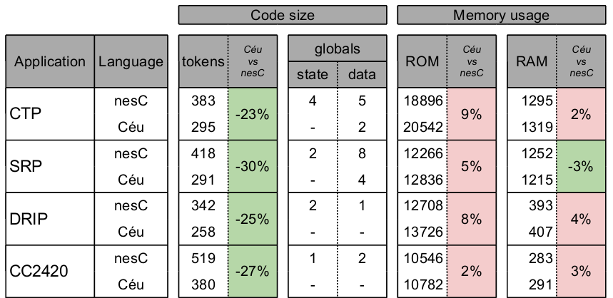
Evaluation
no control globals
globals → locals

Slide 18
Conclusion
A comprehensive and resource-efficient design
A set of compile-time guarantees
  time/memory bounded reactions
  race-free shared variables
  race-free native calls
  finalization for locals
  auto-adjustment for timers in sequence
  synchronization for timers in parallel

Slide 19
Céu for Embedded Systems
Francisco Sant'Anna
LabLua – PUC-Rio
www.lua.inf.puc-rio.br
www.ceu-lang.org

Slide 20
Céu in one feature: par/or
par: lexical composition of activites
  static reasoning, static memory
  synchronous execution
or: orthogonal abortion
  safe/consistent termination
  no need for garbage collection
permeates all aspects of the language
  organism expansion, reference watching, finalization

Slide 21
Internal events
Stack-based execution policy
  (vs queue)
Advanced control mechanisms
  (e.g. subroutines, exceptions)
Bounded memory & execution
  no recursion
event int* inc;
// define subroutine
loop do
var int* p = await inc;
*p = *p + 1;
end
event int* inc;
par do
// define subroutine
loop do
var int* p = await inc;
*p = *p + 1;
end
with
// use subroutine
<...>
var int v = 1;
emit inc => &v;
_assert(v == 2);
end

