Slide 1


Structured Synchronous Programming with Céu
(a data-oriented perspective)
Francisco Sant'Anna
www.ceu-lang.org

Slide 2
Extra
Slides

Slide 3
Synchronous Programming
Real-time/continuous interaction with the environment
  I/O, sensor/actuators
Two approaches (early 80s in France):
  Control oriented (imperative): Esterel
  Data oriented (functional/declarative): Lustre/Signal
Global/external notion of time (e.g., clock ticks)
Synchronous hypothesis
  “Reactions execute infinitely faster in comparison to the input rate.”
The synchronous model requires asynchronous primitives
  take time and execute across reactions (e.g., network communication, heavy computations, etc.)

Slide 4
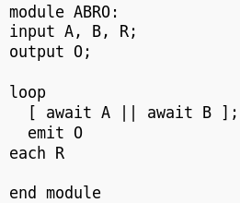
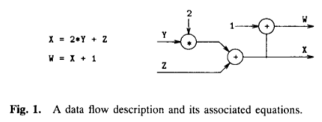
Synchronous Programming
(the beginning)
Esterel
  Control dependency
    Imperative statements
  Reactive to the environment
    Program counter
  Synchronous
    One input at a time
Lustre
  Data dependency
    Equations/Combinators
  Reactive to the environment
    Graph traversal
  Synchronous
    Complete graph traversal

Slide 5
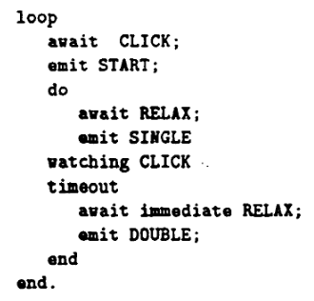
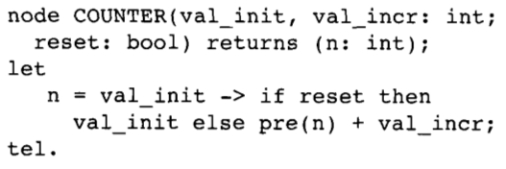
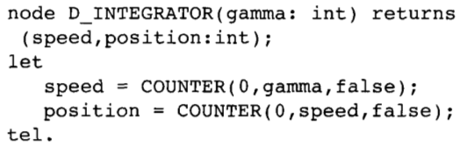
Synchronous Programming
Esterel
  Control dependency
  Imperative statements
  Reactive to the environment
    Program counter
      Synchronous: one input at a time
Lustre
  Data dependency
  Equations/Combinators
  Reactive to the environment
    Graph traversal
      Synchronous: complete traversal
Environment
Input
Output

Slide 6
From “Structured Programming”
To “Structured Reactive Programming”
Control Structures
  Sequences, Loops, Conditionals
Blocks, Scopes, Locals
  Automatic memory management
Subroutines
  Abstraction mechanism
What about reactivity?
  Environment event → Short-lived callback
  No more loops, scopes, etc.
  Breaks structured programming
    “Callbacks as our Generations' goto” [Miguel de Icaza]
The await statement
  Imperative-reactive nature
Compositions
  Control structures + parallels
Synchronous execution model
  Time ~ Sequence of events
Esterel did this back in the '80s
What about abstractions and modularization?

Slide 7



Céu goals
Céu non-goals
Front-end applications
  GUIs, Games, interactive apps
  Desktops → Arduino (4K RAM)
Ruled by the environment
  Immediate/real-time feedback
  Global consensus
Logical reasoning
  Concurrency w/ Determinism
Back-end infrastructure
  High-performance servers
  Clusters, Cloud computing
Independent sessions/actors
  Latency in communication
  Distribution
The C10K problem
  Concurrency w/ Parallelism

Slide 8
Céu Organisms
Organism ~ (Object + Trails)
class Blink do
var int led;
var int but;
with
loop do
par/or do
every 500ms do
_leds_toggle(this.led);
end
with
var int bt =
await PRESS
until bt==this.but;
end
await 2s;
end
end
class <ID> with
<interface>
// properties
// methods
do
<body>
// Céu code
end
Organisms react directly to
the environment

Slide 9
“Reactive” terminology: historical perspective
[1985] “On the development of reactive systems”, David Harel et. al.
[1987] “Statecharts: A Visual Formalism for Complex Systems”, David Harel
[1989] “Real time programming: Special purpose or general purpose languages”, Gérard Berry
[2007-HOPL] "Statecharts in the Making: A Personal Account", David Harel

Slide 10
“Reactive” terminology
[1985] “On the development of reactive systems”, David Harel et. al.
[1987] “Statecharts: A Visual Formalism for Complex Systems”, David Harel

Slide 11
“Reactive” terminology
[1989] “Real time programming: Special purpose or general purpose languages”, Gérard Berry

Slide 12
“Reactive” terminology
[2007-HOPL] "Statecharts in the Making: A Personal Account", David Harel

Slide 13
Reactive languages
discrete

Slide 14
Execution model
Programs starts in the “boot reaction” in a single trail.
Trails execute until they await or terminate. This step is known as “reaction chain” and always executes in bounded time.
An input event occurrence awakes all trails awaiting that event. Repeat “step 2”.
par/and do
<...> // 1
await A;
<...> // 3
with
<...> // 2
await B;
<...> // 4
end
<...> are trail segments that do not await
(e.g. atrbuições, chamadas de função)

Slide 15
Execution model
Synchronous hypothesis: “Reactions execute infinitely faster in comparison to the input rate.”
In theory: a program does not take time on “step 2” and is always idle on “step 3”.
In practice: if an event occurs while a reaction takes place, the event is enqueued for the next reaction.
Reactions to events never overlap.
When multiple trails are active (i.e., awoken from the same event), they execute in the order they appear in the source code.

Slide 16
Bounded execution
Céu ensures bounded execution
  All loops must await or break
Limitation: long computations
loop do
if <cond> then
break;
end
end
loop do
if <cond> then
break;
else
await A;
end
end

Slide 17
Shared memory
var int x=1;
par/and do
await A;
x = x + 1;
with
await B;
x = x * 2;
end
_printf(“%d\n”, x);
var int x=1;
par/and do
await A;
x = x + 1;
with
await A;
x = x * 2;
end
_printf(“%d\n”, x);
Static analysis
  ceu --safety 0 # allows both
  ceu --safety 1 # allows LEFT, refuses RIGHT
  ceu --safety 2 # refuses both

Slide 18
Organism transformation
par/or do
loop do
await 500ms;
_toggle(11);
end
with
loop do
await 1s;
_toggle(12);
end
with
await 1min;
end
class Blink with
var int pin;
var int dt;
do
loop do
await (this.dt)ms;
_toggle(this.pin);
end
end
do
var Blink b1 with
this.pin = 11;
this.dt = 500;
end;
var Blink b2 with
this.pin = 12;
this.dt = 1000;
end;
await 1min;
end
struct _Blink with
var int pin;
var int dt;
end;
do
var _Blink b1, b2;
par/or do
// body of b1
b1.pin = 11;
b1.dt = 500;
loop do
await (b1.dt)ms;
_toggle(b1.pin);
end
await FOREVER;
with
// body of b2
b2.pin = 12;
b2.dt = 1000;
loop do
await (b2.dt)ms;
_toggle(b2.pin);
end
await FOREVER;
with
await 1min;
end
end

Slide 19
Resources
Internal
  Céu -> C
External
  C -> Céu
par/or do
var _message_t msg;
<...> // prepare msg
_send_request(&msg);
await SEND_ACK;
with
<...>
end
par/or do
var _FILE* f = _fopen(...);
_fwrite(..., f);
await 1s;
_fwrite(..., f);
await 1s;
_fclose(f);
with
<...>
end
local memory
to
external pointer
external memory
to
local pointer
May terminate
May terminate
line 5 : call to "_send_request" requires `finalize´
line 2 : attribution requires `finalize´

Slide 20
Resources
Internal
  Céu -> C
External
  C -> Céu
par/or do
var _message_t msg;
<...> // prepare msg
finalize
_send_request(&msg);
with
_send_cancel(&msg);
end
await SEND_ACK;
with
<...>
end
par/or do
var _FILE&? f;
finalize
f = _fopen(...);
with
_fclose(&f);
end
_fwrite(..., &f);
await 1s;
_fwrite(..., &f);
await 1s;
_fclose(&f);
with
<...>
end

Slide 21
Resources
Internal
  Céu -> C
External
  C -> Céu
par/or do
var _message_t msg;
<...> // prepare msg
finalize
_send_request(&msg);
with
_send_cancel(&msg);
end
await SEND_ACK;
with
<...>
end
par/or do
var _FILE&? f;
finalize
f = _fopen(...);
with
_fclose(&f);
end
_fwrite(..., &f);
await 1s;
_fwrite(..., &f);
await 1s;
_fclose(&f);
with
<...>
end

Slide 22
par/or
Céu in one feature
par: lexical composition of activites
  static reasoning, static memory
  synchronous execution
or: orthogonal abortion
  safe/consistent termination
  no need for garbage collection
permeates all aspects of the language
  organism expansion, reference watching, finalization

Slide 23
References
“Real Time Programming: Special Purpose or General Purpose Languages” - G. Berry (1989)
  synchronous model, interactive vs reactive systems
“Preemption in Concurrent Systems” - G. Berry (1993)
  safe/immediate abortion, Esterel semantics
“Safe Concurrent Abstractions for Wireless Sensor Networks” - (SenSys'13)
  static Céu, constrained platforms (8bit CPU, 4K RAM)
“Structured Synchronous Reactive Programming with Céu” - (Modularity'15, FPW/StrangeLoop'14)
  dynamic Céu, abstractions with lexical scope

Slide 24
(Related) Observers
Use the observer pattern
  Create a Blink class
  Create two instances
  Add instances as listeners for timers and button events
  Explicit references
  No loops and parallel compositions (short-lived methods)
In some communities, the observer pattern is a synonym for
imperative reactive programming
(even though Esterel has been around for >30 years)
Memory (heap) management:
  Memory leaks
  Dangling pointers
  Garbage collection (“lapsed listeners”)
We want something as simple as locals with automatic management!

Slide 25
(Related) Esterel
Fundamental differences
  A single external event defines a reaction
    safe shared-memory concurrency
  Stack-based execution for internal events
Other differences
  Finalization for resources
  First-class timers
  Organisms

Slide 26
(Related) Simula
Similar syntactic structure
  Interface + Body
Different execution models
  Cooperative vs Synchronous/Reactive/Independent
Compositions
  Single body vs Parallel compositions
Memory management (reasoning)
  Heap vs Lexical scope

Slide 27
“Free Parallelism”
Two problems:
  signals are not in-memory collections
    (past values should have been handled, future values are not available yet)
  state machines are inherently sequential
    the order matters
    (fold can only be parallel with associative accumulator functions)

