Slide 1



An Overview of Céu
Francisco Sant'Anna
francisco@ime.uerj.br
www.ceu-lang.org

Slide 2


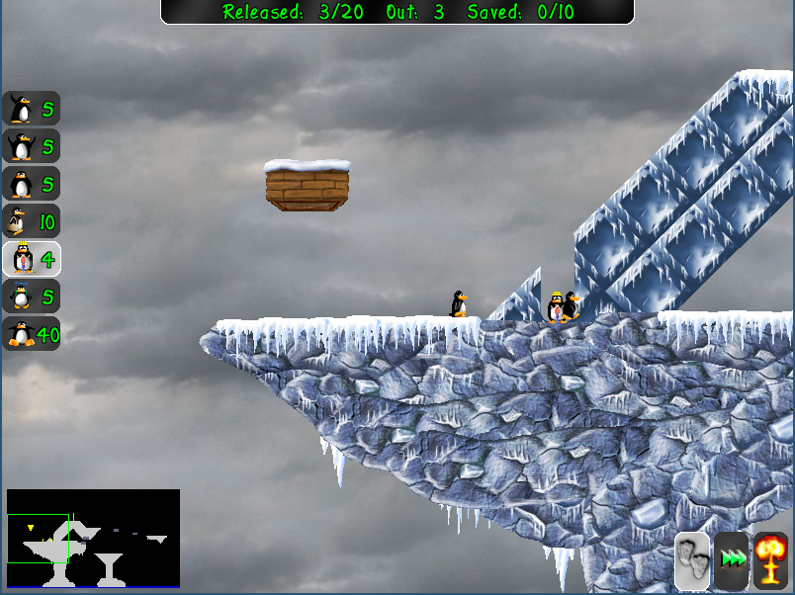
Céu goals
Céu non-goals
Front-end applications
  GUIs, Games, interactive apps
  Desktops → Arduino (4K RAM)
Ruled by the environment
  Immediate/real-time feedback
  Global consensus
Logical reasoning
  Concurrency w/ Determinism
Back-end infrastructure
  High-performance servers
  Clusters, Cloud computing
Independent sessions/actors
  Latency in communication
  Distribution
The C10M problem
  Concurrency w/ Parallelism

Slide 3
Concurrency Models
Asynchronous
  independent activities
  requires synchronization primitives (mutexes, monitors, channels, pipes)
Threads (Java, p-threads)
Processes (UNIX)
Actors (erlang)
Synchronous
  stepwise execution
  requires asynchronous (nonblocking) primitives
Event-driven (callbacks)
State machines
Céu

Slide 4
Concurrency Models
Asynchronous (threads)
  structured programming
  safety issues
  complex implementation
  parallel execution
Synchronous (callbacks)
  unstructured programming
  sync-free concurrency
  small footprint
  serial execution
VS
  structured programming
  sync-free concurrency
  small footprint
  parallel execution
?

Slide 5
“Hello world!” in Céu
Blinking a LED
  on ↔ off every 500ms
  stop after “press”
  restart after 2s
Compositions
  seq, loop, par (trails)
    At any level of depth
  state variables / communication
par/or do
loop do
await 500ms;
_leds_toggle();
end
with
await PRESS;
end
loop do
par/or do
loop do
await 500ms;
_leds_toggle();
end
with
await PRESS;
end
await 2s;
end
loop do
await 500ms;
_leds_toggle();
end
Lines of execution
=
Trails (in Céu)

Slide 6
Overview of Céu
Reactive
  environment in control: events
Imperative
  sequences, loops, assignments
Concurrent
  multiple lines of execution: trails
Synchronous
  trails synchronize at each external event
  trails are always awaiting
Deterministic
  always yields the same outcome for a given timeline

Slide 7
From “Structured Programming”
To “Structured Reactive Programming”
Control Structures
  Sequences, Loops, Conditionals
Blocks, Scopes, Locals
  Lexical memory management
Subroutines
  Abstraction mechanism
What about reactivity?
  Environment event → Short-lived callback
  No more loops, scopes, etc.
  Breaks structured programming
    “Callbacks as our Generations' goto” [Miguel de Icaza]
The await statement
  Imperative-reactive nature
Compositions
  Control structures + parallels
Synchronous execution model
  Time ~ Sequence of events
Esterel did this back in the '80s
What about abstractions and modularization?

Slide 8
[led-04]
(copy&paste)
Two Blinking LEDs
par do
with
end
loop do
par/or do
every 500ms do
_leds_toggle(1);
end
with
var int bt = await PRESS
until bt==1;
end
await 2s;
end
loop do
par/or do
loop do
await 500ms;
_leds_toggle();
end
with
await PRESS;
end
await 2s;
end
The need for abstractions!
loop do
par/or do
every 500ms do
_leds_toggle(2);
end
with
var int bt = await PRESS
until bt==2;
end
await 2s;
end

Slide 9
Céu Abstractions
code/await: a procedure that can await
code/await Led (var int led, var int but) -> FOREVER
do
loop do
par/or do
every 500ms do
_leds_toggle(led);
end
with
var int bt = await PRESS
until bt==but;
end
await 2s;
end
end
A code/await
reacts directly to
the environment

Slide 10
[led-05]
(code/await)
Two Blinking LEDs
code/await Led (var int led, var int but) -> FOREVER
do
<...>
end
par do
await Led(1,1);
with
await Led(2,2);
end
LEDs are reacting
in parallel
await invokes a code/await and waits for its termination

Slide 11
[led-06]
(code/await)
6-Blinking LEDs
code/await Led (var int led, var int but) -> FOREVER
do
<...>
end
par do
await Led(1,1);
with
await Led(2,2);
with
await Led(3,3);
with
await Led(4,4);
with
await Led(5,5);
with
await Led(6,6);
end

Slide 12
[led-07]
(scope)
Lexical Scope
code/await Led (var int led, var int but) -> FOREVER
do
<...>
end
loop do
par/or do
var int bt = await PRESS until bt==0;
with
await Led(1,1);
with
await Led(2,2);
with
await Led(3,3);
with
await Led(4,4);
with
await Led(5,5);
with
await Led(6,6);
end
end
code/await has
lexical scope
code/await out of scope:
data reclaimed and body aborted
code/await management is
as simple as local variables

Slide 13
Structured, Reactive, Abstract.
But we still have a static semantics!

Slide 14
6-Blinking LEDs with
Lexical Scope
loop do
par/or do
par do
<body-1>
with
...
with
<body-n>
end
with
var int bt =
await PRESS
until bt==0;
end
end
par do
<body-1>
with
...
with
<body-k>
end
loop do
par/or do
loop do
await 500ms;
_leds_toggle(i);
end
with
await i-PRESS;
end
await 2s;
end

Slide 15
[bird-01]
(code/await)
Another Example
code/await Bird (var int y, var int speed) -> FOREVER
do
<...>
end
Reaction to the environment is abstracted inside the body
par do
await Bird(100,100);
with
await Bird(300,200);
end
On instantiation, only the interface matters

Slide 16
[bird-02]
(scope)
code/await Bird (var int y, var int speed) -> FOREVER
do
<...>
end
loop do
par/or do
await Bird(100,100);
with
await Bird(100,100);
with
await MOUSE_CLICK;
end
end
Reaction to the environment is abstracted inside the body

Slide 17
[bird-03]
(pool&spawn)
code/await Bird (var int y, var int speed) -> FOREVER
do
<...>
end
pool[5] Bird birds;
loop i in [1 -> 5] do
spawn Bird(70*i, 100+10*i) in birds;
end
await FOREVER;
A pool is a container for code/await instances
spawn invokes a code/await and continues

Slide 18
[bird-04]
(dynamic/bounded)
code/await Bird (var int y, var int speed) -> FOREVER
do
<...>
end
pool[5] Bird birds;
every 1s do
spawn Bird(20+_rand()%HEIGHT, 100+_rand()%100) in birds;
end

Slide 19
[bird-05]
(dynamic/unbounded)
code/await Bird (var int y, var int speed) -> FOREVER
do
<...>
end
pool[] Bird birds;
every 1s do
spawn Bird(...) in birds;
end

Slide 20
[bird-05]
(Bird implementation)
code/await Bird (var int y, var int speed) -> FOREVER
do
par do
every UPDATE do
<animate-bird>
end
with
every DRAW do
<draw-bird>
end
end
end
pool[] Bird birds;
every 1s do
spawn Bird(...) in birds;
end
animation
trail
drawing
trail

Slide 21
[bird-06]
(break/unbounded)
code/await Bird (var int y, var int speed) -> FOREVER
do
par do
every UPDATE do
if x >= WIDTH then
break;
end
<animate-bird>
end
with
every DRAW do
<draw-bird>
end
end
end
pool[] Bird birds;
every 1s do
spawn Bird(...) in birds;
end
animation
trail
drawing
trail

Slide 22
[bird-07]
(break/bounded)
code/await Bird (var int y, var int speed) -> FOREVER
do
par do
every UPDATE do
if x >= WIDTH then
break;
end
<animate-bird>
end
with
every DRAW do
<draw-bird>
end
end
end
pool[5] Bird birds;
every 1s do
spawn Bird(...) in birds;
end
animation
trail
drawing
trail

Slide 23
[bird-08]
(natural termination)
code/await Bird (var int y, var int speed) -> void
do
par/or do
every UPDATE do
if x >= WIDTH then
break;
end
<animate-bird>
end
with
every DRAW do
<draw-bird>
end
end
end
pool[5] Bird birds;
every 1s do
spawn Bird(...) in birds;
end
animation
trail
drawing
trail
the whole body terminates
(natural termination)

Slide 24
[bird-08]
(natural termination)
code/await Bird (var int y, var int speed) -> void
do
par/or do
every UPDATE do
<animate-bird/break>
end
with
every DRAW do
<draw-bird>
end
end
end
pool[5] Bird birds;
every 1s do
spawn Bird(...) in birds;
end;
animation
trail
drawing
trail
the whole body terminates
(natural termination)
natural termination automatically
reclaims dynamic code/await
instances from memory pools
no need for a
free primitive or
garbage collection
spawned code/await
is anonymous

Slide 25
[birds-09]
(pools/scope)
code/await Bird (var int y, var int speed) -> void
do
<...>
end
loop do
par/or do
pool Birds[] birds;
every 1s do
spawn Bird(...) in birds;
end
with
await MOUSE_CLICK;
end
end
pool out of scope:
data and execution body of
all alive code/await
instances are reclaimed
pools also have
lexical scope
heap allocation with
lexical memory management
(vs. garbage collection)

Slide 26
[birds-09]
(pools/scope)
code/await Bird (var int y, var int speed) -> void
do
<...>
end
loop do
watching MOUSE_CLICK do
pool Birds[] birds;
every 1s do
spawn Bird(...) in birds;
end
end
end

Slide 27
[birds-10]
(collision/iterator)
loop do
watching MOUSE_CLICK do
pool Birds[] birds;
par do
every 1s do
spawn Bird(...) in birds;
end
with
every UPDATE do
var& Rect rct1;
event& void col1;
loop (rct1,col1) in birds do
var& Rect rct2;
event& void col2;
loop (rct2,col2) in birds do
if (&rct1<&rct2) and Int(&rct1,&rct2) then
emit col1;
emit col2;
break;
end
end
end
end
end
end
end
temporary alias
(valid only inside the loop)
iterate over the birds
living in the pool
access to internal state
of a code/await in the pool
notifies both code/await
about the collision

Slide 28
[birds-10]
(collision/state)
code/await Bird (var int y, var int speed)
-> (var& Rect rct, event& void collide)
-> FOREVER
do
var Rect my_rct = val Rect(20,y, 50,45);
rct = &my_rct;
event void my_collide;
collide = &my_collide;
par/or do
watching my_collide do
every UPDATE do
<animate/break> // accesses my_rct
end
end
with
every DRAW do
<draw-bird> // accesses my_rct
end
end
end
a code/await may expose
and share its internal state

Slide 29
[birds-11]
(falling)
code/await Bird (...) -> (...) -> void
do
<...>
par/or do
watching my_collide do
every UPDATE do
<animate-bird/break>
end
end
every UPDATE do
<animate-bird-y>
if my_rct.y >= HEIGHT then
break;
end
end
with
every DRAW do
<draw-bird>
end
end
end

Slide 30
[birds-12]
(blink / pause/if)
code/await Bird (...) -> (...) -> void
do
<...>
event bool hide;
par/or do
watching my_collide do
every UPDATE do
<animate-bird/break>
end
end
every UPDATE do
<animate-bird-fall>
end
watching 1s do
loop do
emit hide(true);
await 100ms;
emit hide(false);
await 100ms;
end
end
with
pause/if hide do
every DRAW do
<draw-bird>
end
end
end
end

Slide 31
[birds-13]
(pause)
event bool freeze;
par do
pause/if freeze do
<...> // bird pool, creation and collision
end
with
loop do
var Key key1 = await KEY_PRESS until key1.sym==’p’;
emit freeze(true);
par/or do
every DRAW do
<draw-pause>
end
with
var Key key2 = await KEY_PRESS until key2.sym==’p’;
end
emit freeze(false);
end
end

Slide 32
[birds-14]
(line)
pool Birds[] birds;
par do
every 1s do
spawn Bird(...) in birds;
end
with
every UPDATE do
<collision-detection>
end
with
loop do
var Mouse mse = await MOUSE_CLICK;
var&? Rect found = do
var&? Rect rct;
loop (rct,_) in birds do
if Rect_vs_Mouse(&rct,mse) then
escape &rct;
end
end
end;
watching found do
every DRAW do
<draw-line>
end
end
end
end
checks if a bird
was clicked
watches the bird
while drawing
the line

Slide 33
Summary
Structured Programming -> Structured Synchronous Reactive Programming
  sequences, loops, conditionals
    await + parallels + abortion
  procedures/abstractions
    code/await
  static/dynamic abstractions
    lexical scope

Slide 34
par/or
The workhorse of Céu
  permeates all aspects of the language
par: lexical composition of activites
  static reasoning, static memory
  synchronous execution
or: orthogonal abortion
  safe/consistent termination
    reference watching, finalization (not presented)
  departs from garbage collection

Slide 35
An Overview of Céu
Francisco Sant'Anna
francisco@ime.uerj.br
www.ceu-lang.org

