Slide 1
Advanced Control Reactivity
for Embedded Systems
Francisco Sant'Anna
Roberto Ierusalimschy
Noemi Rodriguez

Slide 2
Constrained Emb.Sys.
Wireless Sensor Networks
Arduino
Microcontrollers
  32K ROM
  4K RAM
Typically developed in C (“bare metal”)

Slide 3
Synchronous Languages
High level
  reactive primitives
Safe
  implicit synchronization
  no locks, bounded execution
Efficient
  in comparison to traditional multi-threading

Slide 4
Synchronous Languages
Control/imperative style
  Explicit parallelism, repetition, preemption
  Esterel
    PRET-C (2009), Sol (2007), OSM (2005)
Dataflow/declarative style
  Values as dependency graphs
  Lustre, Signal
  FRP (functional reactive programming)
    Flask (2008), FrTime (2004), Fran (1997)

Slide 5
Céu
Esterel-based synchronous language
Deterministic execution semantics
→ Shared-memory concurrency
Hierarchical abortion
→ Dataflow programming
Stack-based internal events
→ Exception handling, Limited co-routines

Slide 6
Node programming
System-level
  reactive execution
  control intensive
Concurrent
  safety aspects
Constrained
  32K ROM
  4K RAM

Slide 7
Overview of Céu
Reactive
  environment in control: events
Imperative
  sequences, loops, assignments
Concurrent
  multiple lines of execution: trails
Synchronous
  trails synchronize at each external event
Deterministic
  trails execute in a specific order

Slide 8
Programming models in WSNs
Event-driven programming
  TinyOS/nesC, Contiki/C
Multi-threading
  TinyThreads, Protothreads, ocram
Synchronous languages
  Sol, OSM, Céu
They all rely on non-preemptive lines of execution

Slide 9
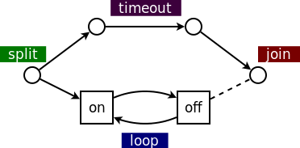
Blinking a LED
  sequential: on=2s, off=1s
  parallel: 1-minute timeout
// nesC: event-driven
event void Boot.booted () {
call T1.start(0);
call T2.start(60000);
}
event void T1.fired() {
static int on = 0;
if (on) {
call Leds.led0Off();
call T1.start(1000);
} else {
call Leds.led0On();
call T1.start(2000);
}
on = !on
}
event void T2.fired() {
call T1.cancel();
call Leds.led0Off();
<...> // continue
}
// Protothreads: multi-threaded
int main() {
PT_INIT(&blink);
timer_set(&timeout,60000);
while (
PT_SCHEDULE(blink()) &&
!timer_expired(timeout)
);
leds_off(LEDS_RED);
<...> // continue
}
PT_THREAD blink() {
while (1) {
leds_on(LEDS_RED);
timer_set(&timer,2000);
PT_WAIT(expired(&timer));
leds_off(LEDS_RED);
timer_set(&timer,1000);
PT_WAIT(expired(&timer));
}
}
// Céu: synchronous
par/or do
loop do
_Leds_led0On();
await 2s;
_Leds_led0Off();
await 1s;
end
with
await 1min;
end
_Leds_led0Off();
<...> // continue

Slide 10
The design of Céu
Synchronous execution
  deterministic scheduler
Shared-memory concurrency
Integration with C
Local scopes and finalization
First-class timers
Internal events

Slide 11
Synchronous execution
input void A, B, C;
par/and do
// trail 1
<...> // non−awaiting statements
await A;
<...>
with
// trail 2
<...>
await B;
<...>
with
// trail 3
<...>
await A;
<...>
await B;
par/and do
// trail 3
<...>
with
// trail 4
<...>
end
end
“internal reactions run infinitely faster in comparison to the rate of external events”

Slide 12
Motivation
Asynchronous (threads)
  structured programming
  safety issues
  complex implementation
  parallel execution
Synchronous (callbacks)
  unstructured programming
  lock-free concurrency
  small footprint
  serial execution
VS
  structured programming
  lock-free concurrency
  small footprint
  parallel execution
?

Slide 13
par/and, par/or, par
loop do
par/and do
await A;
with
await 1s;
end
end
// SAMPLING (”at least”)
...

Slide 14
par/and, par/or, par
loop do
par/or do
await A;
with
await 1s;
end
end
// WATCHDOG (”at most”)
...

Slide 15
Two (possible) problems
Unbounded reaction
  Breaks the synchronous/reactive model
  All paths must either await or break
var int v=0;
await A;
loop do
v = v + 1;
end
await B;

Slide 16
Two (possible) problems
Non-determinism
input void A;
var int v=0;
par/and do
await A;
v = v+1;
with
await B;
v = v*2;
end
return v;
input void A;
var int v=0;
par/and do
await A;
v = v+1;
with
await A;
v = v*2;
end
return v;

Slide 17
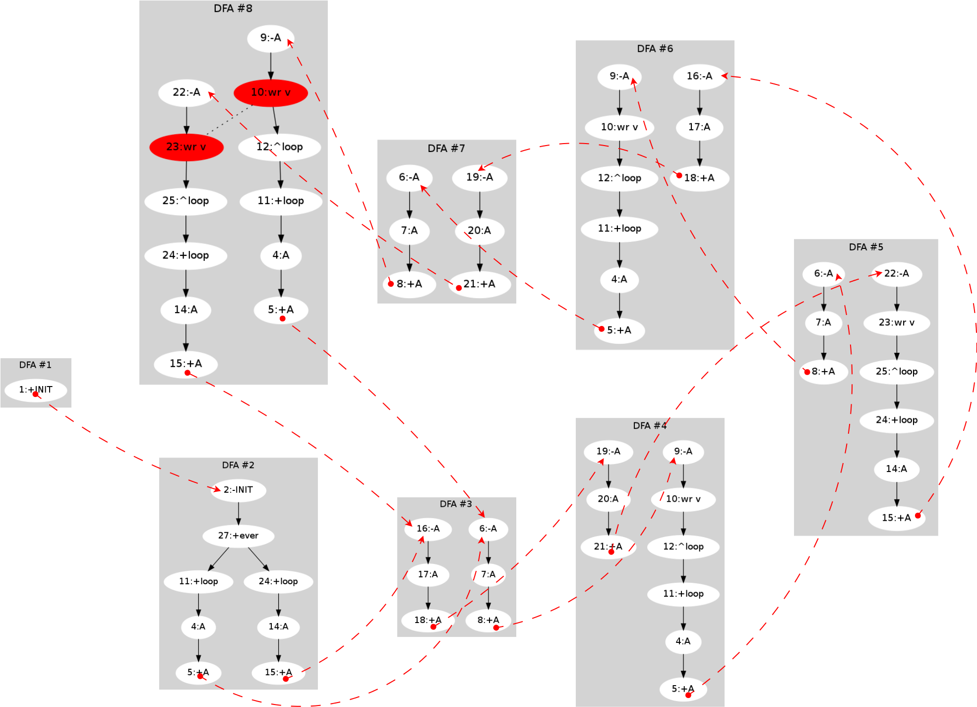
DFA conversion
input void A;
var int v;
par do
loop do
await A;
await A;
v = 1;
end
with
loop do
await A;
await A;
await A;
v = 2;
end
end
Exponential algorithm!

Slide 18
1st class Timers
Timers are very common in embedded apps
loop do
await 2min30s400ms;
... // do something
end
loop do
par/or do
// do something
with
await 500ms;
end
end

Slide 19
1st class Timers
1s + 1s = 2s (model and implementation (!))
loop do
await 10ms;
_printf(“1\n”);
await 1ms;
_printf(“2\n”);
end
15ms elapse
late = 5ms
late = 4ms
par/or do
loop do
await 10ms;
_printf(”1\n”);
await 1ms;
_printf(”2\n”);
end
with
await 15ms;
_printf(”3\n”);
end

Slide 20
1st class Timers
Temporal Analysis
var int v;
par/or do
loop do
await 10ms;
v = 1;
end
with
await 100ms;
v = 2;
end

Slide 21
Summary
Safety
  deterministic execution (exponential static analysis)
  lock-free concurrency (even w/o static analysis)
Expressiveness
  structured / parallel compositions
  1st-class timers
Small footprint
  ROM: 2 Kbytes
  RAM: 50 bytes

Slide 22
What is missing?
Object Oriented sub-system
Stacked execution for internal events
  exceptions, finalization blocks
Asynchronous blocks
  time-consuming computations
  simulation (deterministic & reproducible)
Output events
  communication between processes
Formal semantics
  operational semantics for control primitives

Slide 23
Céu + WSNs
Céu compiles to C
  easily ported to embedded platforms
    (e.g. Arduino,TinyOS)
TinyOS binding
  TOS events become input events in Céu
event message_t* Radio.receive(...) {...}
msg = await RADIO_RECEIVE;
  TOS commands become C functions in Céu
call Leds.set(7);
_Leds_set(7);

Slide 24
Blink (from TinyOS)
implementation {
event void Boot.booted() {
call T0.startPeriodic(250);
call T1.startPeriodic(500);
call T2.startPeriodic(1000);
}
event void T0.fired() {
call Leds.led0Toggle();
}
event void T1.fired() {
call Leds.led1Toggle();
}
event void T2.fired() {
call Leds.led2Toggle();
}
}
deterministic _Leds_led0Toggle
with _leds_led1Toggle,
_leds_led2Toggle;
deterministic _Leds_led1Toggle
with _leds_led2Toggle;
par do
loop do
await 250ms;
_Leds_led0Toggle();
end
with
loop do
await 500ms;
_Leds_led1Toggle();
end
with
loop do
await 1000ms;
_Leds_led2Toggle();
end
end

Slide 25
Demo:
Neighbors Discovery

Slide 26
Simulation
Important in cross-compiling platforms
Simulators
  Usually inaccurate
  Require additional knowledge
  Vary among platforms
Céu uses the own language for simulation
  input events: only source
  asynchronous blocks can emit input events

Slide 27
Simulation
par do
input int Start;
int v = await Start;
loop do
await 10min;
v = v + 1;
_printf(”v = %d\n”, v);
end
with
async do
emit Start=1;
emit 1h35min;
end
return 0;
end

Slide 28

An overview of Céu
(”A Safe and Reactive language
for Embedded Systems”)
www.ceu-lang.org
Thanks!

