Slide 1

Freechains
peer-to-peer content dissemination

Slide 2
Content
  E-mails
  Social media posts
  Webpages, Blogs
  News
  Forums, Mailing lists
  Media streaming
  Instant Messages, Chat
  Teleconference
  Cloud Storage
  Services (delivery, auction)
  Memes
Dissemination
  1 → N
  1 ← N
  1 ↔ 1
  N ↔ N
  1 ↩
Peer to Peer
  No central server
  No central authority
  No need to trust

Slide 3
N↔N intercommunication
(public forum)
user
user y
question
user 1
reply
reply
question
Distributed consensus
Happened-before relation
Best effort
Partial order
user x
question
question
reply
reply
user 2
reply
question
reply
time
Notes:
- best-effort, peers que viram msgs podem ligá-las atrás das novas
- não sabemos se o Y apenas ficou desconectado ou não ligou de propósito

Slide 4
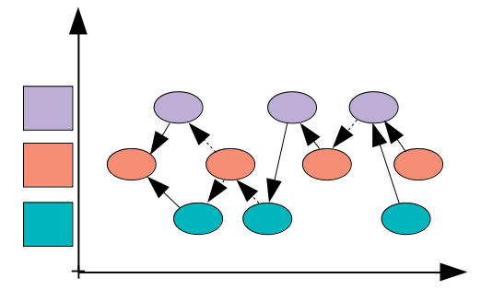
Freechains
Persistent publish-subscribe topic-based model
Peer-to-Peer gossip dissemination
Happened-before best-effort partial order
Per-topic reputation system for healthiness
Chains
(topics)
Peers
Authors

Slide 5
Freechains
# host-1
$ freechains host create /var/freechains
$ freechains host start /var/freechains &
$ freechains chain join /chat
$ freechains chain join /uerj
...
$ freechains chain send /chat host-2
# host-2
$ freechains host create /var/freechains
$ freechains host start /var/freechains &
$ freechains chain join /chat
$ freechains chain join /puc-rio
...
$ freechains chain listen /chat
Chains
Peers
Authors

Slide 6
Freechains
The graph is a Merkle Tree of signed “Blocks”
Block contains quadruple (time,message,prev,backs)
Hash of quadruple identifies block and tree membership
Signature authenticates hash
data Block
{
time : Long
payload : String
prev : String
backs : [String]
hash : String
sign : {
pub : String,
hash : String,
}
}
$ freechains join /chat
$ freechains post /chat “Hello World!” --sign=pvt1
$ freechains post /chat “Just joined!” --sign=pvt2
$ freechains like /chat 2_FFR8XZ --sign=pvt1
0s
/chat
#0_25KX12
-
1h
“Hello World!”
#1_33A051
@pub1
1h30
“Just joined!”
#2_FFR8XZ
@pub2
1h35
+1/#2_FFR8XZ
#3_5R66AJ
@pub1
HEADS
Notes:
- merkle tree enforces order and integrity down to genesis block
- signature ensures authenticity
- not shown, but payload might be encrypted to ensure confidentiality
- single block represents history of peer, remote knows what to sync

Slide 7
Freechains
Peers gossip their trees
Eventually histories across peers will converge
/chat
1h
“Hello World!”
@pub1
1h30
“Just joined!”
@pub2
1h35
+1/#2_FFR8XZ
@pub1
localhost
$ freechains send /chat 152.92.1.117
1h30
“Just joined!”
@pub2
/chat
1h
“Hello World!”
@pub1
1h35
+1/#2_FFR8XZ
@pub1
152.92.1.117
1h32
“Just joined!”
@pub3
HEADS

Slide 8
Freechains
1h30
“Just joined!”
@pub2
152.92.1.117
/chat
1h
“Hello World!”
@pub1
1h35
+1/#2_FFR8XZ
@pub1
1h32
“Just joined!”
@pub3
$ freechains heads /chat
3_5R66AJC1A3F62F1164A28B78C7DECED3EB08B58F092BDE83616193850D41EW6H
2_1R55S18079C3F4BACC99E87191EECD197A846E503586648246003BCBC639DE73
$ freechains get /chat 2_1R55S1...
{
"time" : 3840000,
"payload" : "Just joined!",
"prev" : null,
"backs" : ["1_33A051..."],
"hash" : "2_1R55S1...",
"sign" : {
"hash" : <...>,
"pub" : <pub3>,
},
}

Slide 9
pretty much standard cryptography and unstructured P2P and
solves 1→N, N←1, 1 ↔ 1
mostrar linha de cmd para cada caso
mostrar tabela no final

