Slide 1

Freechains
peer-to-peer content dissemination

Slide 2
Content
  E-mails
  Social media posts
  Webpages, Blogs
  News
  Forums, Mailing lists
  Media streaming
  Instant Messages, Chat
  Teleconference
  Cloud Storage
  Services (delivery, auction)
  Memes
Dissemination
  1 → N
  1 ← N
  1 ↔ 1
  N ↔ N
  1 ↩
  (news)
  (feedback)
  (e-mail)
  (forums)
  (backup)
Peer to Peer
  No central server
  No central authority
  No need to trust
Notes:
- não há necessidade de confiar no servidor
- servidor também no sentido de oferecedor do serviço
- não só em questões de segurança, mas tb na sua capacidade de organizar e selecionar o conteúdo de interesse

Slide 3
N↔N intercommunication
(public forum)
user
user y
question
user 1
reply
reply
question
Distributed consensus
Happened-before relation
Best effort
Partial order
user x
question
question
reply
reply
user 2
reply
question
reply
time
Notes:
- best-effort, peers que viram msgs podem ligá-las atrás das novas
- não sabemos se o Y apenas ficou desconectado ou não ligou de propósito

Slide 4
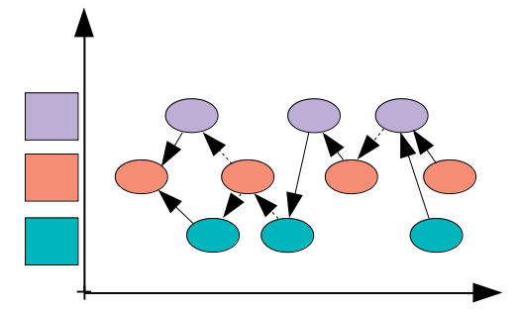
Freechains
Persistent publish-subscribe topic-based model
Peer-to-Peer gossip dissemination
“Happened-before” partial order
Per-topic reputation system for healthiness
Chains
(topics)
Peers
Authors

Slide 5


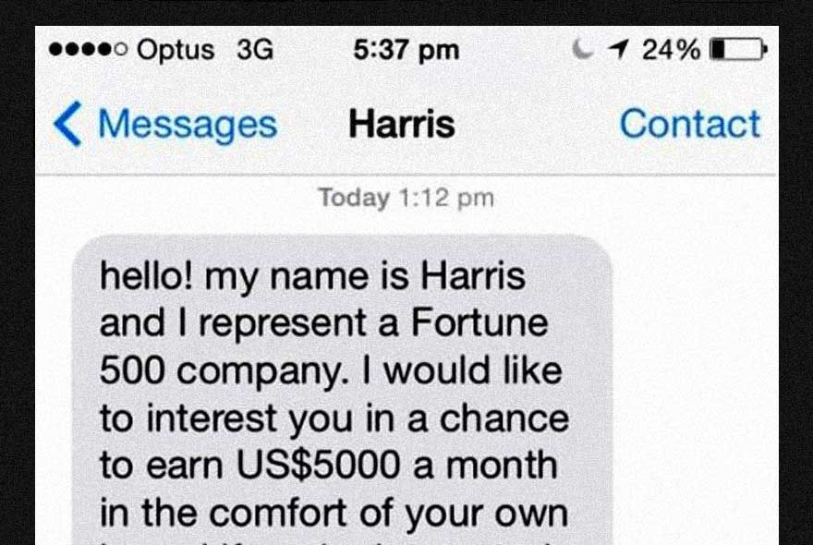

Reputation System
Excess
  Restrict posts (quota)
  Appraise posts (likes)
SPAM
  Demand reputation
Fake
  Supervise reputation
Illegal
  Supervise reputation
undesired
Fairness
  Participants have equal opportunities to communicate
Quality
  Important messages are praised

Slide 6
Reputation System
(likes / reps)
Create
  First post → +30 reps
  Consolidated posts → +1 rep
    >24h, last 90 days, maximum +30 reps
Spend
  New posts
  -1 source (requires +1 rep)
  Remains 2h in quarantine and 24h to become old
Transfer
  Likes and dislikes
  -1 source / ± target

Slide 7
$ freechains post /chat “Hello!” --sign=pvt1
$ freechains post /chat “Joined!” --sign=pvt2
$ freechains like /chat 2_FFR8XZ --sign=pvt1
0s
/chat
#0_25KX12
-
1h
“Hello!”
#1_33A051
@pub1
1h30
“Joined!”
#2_FFR8XZ
@pub2
1h35
+1/#2_FFR8XZ
#3_5R66AJ
@pub1

Slide 8
Reputation System
Height <= 1
Like
Hash verifies
Backs exist
Signature matches
Reps verify (like)
New Block
(post)
otherwise
+2h
+1d
+2d
forwarded
not linked
-1
+1
+1
+1
+1
+1
-1
+1
+1
+1
1h30
“Joined!”
@pub2
1d
“News”
@pub2
/chat
1h
“Hello!”
@pub1
1h35
+1
@pub1
1h40
“Again!”
@pub1
+30
+29
+28
+29
+29
1h40
“Joined!”
@pub3
5h00
“Hey???”
@pub3
-1
not forwarded
not linked

Slide 9
Reputation System
First author is 30 days ahead in reputation
  multiple first authors cannot synchronize
New authors require community approval
  reputation growth is slow (but decline is fast)
New posts are initially penalized
  authors must “choose words” wisely
  posts volume is not rewarded (but quality is)
Old posts are the community wealth
  only form of “production”
  limited to 1/day/author in 30-day window

Slide 10
Reputation System
ACCEPTED
forwarded
linked
ENGRAVED
forwarded
linked
24 hours
block
authorTime
quarantine
period
accepted
time
2 hours + √dt
PENDING
forwarded
not linked
+ >= -
ban
dt
2h + √dt
REJECTED
not forwarded
not linked
BANNED
removed
completely
block
recvTime
24 hours
author | recv | dt | √dt | quarentine | accepted
1h | 10h | 9h | 3h | 5h | 15h
1h | +7d | 7d | 13h | 15h | +7d+15h
1h30
“Joined!”
<pub2>
/chat
1h
“Hello!”
@pub1
1h35
+1
@pub1

Slide 11
Social Consensus
Non-autonomous bookkeeping
Content removal
  not easy to automate based on content reputation
Author linear timeline
  need total order at least for authors
  not hard to accomplish

Slide 12
“Double spend”
Chains are trees
  Authors’ posts are linked lists
    It’s their responsibility to maintain it
    Forks/Merges: reject arriving branch
+1
/chat
...
1h34
+1
@pub1
host 1
1h34
+1
@pub1
/chat
...
1h35
+1
@pub1
send
/chat
...
1h35
+1
@pub1
host 2

Slide 13
“Double spend”
Chains are trees
  Authors’ posts are linked lists
    It’s their responsibility to maintain it
    Forks/Merges: reject arriving branch
      Requires rework from authors (signatures)
      Unacceptable in Blockchains: no sense of community
/chat
...
1h34
+1
@pub1
X
host 1
a
b
c
send
/chat
...
1h35
+1
@pub1
x
y
host 2

Slide 14
Content Removal
SPAM, Fake, Illegal
Pending: 2h+ quarantine
  forwarded but not linked
Ban
  including blocks pointing back to it
  rejected forever (or unban)
  hosts must reach consensus or fork permanently
    again, unacceptable in Blockchains
$ freechains ban /chat 2_1R55S1...
+2h
/chat
...
1h
SPAM
@pub1
-
a
b
+
c

Slide 15
Timing Issues
From the perspective of a host vs other hosts
  Block field authorTime is unique but not reliable (immut)
  Block field recvTime is reliable but not unique (local)
  Host field curTime is reliable but not unique/static (cur)
  We assume malicious authors and hosts (but available)
Time constants (all arbitrary)
  30 minutes: tolerance to future posts
    affects blocks laying in the host
  2+ hours: quarantine period before linking
    affects blocks entering in the chain
  24 hours: negative to positive author reputation period
    affects author reputation

Slide 16
Timing Issues
30 minutes: tolerance to future posts
  cur >= immut - 30min
  Who can lie?
    hosts: choose cur (doesn’t matter, at most deny blocks)
    authors: choose immut (can pretend up to ~30min in the future)
1h30
“Hello!”
@pub1
Host
1h

Slide 17
Timing Issues
2+ hours: quarantine period before linking
  cur >= local + 2h + √(x-b)
  Who can lie?
    hosts: choose cur (doesn’t matter, at most deny linking)
    authors: choose b (newer has marginal advantage)
a
block
author
quarantine
period
accepted
time
b
dt
2h + √dt
y
block
local
x
1h30
“Joined!”
<pub2>

Slide 18
Timing Issues
24 hours: negative to positive author reputation period
  immut’ >= immut + 24h (creation, like, backs accepted)
  Who can lie?
    authors: immut’ (newer has marginal advantage ~30min)
      important: times are immutable across nodes
1h
immut
“Hello!”
@pub1
24h
1d1h
immut’
“Again!”
@pub1

Slide 19
What if...
Forging reputation
  Attacker forges a 1-week fork to collect reps when synchronizing
  Quarantine period slows down the process and facilitates reaction
  Ban won’t affect the chain
early
reputation
1 second
day 1
dummy
@pub1
...
dummy
@pub1
day 7
dummy
@pub1
x
use forged reputation
immediately
+7 reps
/chat
...
day 0
“Hello!”
@pub1
a
b
y
c
block
day 1
quarantine
period
1 week
Day 8
dt
15h
block
day 8

Slide 20
What if...
Ignoring dislikes
  Attacker follows “real time” but ignores history
  Quarantine period indicates the process and facilitates reaction
  Ban will affect the chain
x
a
b
y
-
c
-
block
day n-1
quarantine
period
/chat
...
day 0
“Hello!”
@pub1
day 1
SPAM
@pub1
day 2
SPAM
@pub1
7h
dt
block
day n

Slide 22
-90 days
new
block
head
block
rep?
30+ days late // 30+h pending
new
block
ignore
blocks
4 months
ignore
blocks
local
time
day?
+30 mins
0d
1d
...
-16w
-1d
NOW
+1d

Slide 23
-90 days
new
block
rep?
30+ days late // 30+h pending
head
block
local
time
-120 days
-90 days
new
block
+30 mins
ignore
blocks
ignore
reputation
ignore
blocks

Slide 24
can’t like past
Accepted backs -120d
Not futur]e +30m
mostrar json do like
Manual,social,human
All or nothing, no tok
TODO
Relacao com
Minha tabela
cmd ln like
data Block
{
immut : {
time : Long,
like : Like?,
payload : String,
refs : Array<String>,
backs : Array<Hash>,
height : Int
}
hash : Hash
sign : Signature?,
accepted : Boolean,
localTime : Long
}
Sybil é de ID ou IP?
authors cannot double spend
their posts will create a fork
that never syncs
terminar com consenso
- double spend
- localTime
Our solution to “double spend” is unnaceptable in BitCoin b/c
- not a community

Slide 25
Intercommunication Graphs
News site (public identity)
1→N: post news
1←N: receive comments
user
user 1
comment
comment
owner
news 1
news 2
news ...
news N
user 2
message
comment
comment
time

Slide 26
P2P Distributed Hash Tables
(DHTs)
Fast, Scalable
Trending & Immutable & Large files
  We don’t want everyone to store all these files altogether!
  Typically consumed once (movies, installers)
Search existing content
Publish new content
Access unpopular content
Incentive store and transfer

Slide 27
Communication
Patterns
1 ↔ 1: SMS, Whatsapp
1 → N: Twitter, Facebook, Blog, Webpage, Streaming
N → 1: E-mail, comments
N ↔ N: Group, IRC, Docs, Wikipedia, HackerNews

Slide 28
Consensus
Termination
  Every correct process decides some value.
Validity
  If all processes propose the same value v, then all correct processes decide v.
Integrity
  Every correct process decides at most one value, and if it decides some value v, then v must have been proposed by some process.
Agreement
  Every correct process must agree on the same value.

Slide 29
Bitcoin / Blockchain
Uses proof of work to maintain consensus
  The longest chain, with more work devoted, is the consensus
PROS
  Immune to Sybil attacks
  Total order among transactions
CONS
  Forks cause transaction retransmission
  Forks require rework

Slide 30
Challenges
SPAM resistance
  A node can broadcast publications as fast as possible:
$ while true ; do
freechains publish politics “<random text>”
done

Slide 31
What if...
SPAM
Sybil
Flood

