Slide 1

Freechains
Let’s redistribute the Internet!

Slide 2
Internet Today
Very few companies
  Control our public data
  Collect our private data
  Decide what we consume
    “The algorithms”
  Demand connectivity
    “Cloud Services”
  Impose entry barriers
    “Vendor lock-in”

Slide 3





































Slide 4





Internet Today
bla
bla
Paris
bla
bla
Collect our private data
Decide what we consume
Control our data
Demand connectivity
Collect our private data
Demand connectivity

Slide 5


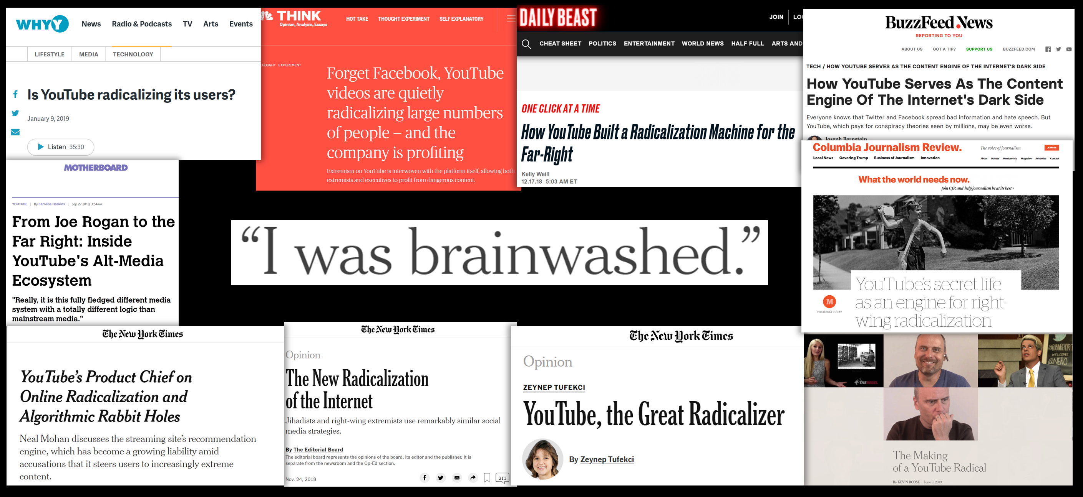


Internet Today
Control our public data
“Algorithm Rabbit Hole”
Specific person
Community
Decide what we consume
Impose entry barriers

Slide 6



Internet Today
Centralization
  Data
  Infrastructure
  Power

Slide 7


What we really need?
(communication patterns)
Public identity
  1→N: feed, streaming, news, repository, website
  1←N: comments/feedback, private message
Private channel
  1↔1: IM, e-mail
  N↔N: closed groups, shared files
  1↩: backup, documents
Public forums
  N↔N: forums, chat, trading
N
2
1

Slide 8
Can we decentralize?
Availability
Confidentiality
Integrity
Authenticity

Slide 9
Intercommunication Graphs
News site (public identity)
1→N: post news
1←N: receive comments
user
user 1
Comment
Comment
owner
News 1
News 2
News ...
News N
user 1
Comment
News site (public identity)
1→N: post news
1←N: receive comments
T₀
time

Slide 10
Internet Today
A peer-to-peer topic-based publish-subscribe system:
  A peer publishes a message to a topic and all subscribed peers eventually receive the message.
Example:
# PEER 1
$ freechains subscribe politics
$ freechains subscribe sports
$ freechains listen
[politics] <a political event>
[sports] <a sports event>
# PEER 2
$ freechains publish politics \ “<a political event>”
# PEER 3
$ freechains publish sports \
“<a sports event>”

Slide 11
Freechains
A peer-to-peer topic-based publish-subscribe system:
  A peer publishes a message to a topic and all subscribed peers eventually receive the message.
Example:
# PEER 1
$ freechains subscribe politics
$ freechains subscribe sports
$ freechains listen
[politics] <a political event>
[sports] <a sports event>
# PEER 2
$ freechains publish politics \ “<a political event>”
# PEER 3
$ freechains publish sports \
“<a sports event>”

Slide 12
Design Goals
The system must not be controlled by an authority (or a minority).
All users must be equally able to publish.
Publishing must not be censurable.
Publications must be amenable to boosting and removal.
Publications must be verifiable and should not be modifiable.
Publications must be permanently available.
The system must be resistant to SPAM.
The system must be scalable to the size of the Internet.

Slide 13
Communication
Patterns
1 ↔ 1: SMS, Whatsapp
1 → N: Twitter, Facebook, Blog, Webpage, Streaming
N → 1: E-mail, comments
N ↔ N: Group, IRC, Docs, Wikipedia, HackerNews

Slide 14
Demo
Start three nodes (0,1,2)
Connect nodes (0 ↔ 1 ↔ 2)
Listen
Publish from 0 (0 → 1 → 2) and from 2 (2 → 1 → 0)

Slide 15
Challenges
All nodes must receive all publications
  Must not miss a single publication
  Must avoid duplicates
  Must respect order (?)
    Total, Partial (?)
A problem of distributed consensus

Slide 16
Consensus
Termination
  Every correct process decides some value.
Validity
  If all processes propose the same value v, then all correct processes decide v.
Integrity
  Every correct process decides at most one value, and if it decides some value v, then v must have been proposed by some process.
Agreement
  Every correct process must agree on the same value.

Slide 17
Bitcoin / Blockchain
Uses proof of work to maintain consensus
  The longest chain, with more work devoted, is the consensus
PROS
  Immune to Sybil attacks
  Total order among transactions
CONS
  Forks cause transaction retransmission
  Forks require rework

Slide 18
Challenges
SPAM resistance
  A node can broadcast publications as fast as possible:
$ while true ; do
freechains publish politics “<random text>”
done

Slide 19
Freechains
Consensus:
  Each topic is a distinct blockchain
SPAM resistance:
  Each topic is actually a multi-layered blockchain
  Each layer requires double of work from previous
  The block and publication require work
  User may subscribe to higher levels only

Slide 20
Demo
Start three nodes (0,1,2)
Subscribe nodes
Connect nodes (0 ↔ 1 ↔ 2)
Listen
Publish from 0 (0 → 1 → 2) and from 2 (2 → 1 → 0)
Subscribe to /10, publish to /0, publish to /10

