Slide 1





Freechains
peer-to-peer content dissemination
www.freechains.org
github.com/Freechains/README
freechains@freechains.org
@freechains_net

Slide 2
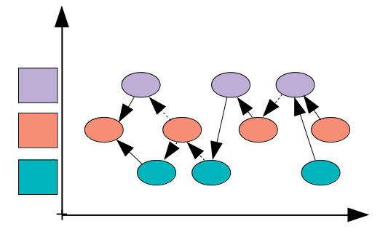
Freechains
Persistent publish-subscribe topic-based model
Peer-to-Peer gossip dissemination
Happened-before best-effort partial order
Per-topic reputation system for healthiness
Chains
(topics)
Peers
Authors

Slide 3


Freechains
Open-source software for PC and mobile
Standalone daemon listening for peers
  local users perform actions
  remote peers synchronize
User interfaces:
  command line
  kotlin library
  textual protocol

Slide 4
Setup
$ freechains host create /var/freechains/
$ freechains host start /var/freechains/ &

Slide 5


Public Identity
(1→N / 1←N)
...
2
1
1→N
1←N

Slide 6
Public Identity
(1→N / 1←N)
$ freechains crypto create pubpvt <passphrase>
57B774… 08C723682978…
$ freechains chain join /57B774… 57B774…
$ freechains chain join /chat
$ freechains chain genesis /57B774…
0_640C6D…
$ freechains chain post /57B774…
inline utf8 “Hello World!” --sign=08C723682978…
/57B774
0_640C6D
/57B774
/57B774
/chat
1_F2C588
“Hello World”
@57B774

Slide 7

$ freechains crypto create pubpvt <passphrase>
$ freechains chain join /57B774… 57B774…
$ freechains chain post /57B774…
inline utf8 “Hello World!” --sign=08C723682978…
$ freechains chain send /57B774… 146.164.17.3
$ freechains chain send /57B774… 152.92.1.117
$ freechains chain send /57B774… 139.82.30.20
/57B774
152.92.1.117
/57B774
0_640C6D
/57B774
1_F2C588
1_F2C588
139.82.30.20
1_F2C588
/57B774
57B774…
08C723682978…
1_F2C588
/57B774
146.164.17.3
Mary
John

Slide 8

Public Forum
(N↔N)

Slide 9
Reputation System
$ freechains chain join /cooking
$ freechains chain post /cooking inline utf8
“Post your best recipes...” --sign=7A553D12EE9A…
$ freechains chain post /cooking inline utf8
“Cut half of a lime...” --sign=08C723682978…
/cooking
0_33E2F1
1_AA5532
@john
2_F5GG12
@mary
+1 rep
3_G5B37F
@john
John
Alan
+30 reps
-1 rep
+1 rep
-1 rep
+1 rep
Mary
Joseph

Slide 10
Reputation System
First author is 30 days ahead in reputation
  he shapes the initial community development
  multiple first authors cannot synchronize
New authors require community approval
  reputation growth is slow
New posts are initially penalized
  authors must “choose words” wisely
  posts volume is not rewarded (but quality is)
Old posts are the community wealth
  only form of “production”
  limited to 1/day/author in 30-day window
  still subject to moderation

Slide 11
Freechains
peer-to-peer content dissemination
www.freechains.org
github.com/Freechains/README
freechains@freechains.org
@freechains_net

