Slide 1


Where do Events Come From?
Reactive and Energy-Efficient Programming From the Ground Up
(In-Progress Paper)
Francisco Sant'Anna
Rio de Janeiro State University
francisco@ime.uerj.br
@_fsantanna
www.ceu-lang.org

Slide 2
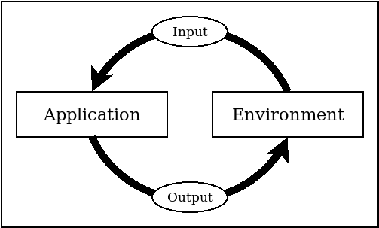
Reactive and Event-Based Systems
Interact with sensors and actuators
Represented as input & output events
An Environment groups the I/O peripherals as a single entity
Application and Environment are connected through an event loop

Slide 3
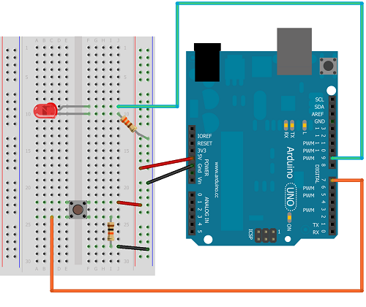
Céu - Arduino
Blink the LED every second, stop on a button press.
input high/low IN_07;
output high/low OUT_09;
par/or do
await IN_07;
with
loop do
await 1s;
emit OUT_09(high);
await 1s;
emit OUT_09(low);
end
end

Slide 4
The Environment
Typically implemented in a host language (e.g., C)
Controls the main event loop
Invokes entry points into the reactive runtime (e.g. callbacks)
Rigid component that evolves in separate from the application
Can we implement the Environment and Application together?

Slide 5
Goal
Take control of the whole event loop
  From input generation, reaction, up to output effects
New asynchronous interrupt handler primitive
  In the context of the synchronous language Céu:
    Prevent race conditions
    Provide automatic standby for applications

Slide 6
Synchronous - Properties
input high/low IN_07;
output high/low OUT_09;
par/or do
await IN_07;
with
loop do
await 1s;
emit OUT_09(high);
await 1s;
emit OUT_09(low);
end
end
Atomicity
  Non-preemptive reactions
  Environment must await
Responsiveness
  Loops must contain awaits
  Application eventually yields

Slide 7
Asynchronous ISRs in Céu
// out.ceu
_pinMode(9, _OUTPUT);
output (high/low v) OUT_09 do
_digitalWrite(9, v);
end
// app.ceu
input none IN_02;
output high/low OUT_09;
#include “out.ceu”
#include “in.ceu”
loop do
await IN_02;
emit OUT_09(call IN_02_Get());
end
// in.ceu
_EICRA |= (1 << _ISC00);
_EIMSK |= (1 << _INT0);
spawn async/isr [_INT0_vect] do
emit IN_02;
end
code INT0_Get (none) -> high/low do
escape _digitalRead(2);
end
sync
async

Slide 8
Preventing Race Conditions
// app.ceu
#include “usart.ceu”
loop do
await USART_RX;
atomic do
var int i;
loop i in [0 -> $rx_buf[ do
// uses rx_buf[i]
end
$rx_buf = 0;
end
end
// usart.ceu
input none USART_RX;
var[32] byte rx_buf;
spawn async/isr [_USART_RX_vect] do
rx_buf = rx_buf .. [_UDR0];
if $rx_buf == 1 then
emit USART_RX;
end
end

Slide 9
Standby Considerations
input high/low IN_07;
output high/low OUT_09;
par/or do
await IN_07;
with
loop do
await 1s;
emit OUT_09(high);
await 1s;
emit OUT_09(low);
end
end
Programs are always awaiting
Only awakes from interrupts
Automatic standby is possible

Slide 10
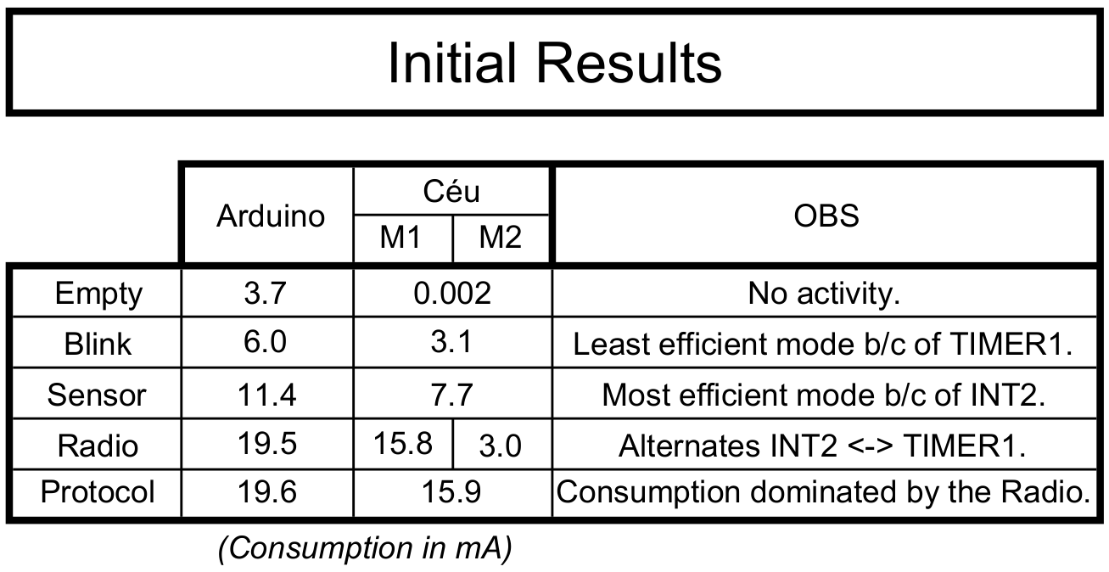
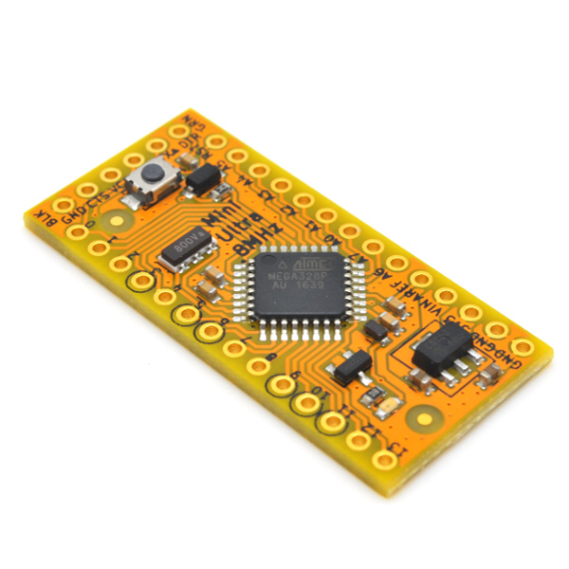
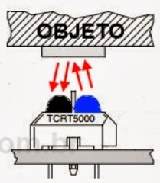
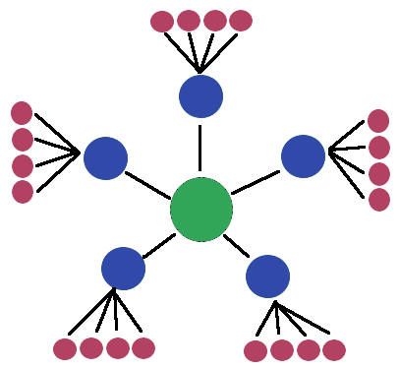
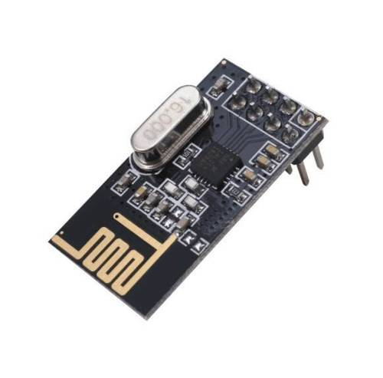
await FOREVER;
loop do
emit PIN(13,high);
await 1s;
emit PIN(13,low);
await 1s;
end
emit PIN(13, _digitalRead(2));
loop do
var bool v = await Pin(2);
emit PIN(13, v);
end
loop do
await 1s;
<...>
await Nrf24l01_TX(...);
<...>
await Nrf24l01_RX(...);
<...>
end
RocketScream
Low-Power
Arduino

Slide 11
Where do Events Come From?
Reactive and Energy-Efficient Programming From the Ground Up
(In-Progress Paper)
Francisco Sant'Anna
Rio de Janeiro State University
francisco@ime.uerj.br
@_fsantanna
www.ceu-lang.org

