Slide 1


Structured Synchronous Reactive Programming for Game Development
Case Study: On Rewriting Pingus from C++ to Céu
Francisco Sant'Anna
Rio de Janeiro State University
francisco@ime.uerj.br
@_fsantanna
www.ceu-lang.org

Slide 2
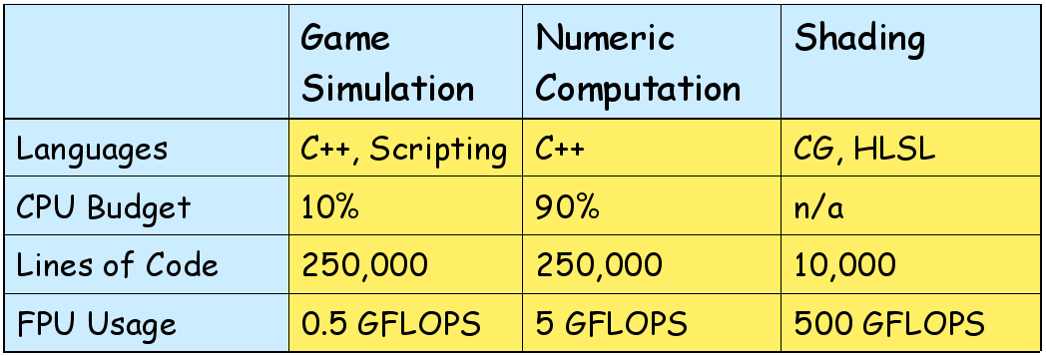
Game Logic / Simulation
About 50% of complexity in games
But only 10% of CPU budget
“Will gladly sacrifice 10% of our performance for 10% higher productivity.”
Appeal for programming alternatives concerning game logic productivity
[Tim Sweeney, POPL’06]

Slide 3
“Hello world!” in Céu
Blinking a LED
  on ↔ off every 500ms
  stop after “press”
  restart after 2s
Compositions
  seq, loop, par (trails)
    At any level of depth
  state variables / communication
par/or do
loop do
await 500ms;
_leds_toggle();
end
with
await PRESS;
end
loop do
par/or do
loop do
await 500ms;
_leds_toggle();
end
with
await PRESS;
end
await 2s;
end
loop do
await 500ms;
_leds_toggle();
end
Lines of execution
=
Trails (in Céu)

Slide 4
From “Structured Programming”
To “Structured Reactive Programming”
Control Structures
  Sequences, Loops, Conditionals
Blocks, Scopes, Locals
  Automatic memory management
What about reactivity?
  Environment event → Short-lived callback
  No more loops, scopes, etc.
  Breaks structured programming
    “Callbacks as our Generations' goto”
The await statement
  Imperative-reactive nature
Compositions
  Control structures + parallels
Synchronous execution model
  Time ~ Sequence of events
  Deterministic behavior
Sensor Networks, Embedded Systems, Multimedia, Games

Slide 5
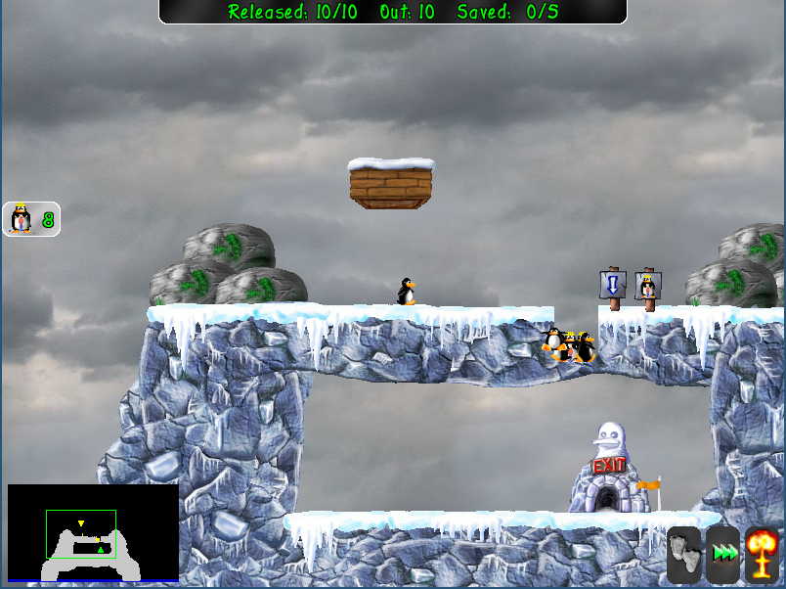
SSRP in Games
Case Study: Pingus
  40k LoC in C++
  20k Game Logic
    10k config., serial., strings, etc.
    10k of reactive code (25%)
Qualitative study
Entrance
Tools
Pingus
Obstacles
Exit

Slide 6
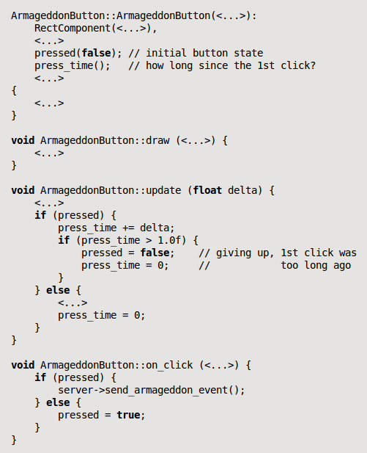
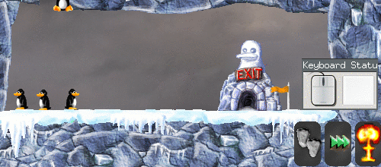
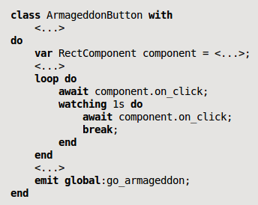
40 LoC

Slide 7
Control-flow patterns in Pingus
Finite State Machines
Dispatching Hierarchies
Lifespan Hierarchies
Continuation Passing
Signaling Mechanisms (not in the paper)

Slide 8
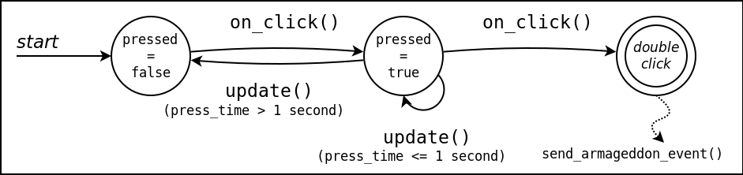
Finite State Machines
Event occurrences lead to transitions between states and trigger actions comprising the behavior of a game entity.

Slide 9

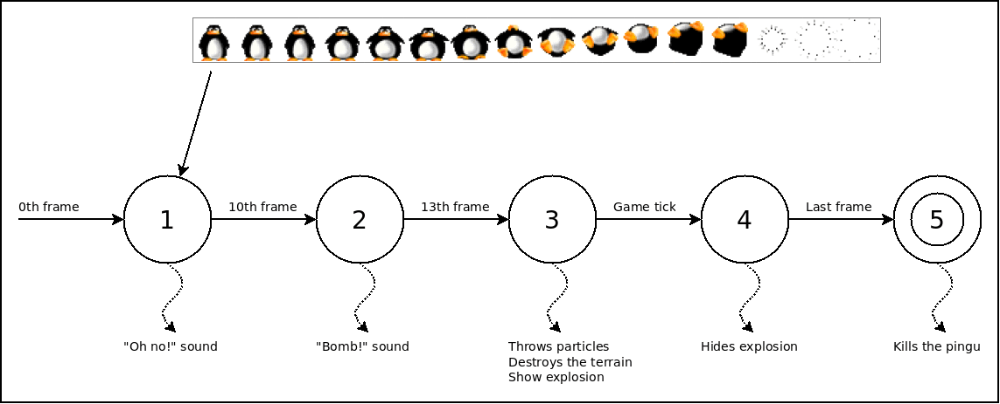
Finite State Machines
Event occurrences lead to transitions between states and trigger actions comprising the behavior of a game entity.
SSRP
  encode states with sequential code (awaits)
  eliminate callbacks and shared variables
  handle states (and only them) in the same contiguous block
Pingus
  30 FSMs in 25 files

Slide 10
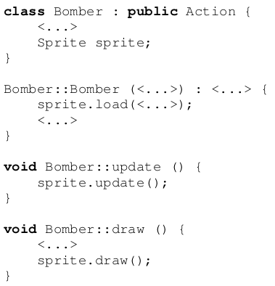
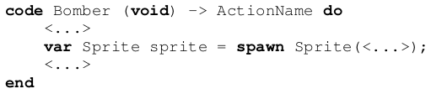
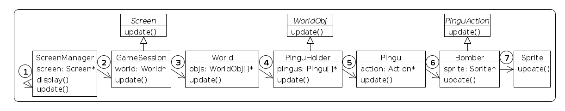
Dispatching Hierarchies
Entities form a dispatching hierarchy in which a container that receives a stimulus automatically forwards it to its managed children.
  goes through dozens of files
  interleaves between game, engine, and possibly third-party classes
SSRP
  bypass the program hierarchy entirely
Pingus
  update()/draw()/resize() touch 50 files and 500 LoC just for dispatching

Slide 11
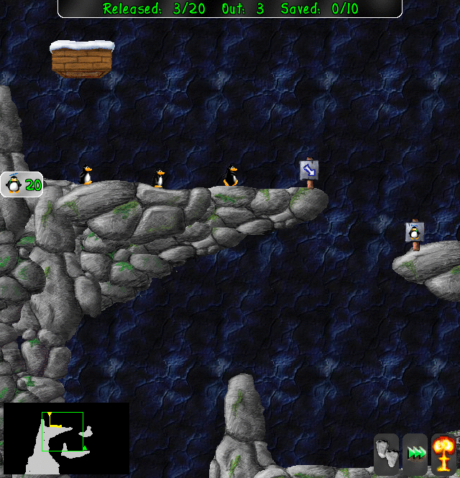
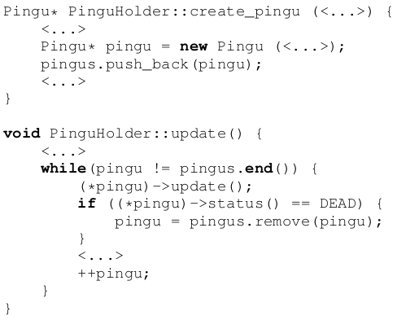
Lifespan Hierarchies
Entities form a lifespan hierarchy in which a terminating container entity automatically destroys its managed children.
SSRP
  lexical scope for abstractions
  natural termination susceptible to immediate reclamation
Pingus
  200 static and 100 dynamic instantiations

Slide 12
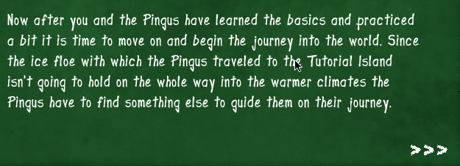
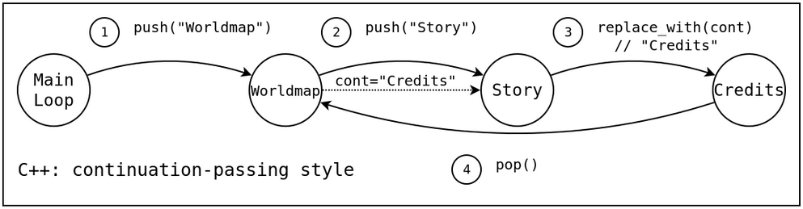
Continuation Passing
The completion of a long lasting activity in the game may carry a continuation, i.e., some action to execute next.
SSRP
  structured control (sequences and loops) vs. data structures and continuation variables (stacks and flags)
  decoupled activities (no pointers)
Pingus
  Screen transitions, menus, level progressions

Slide 13
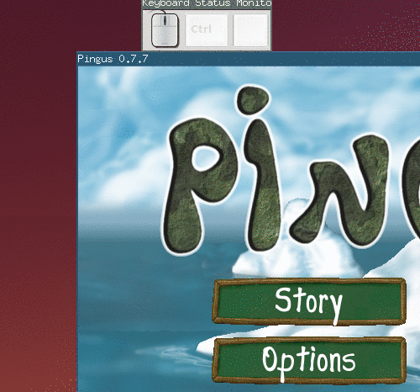
Signaling Mechanisms
Entities often need to communicate explicitly through signaling mechanisms, especially if there is no hierarchy relationship between them.
SSRP
  convenient syntax (emit, await, every)
  never create infinite dependency loops
Pingus
  39 events in 20 files with 200 invocations in over 50 files

Slide 14
Structured Synchronous Reactive Programming for Game Development
Case Study: On Rewriting Pingus from C++ to Céu
Francisco Sant'Anna
Rio de Janeiro State University
francisco@ime.uerj.br
@_fsantanna
www.ceu-lang.org

