Slide 1



Peer-to-Peer Permissionless Consensus via Reputation
github.com/Freechains
Francisco Sant'Anna
francisco@ime.uerj.br
@_fsantanna

Slide 2




Peer-to-Peer Permissionless Consensus via Reputation
Peer-to-Peer / Permissionless
Users → Content
Content → Reputation
Reputation → Consens

Slide 3






Public Forums
Consensus via
Reputatio
Possibly malicious communication
  abuse: excess, SPAM, fake news, illicit material
Messages must...
  reach all users
  respect a consistent order
  be harmless and on topic (subjective!)
Permissionless systems?
  Cryptocurrencies (
✔

Slide 4
Parallel with Bitcoin
Content authoring create reputation
  (vs proof-of-work)
Likes and dislikes transfer reputation
  (vs transactions)
Aggregate reputation determines consensus
  (vs longest chain)
How to prevent double spending?

Slide 5

Forums are DAGs
Spam
10050
Hi
10020
XXX
10040
Likes
10050
Welcome
10000
Like
10030
Fake
10050
...
10010
Hello
10005
Illicit
10050
Permissionless → Untrustworthy
  Timestamps (order)
  Content (quality)
  Sybils (quantity)

Slide 6
(?) DAGs → Consenso (?)
Spam
10050
Hi
10020
XXX
10040
Likes
10050
Welcome
10000
Like
10030
OK
10100
Fake
10050
...
10010
Hello
10005
Illicit
10050

Slide 7
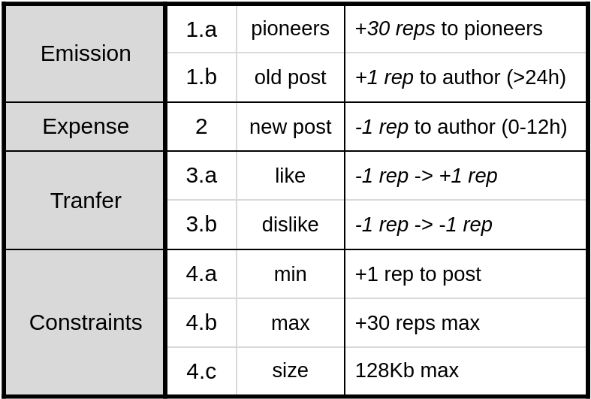
Reputation (reps)
Sybil
Resistance
Forum pioneer → + reps
New content → - reps
Consolidated Content → + reps
Likes & Dislikes → +/- reps

Slide 8
Reputation → Consensus
possible
double spend
path-1
Like-1
14030
Welcome
10000
common
path-2
Like-2
14030
path with
more reps
Welcome
10000
common
path-1
Like-1
14030
path-2
Like-2
14030
Welcome
10000
common
path-2
Like-2
14030
path-1
Like-1
14030

Slide 9
Main Contributions
Recognizing published contents as scarce resources
Using the reputation system to determine consensus
Allowing users to create diversified forums of interest
Supporting content removal without compromising the integrity of the blockchain

Slide 10
Freechains
Permissionless consensus protocol
Consensus via reputation (proof-of-authoring)
Subjective judgment (likes & dislikes)
Solves the double-spending problem
github.com/Freechains

Slide 11
Peer-to-Peer Permissionless Consensus via Reputation
github.com/Freechains
Francisco Sant'Anna
francisco@ime.uerj.br
@_fsantanna

Slide 12
Extra Slides

Slide 13
Problems with Crypto
They enforce a unique timeline to preserve value and immunity to attacks
They lean towards concentration of power due to scaling effects
They impose an external economic cost to use the protocol
They rely exclusively on objective rules to reach consensus

Slide 14
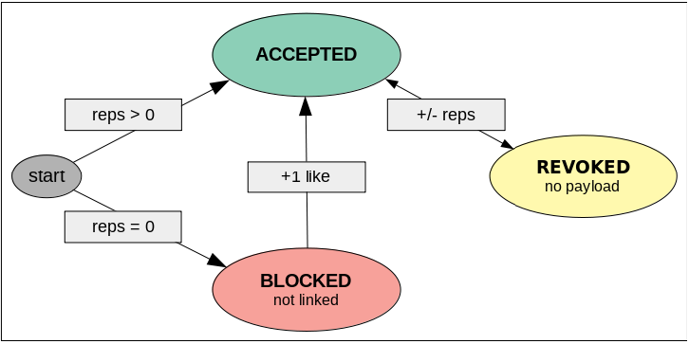
Content Removal
Users can revoke posts with dislikes.
Peers are forced to remove payloads, only forwarding associated blockchain metadata.
Does not compromise the integrity of the blockchain.

Slide 15
Evaluation
Internet Archives
  10k messages
  chat channel, 3 months, Wikimedia Foundation
  newsgroup forum, 9 years, comp.compilers
Evaluate
  metadata overhead
  consensus runtime
  graph forks (asynchronicity)
  blocked messages (bookkeeping)

Slide 16
Evaluation
Metadata overhead
  Chat: 10x
  Newsgroup: 50%
Consensus runtime
  Chat: 125s and 50ms
  Newsgroup: 100s and 70ms
Graph forks (asynchronicity)
  Chat: 18%
  Newsgroup: 14%
Blocked messages (bookkeeping)
  Chat: 3.7%
  Newsgroup: 3.5%

Slide 17
Conclusion
Finally, we do not claim that the proposed reputation system enforces “good” human behavior in any way. Instead, it provides a transparent and quantitative mechanism to help users understand the evolution of forums and act accordingly. Human creativity contrasts with plain economic resources (e.g., proof-of-work), which do not appraise social interactions and also tend to concentrate power over the time.

