Slide 1



An Overview of Céu
A synchronous language inspired by Esterel
Francisco Sant'Anna
francisco@ime.uerj.br
www.ceu-lang.org

Slide 2
“Hello world!” in Céu
Blinking a LED
  on ↔ off every 500ms
  stop after “press”
  restart after 2s
Compositions
  seq, loop, par (trails)
    At any level of depth
  state variables / communication
par/or do
loop do
await 500ms;
_led_toggle();
end
with
await PRESS;
end
loop do
par/or do
loop do
await 500ms;
_led_toggle();
end
with
await PRESS;
end
await 2s;
end
loop do
await 500ms;
_led_toggle();
end
Lines of execution
=
Trails (in Céu)

Slide 3
Céu is heavily inspired by Esterel
Notes:
- I grew up in the FRP “golden age”
- Previous work mixing FRP+Esterel (LuaGravity)
- Abandoned FRP for SSRP with Céu

Slide 4
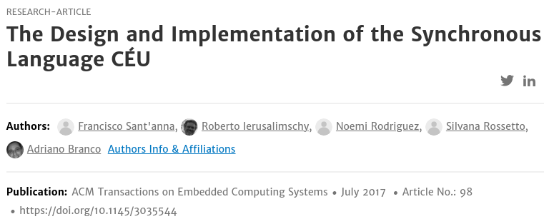
Céu Peculiarities
External events
  notion of time ~ queue of unique events, mutual exclusion
Internal events
  intra reactions, stack based, rich control mechanisms
Concurrency: internal determinism + static checks
  simple, concurrent assignments/system calls
Safe integration with C
  finalization for local/external resources
First-class timers
  dedicated syntax, automatic readjustment
Dynamic execution
  pool allocation, static/lexical memory management
15 min video at ceu-lang.org

Slide 5
1. External Events
external input events
A
B
C
D
Esterel
(fixed tick)
Timeline
(discrete)
tick 0
tick 1
timing
violation
tick 2
tick 3
tick 4
idle
CPU reaction
R(boot)
R(A)
R(B+C)
R(D)
A
B
C
D
Céu
(unique input)
Timeline
(discrete)
boot 0
A 1
B 2
C 3
D 4
CPU reaction
R(boot)
R(A)
R(B)
R(C)
R(D)

Slide 6
2. Internal Events
Stack-based execution
  an emit stacks next statement → awakes awaiting trails in an intra reaction
  emits can nest (hence a stack)
Like function calls
  but richer: coroutines, resumable exceptions, reactive variables
event int∗ inc;
par/or do
loop do
var int∗ p = await inc;
∗p = ∗p + 1;
end
with
var int v = 1;
<...>
emit inc => &v;
assert(v==2);
end
1
4
3
2
stacked
5

Slide 7
3. Internal Determinism
Esterel:
  “if there is no control dependency, as in (call f1() || call f2()) , the order is unspecified and it would be an error to rely on it”
  “if a variable is written by some thread, then it can neither be read nor be written by concurrent threads”
Céu:
  “when multiple trails are active during the same reaction, they are scheduled in lexical order”
  pragmatic (e.g., printf, redraw), but fragile
1
2

Slide 8
3. Simple Static Checks
input void A, B;
var int x = 1;
par/and do
await A;
x = x + 1;
with
await B;
x = x ∗ 2;
end
input void A;
var int y = 1;
par/and do
await A;
y = y + 1;
with
await A;
y = y ∗ 2;
end
never
concurrent
always
concurrent
safe
unsafe
Static checks
  Level 0: both are refused
  Level 1: unsafe is refused
  Level 2: both are accepted
Possible because of uniqueness of inputs
Do not affect the semantics

Slide 9
4. Safe Integration with C
native do
#define NUM 10
void f (void) { <...> }
void g (int v) { <...> }
int id (int v) { <...> }
end
par/and do
_f();
with
_g(_id(_NUM));
end
native @const _NUM;
native @pure _id();
native @safe _f() with _g();
_f
_g
_id
_NUM
unsafe
Trackable identifiers `_´ (C hat)
Assumes all identifiers are conflicting
Annotations to eliminate conflicts

Slide 10
4. Safe Integration with C
Abortion of trails dealing with resources is unsafe
Finalization mechanism
  Pointer assignment must be finalized
  External resource: pointer from C to Céu (memory leak)
  Local resource: pointer from Céu to C (dangling pointer)
par/or do
var _FILE* f;
finalize
f = _fopen(...);
with
_fclose(f);
end
_fwrite(..., f);
await A;
_fwrite(..., f);
with
<...>
end
par/or do
var _buffer_t msg;
<...> // prepare msg
finalize
_send_request(&msg);
with
_send_cancel(&msg);
end
await SEND_ACK;
with
<...>
end
par/or do
var _FILE* f;
f = _fopen(...);
_fwrite(..., f);
await A;
_fwrite(..., f);
_fclose(f);
with
<...>
end
line 2 : requires`finalize´
aborts
here

Slide 11
5. First-Class Timers
Timers, watchdogs, sampling all very common
  Dedicated syntax
  Delta compensation (system vs program mismatch)
var int v;
await 10ms;
v = 1;
await 1ms;
v = 2;
var int v;
par/or do
await 10ms;
await 1ms;
v = 1;
with
await 12ms;
v = 2;
end
15ms from system clock
Δ = 5ms late
Δ = 4ms late
1
2

Slide 12
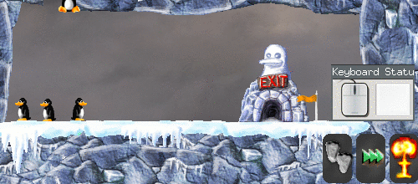
Applications / Other Work
~10-year effort (first commit in 2011)
[games] Structured Synchronous Reactive Programming for Game Development Case Study: On Rewriting Pingus from C++ to Céu, SBGames, 2018
  10k/40k reactive code rewritten
[embed] Transparent Standby for Low-Power, Resource-Constrained Embedded Systems: A Programming Language-Based Approach, LCTES, 2018
  interrupt-service routines, automatic standby
[media] Céu-Media: Local Inter-Media Synchronization Using Céu, WebMedia, 2016
  multimedia applications (videos, slideshows)
[wsns] Terra: Flexibility and Safety in Wireless Sensor Networks, TOSN, 2015
  remote reprogramming

Slide 13
Céu Peculiarities
External events
  time is a queue of unique external events
Internal events
  intra reactions, stack based
Concurrency: internal determinism + static checks
  simple, concurrent assignments/system calls
Safe integration with C
  finalization for local/external resources
First-class timers
  dedicated syntax, automatic synchronization

Slide 14
An Overview of Céu
A synchronous language inspired by Esterel
Francisco Sant'Anna
francisco@ime.uerj.br
www.ceu-lang.org

Slide 15
1. External Events
external input events
A
B
C
D
E
E
Esterel
(fixed tick)
Timeline
(discrete)
tick 0
tick 1
timing
violation
tick 2
tick 3
tick 4
idle
CPU reaction
R(boot)
R(A)
R(B+C)
R(D+E)
A
B
C
D
E
E
Céu
(unique input)
Timeline
(discrete)
boot 0
A 1
B 2
C 3
D 4
E 5
E 6
CPU reaction
R(boot)
R(A)
R(B)
R(C)
R(D)
R(E)
R(E)

Slide 16
Overview of Céu
Reactive
  environment in control: events
Imperative
  sequences, loops, assignments
Concurrent
  multiple lines of execution: trails
Synchronous
  trails synchronize at each external event
  trails are always awaiting
Deterministic
  always yields the same outcome for a given timeline

Slide 17
1. External Events
Why event-driven notion of time?
  Tick length is implementation dependent
  Events are never absolutely simultaneous
  Unique input events imply mutual exclusion
Why not?
  Requires a queue
  Execution is purely reactive
  Ticks are closer to clocks

