Slide 1



Peer-to-Peer Consensus via Authoring Reputation
www.freechains.org
Francisco Sant'Anna
francisco@ime.uerj.br
@_fsantanna

Slide 2




Peer-to-Peer Consensus via
Authoring Reputation
Peer-to-Peer network
Content created by users
Authoring reputation
Consensus based on reputation

Slide 3





























Content Publishing
E-mail
Social media
Webpages, News, Blogs
Forums, Mailing lists
Collaborative platforms
Media streaming
Instant Messages, Chat
Teleconference
Cloud Storage
Services (delivery, auction)

Slide 4



Internet Centralization
Very few companies...
  Collect and control our data
  “Algorithmize” our consumption
  Obstruct competition
The Big Five
“FAAMG”

Slide 5




Peer-to-Peer Alternatives
Eliminate intermediaries
Push responsibilities to users
(data & connectivity)
New challenges!
  no authority
  no infrastructure

Slide 7

Public Forums
Consensus via
Authoring Reputation
Untrusted (possibly malicious) communication
  abuse: excess, SPAM, fake news, illegal content
Messages should…
  reach all users (even those temporarily disconnected)
  arrive in a consistent order
  be respectful and on topic
Peer-to-Peer systems?
  Bitcoin (1,2)
✔

Slide 8
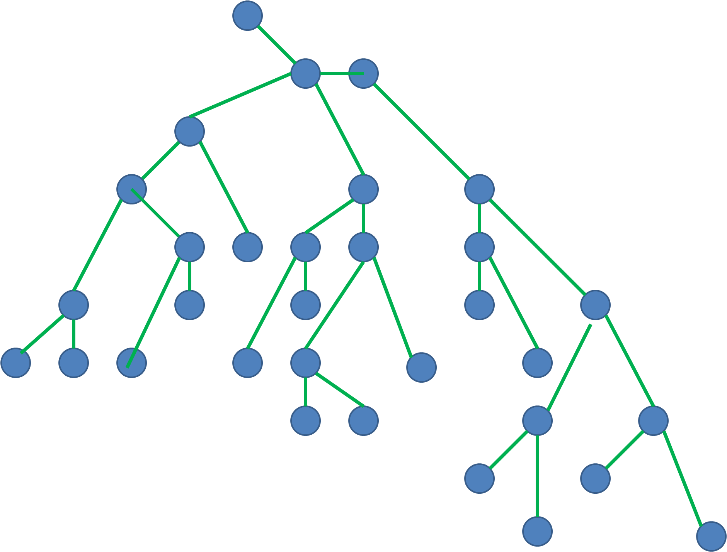
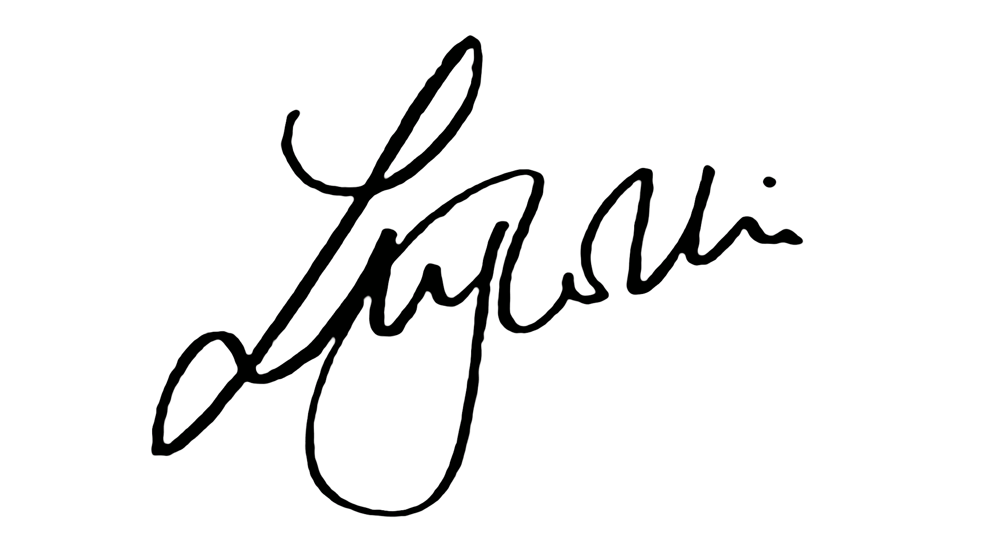
Bitcoin
Permissionless consensus protocol
Scarce virtual assets (bitcoin tokens)
Proof-of-work to reach consensus and earn bitcoins
Solves the double-spending problem
No subjective judgment about transactions

Slide 9
Our Proposal
Permissionless consensus protocol
Scarce virtual assets (reps tokens)
Authoring reputation to reach consensus and earn reps
Solves the double-spending problem
Subjective judgment about posts (likes & dislikes)

Slide 10
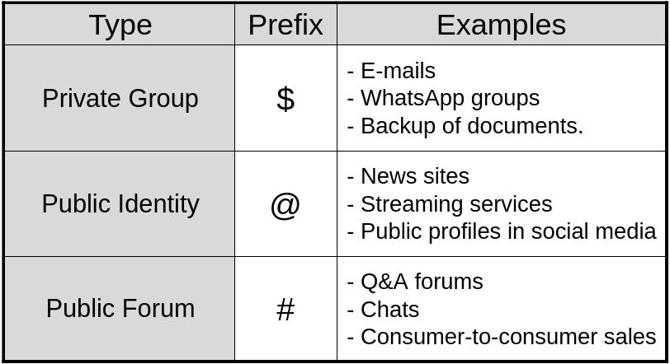


Freechains
Topic-based pubsub, Unstructed P2P
Topic (chain) is a replicated Merkle DAG

Slide 12
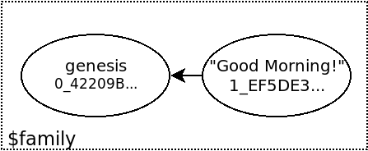
Demo – Private Group
> freechains-host start /tmp/freechains/
Freechains v0.8.4
Waiting for connections on Host(…, port=8330)...
> freechains crypto shared 'senha-muito-forte'
FD6C47C27F5CF6839EDE047CE7EE4285E633E26CBA929913
> freechains chains join '$family' FD6C47…
42209BBF280D4444E39ECEA199C23037058D4F66629D90D7BF1B8C9088B8D0ED
> freechains chain '$family' post inline 'Good morning!'
1_EF5DE364B7F9C0D40550E01FB9AB510F4AFFBBD79DF54302B68B7DB2ECD3F550

Slide 13
Demo – Private Group
(Peer 2)
> freechains-host --port=8331 start '/tmp/8331/'
Freechains v0.8.4
Waiting for connections on Host(…, port=8331)...
> freechains --port=8331 crypto shared 'strong-password'
FD6C47C27F5CF6839EDE047CE7EE4285E633E26CBA929913
> freechains --port=8331 chains join '$family' FD6C47…
42209BBF280D4444E39ECEA199C23037058D4F66629D90D7BF1B8C9088B8D0ED
> freechains --port=8331 peer localhost:8330 recv '$family'
1/1
> freechains --port=8331 chain '$family' heads
1_EF5DE364B7F9C0D40550E01FB9AB510F4AFFBBD79DF54302B68B7DB2ECD3F550
> freechains --port=8331 chain '$family' get payload 1_EF5DE3…
Good Morning!

Slide 14
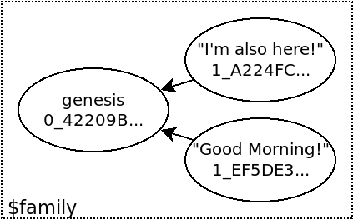
Forks
Typical DAGs are not lists (local-first dApps)
  Fundamental obstacle for consensus
> freechains --port=8331 chains join '$family' FD6C47…
42209BBF280D4444E39ECEA199C23037058D4F66629D90D7BF1B8C9088B8D0ED
> freechains --port=8331 chain '$family' post inline "I'm also here!"
1_A224FCA3F66E1A1CD68812AA51DCAF6699DA1ABC44561D37AB1EE1001AB429A
> freechains --port=8331 peer localhost:8330 recv '$family'
1/1

Slide 15
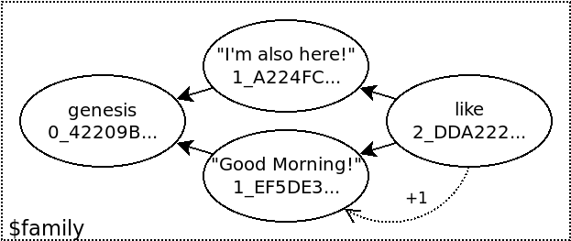
Likes and Dislikes
...
> freechains crypto pubpvt 'my-password'
328B7D… 35CA69…
> freechains chain '$family' like 1_EF5DE36… --sign=35CA69…
2_DDA222EDFD4BE333CF2017D54E91900806DF5006CAC35DFB3E97CD0690EDB22E
> freechains chain '$family' reps 1_EF5DE36…
1

Slide 17
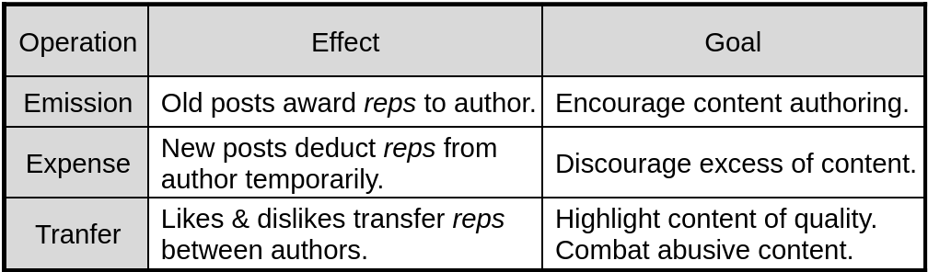
Public Forums
Permissionless public forums
Sybil attacks
  generate fake IDs and disseminate SPAM
Token reps to post and rate content
  New posts expend reps
  Old posts award reps
    human work immune to automation
  Likes & Dislikes transfer reps

Slide 18
Reputation & Consensus
Scarce operations are not yet sufficient
  Sybils
  Conflicting operations (double spend)
Need for consensus
  But how to determine a total order among messages?
✔
✘
Post from
Maria (A)
Maria has 1 rep
accumulated
Maria has 1 rep
accumulated
Post from
Maria (B)
Post from
Maria (A)
Post from
Maria (B)

Slide 19
Consensus Criteria
Favor branches with more reputation
  c-prefix:
  branch-1: C high activity
  branch-2: A/B low activity
  reps(A)+reps(B) > reps(C)
branch-1
X
Y
C
C
X
gen
A
B
C
common-prefix
B
A
branch-2
gen
A
B
C
B
A
C
X
C
Y
X
consensus

Slide 20
Consensus Criteria
Favor branches with more reputation
Blocks after a failure “never existed”
Peers may need to reorder blocks
What if branch-1 is legit?
branch-1
X
Y
C
C
X
gen
A
B
C
common-prefix
B
A
branch-2

Slide 21
Consensus Criteria
Branch with more reputation is ordered first
Hard fork if other branch has 7+ days of posts
branch-1
X
Y
More activity than week
average in the last 28 days
C
C
X
gen
A
B
C
common-prefix
B
A
branch-2

Slide 23
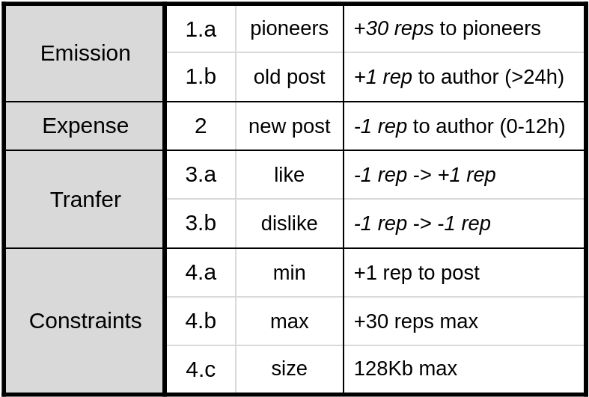
Freechains – Public Forums

Slide 24
Demo – Public Forum
> freechains crypto pubpvt 'pioneer-password'
ADB56B… CBBA77…
> freechains chains join '#forum' ADB56B…
42209BBF280D4444E39ECEA199C23037058D4F66629D90D7BF1B8C9088B8D0ED
> freechains chain '#forum' post --sign=CBBA77… \
inline 'The purpose of this chain is...'
1_87E6C94F232F7182B6E1DF3ACE48DAC08BA999A7CEA3A4FF08DED9AA18C78FE2
genesis
0_42209B…
The purpose…
1_87E6C94…
Pioneer: 30 reps (1.a)
29 reps (2)
30 reps (2)

Slide 25
> freechains crypto pubpvt 'new-author-password'
5DCF47… EFA735…
> freechains chain '#forum' post --sign=EFA735… \
inline "I'm a newbie..."
2_D886BC6DDD6343BB7A01B33270158BE45DE47358B48CF7C2F46D5EAEE8D52806
> freechains chain '#forum' like 2_D886BC… --sign=CBBA77…
3_18025C6A9FDC322762EF9BA8A3B1D24973D2271077F9777D4645D5B6F435BBA8
genesis
42209B…
The purpose…
1_87E6C94…
I’m a newbie…
2_D886BC…
like
3_18025C…
Pioneer: 30 reps
29 reps (3.a)
Newbie: 0 reps
0 reps (2)
1 rep (3.a)
1 reps (2)
2 reps (1.b)

Slide 26
Reputation System
Rule pioneers (1.a) bootstraps chains
Rule old post (1.b) stimulates authoring
Rule new post (2) prevents SPAM with dynamic cost
Rule like (3.a) welcomes new users at a cost
Rule dislike (3.b) censors abusive content
Rule min (4.a) blocks Sybils
Rule max (4.b) stimulates rating and decentralization
Rule size (4.c) prevents DDoS

Slide 27
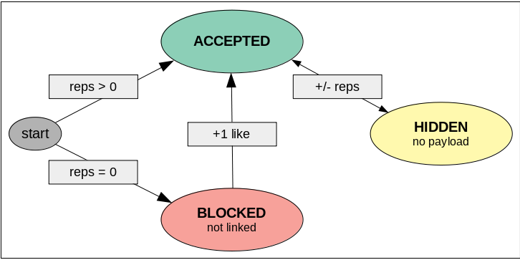
Likes & Dislikes
Welcoming new users
Measuring quality of posts
Censoring abuse (SPAM, fake news, etc)
Post is hidden with at least 3 dislikes and less likes

Slide 29
Reputation & Consensus
P2P permissionless consensus based on reputation
Reputation:
  Generation is expensive
  Verification is cheap (and distributed)
Consensus:
  Human authoring ability as a scarce resource
  vs extrinsic resources (dispendious, opaque, oddly distributed)

Slide 30
Contributions
Make decentralized public forums viable
  Reputation & Consensus mechanism
  Depends exclusively on human work
  Any system that structure messages as DAGs
  Supports local-first software
  Freechains peer-to-peer system
Support CRDTs in collaborative platforms
  Causal order (DAGs) + Total order (consensus)

Slide 31
Peer-to-Peer Consensus via Authoring Reputation
www.freechains.org
Francisco Sant'Anna
francisco@ime.uerj.br
@_fsantanna

Slide 32
Branch i
R_{i} = reps in prefix with authors here
N_{i} = number of posts here
Common Prefix
R = total reps accumulated
Branch j
R_{j} = reps in prefix with authors here
N_{j} = number of posts here
merge
R_{i} > R_{j} ^ N_{j} < 7
R_{j} > R_{i} ^ N_{i} < 7
else
pre
i
pre
i
j
pre
j
i
pre
j

Slide 33
public forum chain
R = reps in common prefix
R_{i} = reps in prefix with authors in branch i
N_{i} = new reps in branch i
R_{j} = reps in prefix with authors in branch j
N_{j} = new reps in branch j
i
(R_{i},N_{i})
pre
(R)
j
(R_{j},N_{j})
merge
N_{i}≥R/2 ^ N_{j}≥R/2
R_{i}>R_{j} ^ N_{j}<R/2
(c)
pre
i
j
(a)
(b)
pre
i
R_{j}>R_{i} ^ N_{i}<R/2
pre
j
pre
j
i

Slide 34
R = reps in common prefix
P = weekly average of posts
R_{i} = reps in prefix with authors in branch i
P_{i} = new posts in branch i
R_{j} = reps in prefix with authors in branch j
P_{j} = new posts in branch j
public forum chain
i
(R_{i},P_{i})
pre
(R,P)
j
(R_{j},P_{j})
Merging in machine i
(a)
P_{i}≥P
pre
i
j
(b)
R_{i}>R_{j}
(c)
R_{j}>R_{i}
pre
j
i

