Slide 1
Software Embarcado
06 – USART
Francisco Sant'Anna
Sala 6020-B
francisco@ime.uerj.br
http://github.com/fsantanna-uerj/SE

Slide 2
Universal Synchronous Asynchronous Receiver Transceiver
Comunicação full duplex
Modo síncrono e assíncrono
Váridos modos de dados/stop bits/paridade
Detecção de overflow
3 fontes de interrupções
Operação básica
  UBRR, UCSR, UDR

Slide 3
Transmissão
#define BAUD (F_CPU/16/9600-1)
void setup (void) {
/*Set baud rate */
UBRR0H = BAUD >> 8;
UBRR0L = BAUD;
/* Enable transmitter */
UCSR0B = 1 << TXEN0; // TXEN="Transmitter Enable"
/* Set frame format: 8data, 2stop bit */
UCSR0C = (1<<USBS0)|(3<<UCSZ00);
}
char data = '0';
int i = 0;
void loop (void) {
delay(1000);
/* Wait for empty transmit buffer */
while ( !( UCSR0A & (1<<UDRE0)) ) // UDRE="Data Register Empty"
;
/* Put data into buffer, sends the data */
UDR0 = data + i; // UDR="Data Register"
i = (i + 1) % 10;
}
Notes:
- delay faz o programa ficar interativo

Slide 4
Recepção
#define BAUD (F_CPU/16/9600-1)
void setup (void) {
/*Set baud rate */
UBRR0H = BAUD >> 8;
UBRR0L = BAUD;
/* Receive transmitter */
UCSR0B = 1 << RXEN0; // RXEN="Receiver Enable"
/* Set frame format: 8data, 2stop bit */
UCSR0C = (1<<USBS0)|(3<<UCSZ00);
pinMode(13, OUTPUT);
}
void loop (void) {
/* Wait for data to be received */
while ( !(UCSR0A & (1<<RXC0)) )
;
unsigned char data = UDR0;
digitalWrite(13, data%2);
}
Notes:
- delay faz o programa ficar interativo

Slide 5
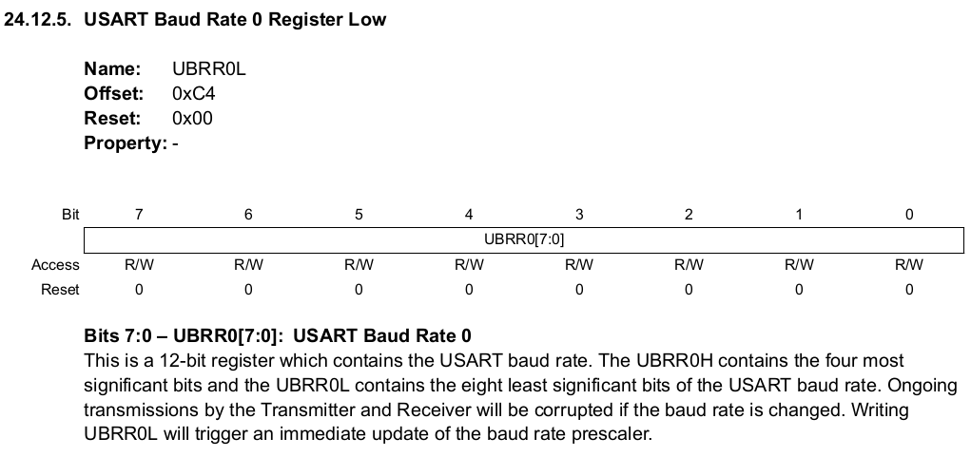
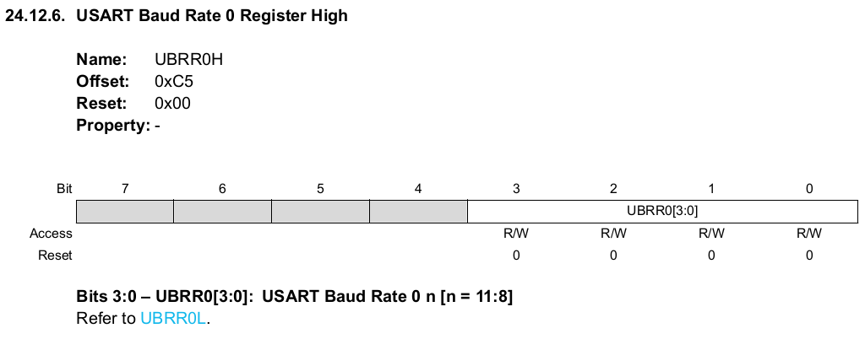
UBRRL

Slide 6
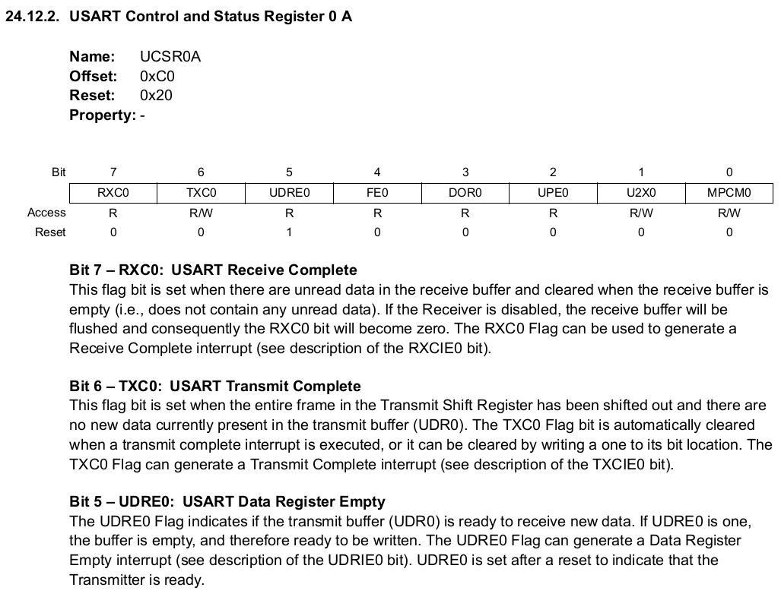
UCSR

Slide 7
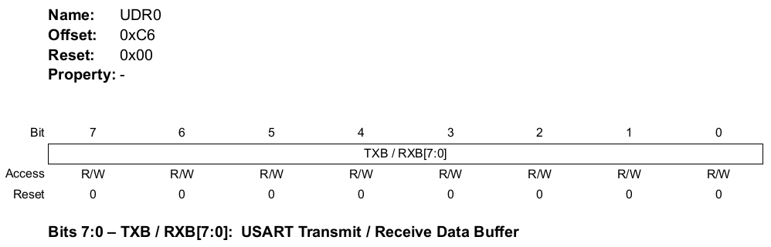
UDR

Slide 8
Interrupções

