Slide 1



Energy Efficiency for
IoT Software in the Large
(Projeto Serrapilheira)
Francisco Sant'Anna
francisco@ime.uerj.br
www.ceu-lang.org

Slide 2
About us...
Research areas:
  Programming Languages
  Distributed Systems
Programming Language “Céu”
  Embedded platforms
  Wireless Sensor Networks (WSNs)
  Games

Slide 4
Energy Efficiency for IoT
14 billion “traditional” network-connected devices (e.g., mobile phones & smart TVs).
50 billion by 2020 with the IoT (e.g., smart bulbs & fitness wearables).
Most energy consumed in standby mode.
Network standby is one of the six fronts on G20's Energy Efficiency Action Plan
  https://www.iea-4e.org/projects/g20

Slide 5
Project Goals
Address energy efficiency through extensive use of standby.
Target constrained embedded architectures that form the IoT.
Provide standby mechanisms at the programming language level that scale to all applications.
Support transparent/non-intrusive standby mechanisms that reduce barriers of adoption.

Slide 6
Project Non-Goals
Adaptive Computing
  QoS (e.g., resolution, frame rate, accuracy)
  Behavior (e.g., switch UI, disable functionalities)
  Don’t take advantage of standby modes (goal 1)
Energy-Aware Network Protocols
  Low-power listening
  Small periods of duty cycles
  Only for networked parts, not automatic (goals 3 & 4)
Complex Hardware Architectures
  Microprocessors, MMU, OS-based, Smartphones
  Not constrained embedded platforms (goal 2)

Slide 7
Our Approach
Enforce idle states of execution
  Céu enforces a reactive model of execution
Infer deepest sleeping mode
  Céu has a semantics amenable to analysis
Put device to sleep
  Céu has a energy-aware runtime
Only awake from interrupts
  Céu provides interrupt service routines (ISRs)

Slide 9
A “Hello world!” in Céu
input on/off PIN_02;
output on/off PIN_13;
loop do
par/or do
loop do
await 1s;
emit PIN_13(on);
await 1s;
emit PIN_13(off);
end
with
await PIN_02;
end
await 2s;
end
Blinking a LED
  on ↔ off every 1s
  stop after button press
  restart after 2s
Lines of execution
=
Trails (in Céu)

Slide 10
A “Hello world!” in Céu
input on/off PIN_02;
output on/off PIN_13;
loop do
par/or do
loop do
await 1s;
emit PIN_13(on);
await 1s;
emit PIN_13(off);
end
with
await PIN_02;
end
await 2s;
end
Blinking a LED
  on ↔ off every 1s
  stop after button press
  restart after 2s
Vocabulary
  Time & I/O (await, emit, etc)
Compositions
  seq, loop, par (trails)
    At any level of depth
  state variables / communication

Slide 11
Overview of Céu
Reactive
  environment in control: events
Imperative
  sequences, loops, assignments
Concurrent
  multiple lines of execution: trails
Synchronous
  trails synchronize at each external event
  trails are always awaiting
Deterministic
  always yields the same outcome for a given timeline

Slide 12

Synchronous Execution Model
Programs starts in the “boot reaction” in a single trail.
Trails execute until they await or terminate. This step is known as “reaction chain” and always executes in bounded time.
An input event occurrence awakes all trails awaiting that event. Repeat “step 2”.
par/and do
<...> // 1
await A;
<...> // 3
with
<...> // 2
await B;
<...> // 4
end
<...> are trail segments that do not await
(e.g. assignments, calls)

Slide 13
Unbounded Execution
  Breaks the synchronous/reactive model
var int v=0;
await A;
loop do
v = v + 1;
end
await B;
Is await B ever reached?

Slide 14
Bounded execution
Céu ensures bounded execution
  All loops must await or break
Limitation: heavy computations
loop do
if <cond> then
break;
end
end
loop do
if <cond> then
break;
else
await A;
end
end

Slide 15
Shared memory
var int x=1;
par/and do
await A;
x = x + 1;
with
await B;
x = x * 2;
end
_printf(“%d\n”, x);
var int x=1;
par/and do
await A;
x = x + 1;
with
await A;
x = x * 2;
end
_printf(“%d\n”, x);
Static analysis
  ceu --safety 0 # allows both
  ceu --safety 1 # allows LEFT, refuses RIGHT
  ceu --safety 2 # refuses both

Slide 16
par/or
Céu in one feature
par: lexical composition of activities
  static reasoning, static memory
  synchronous execution
or: orthogonal abortion
  safe/consistent termination
  no need for garbage collection
permeates all aspects of the language
  organism expansion, reference watching, finalization

Slide 18
Project In Practice...
Hardware infrastructure
  Off-the-shelf Arduinos (ATMega328, Cortex-M0)
Software infrastructure
  Implement an energy-aware runtime for Céu
  Rewrite device drivers in Céu (timers, SPI, Radio)
Applications
  Rewrite existing IoT applications in Céu
    Time to rewrite
    Coding “aesthetics”
    Energy consumption

Slide 19
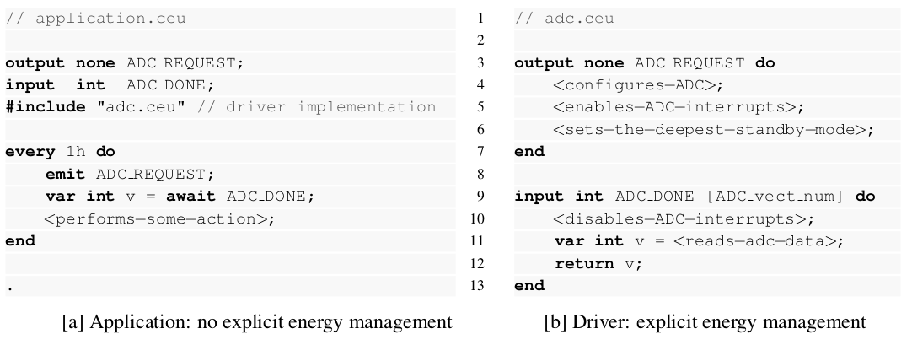
An example
// application.ino
void loop () {
delay(3600000);
int v = analogRead();
<performs-some-action>
}
// wiring_analog.c
int analogRead () {
<...>
while (bit_is_set(<...>)) {}
return <...>;
}

Slide 20
Research Topics
Language level
  Primitive support for interrupt service routines
  Energy-aware runtime system
HAL level
  Event-driven syscall API
  Driver infrastructure
  Synchronous/Asynchronous interaction
Application level
  IoT applications
  Evaluation (e.g., energy consumption)

Slide 21
Current Status
SenSys’13, ACM Embedded Networked Sensor Systems
  Safe System-level Concurrency on Resource-Constrained Nodes
TECS’17, ACM Transactions on Embedded Computing Systems
  The Design and Implementation of the Synchronous Language Céu
GSoC’17, Google Summer of Code 2017
  Interrupt-based drivers and libraries for Céu-Arduino
Drivers
  Arduino UNO (ATMega328): Timer/Analog/Serial/SPI
  Arduino Zero (ARM Cortex M0+): Timer
Energy-Aware Runtime
  Basic Sleep Mode

Slide 23
Financiamento Serrapilheira
60/2000 projetos receberam até R$100k por 1 ano
12/60 projetos receberão até R$1M por mais 3 anos
Nosso projeto é de 70k
  10k para viagens e equipamentos
  60k para bolsas
    1-2 alunos de graduação
    1-2 alunos de mestrado

Slide 24
Energy Efficiency for
IoT Software in the Large
(Projeto Serrapilheira)
Francisco Sant'Anna
francisco@ime.uerj.br
www.ceu-lang.org

