Slide 1
Energy Efficiency for IoT Software in the Large
Francisco Sant’Anna
UERJ

Slide 2

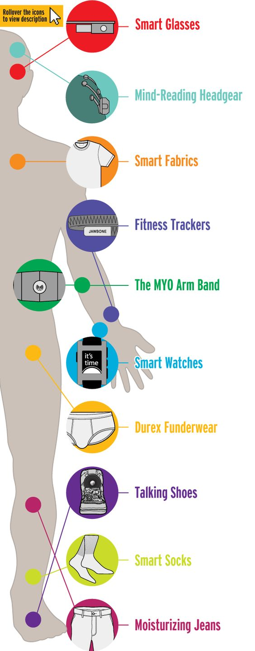
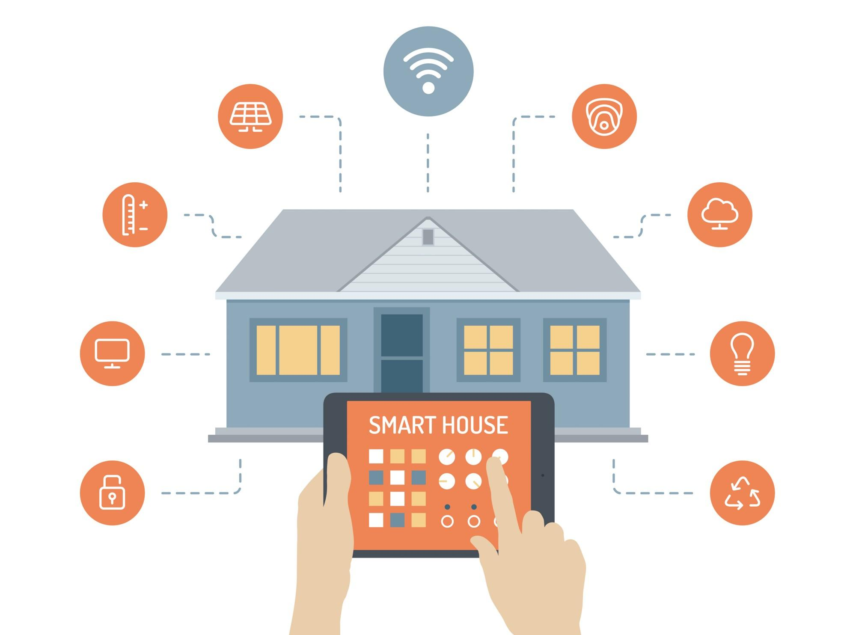

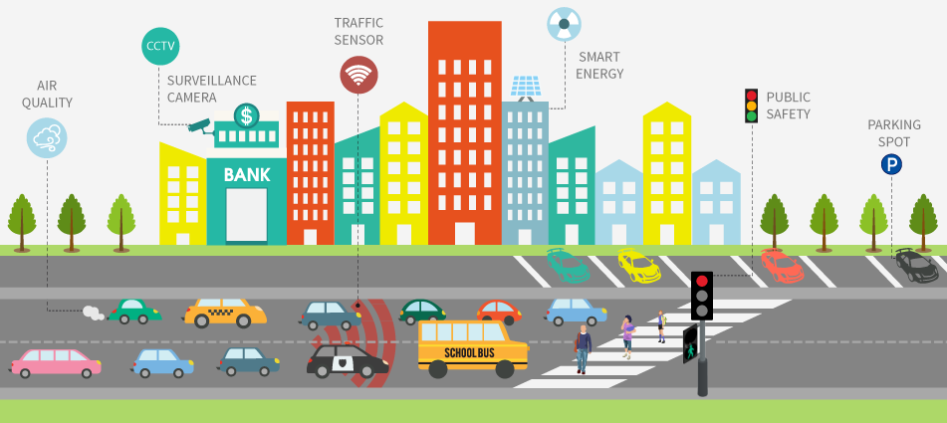
From “Traditional Internet” to the “Internet of Things”
Today: 15 billion traditional devices
Tomorrow: 50 billion IoT devices (2020)

Slide 3

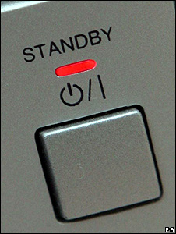
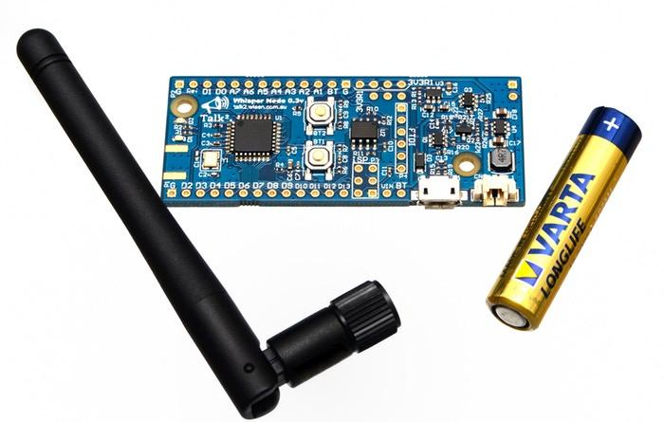
Energy Efficiency for the IoT
Challenges: Pollution and Autonomy
Opportunities: Effective use of “standby”
30-50% economy with existing technologies

Slide 4
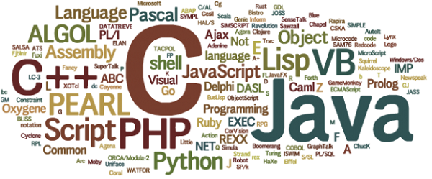

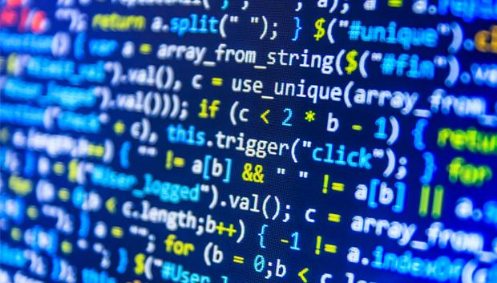
Céu: An Energy-Aware Programming Language
All smart devices have software...
… and all software is written in a programming language
But current programming languages were not designed with energy efficiency in mind!

Slide 5





But what really is a Programming Language?
A computer is programmable,
but how?

Slide 6





But what really is a Programming Language?
Machine Language
The Compiler (or Interpreter)
The Language
every 10s do
readSensor();
transmitMsg();
end
Design
and Implementation

Slide 7

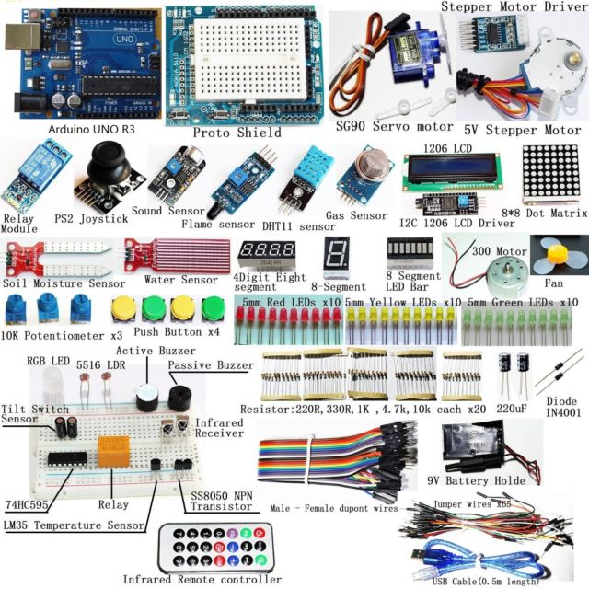
Current languages were not designed with energy efficiency in mind...
...and neither with the surrounding physical world in mind.
Most energy is consumed by peripherals!
computer
peripherals
IoT sensors
& actuators

Slide 8
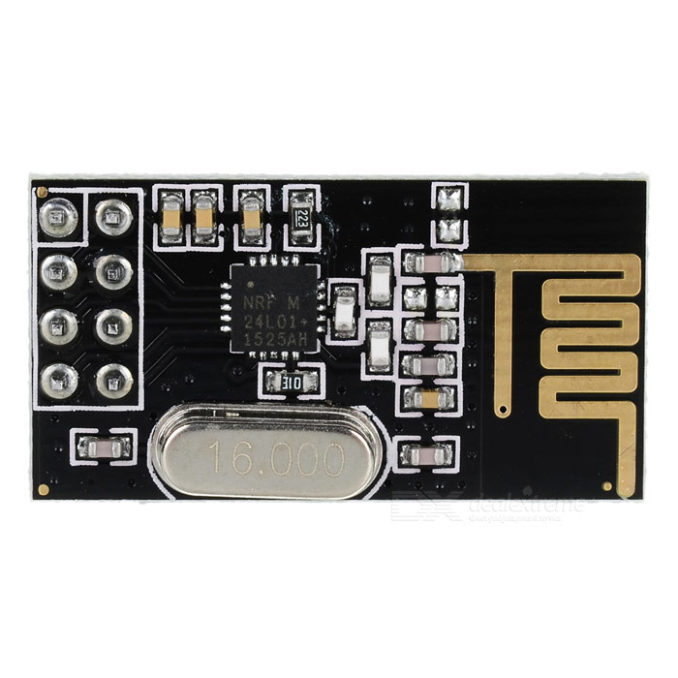
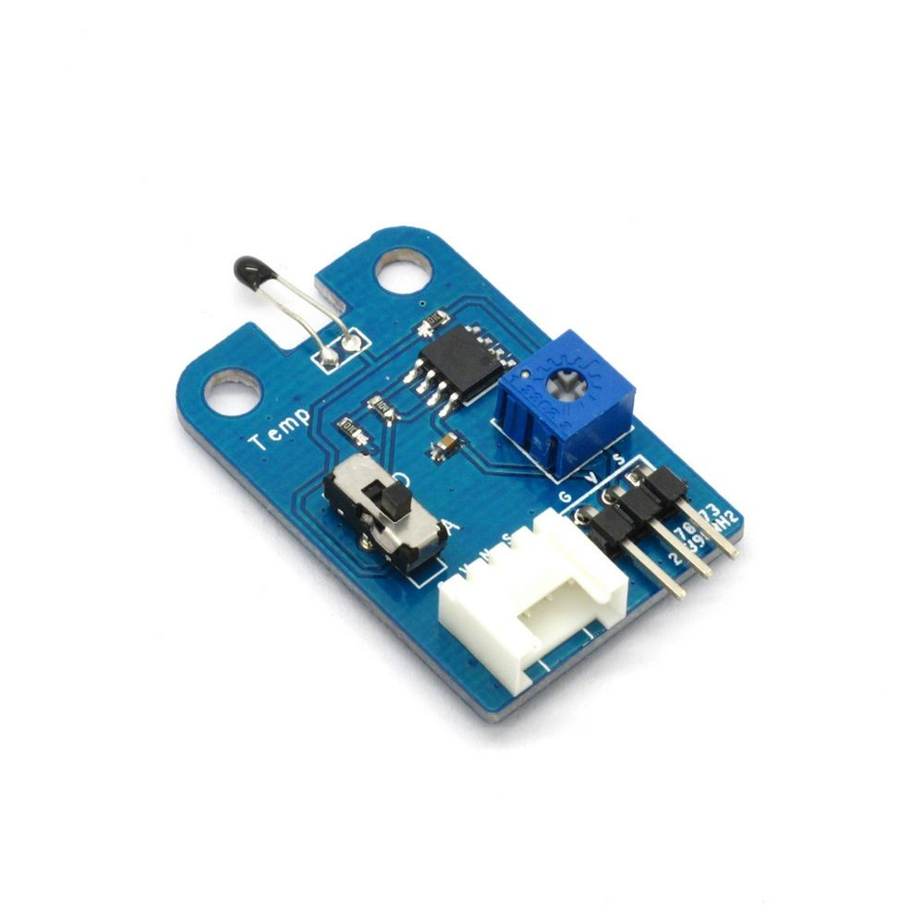
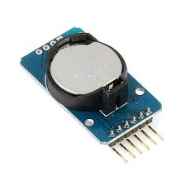
How can we approach energy efficiency from a programming language’s perspective?
await 1s
v <- await TEMPERATURE
emit RADIO -> v
Dedicated vocabulary
  await, emit
Infer what is not said
  turn unused sensors off
radio
temp
clock
Save energy!

Slide 9
Our approach with Céu
Enforcing that the program reaches an idle state after each input
Putting the device in standby mode whenever the program is idle
Awaking the program only from hardware interrupts on inputs

Slide 10
Proof of Termination
We want to prove that all programs ever written in Céu always reach idle states in finite time for every possible input.
aka “Halting Problem”
  undecidable in general
A programming language is also about what it cannot express.
Is this language still useful?
Trade-offs, it’s a design problem.
  (Spoiler: Yes it can be useful!)
loop forever

Slide 11
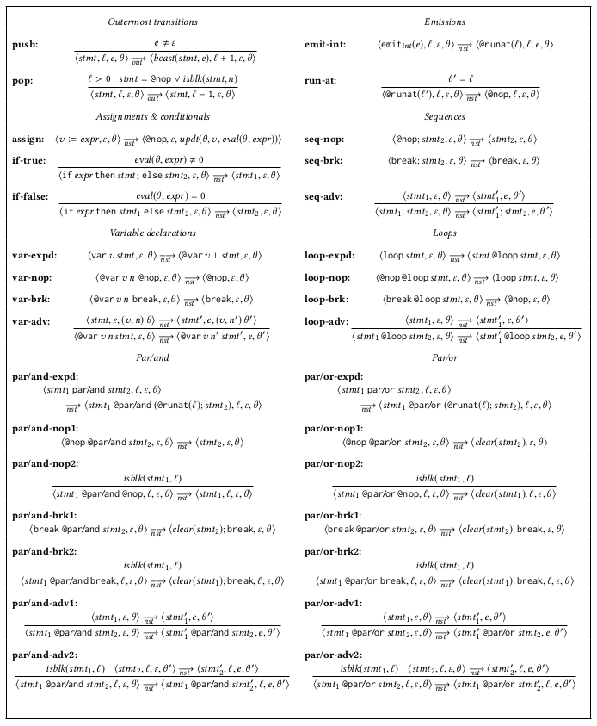
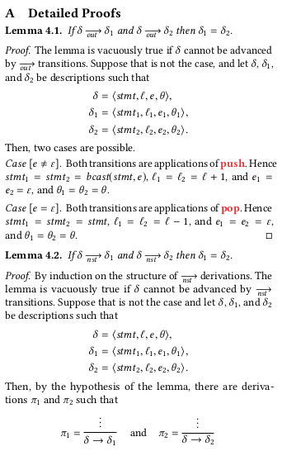
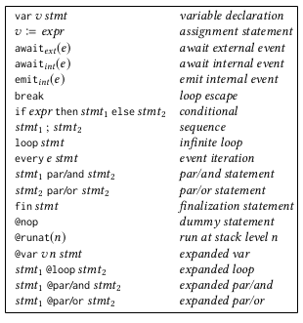

How can we prove properties about languages?
Math!
  Formalize the grammar (syntax)
  Formalize the execution (semantics)
  Prove the desired properties
    termination in finite time
    deterministic execution
    memory boundedness

Slide 12
Summary
Approach energy efficiency from a programming language’s perspective
Design
  Dedicated vocabulary
  Enforce idle states
Implementation
  Work with standard IoT devices
  Apply standby automatically
Formalization
  Describe the language mathematically
  Prove properties: termination, determinism, memory
LCTES’18: Transparent Standby for Low-Power, Resource-Constrained Embedded Systems
REBLS’18: Reactive and Energy-Efficient Programming From The Ground Up
LCTES’18: A Memory-Bounded, Deterministic and Terminating Semantics for the Synchronous Programming Language Céu
JSA’19: A Memory-Bounded, Deterministic and Terminating Semantics for the Synchronous Programming Language Céu

