Slide 1



Transparent Standby for Low-Power,
Resource-Constrained Embedded Systems
A Programming Language-Based Approach
Francisco Sant'Anna
francisco@ime.uerj.br
@_fsantanna
www.ceu-lang.org

Slide 2

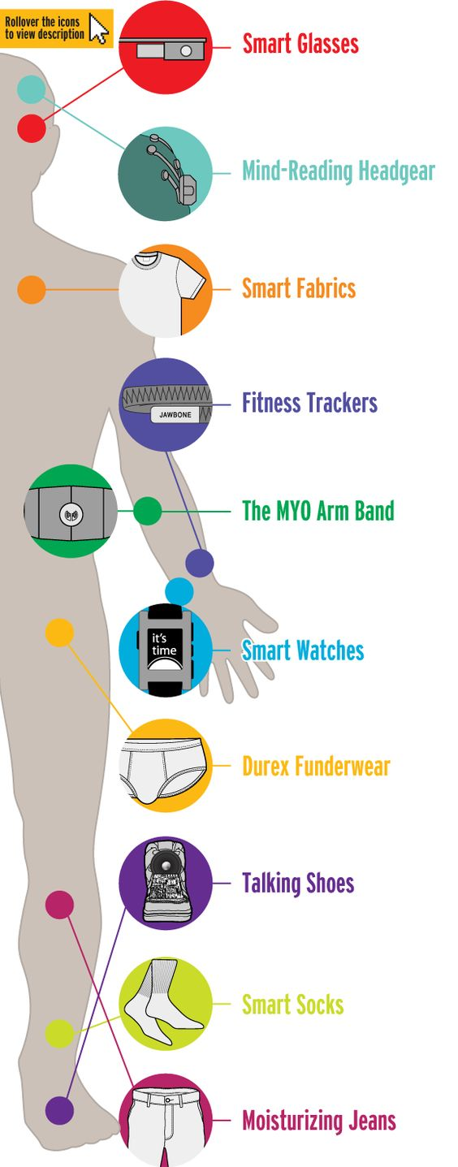
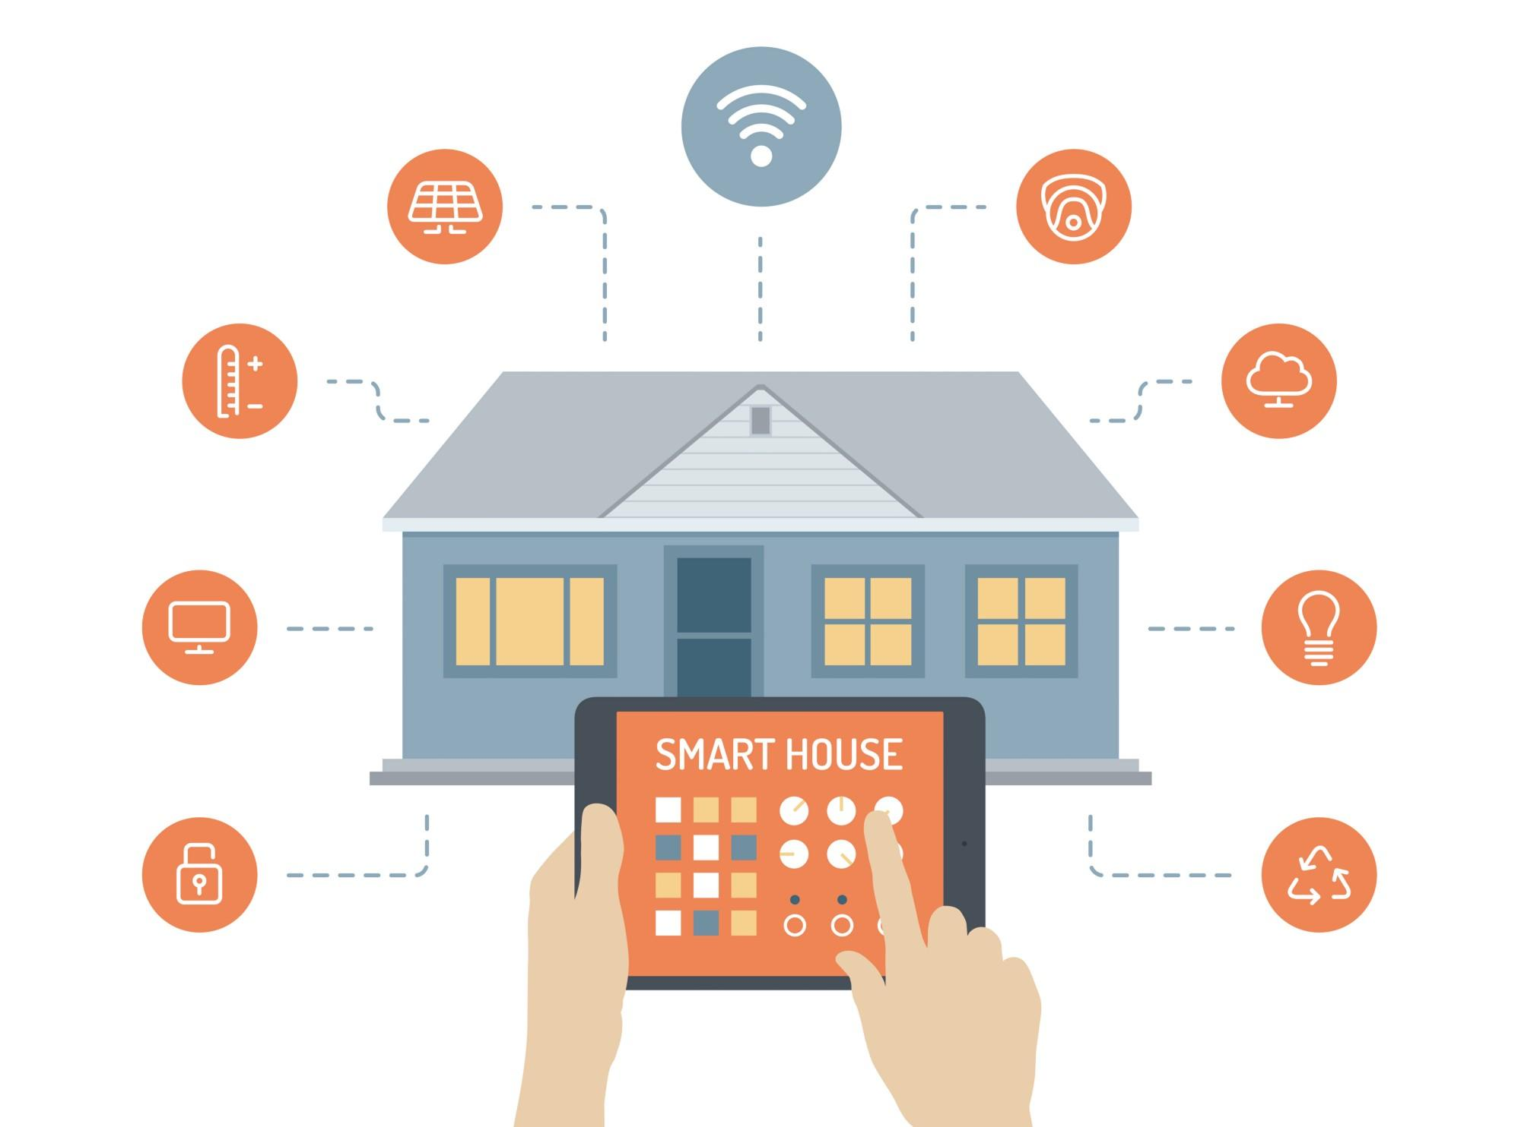

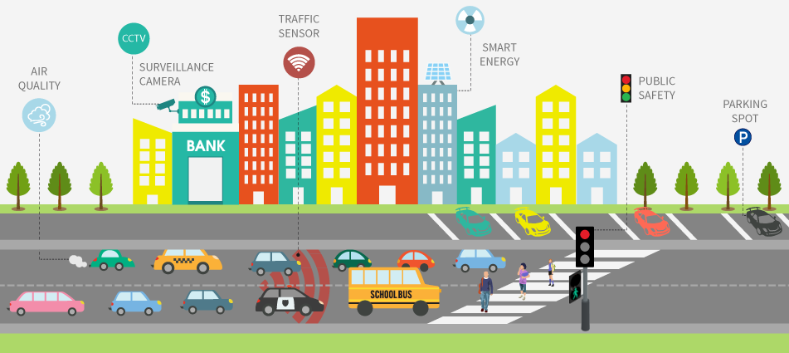
From “Traditional” Internet to “IoT”
Today: 15 billion devices
Tomorrow: 50 billion devices (2020)

Slide 3

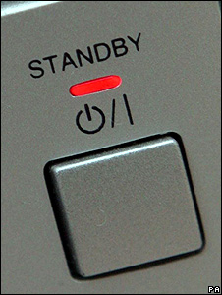
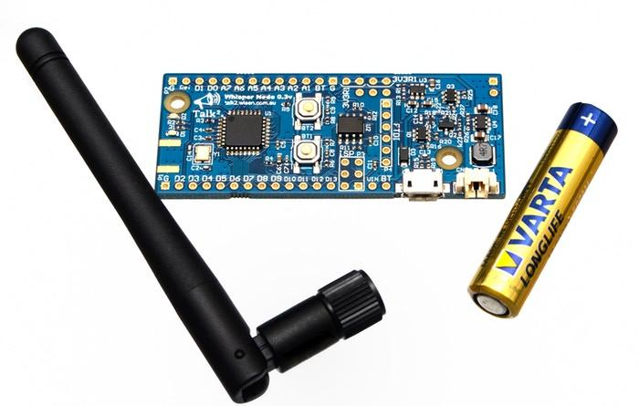
Energy Efficiency for the IoT
Challenges: Pollution, Autonomy
Opportunity: Effective “standby”
30-50% economy with existing technologies

Slide 4



All smart devices have software...
… which is written in a language
Current languages have not been designed with energy efficiency in mind!

Slide 6
Our Research Goals
Address energy efficiency through rigorous use of standby.
Target constrained embedded architectures that form the IoT.
Provide standby mechanisms at the programming language level that scale to all applications.
Support transparent/non-intrusive standby mechanisms that reduce barriers of adoption.

Slide 7
Research Non-Goals
Adaptive Computing
  QoS (e.g., resolution, frame rate, accuracy)
  Behavior (e.g., switch UI, disable functionalities)
  Don’t take advantage of standby modes (goal 1)
Energy-Aware Network Protocols
  Low-power listening
  Small periods of duty cycles
  Only for networked parts, not automatic (goals 3 & 4)
Complex Hardware Architectures
  Microprocessors, MMU, OS-based, Smartphones
  Not constrained embedded platforms (goal 2)

Slide 8
General Approach
(standby, constrained, programming language, transparent)
Enforce idle states of execution
Infer deepest sleeping mode
Put device to sleep
Only awake from interrupts

Slide 10
A Motivating Example
Every second, read sensor value and broadcast it.
Arduino
Céu
while (1) {
delay(1000);
int v = analogRead();
radioWrite(v);
}
loop do
await 1s;
int v = await AnalogRead();
await RadioWrite(v);
end

Slide 11
Let’s add concurrency...
Every second, read sensor value and broadcast it.
Stop immediately as soon as a message arrives.
Arduino
uint32_t lst = millis();
while (1) {
if (radioAvail())
break;
uint32_t cur = millis();
if (cur > lst+1000) {
lst = cur;
int v = analogRead();
radioWrite(v);
}
}
while (1) {
delay(1000);
int v = analogRead();
radioWrite(v);
}

Slide 12
Let’s add concurrency...
Every second, read sensor value and broadcast it.
Stop immediately as soon as a message arrives.
Arduino
Céu
uint32_t lst = millis();
while (1) {
if (radioAvail())
break;
uint32_t cur = millis();
if (cur > lst+1000) {
lst = cur;
int v = analogRead();
radioWrite(v);
}
}
par/or do
await RadioAvail();
with
loop do
await 1s;
int v = await AnalogRead();
await RadioWrite(v);
end
end

Slide 13
Standby Considerations
Every second, read sensor value and broadcast it.
Stop immediately as soon as a message arrives.
Arduino
Céu
uint32_t lst = millis();
while (1) {
if (radioAvail())
break;
uint32_t cur = millis();
if (cur > lst+1000) {
lst = cur;
int v = analogRead();
radioWrite(v);
}
}
par/or do
await RadioAvail();
with
loop do
await 1s;
int v = await AnalogRead();
await RadioWrite(v);
end
end

Slide 14
Céu in a Nutshell
Reactive
  environment in control: events
Imperative
  sequences, loops, assignments
Concurrent
  multiple lines of execution: trails
Synchronous (based on Esterel)
  trails synchronize at each external event
  trails are always awaiting
Deterministic
  always yields the same outcome for a given timeline

Slide 16
In Practice...
Hardware infrastructure
  Off-the-shelf Arduinos (ATMega328, Cortex-M0)
Software infrastructure
  Implement an energy-aware runtime for Céu
  Rewrite device drivers in Céu (timers, ADC, Radio)
Applications
  Rewrite existing IoT applications in Céu
    Time to rewrite, Coding “aesthetics”, Energy consumption

Slide 17
par/or do
await RadioAvail();
with
loop do
await 1s;
int v = await AnalogRead();
await RadioWrite(v);
end
end
output void ADC_REQUEST do
ADMUX = 0x40|(A0&0x07);
bitSet(ADCSRA, ADIE);
bitSet(ADCSRA, ADSC);
end
input ADC_vect_num do
bitClear(ADCSRA, ADIE);
emit ADC_DONE(ADC);
end
code AnalogRead (void) -> int do
PM_SET(PM_ADC, 1);
do finalize with
PM_SET(PM_ADC, 0);
end
emit ADC_REQUEST;
int value = await ADC_DONE;
escape value;
end

Slide 18
par/or do
await RadioAvail();
with
loop do
await 1s;
int v = await AnalogRead();
await RadioWrite(v);
end
end
output void ADC_REQUEST do
ADMUX = 0x40|(A0&0x07);
bitSet(ADCSRA, ADIE);
bitSet(ADCSRA, ADSC);
end
input ADC_vect_num do
bitClear(ADCSRA, ADIE);
emit ADC_DONE(ADC);
end
void pm_sleep (void) {
if (PM_GET(PM_TIMER1)) {
sleep_1(<...>)
} else if (PM_GET(PM_ADC)) {
sleep_2(<...>);
} else {
sleep_3(<...>);
}
}
}
code AnalogRead (void) -> int do
PM_SET(PM_ADC, 1);
do finalize with
PM_SET(PM_ADC, 0);
end
emit ADC_REQUEST;
int value = await ADC_DONE;
escape value;
end

Slide 19
par/or do
await RadioAvail();
with
loop do
await 1s;
int v = await AnalogRead();
await RadioWrite(v);
end
end
output void ADC_REQUEST do
ADMUX = 0x40|(A0&0x07);
bitSet(ADCSRA, ADIE);
bitSet(ADCSRA, ADSC);
end
input ADC_vect_num do
bitClear(ADCSRA, ADIE);
emit ADC_DONE(ADC);
end
void pm_sleep (void) {
if (PM_GET(PM_TIMER1)) {
sleep_1(<...>)
} else if (PM_GET(PM_ADC)) {
sleep_2(<...>);
} else {
sleep_3(<...>);
}
}
}
code AnalogRead (void) -> int do
PM_SET(PM_ADC, 1);
do finalize with
PM_SET(PM_ADC, 0);
end
emit ADC_REQUEST;
int value = await ADC_DONE;
escape value;
end

Slide 20
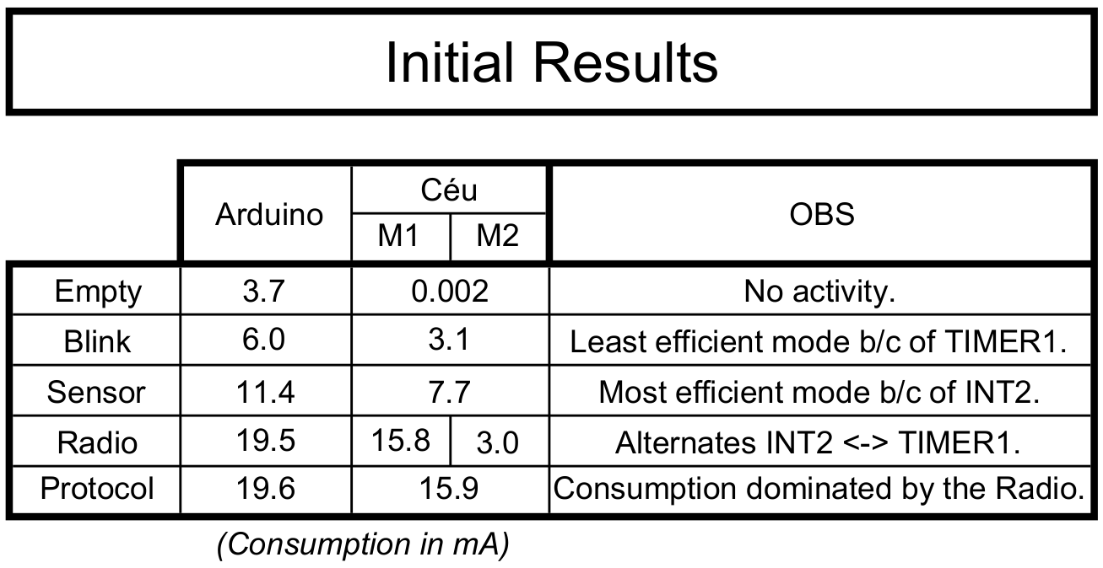
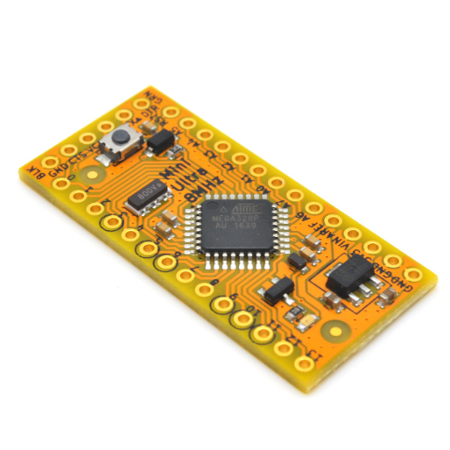
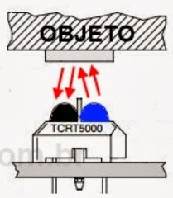
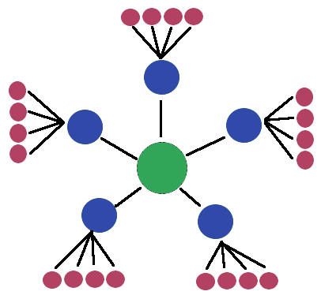
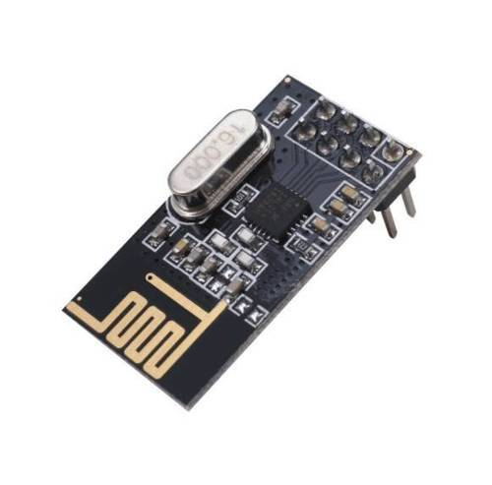
await FOREVER;
loop do
emit PIN(13,high);
await 1s;
emit PIN(13,low);
await 1s;
end
emit PIN(13, _digitalRead(2));
loop do
var bool v = await Pin(2);
emit PIN(13, v);
end
loop do
await 5s;
<...>
await Nrf24l01_TX(...);
<...>
await Nrf24l01_RX(...);
<...>
end
RocketScream
Low-Power
Arduino

Slide 21
General Approach
(standby, constrained, programming language, transparent)
Enforce idle states of execution
  Céu enforces a reactive model of execution
Infer deepest sleeping mode
  Céu has a semantics amenable to analysis
Put device to sleep
  Céu has an energy-aware runtime
Only awake from interrupts
  Céu provides interrupt service routines (ISRs)
par/or do
await RadioAvail();
with
loop do
await 1s;
int v = await AnalogRead();
await RadioWrite(v);
end
end

Slide 22
Transparent Standby for Low-Power,
Resource-Constrained Embedded Systems
A Programming Language-Based Approach
Francisco Sant'Anna
francisco@ime.uerj.br
@_fsantanna
www.ceu-lang.org

Slide 24
Standby Efficiency for IoT
15 billion “traditional” network-connected devices in 2015 (e.g., mobile phones & smart TVs).
75 billion by 2025 with the IoT (e.g., smart bulbs & fitness wearables). [2016]
Most energy consumed in standby mode.
Network standby is one of the six fronts on IEA/G20's Energy Efficiency Action Plan
  https://www.iea-4e.org/projects/g20

Slide 25
Related Publications
SenSys’13, ACM Embedded Networked Sensor Systems
  Safe System-level Concurrency on Resource-Constrained Nodes
TECS’17, ACM Transactions on Embedded Computing Systems
  The Design and Implementation of the Synchronous Language Céu
LCTES’18, ACM Conference on Languages, Compilers, and Tools for Embedded Systems
  A Memory-Bounded, Deterministic and Terminating Semantics
  for the Synchronous Programming Language Céu
LCTES’18, ACM Conference on Languages, Compilers, and Tools for Embedded Systems
  WIP: Transparent Standby for Low-Power, Resource-Constrained
  Embedded Systems

Slide 26
Cooperation Opportunities
Hardware infrastructure
  Off-the-shelf Arduinos (ATMega328, Cortex-M0)
Software infrastructure
  Implement an energy-aware runtime for Céu
  Rewrite device drivers in Céu (timers, ADC, Radio)
Applications
  Rewrite existing IoT applications in Céu
    Time to rewrite
    Coding “aesthetics”
    Energy consumption

