Slide 1



Transparent Standby for Low-Power,
Resource-Constrained Embedded Systems
A Programming Language-Based Approach
Francisco Sant'Anna
francisco@ime.uerj.br
@_fsantanna
www.ceu-lang.org

Slide 2
Our Research Goals

Slide 3
Our Research Goals
Address energy efficiency through rigorous use of standby.

Slide 4
Our Research Goals
Address energy efficiency through rigorous use of standby.
Target constrained embedded architectures that form the IoT.

Slide 5
Our Research Goals
Address energy efficiency through rigorous use of standby.
Target constrained embedded architectures that form the IoT.
Provide standby mechanisms at the programming language level that scale to all applications.

Slide 6
Our Research Goals
Address energy efficiency through rigorous use of standby.
Target constrained embedded architectures that form the IoT.
Provide standby mechanisms at the programming language level that scale to all applications.
Support transparent/non-intrusive standby mechanisms that reduce barriers of adoption.

Slide 7
General Approach
(standby, constrained, programming language, transparent)

Slide 8
General Approach
(standby, constrained, programming language, transparent)
Enforce idle states of execution

Slide 9
General Approach
(standby, constrained, programming language, transparent)
Enforce idle states of execution
Infer deepest sleeping mode

Slide 10
General Approach
(standby, constrained, programming language, transparent)
Enforce idle states of execution
Infer deepest sleeping mode
Put device to sleep

Slide 11
General Approach
(standby, constrained, programming language, transparent)
Enforce idle states of execution
Infer deepest sleeping mode
Put device to sleep
Only awake from interrupts

Slide 12
A Motivating Example

Slide 13
A Motivating Example
Every second, read sensor value and broadcast it.

Slide 14
A Motivating Example
Every second, read sensor value and broadcast it.
Arduino

Slide 15
A Motivating Example
Every second, read sensor value and broadcast it.
Arduino
while (1) {
delay(1000);
int v = analogRead();
radioWrite(v);
}

Slide 16
A Motivating Example
Every second, read sensor value and broadcast it.
Arduino
Céu
while (1) {
delay(1000);
int v = analogRead();
radioWrite(v);
}

Slide 17
A Motivating Example
Every second, read sensor value and broadcast it.
Arduino
Céu
while (1) {
delay(1000);
int v = analogRead();
radioWrite(v);
}
loop do
await 1s;
int v = await AnalogRead();
await RadioWrite(v);
end

Slide 18
A Motivating Example
Every second, read sensor value and broadcast it.
Arduino
Céu
while (1) {
delay(1000);
int v = analogRead();
radioWrite(v);
}
loop do
await 1s;
int v = await AnalogRead();
await RadioWrite(v);
end

Slide 19
A Motivating Example
Every second, read sensor value and broadcast it.
Arduino
Céu
while (1) {
delay(1000);
int v = analogRead();
radioWrite(v);
}
loop do
await 1s;
int v = await AnalogRead();
await RadioWrite(v);
end

Slide 20
Let’s add concurrency...
Every second, read sensor value and broadcast it.

Slide 21
Let’s add concurrency...
Every second, read sensor value and broadcast it.
Arduino
while (1) {
delay(1000);
int v = analogRead();
radioWrite(v);
}

Slide 22
Let’s add concurrency...
Every second, read sensor value and broadcast it.
Stop immediately as soon as a message arrives.
Arduino
while (1) {
delay(1000);
int v = analogRead();
radioWrite(v);
}

Slide 23
Let’s add concurrency...
Every second, read sensor value and broadcast it.
Stop immediately as soon as a message arrives.
Arduino
while (1) {
delay(1000);
int v = analogRead();
radioWrite(v);
}

Slide 24
Let’s add concurrency...
Every second, read sensor value and broadcast it.
Stop immediately as soon as a message arrives.
Arduino
while (1) {
delay(1000);
int v = analogRead();
radioWrite(v);
}

Slide 25
Let’s add concurrency...
Every second, read sensor value and broadcast it.
Stop immediately as soon as a message arrives.
Arduino
uint32_t lst = millis();
while (1) {
if (radioAvail())
break;
uint32_t cur = millis();
if (cur > lst+1000) {
lst = cur;
int v = analogRead();
radioWrite(v);
}
}
while (1) {
delay(1000);
int v = analogRead();
radioWrite(v);
}

Slide 26
Let’s add concurrency...
Every second, read sensor value and broadcast it.
Stop immediately as soon as a message arrives.
Arduino
uint32_t lst = millis();
while (1) {
if (radioAvail())
break;
uint32_t cur = millis();
if (cur > lst+1000) {
lst = cur;
int v = analogRead();
radioWrite(v);
}
}
while (1) {
delay(1000);
int v = analogRead();
radioWrite(v);
}

Slide 27
Let’s add concurrency...
Every second, read sensor value and broadcast it.
Stop immediately as soon as a message arrives.
Arduino
uint32_t lst = millis();
while (1) {
if (radioAvail())
break;
uint32_t cur = millis();
if (cur > lst+1000) {
lst = cur;
int v = analogRead();
radioWrite(v);
}
}
while (1) {
delay(1000);
int v = analogRead();
radioWrite(v);
}

Slide 28
Let’s add concurrency...
Every second, read sensor value and broadcast it.
Stop immediately as soon as a message arrives.
Arduino
uint32_t lst = millis();
while (1) {
if (radioAvail())
break;
uint32_t cur = millis();
if (cur > lst+1000) {
lst = cur;
int v = analogRead();
radioWrite(v);
}
}
while (1) {
delay(1000);
int v = analogRead();
radioWrite(v);
}

Slide 29
Let’s add concurrency...
Every second, read sensor value and broadcast it.
Stop immediately as soon as a message arrives.
Arduino
uint32_t lst = millis();
while (1) {
if (radioAvail())
break;
uint32_t cur = millis();
if (cur > lst+1000) {
lst = cur;
int v = analogRead();
radioWrite(v);
}
}
while (1) {
delay(1000);
int v = analogRead();
radioWrite(v);
}

Slide 30
Let’s add concurrency...
Every second, read sensor value and broadcast it.
Stop immediately as soon as a message arrives.
Arduino
uint32_t lst = millis();
while (1) {
if (radioAvail())
break;
uint32_t cur = millis();
if (cur > lst+1000) {
lst = cur;
int v = analogRead();
radioWrite(v);
}
}

Slide 31
Let’s add concurrency...
Every second, read sensor value and broadcast it.
Stop immediately as soon as a message arrives.
Arduino
Céu
uint32_t lst = millis();
while (1) {
if (radioAvail())
break;
uint32_t cur = millis();
if (cur > lst+1000) {
lst = cur;
int v = analogRead();
radioWrite(v);
}
}

Slide 32
Let’s add concurrency...
Every second, read sensor value and broadcast it.
Stop immediately as soon as a message arrives.
Arduino
Céu
uint32_t lst = millis();
while (1) {
if (radioAvail())
break;
uint32_t cur = millis();
if (cur > lst+1000) {
lst = cur;
int v = analogRead();
radioWrite(v);
}
}
par/or do
await RadioAvail();
with
loop do
await 1s;
int v = await AnalogRead();
await RadioWrite(v);
end
end

Slide 33
Let’s add concurrency...
Every second, read sensor value and broadcast it.
Stop immediately as soon as a message arrives.
Arduino
Céu
uint32_t lst = millis();
while (1) {
if (radioAvail())
break;
uint32_t cur = millis();
if (cur > lst+1000) {
lst = cur;
int v = analogRead();
radioWrite(v);
}
}
par/or do
await RadioAvail();
with
loop do
await 1s;
int v = await AnalogRead();
await RadioWrite(v);
end
end

Slide 34
Let’s add concurrency...
Every second, read sensor value and broadcast it.
Stop immediately as soon as a message arrives.
Arduino
Céu
uint32_t lst = millis();
while (1) {
if (radioAvail())
break;
uint32_t cur = millis();
if (cur > lst+1000) {
lst = cur;
int v = analogRead();
radioWrite(v);
}
}
par/or do
await RadioAvail();
with
loop do
await 1s;
int v = await AnalogRead();
await RadioWrite(v);
end
end

Slide 35
Standby Considerations
Every second, read sensor value and broadcast it.
Stop immediately as soon as a message arrives.
Arduino
Céu
uint32_t lst = millis();
while (1) {
if (radioAvail())
break;
uint32_t cur = millis();
if (cur > lst+1000) {
lst = cur;
int v = analogRead();
radioWrite(v);
}
}
par/or do
await RadioAvail();
with
loop do
await 1s;
int v = await AnalogRead();
await RadioWrite(v);
end
end

Slide 36
Standby Considerations
Every second, read sensor value and broadcast it.
Stop immediately as soon as a message arrives.
Arduino
Céu
uint32_t lst = millis();
while (1) {
if (radioAvail())
break;
uint32_t cur = millis();
if (cur > lst+1000) {
lst = cur;
int v = analogRead();
radioWrite(v);
}
}
par/or do
await RadioAvail();
with
loop do
await 1s;
int v = await AnalogRead();
await RadioWrite(v);
end
end

Slide 37
Standby Considerations
Every second, read sensor value and broadcast it.
Stop immediately as soon as a message arrives.
Arduino
Céu
uint32_t lst = millis();
while (1) {
if (radioAvail())
break;
uint32_t cur = millis();
if (cur > lst+1000) {
lst = cur;
int v = analogRead();
radioWrite(v);
}
}
par/or do
await RadioAvail();
with
loop do
await 1s;
int v = await AnalogRead();
await RadioWrite(v);
end
end

Slide 38
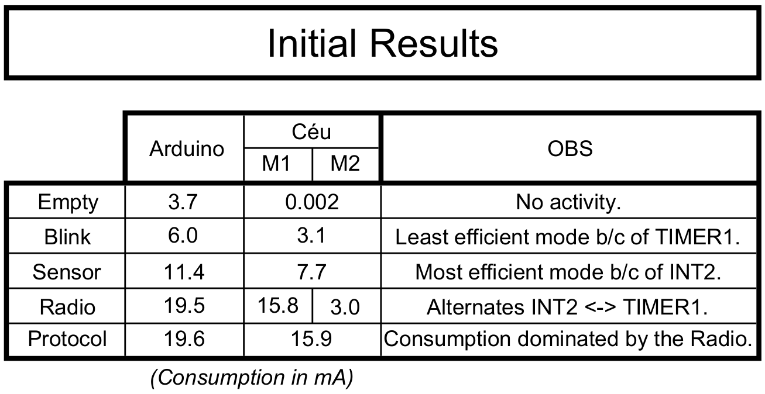

Slide 39
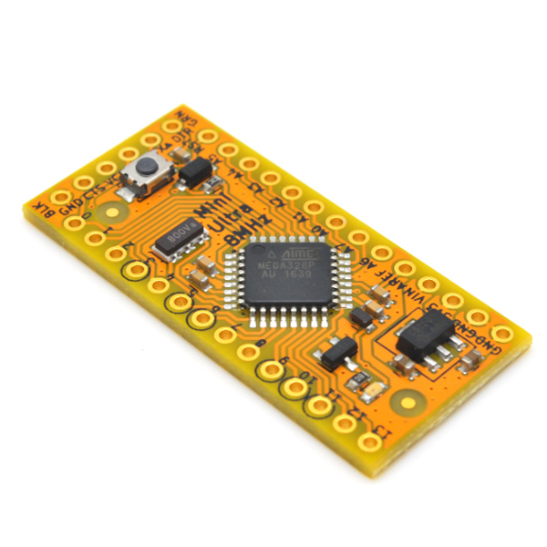
RocketScream
Low-Power
Arduino

Slide 40
RocketScream
Low-Power
Arduino

Slide 41
await FOREVER;
RocketScream
Low-Power
Arduino

Slide 42
await FOREVER;
RocketScream
Low-Power
Arduino

Slide 43
await FOREVER;
RocketScream
Low-Power
Arduino

Slide 44
await FOREVER;
loop do
emit PIN(13,high);
await 1s;
emit PIN(13,low);
await 1s;
end
RocketScream
Low-Power
Arduino

Slide 45
await FOREVER;
loop do
emit PIN(13,high);
await 1s;
emit PIN(13,low);
await 1s;
end
RocketScream
Low-Power
Arduino

Slide 46
await FOREVER;
loop do
emit PIN(13,high);
await 1s;
emit PIN(13,low);
await 1s;
end
RocketScream
Low-Power
Arduino

Slide 47
await FOREVER;
loop do
emit PIN(13,high);
await 1s;
emit PIN(13,low);
await 1s;
end
RocketScream
Low-Power
Arduino

Slide 48
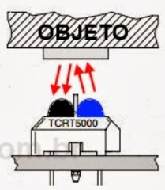
await FOREVER;
loop do
emit PIN(13,high);
await 1s;
emit PIN(13,low);
await 1s;
end
RocketScream
Low-Power
Arduino

Slide 49
await FOREVER;
loop do
emit PIN(13,high);
await 1s;
emit PIN(13,low);
await 1s;
end
emit PIN(13, _digitalRead(2));
loop do
var bool v = await Pin(2);
emit PIN(13, v);
end
RocketScream
Low-Power
Arduino

Slide 50
await FOREVER;
loop do
emit PIN(13,high);
await 1s;
emit PIN(13,low);
await 1s;
end
emit PIN(13, _digitalRead(2));
loop do
var bool v = await Pin(2);
emit PIN(13, v);
end
RocketScream
Low-Power
Arduino

Slide 51
await FOREVER;
loop do
emit PIN(13,high);
await 1s;
emit PIN(13,low);
await 1s;
end
emit PIN(13, _digitalRead(2));
loop do
var bool v = await Pin(2);
emit PIN(13, v);
end
RocketScream
Low-Power
Arduino

Slide 52
await FOREVER;
loop do
emit PIN(13,high);
await 1s;
emit PIN(13,low);
await 1s;
end
emit PIN(13, _digitalRead(2));
loop do
var bool v = await Pin(2);
emit PIN(13, v);
end
RocketScream
Low-Power
Arduino

Slide 53
await FOREVER;
loop do
emit PIN(13,high);
await 1s;
emit PIN(13,low);
await 1s;
end
emit PIN(13, _digitalRead(2));
loop do
var bool v = await Pin(2);
emit PIN(13, v);
end
RocketScream
Low-Power
Arduino

Slide 54
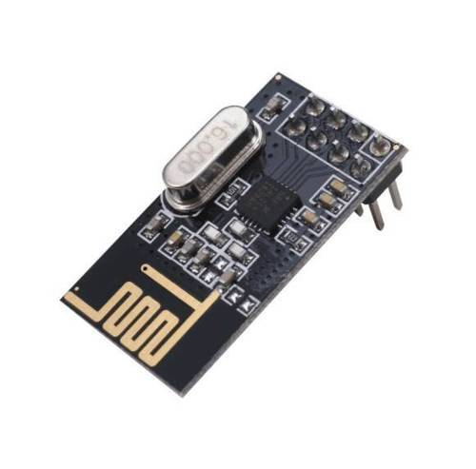
await FOREVER;
loop do
emit PIN(13,high);
await 1s;
emit PIN(13,low);
await 1s;
end
emit PIN(13, _digitalRead(2));
loop do
var bool v = await Pin(2);
emit PIN(13, v);
end
RocketScream
Low-Power
Arduino

Slide 55
await FOREVER;
loop do
emit PIN(13,high);
await 1s;
emit PIN(13,low);
await 1s;
end
emit PIN(13, _digitalRead(2));
loop do
var bool v = await Pin(2);
emit PIN(13, v);
end
loop do
await 1s;
<...>
await Nrf24l01_TX(...);
<...>
await Nrf24l01_RX(...);
<...>
end
RocketScream
Low-Power
Arduino

Slide 56
await FOREVER;
loop do
emit PIN(13,high);
await 1s;
emit PIN(13,low);
await 1s;
end
emit PIN(13, _digitalRead(2));
loop do
var bool v = await Pin(2);
emit PIN(13, v);
end
loop do
await 1s;
<...>
await Nrf24l01_TX(...);
<...>
await Nrf24l01_RX(...);
<...>
end
RocketScream
Low-Power
Arduino

Slide 57
await FOREVER;
loop do
emit PIN(13,high);
await 1s;
emit PIN(13,low);
await 1s;
end
emit PIN(13, _digitalRead(2));
loop do
var bool v = await Pin(2);
emit PIN(13, v);
end
loop do
await 1s;
<...>
await Nrf24l01_TX(...);
<...>
await Nrf24l01_RX(...);
<...>
end
RocketScream
Low-Power
Arduino

Slide 58
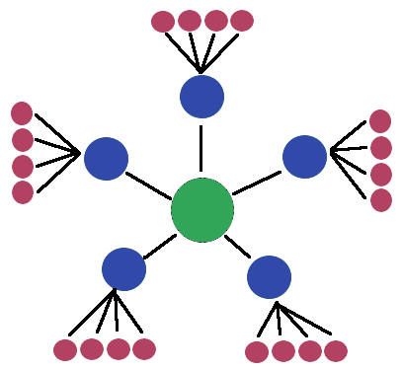
await FOREVER;
loop do
emit PIN(13,high);
await 1s;
emit PIN(13,low);
await 1s;
end
emit PIN(13, _digitalRead(2));
loop do
var bool v = await Pin(2);
emit PIN(13, v);
end
loop do
await 1s;
<...>
await Nrf24l01_TX(...);
<...>
await Nrf24l01_RX(...);
<...>
end
RocketScream
Low-Power
Arduino

Slide 59
General Approach
(standby, constrained, programming language, transparent)
par/or do
await RadioAvail();
with
loop do
await 1s;
int v = await AnalogRead();
await RadioWrite(v);
end
end

Slide 60
General Approach
(standby, constrained, programming language, transparent)
Enforce idle states of execution
par/or do
await RadioAvail();
with
loop do
await 1s;
int v = await AnalogRead();
await RadioWrite(v);
end
end

Slide 61
General Approach
(standby, constrained, programming language, transparent)
Enforce idle states of execution
  Céu enforces a reactive model of execution
Infer deepest sleeping mode
par/or do
await RadioAvail();
with
loop do
await 1s;
int v = await AnalogRead();
await RadioWrite(v);
end
end

Slide 62
General Approach
(standby, constrained, programming language, transparent)
Enforce idle states of execution
  Céu enforces a reactive model of execution
Infer deepest sleeping mode
par/or do
await RadioAvail();
with
loop do
await 1s;
int v = await AnalogRead();
await RadioWrite(v);
end
end

Slide 63
General Approach
(standby, constrained, programming language, transparent)
Enforce idle states of execution
  Céu enforces a reactive model of execution
Infer deepest sleeping mode
  Céu has a semantics amenable to analysis
Put device to sleep
par/or do
await RadioAvail();
with
loop do
await 1s;
int v = await AnalogRead();
await RadioWrite(v);
end
end

Slide 64
General Approach
(standby, constrained, programming language, transparent)
Enforce idle states of execution
  Céu enforces a reactive model of execution
Infer deepest sleeping mode
  Céu has a semantics amenable to analysis
Put device to sleep
par/or do
await RadioAvail();
with
loop do
await 1s;
int v = await AnalogRead();
await RadioWrite(v);
end
end

Slide 65
General Approach
(standby, constrained, programming language, transparent)
Enforce idle states of execution
  Céu enforces a reactive model of execution
Infer deepest sleeping mode
  Céu has a semantics amenable to analysis
Put device to sleep
  Céu has an energy-aware runtime
Only awake from interrupts
par/or do
await RadioAvail();
with
loop do
await 1s;
int v = await AnalogRead();
await RadioWrite(v);
end
end

Slide 66
General Approach
(standby, constrained, programming language, transparent)
Enforce idle states of execution
  Céu enforces a reactive model of execution
Infer deepest sleeping mode
  Céu has a semantics amenable to analysis
Put device to sleep
  Céu has an energy-aware runtime
Only awake from interrupts
  Céu provides interrupt service routines (ISRs)
par/or do
await RadioAvail();
with
loop do
await 1s;
int v = await AnalogRead();
await RadioWrite(v);
end
end

Slide 67
Transparent Standby for Low-Power,
Resource-Constrained Embedded Systems
A Programming Language-Based Approach
Francisco Sant'Anna
francisco@ime.uerj.br
@_fsantanna
www.ceu-lang.org

Slide 69
Standby Efficiency for IoT

Slide 70
Standby Efficiency for IoT
15 billion “traditional” network-connected devices in 2015 (e.g., mobile phones & smart TVs).

Slide 71
Standby Efficiency for IoT
15 billion “traditional” network-connected devices in 2015 (e.g., mobile phones & smart TVs).
75 billion by 2025 with the IoT (e.g., smart bulbs & fitness wearables). [2016]

Slide 72
Standby Efficiency for IoT
15 billion “traditional” network-connected devices in 2015 (e.g., mobile phones & smart TVs).
75 billion by 2025 with the IoT (e.g., smart bulbs & fitness wearables). [2016]
Most energy consumed in standby mode.

Slide 73
Standby Efficiency for IoT
15 billion “traditional” network-connected devices in 2015 (e.g., mobile phones & smart TVs).
75 billion by 2025 with the IoT (e.g., smart bulbs & fitness wearables). [2016]
Most energy consumed in standby mode.
Network standby is one of the six fronts on IEA/G20's Energy Efficiency Action Plan
  https://www.iea-4e.org/projects/g20

Slide 74
From “Traditional” Internet to “IoT”

Slide 75

From “Traditional” Internet to “IoT”
Today: 15 billion devices

Slide 76

From “Traditional” Internet to “IoT”
Today: 15 billion devices

Slide 77
From “Traditional” Internet to “IoT”
Today: 15 billion devices
Tomorrow: 50 billion devices (2020)

Slide 78
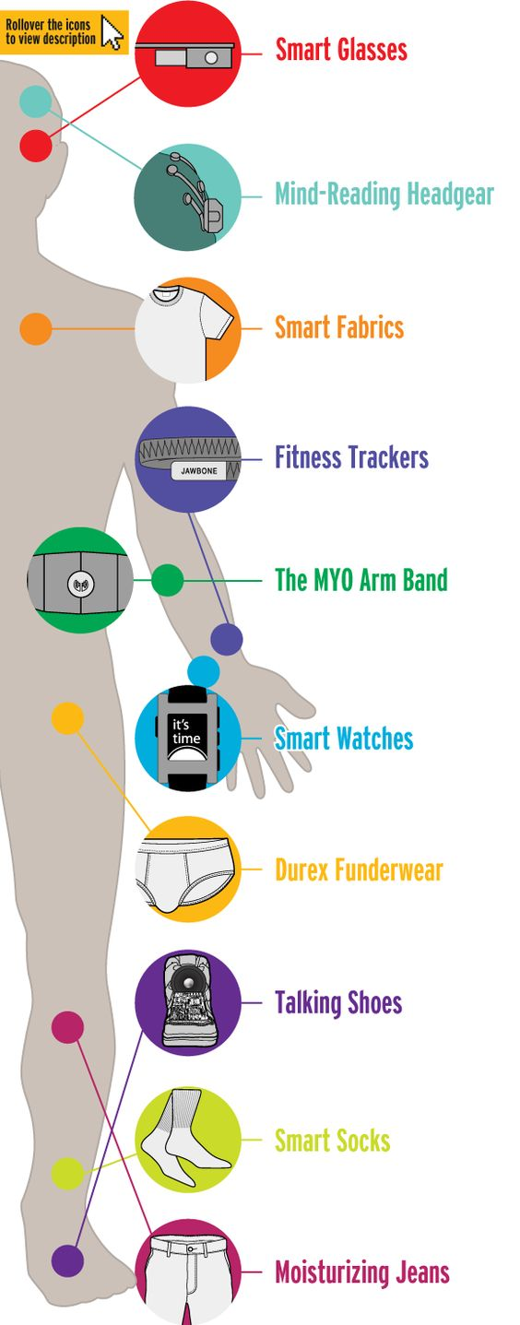
From “Traditional” Internet to “IoT”
Today: 15 billion devices
Tomorrow: 50 billion devices (2020)

Slide 79
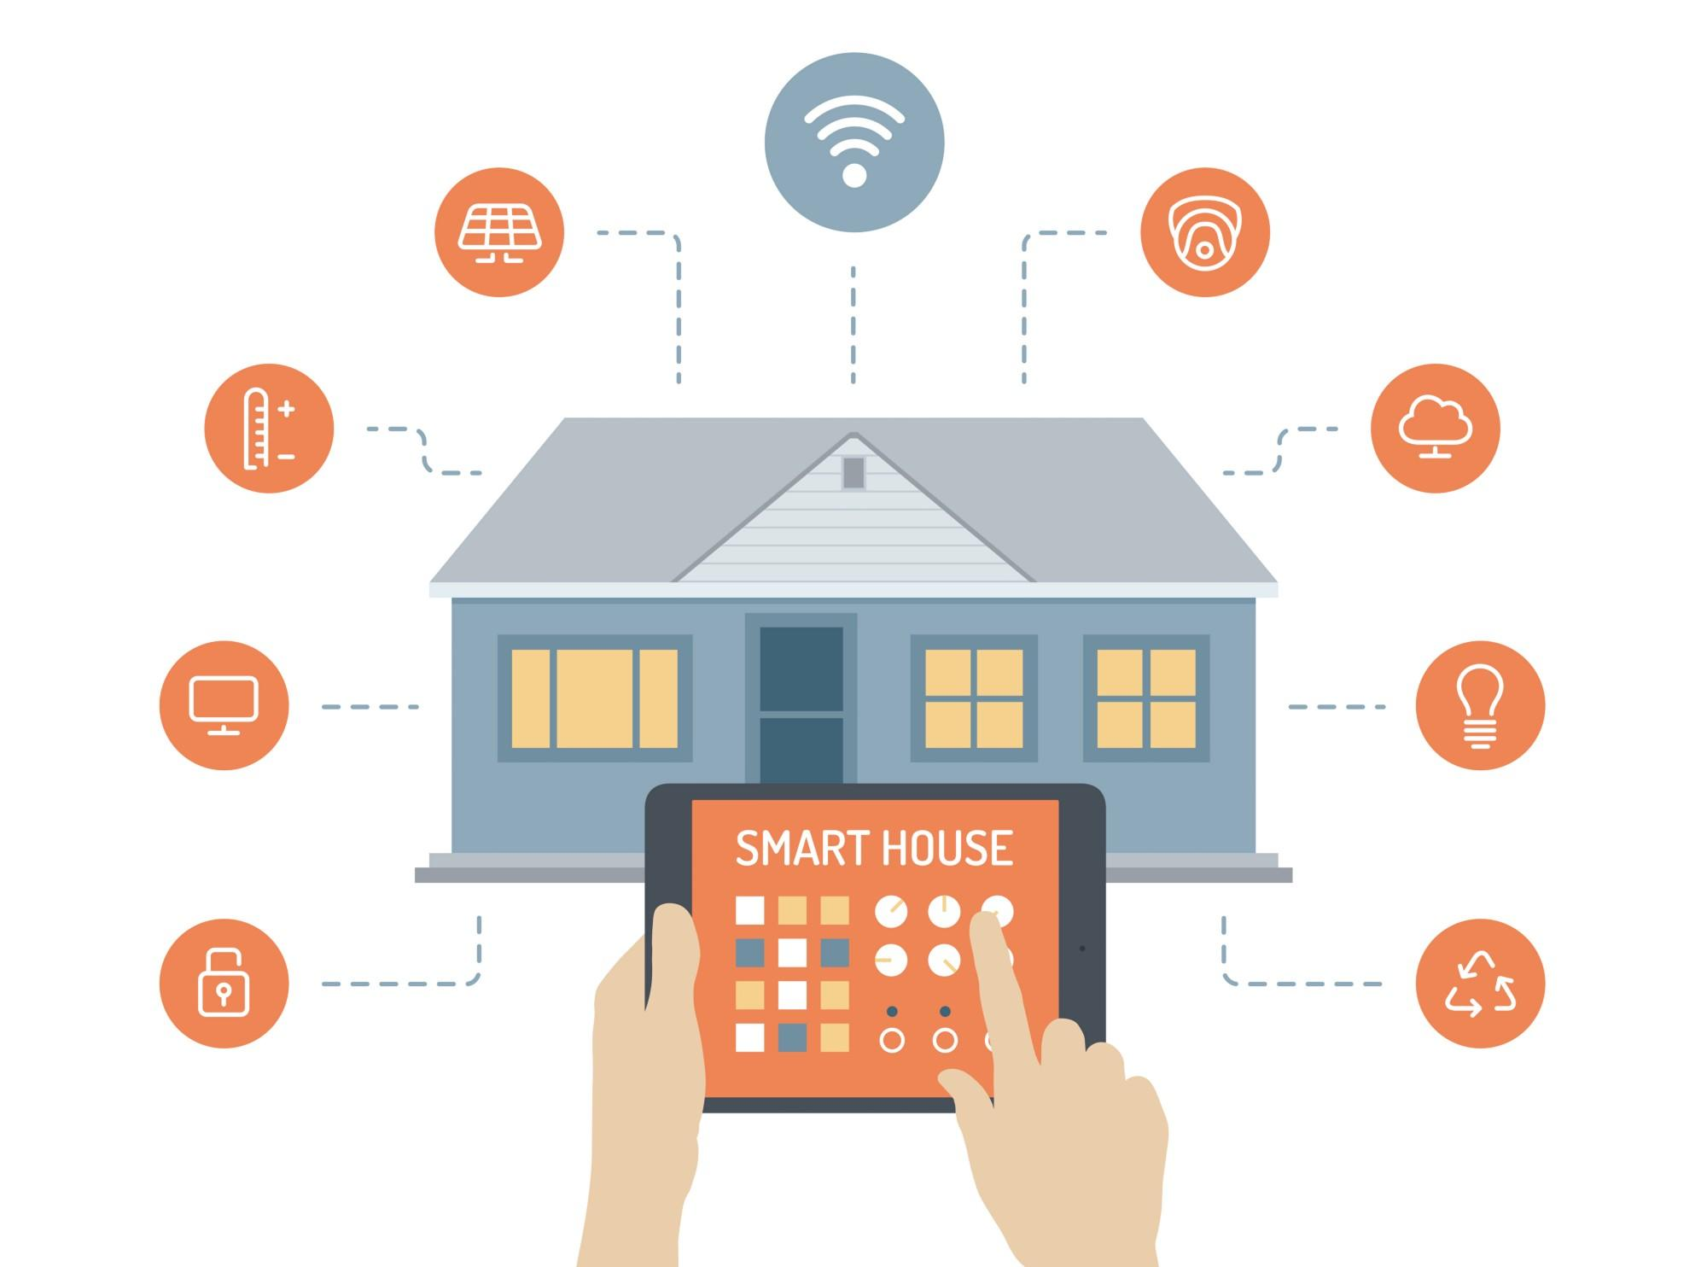
From “Traditional” Internet to “IoT”
Today: 15 billion devices
Tomorrow: 50 billion devices (2020)

Slide 80
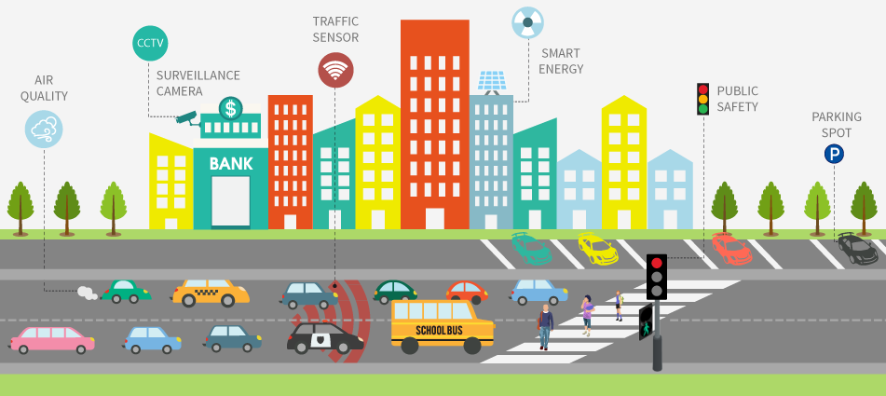
From “Traditional” Internet to “IoT”
Today: 15 billion devices
Tomorrow: 50 billion devices (2020)

Slide 81
Energy Efficiency for the IoT

Slide 82

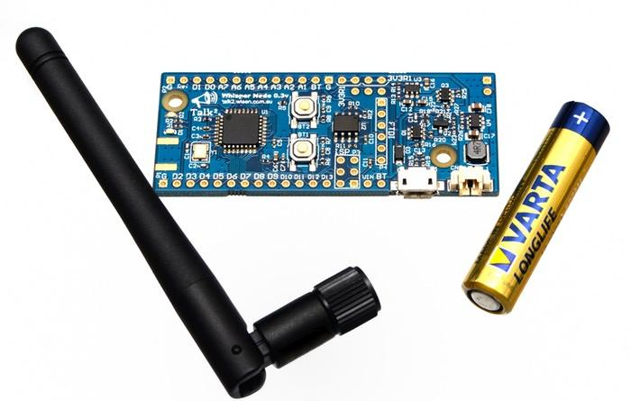
Energy Efficiency for the IoT
Challenges: Pollution, Autonomy

Slide 83
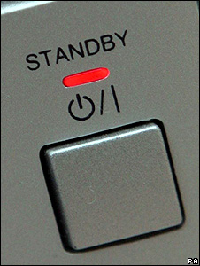
Energy Efficiency for the IoT
Challenges: Pollution, Autonomy
Opportunity: Effective “standby”

Slide 84
Energy Efficiency for the IoT
Challenges: Pollution, Autonomy
Opportunity: Effective “standby”
30-50% economy with existing technologies

Slide 86

All IoT devices have software...

Slide 87
All IoT devices have software...

Slide 88
All IoT devices have software...
… which is written in a language

Slide 89

All IoT devices have software...
… which is written in a language

Slide 90
All IoT devices have software...
… which is written in a language
Current languages have not been designed with energy efficiency in mind!

Slide 91
All IoT devices have software...
… which is written in a language
Current languages have not been designed with energy efficiency in mind!

Slide 92

All IoT devices have software...
… which is written in a language
Current languages have not been designed with energy efficiency in mind!

Slide 93
Céu in a Nutshell

Slide 94
Céu in a Nutshell
Reactive
  environment in control: events

Slide 95
Céu in a Nutshell
Reactive
  environment in control: events
Imperative
  sequences, loops, assignments

Slide 96
Céu in a Nutshell
Reactive
  environment in control: events
Imperative
  sequences, loops, assignments
Concurrent
  multiple lines of execution: trails

Slide 97
Céu in a Nutshell
Reactive
  environment in control: events
Imperative
  sequences, loops, assignments
Concurrent
  multiple lines of execution: trails
Synchronous (based on Esterel)
  trails synchronize at each external event

Slide 98
Céu in a Nutshell
Reactive
  environment in control: events
Imperative
  sequences, loops, assignments
Concurrent
  multiple lines of execution: trails
Synchronous (based on Esterel)
  trails synchronize at each external event
  trails are always awaiting

Slide 99
Céu in a Nutshell
Reactive
  environment in control: events
Imperative
  sequences, loops, assignments
Concurrent
  multiple lines of execution: trails
Synchronous (based on Esterel)
  trails synchronize at each external event
  trails are always awaiting
Deterministic
  always yields the same outcome for a given timeline

Slide 100
Research Non-Goals

Slide 101
Research Non-Goals
Adaptive Computing
  QoS (e.g., resolution, frame rate, accuracy)
  Behavior (e.g., switch UI, disable functionalities)

Slide 102
Research Non-Goals
Adaptive Computing
  QoS (e.g., resolution, frame rate, accuracy)
  Behavior (e.g., switch UI, disable functionalities)
  Don’t take advantage of standby modes (goal 1)

Slide 103
Research Non-Goals
Adaptive Computing
  QoS (e.g., resolution, frame rate, accuracy)
  Behavior (e.g., switch UI, disable functionalities)
  Don’t take advantage of standby modes (goal 1)
Energy-Aware Network Protocols
  Low-power listening
  Small periods of duty cycles

Slide 104
Research Non-Goals
Adaptive Computing
  QoS (e.g., resolution, frame rate, accuracy)
  Behavior (e.g., switch UI, disable functionalities)
  Don’t take advantage of standby modes (goal 1)
Energy-Aware Network Protocols
  Low-power listening
  Small periods of duty cycles
  Only for networked parts, not automatic (goals 3 & 4)

Slide 105
Research Non-Goals
Adaptive Computing
  QoS (e.g., resolution, frame rate, accuracy)
  Behavior (e.g., switch UI, disable functionalities)
  Don’t take advantage of standby modes (goal 1)
Energy-Aware Network Protocols
  Low-power listening
  Small periods of duty cycles
  Only for networked parts, not automatic (goals 3 & 4)
Complex Hardware Architectures
  Microprocessors, MMU, OS-based, Smartphones

Slide 106
Research Non-Goals
Adaptive Computing
  QoS (e.g., resolution, frame rate, accuracy)
  Behavior (e.g., switch UI, disable functionalities)
  Don’t take advantage of standby modes (goal 1)
Energy-Aware Network Protocols
  Low-power listening
  Small periods of duty cycles
  Only for networked parts, not automatic (goals 3 & 4)
Complex Hardware Architectures
  Microprocessors, MMU, OS-based, Smartphones
  Not constrained embedded platforms (goal 2)

Slide 107
In Practice...

Slide 108
In Practice...
Hardware infrastructure

Slide 109
In Practice...
Hardware infrastructure
  Off-the-shelf Arduinos (ATMega328, Cortex-M0)
Software infrastructure

Slide 110
In Practice...
Hardware infrastructure
  Off-the-shelf Arduinos (ATMega328, Cortex-M0)
Software infrastructure
  Implement an energy-aware runtime for Céu

Slide 111
In Practice...
Hardware infrastructure
  Off-the-shelf Arduinos (ATMega328, Cortex-M0)
Software infrastructure
  Implement an energy-aware runtime for Céu
  Rewrite device drivers in Céu (timers, ADC, Radio)
Applications

Slide 112
In Practice...
Hardware infrastructure
  Off-the-shelf Arduinos (ATMega328, Cortex-M0)
Software infrastructure
  Implement an energy-aware runtime for Céu
  Rewrite device drivers in Céu (timers, ADC, Radio)
Applications
  Rewrite existing IoT applications in Céu

Slide 113
In Practice...
Hardware infrastructure
  Off-the-shelf Arduinos (ATMega328, Cortex-M0)
Software infrastructure
  Implement an energy-aware runtime for Céu
  Rewrite device drivers in Céu (timers, ADC, Radio)
Applications
  Rewrite existing IoT applications in Céu
    Time to rewrite, Coding “aesthetics”, Energy consumption

Slide 114
In Practice...
Hardware infrastructure
  Off-the-shelf Arduinos (ATMega328, Cortex-M0)
Software infrastructure
  Implement an energy-aware runtime for Céu
  Rewrite device drivers in Céu (timers, ADC, Radio)
Applications
  Rewrite existing IoT applications in Céu
    Time to rewrite, Coding “aesthetics”, Energy consumption

Slide 115
par/or do
await RadioAvail();
with
loop do
await 1s;
int v = await AnalogRead();
await RadioWrite(v);
end
end

Slide 116
par/or do
await RadioAvail();
with
loop do
await 1s;
int v = await AnalogRead();
await RadioWrite(v);
end
end

Slide 117
par/or do
await RadioAvail();
with
loop do
await 1s;
int v = await AnalogRead();
await RadioWrite(v);
end
end
code AnalogRead (void) -> int do
PM_SET(PM_ADC, 1);
do finalize with
PM_SET(PM_ADC, 0);
end
emit ADC_REQUEST;
int value = await ADC_DONE;
escape value;
end

Slide 118
par/or do
await RadioAvail();
with
loop do
await 1s;
int v = await AnalogRead();
await RadioWrite(v);
end
end
code AnalogRead (void) -> int do
PM_SET(PM_ADC, 1);
do finalize with
PM_SET(PM_ADC, 0);
end
emit ADC_REQUEST;
int value = await ADC_DONE;
escape value;
end

Slide 119
par/or do
await RadioAvail();
with
loop do
await 1s;
int v = await AnalogRead();
await RadioWrite(v);
end
end
code AnalogRead (void) -> int do
PM_SET(PM_ADC, 1);
do finalize with
PM_SET(PM_ADC, 0);
end
emit ADC_REQUEST;
int value = await ADC_DONE;
escape value;
end

Slide 120
par/or do
await RadioAvail();
with
loop do
await 1s;
int v = await AnalogRead();
await RadioWrite(v);
end
end
code AnalogRead (void) -> int do
PM_SET(PM_ADC, 1);
do finalize with
PM_SET(PM_ADC, 0);
end
emit ADC_REQUEST;
int value = await ADC_DONE;
escape value;
end

Slide 121
par/or do
await RadioAvail();
with
loop do
await 1s;
int v = await AnalogRead();
await RadioWrite(v);
end
end
code AnalogRead (void) -> int do
PM_SET(PM_ADC, 1);
do finalize with
PM_SET(PM_ADC, 0);
end
emit ADC_REQUEST;
int value = await ADC_DONE;
escape value;
end

Slide 122
par/or do
await RadioAvail();
with
loop do
await 1s;
int v = await AnalogRead();
await RadioWrite(v);
end
end
code AnalogRead (void) -> int do
PM_SET(PM_ADC, 1);
do finalize with
PM_SET(PM_ADC, 0);
end
emit ADC_REQUEST;
int value = await ADC_DONE;
escape value;
end

Slide 123
par/or do
await RadioAvail();
with
loop do
await 1s;
int v = await AnalogRead();
await RadioWrite(v);
end
end
output void ADC_REQUEST do
ADMUX = 0x40|(A0&0x07);
bitSet(ADCSRA, ADIE);
bitSet(ADCSRA, ADSC);
end
code AnalogRead (void) -> int do
PM_SET(PM_ADC, 1);
do finalize with
PM_SET(PM_ADC, 0);
end
emit ADC_REQUEST;
int value = await ADC_DONE;
escape value;
end

Slide 124
par/or do
await RadioAvail();
with
loop do
await 1s;
int v = await AnalogRead();
await RadioWrite(v);
end
end
output void ADC_REQUEST do
ADMUX = 0x40|(A0&0x07);
bitSet(ADCSRA, ADIE);
bitSet(ADCSRA, ADSC);
end
code AnalogRead (void) -> int do
PM_SET(PM_ADC, 1);
do finalize with
PM_SET(PM_ADC, 0);
end
emit ADC_REQUEST;
int value = await ADC_DONE;
escape value;
end

Slide 125
par/or do
await RadioAvail();
with
loop do
await 1s;
int v = await AnalogRead();
await RadioWrite(v);
end
end
output void ADC_REQUEST do
ADMUX = 0x40|(A0&0x07);
bitSet(ADCSRA, ADIE);
bitSet(ADCSRA, ADSC);
end
code AnalogRead (void) -> int do
PM_SET(PM_ADC, 1);
do finalize with
PM_SET(PM_ADC, 0);
end
emit ADC_REQUEST;
int value = await ADC_DONE;
escape value;
end

Slide 126
par/or do
await RadioAvail();
with
loop do
await 1s;
int v = await AnalogRead();
await RadioWrite(v);
end
end
output void ADC_REQUEST do
ADMUX = 0x40|(A0&0x07);
bitSet(ADCSRA, ADIE);
bitSet(ADCSRA, ADSC);
end
async/isr ADC_vect_num do
bitClear(ADCSRA, ADIE);
emit ADC_DONE(ADC);
end
code AnalogRead (void) -> int do
PM_SET(PM_ADC, 1);
do finalize with
PM_SET(PM_ADC, 0);
end
emit ADC_REQUEST;
int value = await ADC_DONE;
escape value;
end

Slide 127
par/or do
await RadioAvail();
with
loop do
await 1s;
int v = await AnalogRead();
await RadioWrite(v);
end
end
output void ADC_REQUEST do
ADMUX = 0x40|(A0&0x07);
bitSet(ADCSRA, ADIE);
bitSet(ADCSRA, ADSC);
end
async/isr ADC_vect_num do
bitClear(ADCSRA, ADIE);
emit ADC_DONE(ADC);
end
code AnalogRead (void) -> int do
PM_SET(PM_ADC, 1);
do finalize with
PM_SET(PM_ADC, 0);
end
emit ADC_REQUEST;
int value = await ADC_DONE;
escape value;
end

Slide 128
par/or do
await RadioAvail();
with
loop do
await 1s;
int v = await AnalogRead();
await RadioWrite(v);
end
end
output void ADC_REQUEST do
ADMUX = 0x40|(A0&0x07);
bitSet(ADCSRA, ADIE);
bitSet(ADCSRA, ADSC);
end
input ADC_vect_num do
bitClear(ADCSRA, ADIE);
emit ADC_DONE(ADC);
end
void pm_sleep (void) {
if (PM_GET(PM_TIMER1)) {
sleep_1(<...>)
} else if (PM_GET(PM_ADC)) {
sleep_2(<...>);
} else {
sleep_3(<...>);
}
}
}
code AnalogRead (void) -> int do
PM_SET(PM_ADC, 1);
do finalize with
PM_SET(PM_ADC, 0);
end
emit ADC_REQUEST;
int value = await ADC_DONE;
escape value;
end

Slide 129
par/or do
await RadioAvail();
with
loop do
await 1s;
int v = await AnalogRead();
await RadioWrite(v);
end
end
output void ADC_REQUEST do
ADMUX = 0x40|(A0&0x07);
bitSet(ADCSRA, ADIE);
bitSet(ADCSRA, ADSC);
end
input ADC_vect_num do
bitClear(ADCSRA, ADIE);
emit ADC_DONE(ADC);
end
void pm_sleep (void) {
if (PM_GET(PM_TIMER1)) {
sleep_1(<...>)
} else if (PM_GET(PM_ADC)) {
sleep_2(<...>);
} else {
sleep_3(<...>);
}
}
}
code AnalogRead (void) -> int do
PM_SET(PM_ADC, 1);
do finalize with
PM_SET(PM_ADC, 0);
end
emit ADC_REQUEST;
int value = await ADC_DONE;
escape value;
end

Slide 130
Related Publications

Slide 131
Related Publications
SenSys’13, ACM Embedded Networked Sensor Systems
  Safe System-level Concurrency on Resource-Constrained Nodes

Slide 132
Related Publications
SenSys’13, ACM Embedded Networked Sensor Systems
  Safe System-level Concurrency on Resource-Constrained Nodes
TECS’17, ACM Transactions on Embedded Computing Systems
  The Design and Implementation of the Synchronous Language Céu

Slide 133
Related Publications
SenSys’13, ACM Embedded Networked Sensor Systems
  Safe System-level Concurrency on Resource-Constrained Nodes
TECS’17, ACM Transactions on Embedded Computing Systems
  The Design and Implementation of the Synchronous Language Céu
LCTES’18, ACM Conference on Languages, Compilers, and Tools for Embedded Systems
  A Memory-Bounded, Deterministic and Terminating Semantics
  for the Synchronous Programming Language Céu

Slide 134
Related Publications
SenSys’13, ACM Embedded Networked Sensor Systems
  Safe System-level Concurrency on Resource-Constrained Nodes
TECS’17, ACM Transactions on Embedded Computing Systems
  The Design and Implementation of the Synchronous Language Céu
LCTES’18, ACM Conference on Languages, Compilers, and Tools for Embedded Systems
  A Memory-Bounded, Deterministic and Terminating Semantics
  for the Synchronous Programming Language Céu
LCTES’18, ACM Conference on Languages, Compilers, and Tools for Embedded Systems
  WIP: Transparent Standby for Low-Power, Resource-Constrained
  Embedded Systems

Slide 135
Related Publications
SenSys’13, ACM Embedded Networked Sensor Systems
  Safe System-level Concurrency on Resource-Constrained Nodes
TECS’17, ACM Transactions on Embedded Computing Systems
  The Design and Implementation of the Synchronous Language Céu
LCTES’18, ACM Conference on Languages, Compilers, and Tools for Embedded Systems
  A Memory-Bounded, Deterministic and Terminating Semantics
  for the Synchronous Programming Language Céu
LCTES’18, ACM Conference on Languages, Compilers, and Tools for Embedded Systems
  WIP: Transparent Standby for Low-Power, Resource-Constrained
  Embedded Systems

Slide 136
Cooperation Opportunities
Hardware infrastructure
  Off-the-shelf Arduinos (ATMega328, Cortex-M0)
Software infrastructure
  Implement an energy-aware runtime for Céu
  Rewrite device drivers in Céu (timers, ADC, Radio)
Applications
  Rewrite existing IoT applications in Céu
    Time to rewrite
    Coding “aesthetics”
    Energy consumption

Slide 137
Cooperation Opportunities
Hardware infrastructure
  Off-the-shelf Arduinos (ATMega328, Cortex-M0)
Software infrastructure
  Implement an energy-aware runtime for Céu
  Rewrite device drivers in Céu (timers, ADC, Radio)
Applications
  Rewrite existing IoT applications in Céu
    Time to rewrite
    Coding “aesthetics”
    Energy consumption

