Slide 1
Better Voting Methods
Jan Kok
Notes:
Frequently, presenters must deliver material of a technical nature to an audience unfamiliar with the topic or vocabulary. The material may be complex or heavy with detail. To present technical material effectively, use the following guidelines from Dale Carnegie Training®.
Consider the amount of time available and prepare to organize your material. Narrow your topic. Divide your presentation into clear segments. Follow a logical progression. Maintain your focus throughout. Close the presentation with a summary, repetition of the key steps, or a logical conclusion.
Keep your audience in mind at all times. For example, be sure data is clear and information is relevant. Keep the level of detail and vocabulary appropriate for the audience. Use visuals to support key points or steps. Keep alert to the needs of your listeners, and you will have a more receptive audience.

Slide 2
Outline
Plurality Voting, and its many problems
Better Methods: Score Voting, Approval Voting
How do we get a better method implemented?

Slide 3
Plurality Voting: Our “Usual” Method
Vote for one candidate for each office.
Whoever gets the most votes wins.
Treasurer
Choose one :
Demi Cratt O
Rhea Publican O
Ima Green O
Lee Bertarian O
Notes:
In your opening, establish the relevancy of the topic to the audience. Give a brief preview of the presentation and establish value for the listeners. Take into account your audience’s interest and expertise in the topic when choosing your vocabulary, examples, and illustrations. Focus on the importance of the topic to your audience, and you will have more attentive listeners.

Slide 4
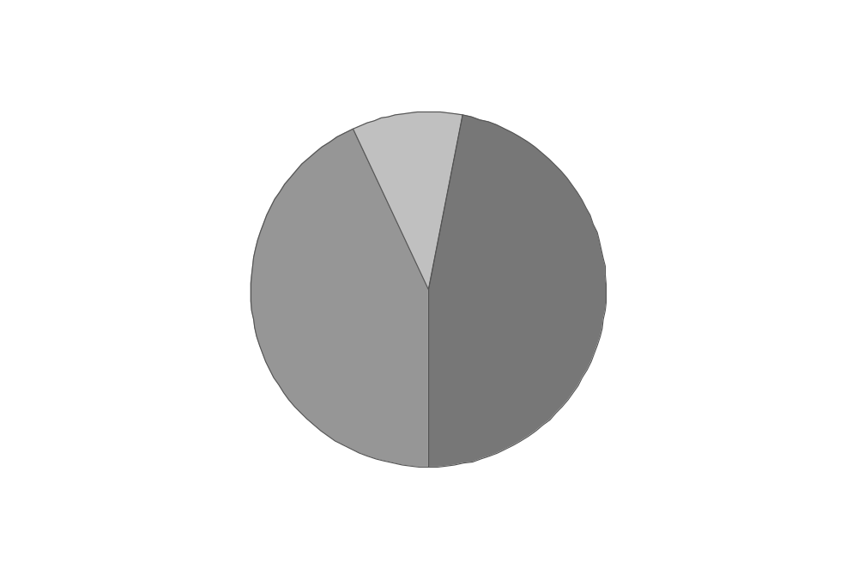
Plurality Voting: Problems
OK when there are just two candidates, but breaks down with more than two.
Voting for third party candidate is likely to be contrary to voter’s interest.
Voters are forced to choose the “lesser of
two evils”
Notes:
If you have several points, steps, or key ideas use multiple slides. Determine if your audience is to understand a new idea, learn a process, or receive greater depth to a familiar concept. Back up each point with adequate explanation. As appropriate, supplement your presentation with technical support data in hard copy or on disc, e-mail, or the Internet. Develop each point adequately to communicate with your audience.

Slide 5
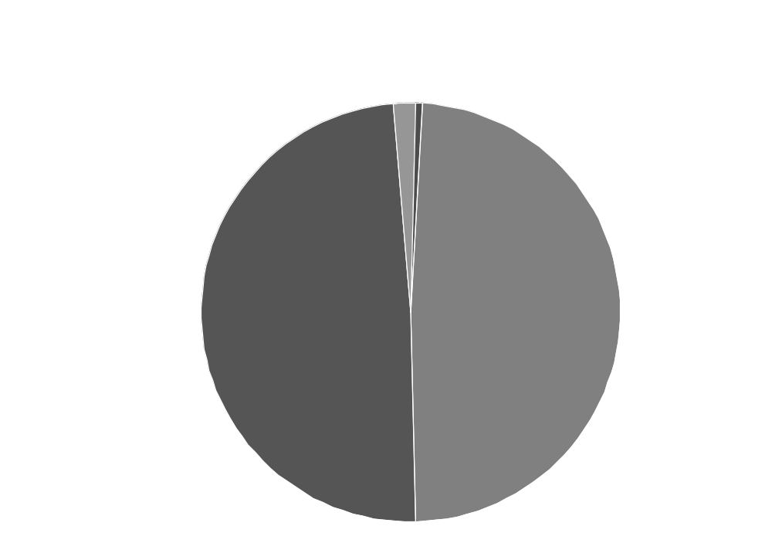
Florida, 2000

Slide 6
Plurality Voting: Problems
The two-party duopoly is perpetuated.
Third parties are ignored. Their ideas are not discussed.
The true level of support for third parties and their ideas is hard to measure.
Notes:
If you have several points, steps, or key ideas use multiple slides. Determine if your audience is to understand a new idea, learn a process, or receive greater depth to a familiar concept. Back up each point with adequate explanation. As appropriate, supplement your presentation with technical support data in hard copy or on disc, e-mail, or the Internet. Develop each point adequately to communicate with your audience.

Slide 7
Plurality Voting: Problems
Similar candidates “split the vote” and hurt their common interest.
Thus, the hostility of the Democratic party toward Nader, for example.
In order to have a chance of winning, politicians are forced to work within one of the two major parties – even if their values don’t match well their chosen party.
Notes:
If you have several points, steps, or key ideas use multiple slides. Determine if your audience is to understand a new idea, learn a process, or receive greater depth to a familiar concept. Back up each point with adequate explanation. As appropriate, supplement your presentation with technical support data in hard copy or on disc, e-mail, or the Internet. Develop each point adequately to communicate with your audience.

Slide 8
Plurality Voting: Problems
Straight plurality can elect a “fanatical” candidate.
Runoff elections alleviate the problem, but are expensive, and may not choose the best mainstream candidate.
Jospin – socialist, Prime Minister
Chiraq – corruption scandals while mayor of Paris
Le Pen – anti-Semitic, xenophobe
Notes:
If you have several points, steps, or key ideas use multiple slides. Determine if your audience is to understand a new idea, learn a process, or receive greater depth to a familiar concept. Back up each point with adequate explanation. As appropriate, supplement your presentation with technical support data in hard copy or on disc, e-mail, or the Internet. Develop each point adequately to communicate with your audience.

Slide 9


Plurality Voting: Problems
“Vote for a Crook, not a Fascist!”
Notes:
If you have several points, steps, or key ideas use multiple slides. Determine if your audience is to understand a new idea, learn a process, or receive greater depth to a familiar concept. Back up each point with adequate explanation. As appropriate, supplement your presentation with technical support data in hard copy or on disc, e-mail, or the Internet. Develop each point adequately to communicate with your audience.

Slide 10
Score Voting a.k.a. Range Voting or the Point System
Voters give each candidate a score in the range 0 to 10 (say).
The candidate with the highest average score wins.
Treasurer
0 1 2 3 4 5 6 7 8 9 10
Demi Cratt O O O O O O O O O O O
Rhea Publican O O O O O O O O O O O
Ima Green O O O O O O O O O O O
Lee Bertarian O O O O O O O O O O O

Slide 11
Score Voting
How people might have voted in 2004
Republican: Bush=10, Peroutka=2, Badnarik=2, others=0
Democrat: Kerry=10, Nader=2, others=0
“Anyone but Bush” Green: Cobb=10, Nader=9, Kerry=9, Bush=0, others=?
“Sincere” Green: Cobb=10, Nader=8, Kerry=1, Bush=0, others=?
Jan: Badnarik=10, Cobb=9, Nader=9, Peroutka=5? Brown=2? Kerry=1, Bush=0

Slide 12
Score Voting: + and –
++ FAMILIARITY: Practically everyone has filled in feedback forms where you rate something on a scale of 0 to 5.
++ FAMILIARITY: People are familiar with Olympic scoring which is similar.
++ FAMILIARITY: People are familiar with the idea of scores used in schools.

Slide 13
Score Voting: + and -
+++++ Solves pretty much all the problems with plurality voting.
+++ In particular, there is NEVER any reason NOT to give the highest score to your favorite candidate.
+++ Alternative parties are not squeezed out – alternative viewpoints would be more widely discussed.

Slide 14
Score Voting: + and -
++ Easy and cheap to implement: can be handled by existing voting equipment.
+ Expressive: With ranked voting, does the vote Cobb>Kerry>Bush mean that the voter likes Kerry a lot or just a little better than Bush? Voters who want to vote sincerely can express their true opinions of all the candidates.

Slide 15
Score Voting: + and -
- “Most voters will vote 0’s and 10’s, so why bother with the other scores?”
- Dilemma for strategic voters when there are three close frontrunners. Do you give the lesser-evil candidate a high score or a low score?
- Approval Voting and Plurality Voting are simpler.

Slide 16
Score Voting: A couple versions
Blanks count as zeros
  Simplest and “safest”
Blanks don’t count in average
  Doesn’t penalize candidates who are not well-known by voters.
  In practice, this version is more complicated in several ways. A detailed discussion would take AT LEAST 10 minutes. So, avoid discussion of this option when time is limited, and focus on the blanks-as-zeros version.

Slide 17
Approval Voting
Vote 0 (disapprove) or 1 (approve) for each candidate.
Whoever gets the highest average score wins.
Treasurer
Vote 1 or 0 for each: 1 0
Demi Cratt O O
Rhea Publican O O
Ima Green O O
Lee Bertarian O O
Notes:
If you have several points, steps, or key ideas use multiple slides. Determine if your audience is to understand a new idea, learn a process, or receive greater depth to a familiar concept. Back up each point with adequate explanation. As appropriate, supplement your presentation with technical support data in hard copy or on disc, e-mail, or the Internet. Develop each point adequately to communicate with your audience.

Slide 18
Approval Voting
Vote for as many candidates as you “approve” of.
Whoever gets the most votes wins.
“Plurality done right”
Treasurer
Choose one or more :
Demi Cratt O
Rhea Publican O
Ima Green O
Lee Bertarian O
Notes:
If you have several points, steps, or key ideas use multiple slides. Determine if your audience is to understand a new idea, learn a process, or receive greater depth to a familiar concept. Back up each point with adequate explanation. As appropriate, supplement your presentation with technical support data in hard copy or on disc, e-mail, or the Internet. Develop each point adequately to communicate with your audience.

Slide 19
Approval Voting: + and -
+++ Easy to understand.
+++ Easy to change from Plurality to Approval.
+++ Avoids almost all of the problems with Plurality.
Third party supporters must decide when to drop support for major party.
Other voting systems can give more information about voter preferences.
Notes:
Determine the best close for your audience and your presentation. Close with a summary; offer options; recommend a strategy; suggest a plan; set a goal. Keep your focus throughout your presentation, and you will more likely achieve your purpose.

Slide 20
Majority Defeat Disqualification Approval (MDDA)
Solves the three-frontrunner dilemma with Score and Approval voting
Rank only the candidates you approve of 1st, 2nd, 3rd… (Ties are allowed)
Treasurer
1st 2nd 3rd 4th
Demi Cratt O O O O
Rhea Publican O O O O
Ima Green O O O O
Lee Bertarian O O O O

Slide 21
MDDA
Candidates who are ranked lower than other candidates on a majority of ballots are disqualified (unless all are disqualified, then none are disqualified)
Among the candidates who are not defeated by a majority, the one who is ranked on the most ballots (highest Approval) wins.

Slide 22
MDDA: + and -
+++ Never an incentive to “betray one’s favorite” – unlike IRV
+ Some people prefer ranking-based methods to ratings-based methods
- New, not well known

Slide 23
How MDDA solves
3-frontrunners dilemma
Suppose Left, Middle and Right are about equally approved.
34 Leftist voters vote Left>Middle
32 Centrist voters vote Middle>their-2nd-choice
34 Rightist voters vote Right>Middle

Slide 24
How MDDA solves
3-frontrunners dilemma
Suppose Left, Middle and Right are about equally approved.
34 Leftist voters vote Left>Middle
32 Centrist voters vote Middle>their-2nd-choice
34 Rightist voters vote Right>Middle

Slide 25
Condorcet Voting
Rank the candidates 1, 2, 3…
Winner is chosen by round-robin tournament.
Treasurer
1st 2nd 3rd 4th
Demi Cratt O O O O
Rhea Publican O O O O
Ima Green O O O O
Lee Bertarian O O O O

Slide 26
Counting Condorcet Ballots
35 A>B>C
25 B>A>C
40 C>B>A
 | a | b | c
A |  | 35 | 35 +25
B | 25 +40 |  | 35 +25
C | 40 | 40

Slide 27
Condorcet Voting: + and -
+++ “Fanatic” candidate can’t win.
+++ More info about voter preferences is available than for Plurality or Approval.
- Voters may still feel compelled to rank major party candidate first (lesser of two evils)
- Voting is simple, but counting method is somewhat complicated in the details.
- Relatively unknown, no track record.

Slide 28
IRV Problems
40 Left>Middle
25 Middle>Right
35 Right>Middle
Middle is eliminated and Right Wins
Problem: 40 Left + 25 Middle = 60 voters who preferred Middle to the winner!
Problem: the Left>Middle voters have an incentive to vote Middle>Left, thus sending false messages about true preferences.
Note that Australia has used IRV for 80 years and still has 2-party domination.

Slide 29
Instant Runoff Voting (IRV)
Rank the candidates 1, 2, 3…
Eliminate candidate with fewest votes, redistribute ballots, until one candidate has a majority.
Treasurer
1st 2nd 3rd 4th
Demi Cratt O O O O
Rhea Publican O O O O
Ima Green O O O O
Lee Bertarian O O O O

Slide 30
Instant Runoff Voting: + and -
+++ “Fanatic” candidate can’t win.
+++ More voter preference info available than for Plurality or Approval
+ Easy to vote, fairly easy to understand counting.
O Track record: Used in Australia, etc.
-- Voters feel compelled to choose “lesser of two evils”. Australia still has two major parties.

Slide 31
How many lives could have been/could be saved by a better voting method?
See CRV web page for details
Vietnam war – 1,000,000
The second US-Iraq War – 50,000
Antibiotics in animal feeds – 1 billion

Slide 32
How to get better voting methods into use
Get third party support.
Develop a movement! Spread the word! Use Score Voting or Approval Voting in your own organizations!
Get the Democrat and Republican parties to use Score Voting for their internal elections.

Slide 33
Third party support
Third parties are hurt the most by Plurality voting, therefore third parties should be most enthusiastic promoters of better methods.
Unite around Score Voting, since it gives greatest advantage to smaller parties compared with other methods.
Include voting reform in all third party platforms.
Use Score Voting (or Approval if simplicity and ease of counting is most important) for party internal elections – lead by example, practice what we preach.

Slide 34
2004 Exit poll study using Plurality, Approval, and Score Voting
Candidate | Plurality % | Approval % | Avg. Score 0-100
Bush | 50.7 | 39 | 40
Kerry | 48.3 | 61 | 55
Nader | 0.38 | 21 | 25
Badnarik | 0.32 | 0.6 | 9
Cobb | 0.10 | 2 | 5
Peroutka | 0.12 | 1 | 6

Slide 35
Iowa ‘08
Score Voting can help choose better candidates in PRIMARY ELECTIONS – candidates with broader appeal inside and outside the party.
More appealing candidates -> better chance of winning in general election.
Therefore, it’s in the Democrat and Republican parties’ own best interests to use Score Voting in their candidate selection process.
Focus on Iowa ’08 – the nation will be watching. Free publicity for this “new” voting method.

Slide 36
Ways to Help
Get informed. Visit the Center for Range Voting website, learn about Range Voting (= Score Voting), Approval Voting and other methods.
Give us your endorsement – fast and easy, but very important!
Help develop outreach materials. Help improve the website. Help with research.
Spread the word!

Slide 37
Conclusions
Several alternative voting systems are available that are superior to Plurality.
Ballot and voting procedures are easy to understand.
Lesser of two evil problem can be alleviated.
Wider realistic choice of candidates available to voters.
Wider range of IMPORTANT issues discussed in campaigns.
LEND A HAND! LET’S GET MOVING!

Slide 38

http://www.mediarebellion.com/i/hosted/cobra/Chthu%205.jpg

