Slide 1
A Comparison of America’s Large Cities In Terms of Access to Ethnic Foods
IBM Applied Data Science Capstone
Fereshteh Bashiri

Slide 2
Introduction
Food is not just nutrients; it is a simple way to bring back memories and make people feel good. It is also a way for immigrants to connect with local residents.
By looking at some major US cities, which were prominent destinations for many immigrants, we are interested in finding out:
Whether a specific city had been a significant destination for people of a particular ethnicity?
Is there any tentative business opportunities for investors in the food and restaurant industry?

Slide 3
Interested Audience
This project is in the interest of two groups:
Historians and social science research communities who are interested in the impact of immigration on American societies
Business investors and entrepreneurs who are interested in the establishment of a new ethnic chain restaurant

Slide 4
Data
Given a list of cities of interest in the US:
Nominatim geolocator to obtain latitude/longitude of each city;
Foursquare API to obtain a list of restaurants in downtown area of each city.
*Note: Free version of Foursquare API will provide 100 venues per request, which I think is enough for the purpose of this project.

Slide 5
Data Pre-processing
It contains:
Collecting data;
Removing irrelevant rows of data in which the term “Restaurant” (as an indicator of ethnic food) is not used;
Reorganizing the filtered data into by creating dummy variables from all unique venue categories and computing the frequency of having them in each city.
Summary of the data after pre-processing:
851 venues in 61 unique categories!

Slide 6
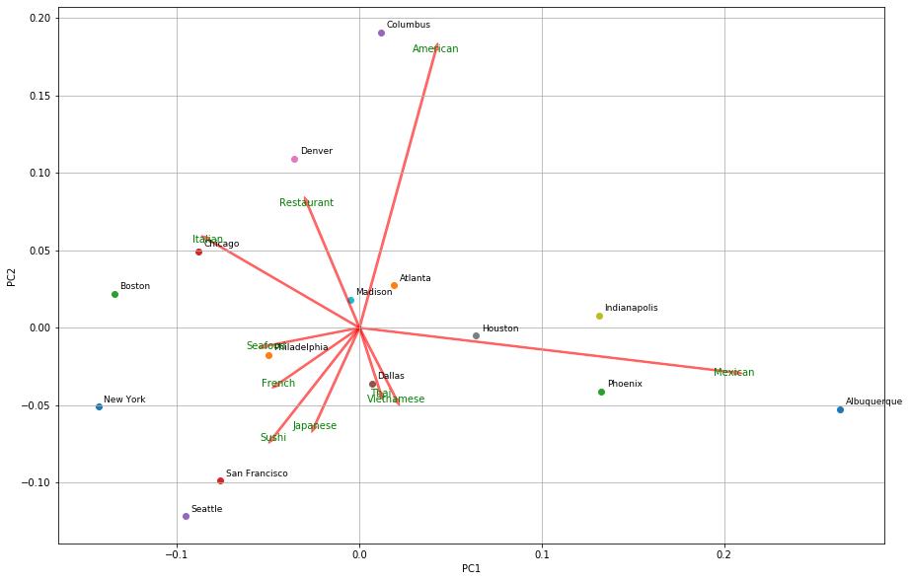
Data Analysis
Data visualization using PCA
A Biplot illustrating:
PC scores and PC loading vectors

Slide 7
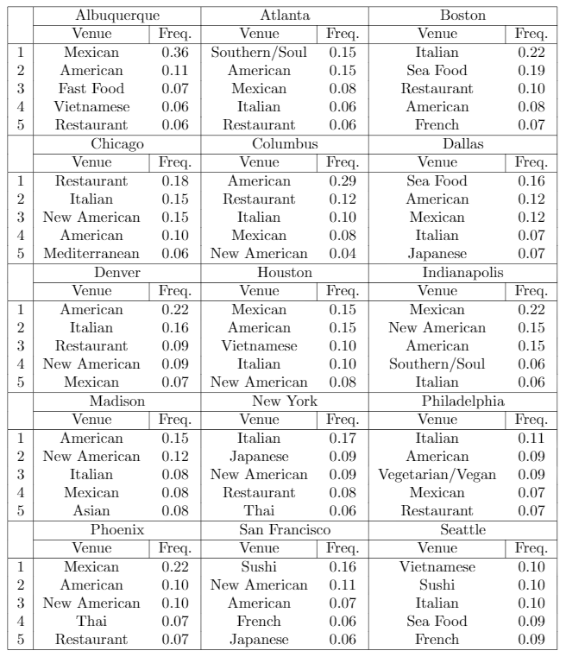
Data Analysis
Analyzing each city separately:
Top 5 venues and their frequency
Observation:
1 in every 3 restaurants in downtown Albuquerque is serving Mexican food!

Slide 8
Data Analysis
 | rank 1 | rank 2 | rank 3 | rank 4 | rank 5
Albuquerque | Mexican | American | Fast Food | Vietnamese | Restaurant
Atlanta | Southern / Soul | American | Mexican | Italian | Restaurant
Boston | Italian | Seafood | Restaurant | American | French
Chicago | Restaurant | Italian | New American | American | Mediterranean
Columbus | American | Restaurant | Italian | Mexican | New American
Dallas | Seafood | American | Mexican | Italian | Japanese
Denver | American | Italian | Restaurant | New American | Mexican
Houston | Mexican | American | Vietnamese | Italian | New American
Indianapolis | Mexican | New American | American | Southern / Soul | Italian
Madison | American | New American | Italian | Mexican | Asian
New York | Italian | Japanese | New American | Restaurant | Thai
Philadelphia | Italian | American | Vegetarian / Vegan | Mexican | Restaurant
Phoenix | Mexican | American | New American | Thai | Restaurant
San Francisco | Sushi | New American | American | French | Japanese
Seattle | Vietnamese | Sushi | Italian | Seafood | French
Top 5 categories per each city in a view

Slide 9
Data Analysis
Clustering using K-Means
Euclidean similarity metric
K cluster = 4
Cluster 0 | Cluster 1 | Cluster 2 | Cluster 3
Columbus | Atlanta | Boston | Albuquerque
Denver | Dallas | Chicago | Houston
- | Madison | New York | Indianapolis
- | Philadelphia | San Francisco | Phoenix
- | - | Seattle | -

Slide 10
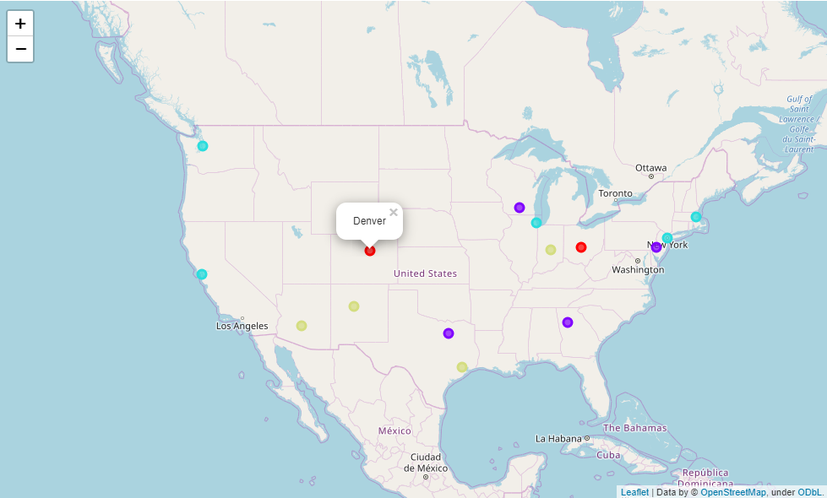
Data Analysis
Observation of clusters on a map of the US

Slide 11
Results and Discussion
The biplot figure of PCA:
First and second loading vectors place a high weight on Mexican and American restaurants, respectively.
Houston, Indianapolis, Phoenix and Albuquerque are spread along the first PC, in compliant with the clustering results using K-Mean in which they are also clustered in a same group
We can trace back immigration of Italians to the US between 1880 to 1920, as they settled down in major industrial cities, by looking at the popularity of Italian food in the east coast including Boston, New York, Philadelphia, and Chicago

Slide 12
Results and Discussion
Popularity of different cuisines:
East coast: Italian food
West coast: Sea food and east Asian cuisines
Central US: American food
Business opportunity:
Indian food!
* While Indian-Asian ethnic is one of the fastest growing ethnics in the US, we observed only 11 Indian restaurants (1.3% of the total filtered data) within downtown area of 15 major US cities!

Slide 13
Conclusion and Future Directions
Python and Machine Learning are very useful tools for digging into data and solving real-world problems.
Accepting immigrants into the US has provided a unique opportunity. People easily get exposed to a variety of ethnic foods.
Future direction:
Using a list of all neighborhoods of each city to investigate which neighborhoods are justifiable for investing in our business idea

