Slide 1
Solana Validator Score
Draft Review of 6 tables, key outliers, and available metrics.

Slide 2
Available Tables
Historical | Snapshot | Explainer
Stake Account | Stake Accounts | For each Epoch, a Stake Public Key (not validator?) has an Active Stake (and Active SOL) balances, that change while active and delegated.
Vote Account | Vote Accounts
Validator App Data | Validators App Data

Slide 3
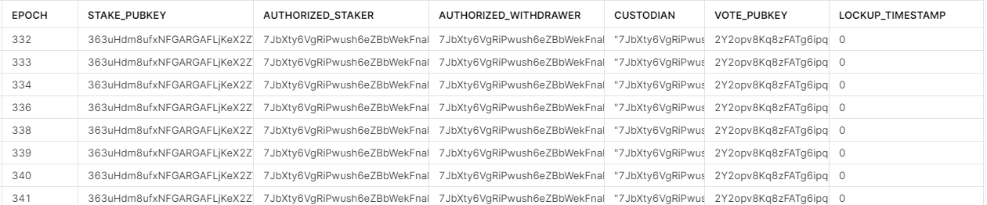
Stake Accounts Variables
Column | Description | Potential Use in Metric?
Epoch | Epochs are 1-2 days | This acts as time for metrics
Stake pubkey | Identifier for a single staker? | Unique ID for a validator in an epoch
Authorized staker | Account that signs delegate/deactivate tx | “Simplicity” (1 staker)
Authorized withdrawer | Account that signs withdrawals | “Simplicity” (1 withdrawer)
Lockup | Details on when SOL can be withdrawn [custodian, epoch, timestamp] | “Simplicity” (1 custodian) “Locked” (timestamp in future)
Vote pubkey | Public key for vote account w/ stake delegated | ID for linking to Vote Account table
Stake Public Key is matched to {staker, withdrawer, custodian, voter} keys in each epoch

Slide 4
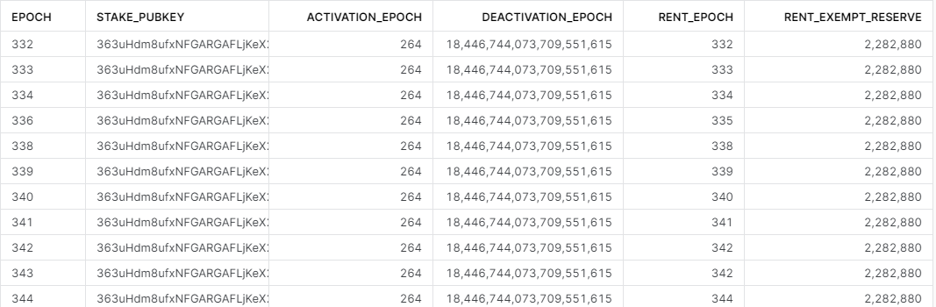
Stake Accounts Variables
Column | Description | Potential Use in Metric?
Epoch | Epochs are 1-2 days | This acts as time for metrics
Stake pubkey | Identifier for a single staker | Unique ID for a validator in an epoch
Activation Epoch | First epoch | Early Validator (percentile)
Deactivation epoch | Planned deactivation | Deprecation planned (deactivation is not max value 18446744073709551615 OR past deactivation
Rent epoch | Expected future epoch where rent owed | N/A (required to be exempt, unless actively deactivating) – a few exceptions found
Rent Exempt Reserve | Programs pay rent for data/memory, hold enough and you don’t need to pay. | “Above & Beyond” – holds more than minimum (2,282,880) (~547 hold 12x min, not sure why)
Stake Public Key have an activated epoch, planned deactivation, and may have to pay rent (unless exempt)

Slide 5
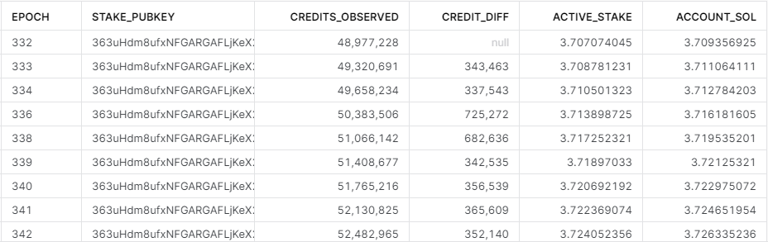
Stake Accounts Variables
Column | Description | Potential Use in Metric?
Epoch | Epochs are 1-2 days | This acts as time for metrics
Stake pubkey | Identifier for a single validator | Unique ID for a validator in an epoch
Credits Observed | Credits accumulated for staking rewards via voting | Consistency Score – good validators have less variance in credits b/c they are consistent
Active stake | Amount of SOL actively in stake | Decreasing vs increasing?
Account sol | SOL held by the account | Account Sol / Active Stake % (should this be >1.00?)
Stake Public Key, through voting, earn Credits. (Proportionally?) they accumulate SOL that is staked.

Slide 6
Stake Accounts Variables
Column | Description | Potential Use in Metric?
Epoch | Epochs are 1-2 days | This acts as time for metrics
Authorized staker | Account that signs delegate/deactivate tx | “Simplicity” (1 staker)
Authorized withdrawer | Account that signs withdrawals | “Simplicity” (1 withdrawer)
Lockup | Details on when SOL can be withdrawn [custodian, epoch, timestamp] | “Simplicity” (1 custodian) “Locked” (timestamp in future)
Rent Exempt Reserve | Programs pay rent for data/memory, hold enough and you don’t need to pay. | “Above & Beyond” – holds more than minimum (2,282,880) (~547 hold 12x min, not sure why)
Credits Observed | Credits accumulated for staking rewards via voting | Consistency Score – good validators have less variance in credits b/c they are consistent
Activation Epoch | First epoch | Early Validator (percentile)
Deactivation epoch | Planned deactivation | Deprecation planned (deactivation is not max value 18446744073709551615 OR past deactivation
Active stake | Amount of SOL actively in stake | Decreasing vs increasing?
Vote pubkey | Public key for vote account w/ stake delegated | ID for linking to Vote Account table
Warmup/cooldown rate | Rate to activate or deactivate stake | N/A
Type Stake | Uninitialized, delegated, initialized, null | Filter this to delegated
Program | Stake/null | Ignore nulls
Account sol | SOL held by the account | Account Soul / Active Stake % (should this be above 1.00?)
Rent epoch | Expected future epoch where rent owed | N/A (required to be exempt, unless actively deactivating) – a few exceptions found
Stake pubkey | Identifier for a single validator | Unique ID for a validator in an epoch

Slide 7
Example “Simple” Staker at Epoch 431
Stake Pubkey: 363uHdm8ufxNFGARGAFLjKeX2ZVaNwyoWXr3SLxTkGTG
Authorized Staker: 7JbXty6VgRiPwush6eZBbWekFnaR3JATGP6Lz8NEy243
Authorized Withdrawer: 7JbXty6VgRiPwush6eZBbWekFnaR3JATGP6Lz8NEy243
Custodian: 7JbXty6VgRiPwush6eZBbWekFnaR3JATGP6Lz8NEy243
Not always self, sometimes 1111….11111 or other special account.
“Simple” = 1 staker, 1 withdrawer, 1 custodian.
“Self” = staker, withdrawer, custodian are all the same.
Vote Pubkey: 2Y2opv8Kq8zFATg6ipqb2AjgCf18tkv1CLMLXQGif2NH
Activated Epoch: 264
“OG” status
Deactivation Epoch: 18446744073709551615 (Max)

Slide 8
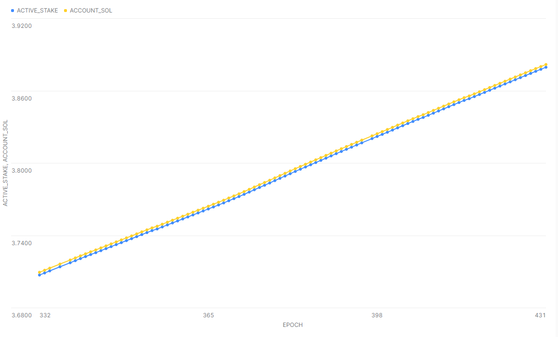
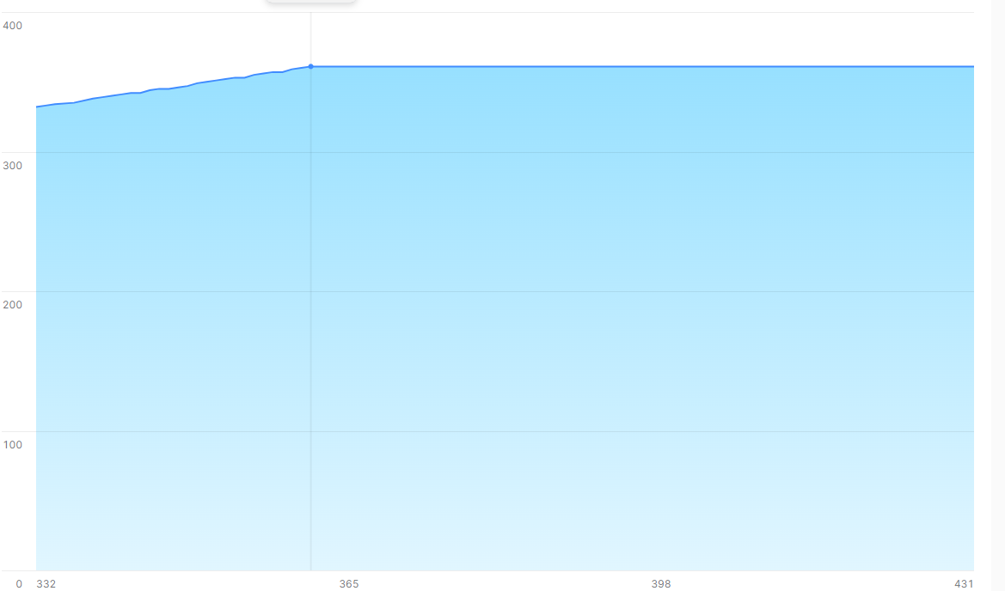
Example “Simple” Staker
Active Stake & Account Sol & Credits goes up over time
Rent Epoch follows epoch, until epoch 361.
Q– this staker owes rent? How do we identify rent paid?
Does data simply not include rent payments & rent-payer (authorized withdrawer)?

Slide 9
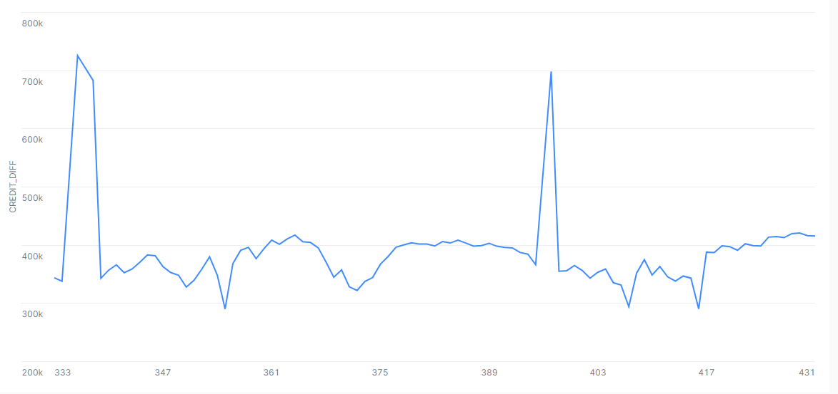
Example “Simple” Staker
Credit grows over time, (spikes are missing epochs)
Not consistent per epoch, can fluctuate (is lower variance better?)

Slide 10
Example “Complex” Staker at Epoch 431
Stake Pubkey: EyQBSZzbUV2p1QZTUGPvbgGFrgRWSucGxm7GuW7Bv8un
Authorized Staker:
Before epoch 397: 6hpMTcU76pCkSZHG1qdfw8ZrM9rFwFCpmKZWqBc5VXr3
epoch 397 & 398: n6Sqjg44X4JqbZYARSpLg2Qdd78PbGopeRX2cKxwzJm
Epoch 399-431: AKKH8ak4kc44CTo9x33cErfQ14ZYJc9sb9TieGmyynS4
Authorized Withdrawer (match & changes with staker in each epoch range)
Custodian: 11111111111111111111111111111111
“Complex” = 3 staker, 3 withdrawer, 2 vote pubkey, 1 custodian.
Vote Pubkey: switches starting epoch 397
J9Go27V87fCdJtjMxmFJu48ctrHzFoe6xQpA6Ecq4Wkw
J8xfTV9UVS1cdaZj4toDd5Q1kgJ41buq19YDB3xH77AU
Q- can we identify if de-activated 396? No cooldown?
Activated Epoch: 196
“OG” status
Deactivation Epoch: 18446744073709551615 (Max)

Slide 11
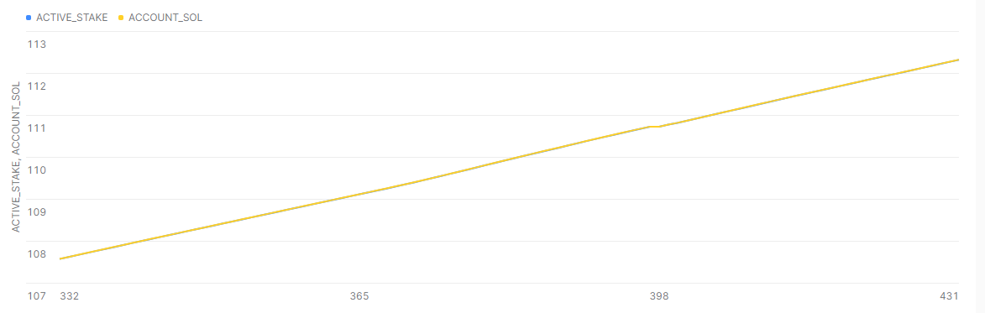
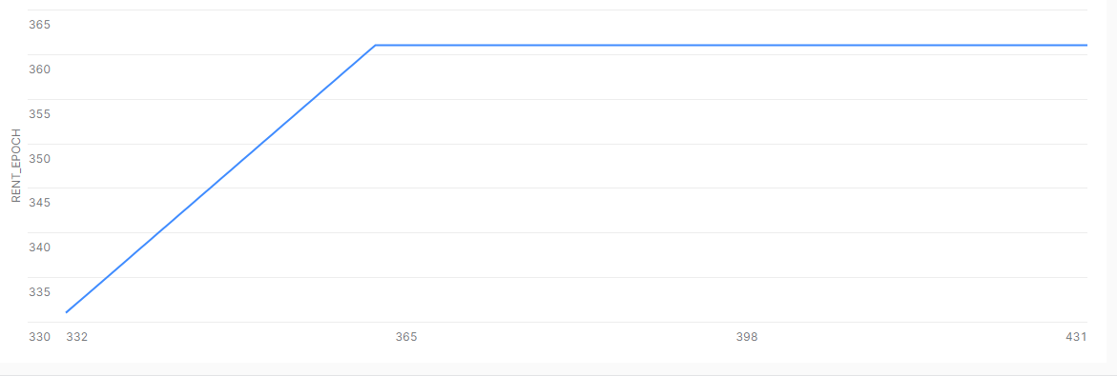
Example “Complex” Staker
Active Stake & Account Sol goes up over time
Rent Epoch follows epoch, until epoch 361. (same as simple curiously…)
Q– this staker owes rent? How do we identify rent paid?

Slide 12
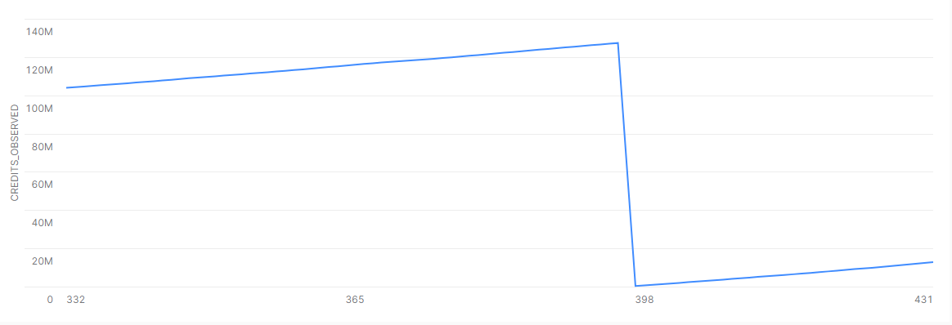
Example “Complex” Staker
Credit grows over time except for the swap around epoch 396 (switches)
Not the same per epoch, can fluctuate (is lower variance better?)

Slide 13
Available Tables
Historical | Snapshot | Explainer
Stake Account | Stake Accounts | For each Epoch, a Stake Public Key (validator) has an Active Stake (and Active SOL) balances, that change while active and delegated.
Vote Account | Vote Accounts | A stake account VOTE_PUBKEY aligns with PUBKEY voting activity.
Validator App Data | Validators App Data

Slide 14
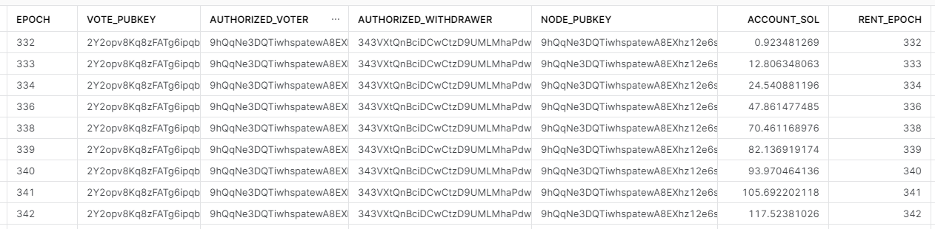
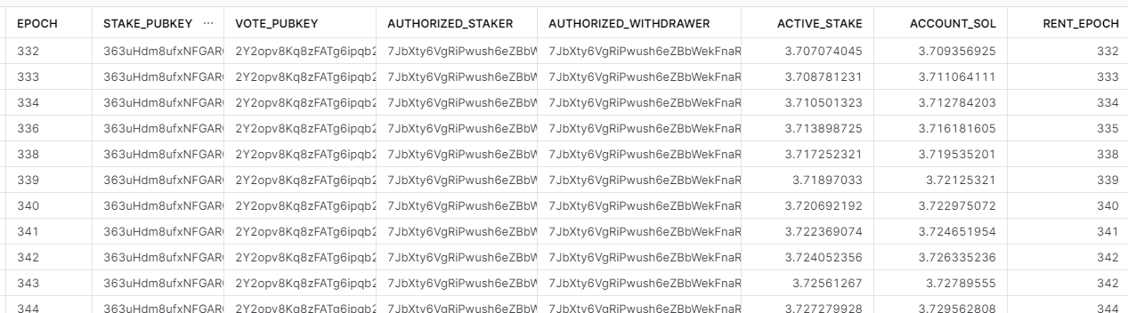
Stake Account <> Vote Account Confusion
Vote Account Data for voter 2Y2opv8K
Stake Account Data for pubkey 363uHdm
“Simple” = 1 staker, 1 withdrawer, 1 custodian.
“Self” = staker, withdrawer, custodian are all the same.

Slide 15
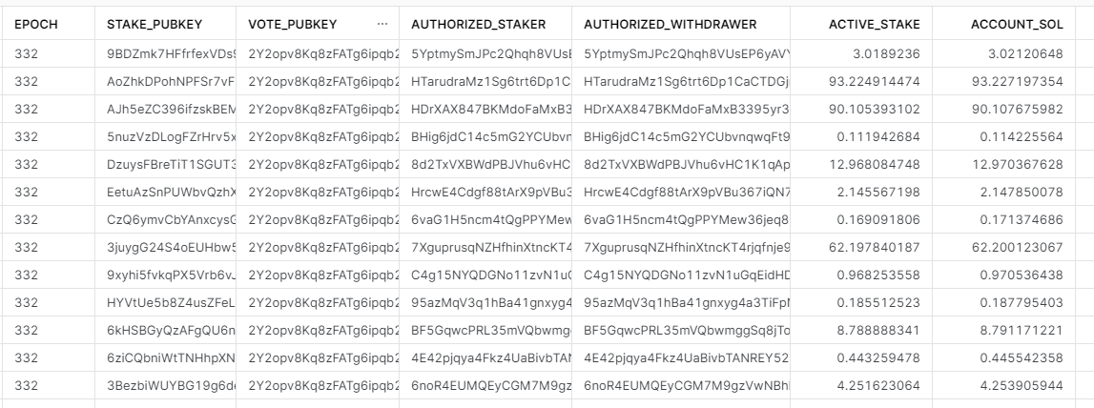
Multiple stakers to single vote_pubkey
Vote Account Data for voter 2Y2opv8K
Unique Voter/Withdrawer/Node_Pubkey for voter 2Y2… Only 1 of them !?
Vote pubkey not tied back to all stake_pubkey
Stake Account Data for voter 2Y2opv8K
Stake Account Data for voter 2Y2opv8K

Slide 16
Voter 2Y2opv8K has only 1 [node pubkey, authorized voter, authorized withdrawer] in vote account data
Stake Account Data for voter 2Y2opv8K
If VOTER is the validator, and stake_pubkeys are delegators to validator. Should we use only stake account data?

Slide 17
Stake Account vs Vote Account
Using stake data at epoch 334, summarize at the vote_pubkey level (i.e., combine all the stakers)
Using vote data (1 node_pubkey)

Slide 18
Available Tables
Historical | Snapshot | Explainer
Stake Account | Stake Accounts | For each Epoch, a Stake Public Key (validator) has an Active Stake (and Active SOL) balances, that change while active and delegated.
Vote Account | Vote Accounts | A stake account VOTE_PUBKEY aligns with PUBKEY voting activity.
Validator App Data | Validators App Data | A vote_pubkey aligns to a node_pubkey which operates from a location, running a software version, etc.

Slide 19
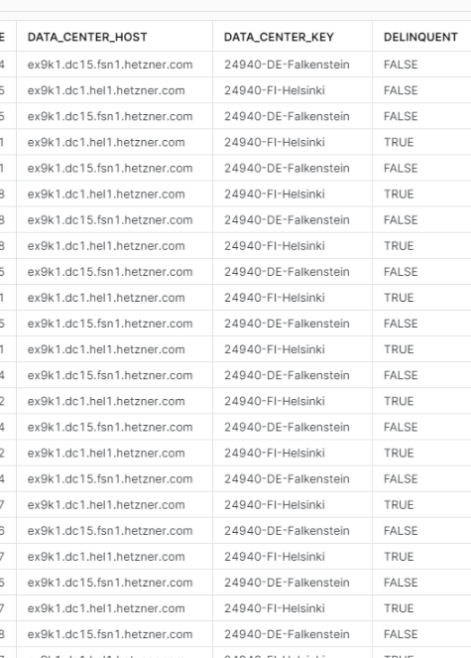
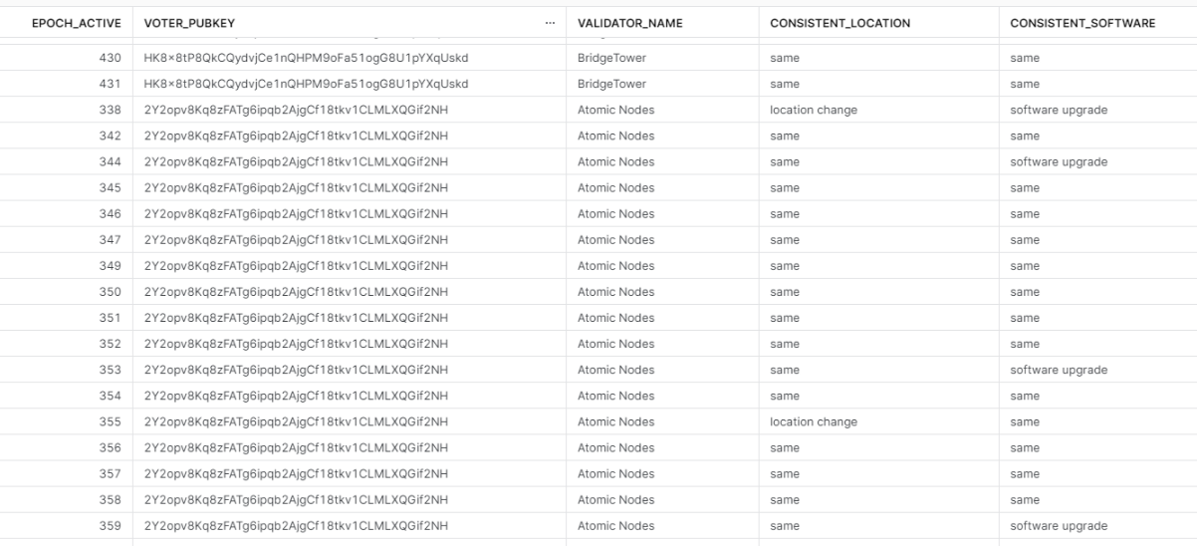
What is Delinquent?

Slide 20
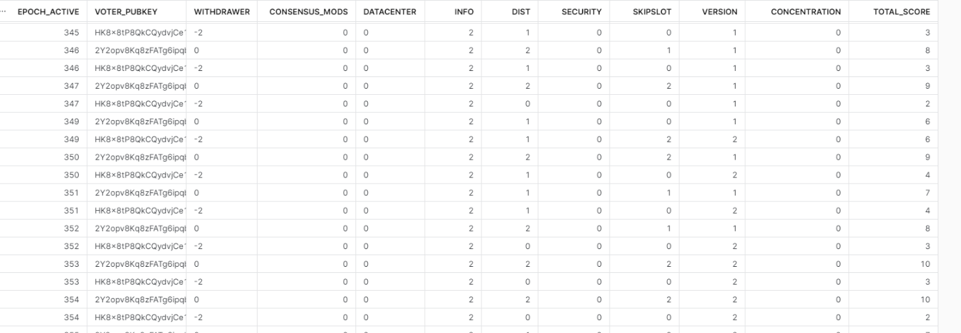
How are scores derived?
Which are fastest highest value changes voters can make to improve?

