Slide 1
Draft Metrics Visuals
Solana Validator Score

Slide 2
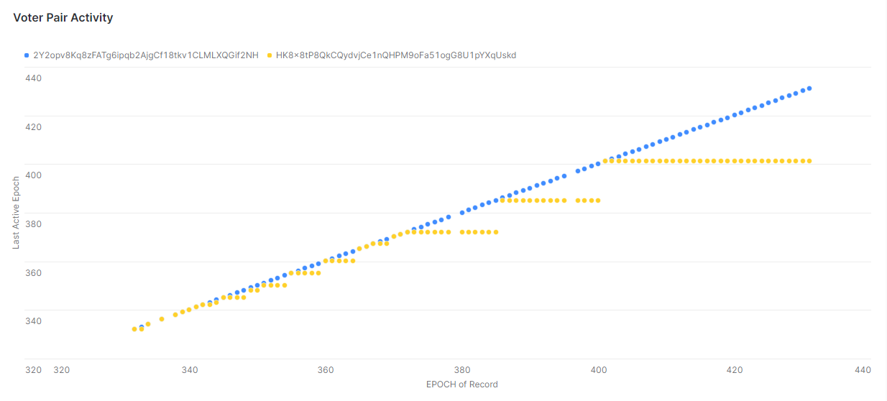
2 Voter Activity Chart (epochs 332 – 431)
diagonal = active in recorded epoch
straight = deactivated in recorded epoch
data: historic vote account from foundation

Slide 3
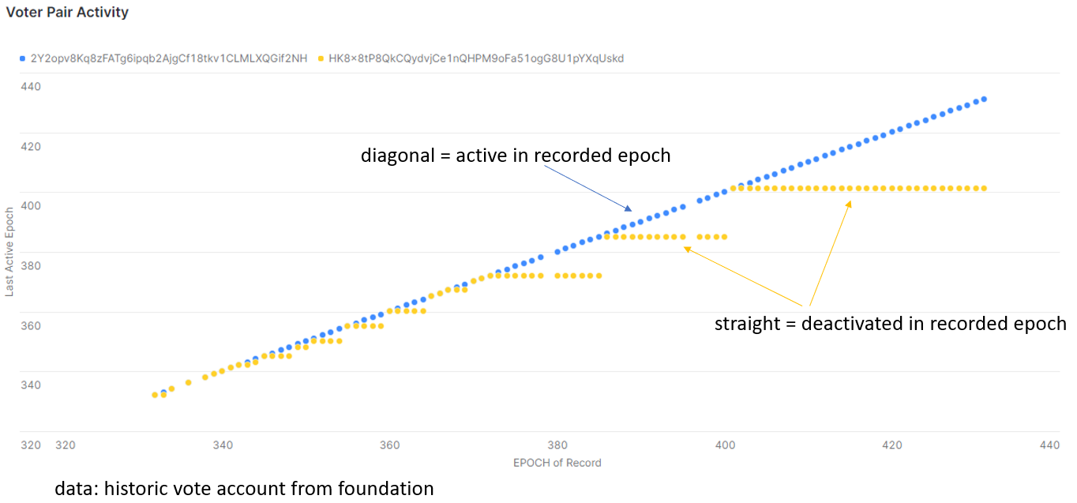
Potential Metrics from Activity Chart
Validator (Voter) Age
# epochs since activation
Validator (Voter) Experience
# epochs active
Validator Lifetime Active %
Experience / Age * 100
Validator Rolling Deactivations
# Epochs missed in last 64 epochs
Validator Rolling Active %
Rolling Deactivations / 64

Slide 4
Result for 2 Voters as of Epoch 431
Metric | Voter 2Y2 | Voter HK8
First epoch* | 332 | 332
Latest epoch (to be active in) | 431 | 401
Age | 99 | 99
Experience | 96 | 18
Lifetime Active % | 96.96% | 18.18%
Epochs Active in Last 64 Epochs | 62 | 4
Active % in last 64 Epochs | 96.875% | 6.25%
Validator (Voter) Age
# epochs since activation
Validator (Voter) Experience
# epochs active
Validator Lifetime Active %
Experience / Age * 100
Validator Rolling Active
# Epochs active in last 64 epochs
Validator Rolling Active %
Rolling Active / 64
64 chosen because that is how long epoch_credits are tracked; can go lower, e.g., 10.
*Data limited to epochs 332 – 431, so age may be skewed. Based exclusively on historical vote data from foundation. Snapshot (ongoing data from Flipside RPC calls) may introduce gaps.

Slide 5
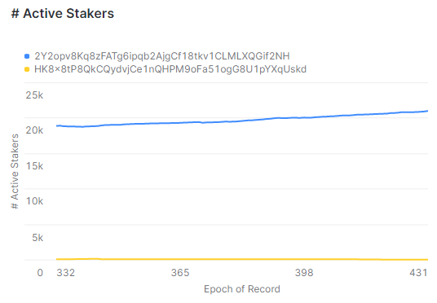
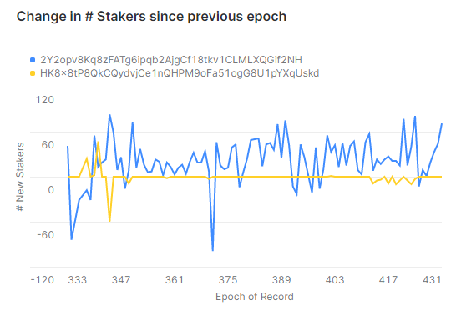
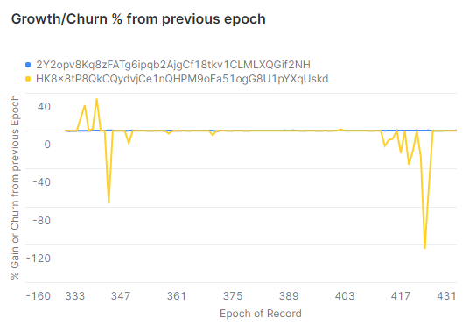
2 Voter Stakers Chart (epochs 332 – 431)
Very large differences in Stake Pubkeys staked to Voters
Raw Change interesting
Churn hurts smaller voters (1 staker big %)
data: historic stake account from foundation

Slide 6
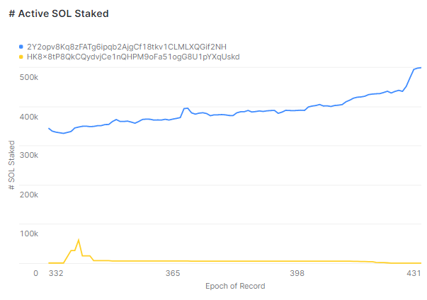
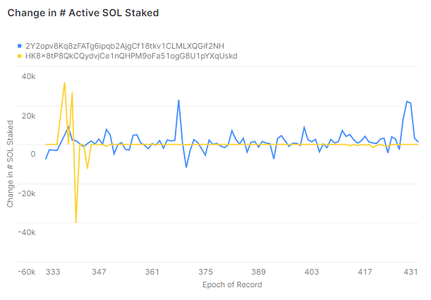
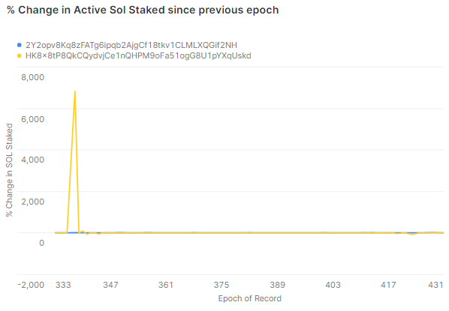
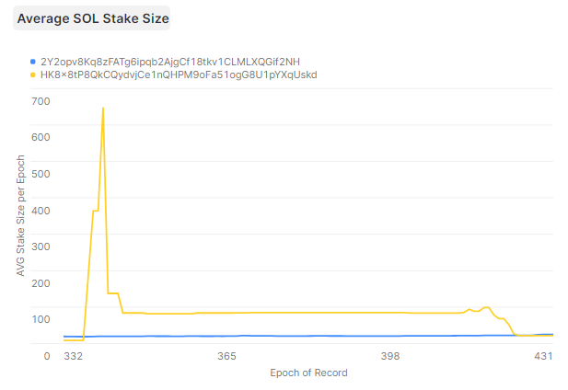
2 Voter SOL Stake Chart (epochs 332 – 431)
Very large differences in Stake Pubkeys # of Active SOL Stake
Raw Change in Sol Staked
Huge variance with smaller voters
Average SOL Stake per Staker may be interesting
data: historic stake account from foundation

Slide 7
Potential Metrics from Stakers Chart
# Active Stakers
Stake Pubkeys w/ Deactivation Epoch > Epoch of Record
Change in # Stakers since previous epoch
Growth/Churn % from previous epoch
Change in # Stakers / # Active Stakers
Hurts validators w/ smaller base (each staker big deal)
Smooth out growth/churn, but still punishes smaller validators.

Slide 8
Potential Metrics from SOL Stakes Chart
# SOL Staked
Stake Pubkeys Active Stake w/ Deactivation Epoch > Epoch of Record
Change in # SOL Staked since previous epoch
Growth/Churn % from previous epoch
Change in # SOL Stake / # SOL Stake
Helps validators w/ smaller base (each SOL is big deal)

Slide 9
Staker & Stake Result for 2 Voters Epoch 431
Metric | Voter 2Y2 | Voter HK8
# Active Stakers | 20,973 | 5
# New Stakers in Epoch | 71 | 0
Staker Growth % | 0.34% | 0%
# SOL Stake | 498,472.79 | 102.95
# New SOL Stake in Epoch | 1,150.06 | 0
SOL Stake Growth % | 0.23 | 0
AVG Sol Stake Size | 23.77 | 20.59
# Active Stakers
Stake Pubkeys w/ Deactivation Epoch > Epoch of Record
Change in # Stakers since previous epoch
Growth/Churn % from previous epoch
# SOL Stake
Change in # Sol Stake
Growth/Churn % Sol Stake
Average Sol Stake Size
*Data limited to epochs 332 – 431
Based exclusively on historical stake data from foundation. Snapshot (ongoing data from Flipside RPC calls) may introduce gaps.

Slide 10
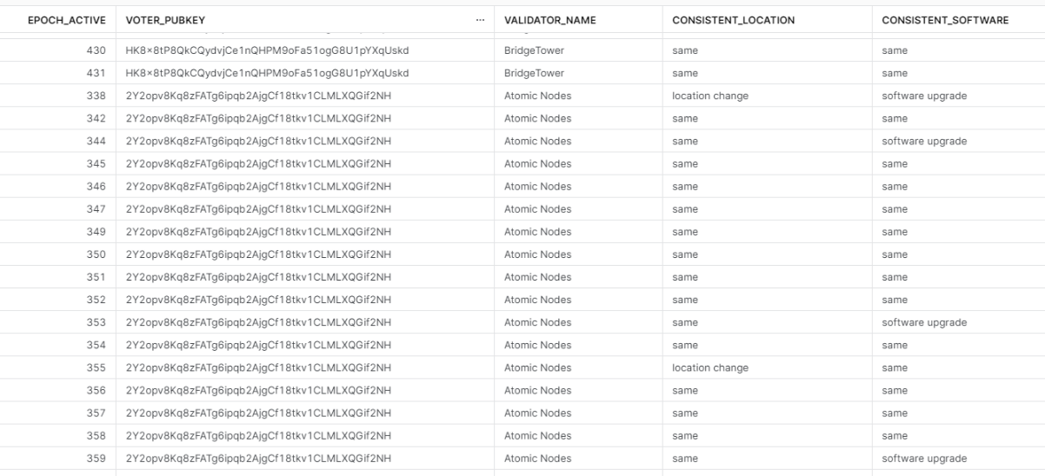
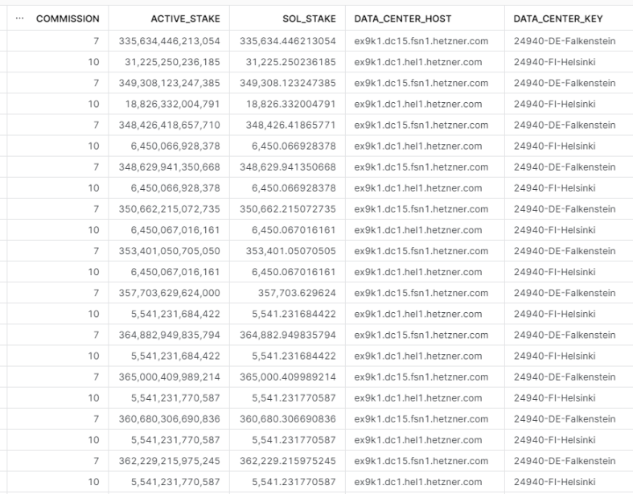
Potential Metrics from AppData Chart
Location Consistency
# Latitude changes in last 64 epochs
Software Upgrades
# Software Upgrades in last 64 epochs
Can benchmark this to others
= epoch|recommended_version ?
Commission Consistency?
Benchmark to average (non-100)

Slide 11
Voter: 2Y2opv8Kq8zFATg6ipqb2AjgCf18tkv1CLMLXQGif2NH
Epoch
431
# Sol Staked
498,472
Age (epochs)
99
Lifetime Active %
97%
Stat | Value | Detail
Software Version: | 1.13.6 | Highest Available: 1.14.7
Node Location: | France
Current Status: | Active
10-Epoch Active %: | 100% | 7.1% above average
10-Epoch Attendance* Rate %: | 97.5% | 3.3% above average
Commission Rate | 7%

