Slide 1
Game Brainstorm Session пуля // PULYA
Translates to: Bullet
A Souls-like Bullet Hell set in Post-WWI Russia

Slide 2
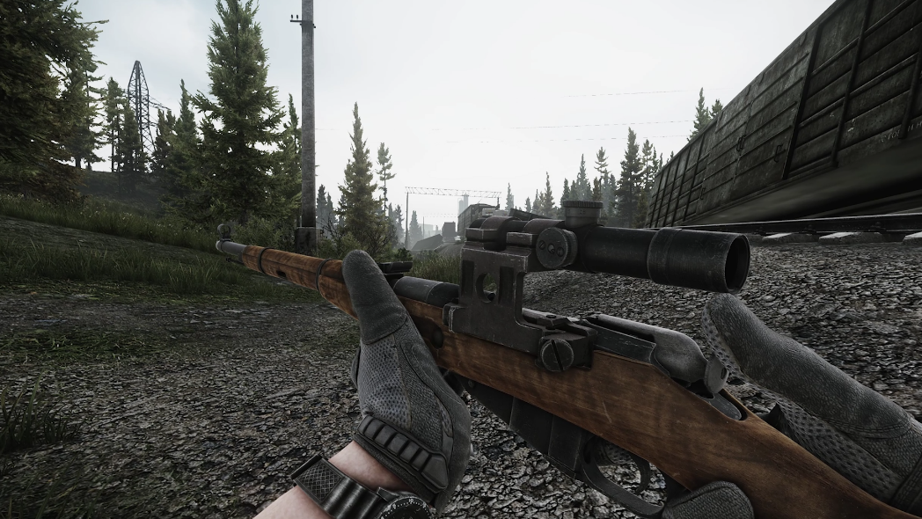
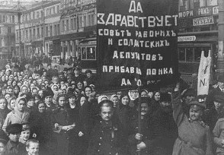
Theme
Post-WWI Russia. Quite a unique setting, as well as having limited quality guns (mainly revolvers, bolt-actions and shotguns). This adds to the difficulty of the game – which is important as it takes from Dark Souls – as the guns mostly have to be loaded bullet-by-bullet and have low capacities (around 6 shots).

Slide 3
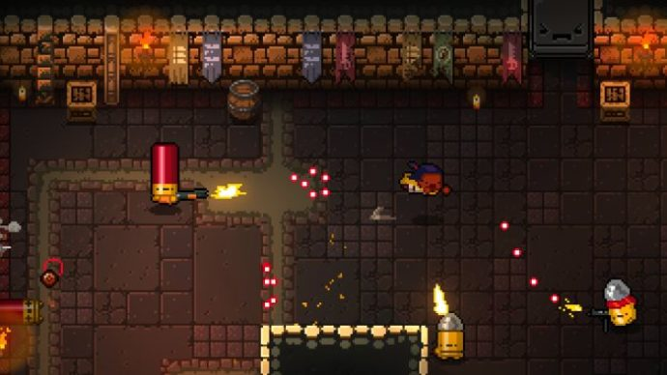
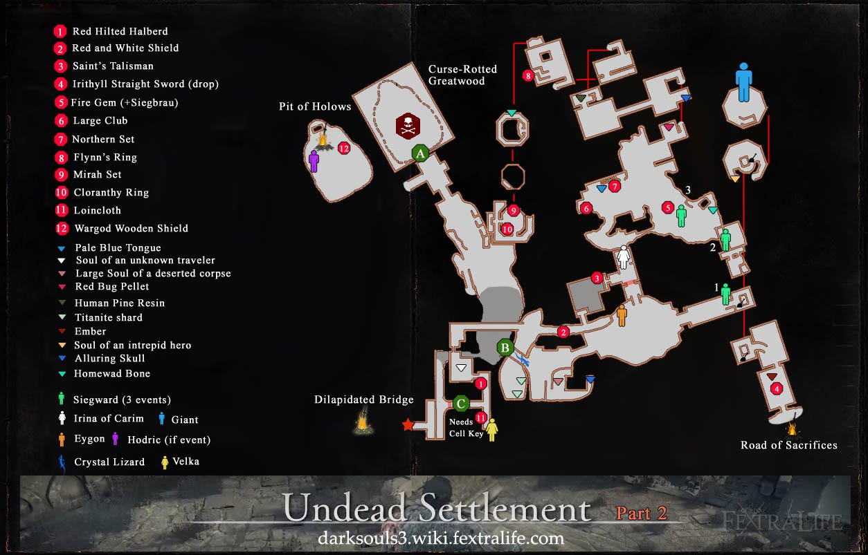
Genre
Top-down bullet hell shooter (similar to Enter the Gungeon). This is because working in 2D is easier than making a 3D game, and it will also make the gameplay loop much more manageable for the user, without having to worry about a 3 dimensional space.
Map design similar to Dark Souls, with large interconnected maps and an emphasis on exploration, and it wont be a roguelike.

Slide 4
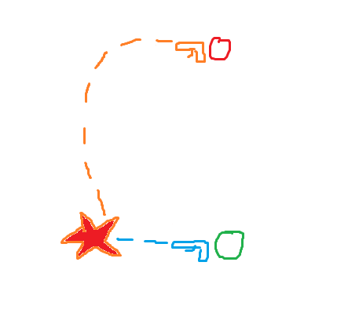
Core Gameplay Loop
Similar to other top-down shooters, draw being that you are unable to kill the enemy by just shooting them. To kill them, you need to shoot one of their bullets out of the air (a “parry” move). Then it will get sent back to them and destroy their shield/down them, allowing you to melee them for the kill
Harder enemies will arc their shot less and have a more direct path towards you (harder to hit)

