Slide 1


engine.compare
API Description
10
compare
subject vs. nominal
text streams
Dr. Frank-René Schäfer
2021y05m30d

Slide 2
engine.compare
API Description
10
Overview:
application
basic concepts (bc)
API functions
API objects

Slide 3

engine.compare application – general idea of versatileut
10
test app
output
reference
output
test verdict
are both outputs equivalent?
[LineAssociationChunk:LINE_SEQUENCE]
. .line_association_list: <list>
. . [LineAssociation]
. . . .subject: [Line]
. . . . .line_n: 1
. . . . .sequence: <tuple>
. . . . . LineElement:ANALOGY("((A))")
. . . . . LineElement:EQUIVALENCE_PATTERN(" ")
. . . . . LineElement:STRING("is")
. . . . . LineElement:EQUIVALENCE_PATTERN(" ")
. . . . . LineElement:STRING("good.")
. . . .nominal: [Line]
. . . . .line_n: 1
. . . . .sequence: <tuple>
. . . . . LineElement:ANALOGY("((1))")
. . . . . LineElement:EQUIVALENCE_PATTERN(" ")
. . . . . LineElement:STRING("is")
. . . . . LineElement:EQUIVALENCE_PATTERN(" ")
. . . . . LineElement:STRING("good.")
. . . .edit_list: [GOOD, GOOD, GOOD, GOOD, GOOD]
. . [LineAssociation]
. . . .subject: [Line]
. . . . .line_n: 2
. . . . .sequence: <tuple>
. . . . . LineElement:ANALOGY("((A))")
. . . . . LineElement:EQUIVALENCE_PATTERN(" ")
. . . . . LineElement:STRING("is")
. . . . . LineElement:EQUIVALENCE_PATTERN(" ")
. . . . . LineElement:STRING("bad.")
. . . .nominal: [Line]
. . . . .line_n: 2
. . . . .sequence: <tuple>
. . . . . LineElement:ANALOGY("((2))")
. . . . . LineElement:EQUIVALENCE_PATTERN(" ")
. . . . . LineElement:STRING("is")
. . . . . LineElement:EQUIVALENCE_PATTERN(" ")
. . . . . LineElement:STRING("not")
. . . . . LineElement:EQUIVALENCE_PATTERN(" ")
. . . . . LineElement:STRING("so")
. . . . . LineElement:EQUIVALENCE_PATTERN(" ")
. . . . . LineElement:STRING("good.")
. . . .edit_list: [SUBSTITUTE, GOOD, GOOD, GOOD, INSERT, INSERT, INSERT, INSERT, SUBSTITUTE]
. . [LineAssociation]
. . . .subject: [Line]
. . . . .line_n: 3
. . . . .sequence: <tuple>
. . . . . LineElement:NUMERIC("4711,tol=0.1")
. . . . . LineElement:EQUIVALENCE_PATTERN(" ")
. . . . . LineElement:ANALOGY("((is))")
. . . . . LineElement:EQUIVALENCE_PATTERN(" ")
. . . . . LineElement:ANALOGY("((a))")
. . . . . LineElement:EQUIVALENCE_PATTERN(" ")
. . . . . LineElement:EQUIVALENCE_PATTERN("number")
. . . . . LineElement:STRING(".")
. . . .nominal: [Line]
. . . . .line_n: 3
. . . . .sequence: <tuple>
. . . . . LineElement:NUMERIC("4712,tol=0.1")
. . . . . LineElement:EQUIVALENCE_PATTERN(" ")
. . . . . LineElement:ANALOGY("((ist))")
. . . . . LineElement:EQUIVALENCE_PATTERN(" ")
. . . . . LineElement:ANALOGY("((eine))")
. . . . . LineElement:EQUIVALENCE_PATTERN(" ")
. . . . . LineElement:EQUIVALENCE_PATTERN("Zahl")
. . . . . LineElement:STRING(".")
. . . .edit_list: [GOOD, GOOD, GOOD, GOOD, GOOD, GOOD, GOOD, GOOD]
. .analogy_db: [AnalogyDb]
. . .:1&1: "((A))"="((1))"
. . .:3&3: "((a))"="((eine))", "((is))"="((ist))"
[LineAssociationChunk:LINE_SEQUENCE]
. .line_association_list: <list>
. . [LineAssociation]
. . . .subject: [Line]
. . . . .line_n: 1
. . . . .sequence: <tuple>
. . . . . LineElement:ANALOGY("((A))")
. . . . . LineElement:EQUIVALENCE_PATTERN(" ")
. . . . . LineElement:STRING("is")
. . . . . LineElement:EQUIVALENCE_PATTERN(" ")
. . . . . LineElement:STRING("good.")
. . . .nominal: [Line]
. . . . .line_n: 1
. . . . .sequence: <tuple>
. . . . . LineElement:ANALOGY("((1))")
. . . . . LineElement:EQUIVALENCE_PATTERN(" ")
. . . . . LineElement:STRING("is")
. . . . . LineElement:EQUIVALENCE_PATTERN(" ")
. . . . . LineElement:STRING("good.")
. . . .edit_list: [GOOD, GOOD, GOOD, GOOD, GOOD]
. . [LineAssociation]
. . . .subject: [Line]
. . . . .line_n: 2
. . . . .sequence: <tuple>
. . . . . LineElement:ANALOGY("((A))")
. . . . . LineElement:EQUIVALENCE_PATTERN(" ")
. . . . . LineElement:STRING("is")
. . . . . LineElement:EQUIVALENCE_PATTERN(" ")
. . . . . LineElement:STRING("bad.")
. . . .nominal: [Line]
. . . . .line_n: 2
. . . . .sequence: <tuple>
. . . . . LineElement:ANALOGY("((2))")
. . . . . LineElement:EQUIVALENCE_PATTERN(" ")
. . . . . LineElement:STRING("is")
. . . . . LineElement:EQUIVALENCE_PATTERN(" ")
. . . . . LineElement:STRING("not")
. . . . . LineElement:EQUIVALENCE_PATTERN(" ")
. . . . . LineElement:STRING("so")
. . . . . LineElement:EQUIVALENCE_PATTERN(" ")
. . . . . LineElement:STRING("good.")
. . . .edit_list: [SUBSTITUTE, GOOD, GOOD, GOOD, INSERT, INSERT, INSERT, INSERT, SUBSTITUTE]
. . [LineAssociation]
. . . .subject: [Line]
. . . . .line_n: 3
. . . . .sequence: <tuple>
. . . . . LineElement:NUMERIC("4711,tol=0.1")
. . . . . LineElement:EQUIVALENCE_PATTERN(" ")
. . . . . LineElement:ANALOGY("((is))")
. . . . . LineElement:EQUIVALENCE_PATTERN(" ")
. . . . . LineElement:ANALOGY("((a))")
. . . . . LineElement:EQUIVALENCE_PATTERN(" ")
. . . . . LineElement:EQUIVALENCE_PATTERN("number")
. . . . . LineElement:STRING(".")
. . . .nominal: [Line]
. . . . .line_n: 3
. . . . .sequence: <tuple>
. . . . . LineElement:NUMERIC("4712,tol=0.1")
. . . . . LineElement:EQUIVALENCE_PATTERN(" ")
. . . . . LineElement:ANALOGY("((ist))")
. . . . . LineElement:EQUIVALENCE_PATTERN(" ")
. . . . . LineElement:ANALOGY("((eine))")
. . . . . LineElement:EQUIVALENCE_PATTERN(" ")
. . . . . LineElement:EQUIVALENCE_PATTERN("Zahl")
. . . . . LineElement:STRING(".")
. . . .edit_list: [GOOD, GOOD, GOOD, GOOD, GOOD, GOOD, GOOD, GOOD]
. .analogy_db: [AnalogyDb]
. . .:1&1: "((A))"="((1))"
. . .:3&3: "((a))"="((eine))", "((is))"="((ist))"
subject
nominal

Slide 4

engine.compare application – tolerance in comparison
10
subject
nominal
X: 0.815000001
Path: my\path\to\file.txt
X: 0.815
Path: my/path/to/file.txt
tiny/no change in functionality may cause false negative verdicts
(different math lib, a bit more white space, other file path delimiter, …)
require
rational tolerance

Slide 5
engine.compare bc – tolerance types
10
EQUIVALENCE PATTERN: two strings be considered equivalent if the match the same regular expression. For example, one white space is equivalent to any number of white spaces.
NUMERIC: only requires a certain numeric precision for equivalence.
ANALOGY: different strings appear consistently in same pairs.
VISIBLE NOTHING: is completely ignored during equivalence considerations.

Slide 6
engine.compare bc – tolerance based comparison
10
rigid: compare plain character streams.
computed 0.815 stored in ((0x8edff1d))
tolerance: compare interpreted line elements
computed 0.815 stored in ((0x8edff1d))
STRING
NUMERIC
EQUIVALENT PATTERN
“[ \t]+”
ANALOGY

Slide 7
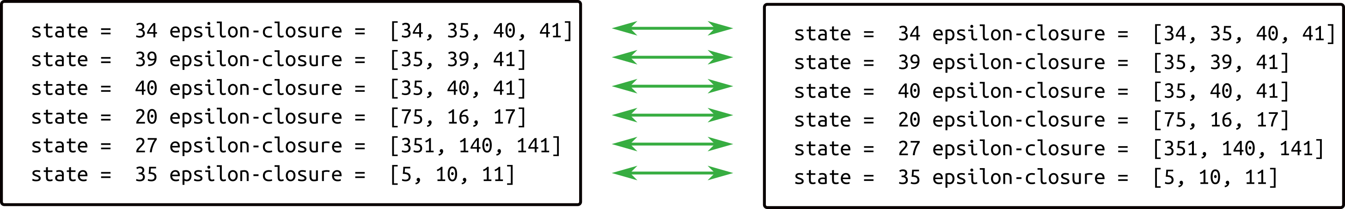

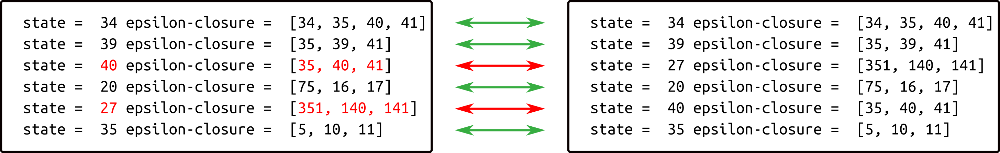

engine.compare bc – line sequences vs. potpourri
10
LineSequence:
sequence
matters
subject
nominal

Slide 8
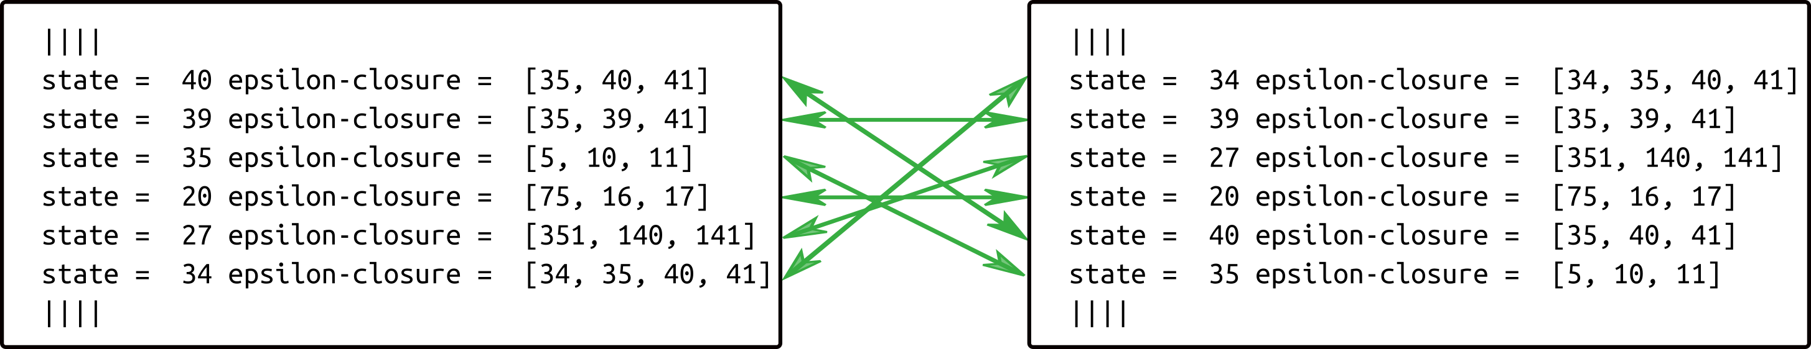
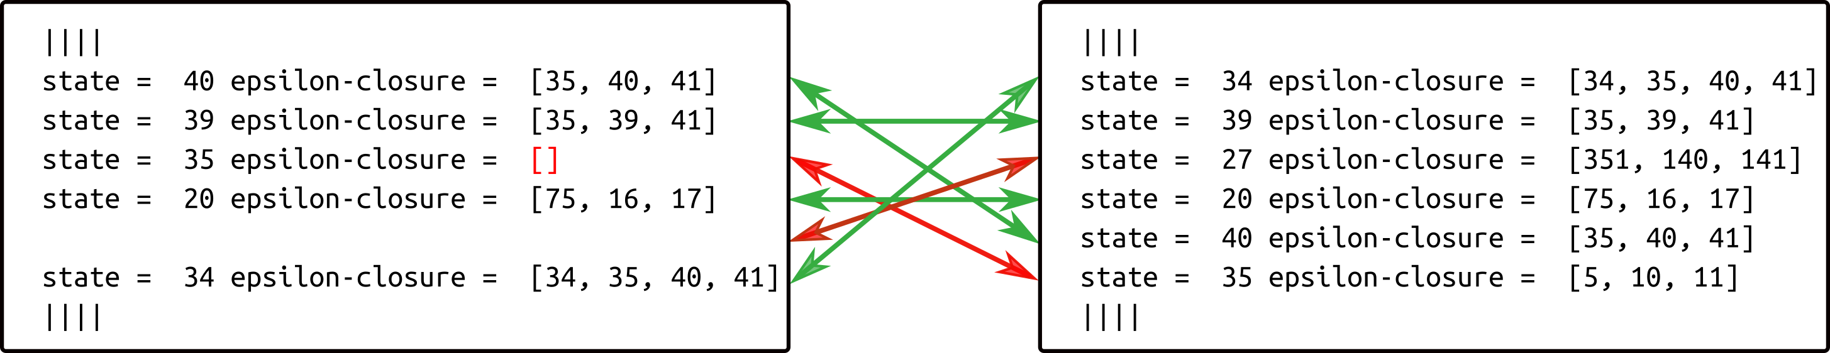
engine.compare bc – line sequences vs. potpourri
10
Potpourri:
sequence
irrelevant
subject
nominal

Slide 9
engine.compare
API Functions (main.py)
10
compare(subject, nominal)
=> verdict about equivalence (True, False)
line_associations(subject, nominal)
=> description of difference (for ‘difftool’)

Slide 10
engine.compare
API Functions (main.py)
10
subject, nominal = ‘line provider’
sole requirement:
member function .readline()
returns character string of a line.
returns empty string if exhausted.

