Slide 1
Analyst Coverage and the Profitability of Bold Recommendations
Foong Soon Cheong, NYU Shanghai
Changhee Lee, Ramapo College

Slide 2
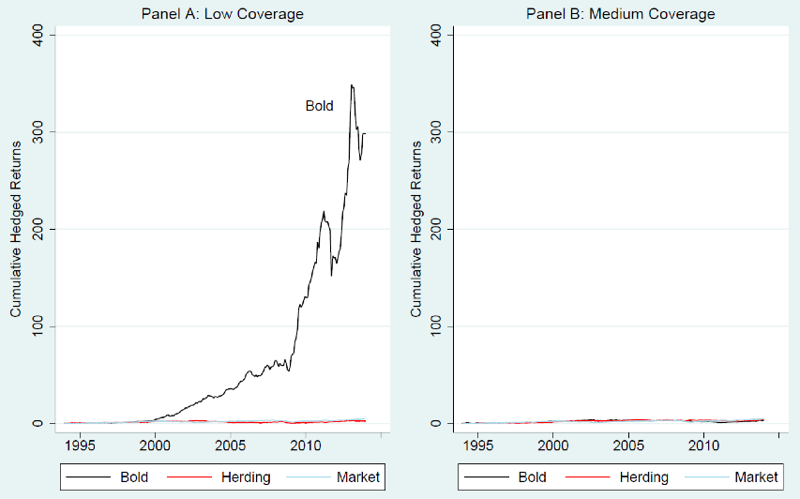
Figure 1: Panel A
Simple Trading Strategy
Select firms followed by less than three analysts
Buy (Sell) when rec’d upgraded (downgraded)
Bold, not herding
Yields 34% per year
Notes:
Let me begin by describing a simple trading trading strategy. And in the process, I’ll also define some important terms that are necessary for our discussion today.
Focus only on firms that are followed by less than 3 analysts. Buy when the recommendation are upgraded, and sell when they are downgraded. Do so only for the bold recommendations, not herding ones. This strategy generates a return of 34% per year.

Slide 3
Timeline / Definition
Feb 17
Mar 17
Apr 1
Apr 30
Consensus: Hold
Analyst #1: Hold
Consensus: Hold
Analyst #1: Buy
Upgrade ➔ Buy in month t+1
(no look-ahead bias)
“Bold” if it deviates away from the prior period consensus recommendation (Clement and Tse, 2005)
Notes:
Each month, IBES announces various statistics for each firm followed by analysts:
# of analyst, consensus EPS forecast, consensus stock rec’d.
“Bold” is not “brave” or courageous
Consensus is just the mean

Slide 4
Timeline / Definition
Feb 17
Mar 17
Apr 1
Apr 30
Consensus: Hold
Analyst #1: Hold
Consensus: Buy
Analyst #1: Strong Buy
Upgrade ➔ Buy in month t+1
(no look-ahead bias)
“Bold” if it deviates away from the prior period consensus recommendation (Clement and Tse, 2005)
Robustness: “Bold” if it is different from the contemporaneous consensus.

Slide 5
Things to Note
Stock recommendation, not EPS forecast
EPS forecast is merely one of the many items an analyst forecasts to support their valuation and stock recommendation
Change in recommendation, not level
Upgrade or Downgrade (Francis and Soffer, 1997)

Slide 6
Outline
Motivation
Hypothesis
Research Design
Data
Conclusion

Slide 7
Motivation
Why would some analysts deviate away from the "herd”, and issue "bold" recommendations?

Slide 8
Hypothesis
Analysts issue bold rec’d when they believe they have some comparative advantage (e.g., higher ability or private info)
But this belief is less likely to be correct for firms followed by many analysts
Because prices of those firms incorporate a richer set of info (Roulstone, 2003; and Bowen, Chen, and Cheng, 2008)
And conversely, more likely to be correct when followed by few analysts
Notes:
Winners’ curse

Slide 9
Hypothesis (to paraphrase)
Analysts should assess the skill of the peer analysts before deviating, and larger peer groups make this task difficult
Prior studies find that overconfidence is more prevalent for difficult tasks (Svenson, 1981, Barber and Odean, 2001)
Analysts who deviate away from the consensus tend to be overconfident when there are many other peer analysts.

Slide 10
Tension (alternative prediction)
Whether our hypothesis is correct is an empirical question
Analyst coverage is endogenous
More or less effort needed for high coverage?

Slide 11
Research Design
 | Herding | Bold
Low
Medium
High
Partition the firm-months into three equal groups: Low, Medium, and High coverage

Slide 12
Trading Strategy
Each month, IBES announces the consensus stock rec’d, EPS forecast, # of analysts, etc. for each firm
We infer the identity of analysts underlying these consensus, and their stock rec’d and EPS forecast (Glushkov, 2009)
If stock rec’d are upgraded (downgraded), buy (sell) in the following month t+1 (Jegadeesh, Kim, Krische, and Lee, 2004)

Slide 13
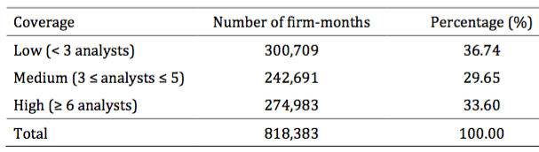
Table 1 Sample Selection

Slide 14
Table 2 Buy-and-Hold Return
 | Herding | Bold | Bold – Herding
Low | 0.75* | 2.56*** | 1.81***
Medium | 0.74*** | 0.67** | -0.07
High | 0.26** | 0.08 | -0.18
Low – High | 0.48 | 2.48*** | 1.99***

Slide 15
Figure 1: Panels A and B

Slide 16
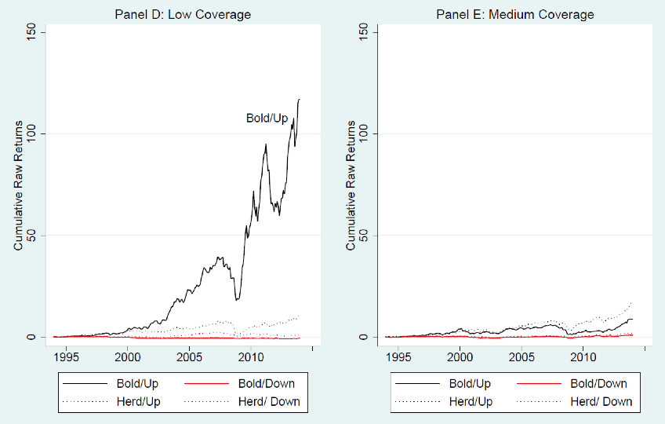
Figure 1: Panels D and E

Slide 17
Table 3 Risk-Adjusted Return
 | Herding | Bold | Bold – Herding
Low | 0.73 | 2.49*** | 1.76***
Medium | 0.71 | 0.62 | -0.09
High | 0.35 | 0.13 | -0.22
Low – High | 0.38 | 2.36*** | 1.98***
Notes:
Fama-French three-factors, plus momentum

Slide 18
Table 4 Effect of Earnings Announcement
 | Herding | Bold | Bold – Herding
Low | 0.62 | 3.87*** | 3.25**
Medium | 0.63 | 0.49 | -0.13
High | 0.19 | -0.18 | -0.37
Low – High | 0.43 | 4.05*** | 3.62**

Slide 19
Table 5 Earnings Surprise (Consensus)
 | Herding | Bold | Bold – Herding
Low | 0.30 | 0.67*** | 0.38
Medium | 0.14 | 0.09 | -0.05
High | 0.15*** | 0.07 | -0.08
Low – High | 0.15 | 0.60*** | 0.45

Slide 20
Table 5 Earnings Surprise (Individual)
 | Herding | Bold | Bold – Herding
Low | 0.88* | 1.80*** | 0.92
Medium | 0.53 | -0.05 | -0.58
High | 0.29* | 0.39 | 0.10
Low – High | 0.59 | 1.41* | 0.82

Slide 21
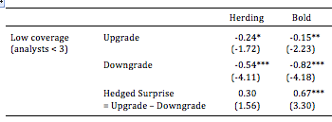
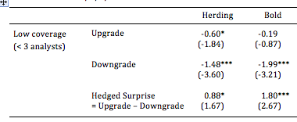
Table 5 Earnings Surprise
Consensus
EPS Surprise
Individual
EPS Surprise

Slide 22
Table 6 Selection Bias
 | Herding | Bold | Bold – Herding
Low | 3.35 | 5.84** | 2.49
Medium | 4.22 | 1.17 | -3.05
High | 1.34 | -0.13 | -1.47
Low – High | 2.01 | 5.97** | 3.96

Slide 23
Table 7 Initial Stock Price Reaction
 | Herding | Bold | Bold – Herding
Low | 1.06*** | 1.23*** | 0.17
Medium | 0.92*** | 1.18*** | 0.26
High | 0.65*** | 0.77*** | 0.12
Low – High | 0.41** | 0.46** | 0.05

Slide 24
Conclusion
Why do some analysts deviate away from the consensus?
They think they have relatively higher ability / private info
Perception less (more) likely to be right when info environment is more (less) transparent
Highly profitable to trade based on [bold, low] recommendations
Prior literature documents very low returns (Barber et al., 2001)
Profitability is partly due to the earnings news
EPS forecast appears biased to support the stock recommendations
Rules out alternative explanations (e.g., selection bias)

Slide 25
Thank you Comments? ➔ Email: fscheong@nyu.edu

