Slide 1
Coverage Changes and EPS Forecast Accuracy
Foong Soon Cheong, NYU Shanghai
Changhee Lee, Ramapo College
Dan Palmon, Rutgers

Slide 2
Table of Contents
Motivation
Research Question
Hypothesis Development
Data, Variables
Empirical Results
Conclusion

Slide 3

Motivation
Accounting researchers use analysts’ earnings forecasts as a proxy for the capital
markets’ expectation
of earnings.

Slide 4
Motivation
EPS forecast: key ingredient to valuation models

Slide 5
Research Question
Longstanding interest in factors that determine the accuracy of EPS forecast accuracy
In this paper, we examine the accuracy of newly added / dropped forecast
Coverage
Changes
EPS Forecast Accuracy

Slide 6
Hypotheses Development
Previous literature highlight the importance of experience. E.g., Brown 2001; Clement 1999; Jacob, Lys, and Neale 1999; Clement and Tse 2005.
First forecast: less accuracy
Last forecast: more accurate
Other studies point out the importance of selection bias. E.g., McNichols and O'Brien (1997)
First forecast: more accurate
Last forecast: less accurate

Slide 7
What did we find?
Our results
First forecast: less accurate
Last forecast: less accurate
Not driven by:
rookie analysts
retiring analysts
analysts followed non-primary industries

Slide 8
How does our research design differs from McNichols and O’Brien (1997)?
we use a paired-sample analysis, where we compare the forecast accuracy between an analyst and their peer analysts for the same firm and at the same time.
Unaffected by confounding firm-effects or year-effects
our results are robust to both univariate and multivariate regression analysis
McNichols and O’Brien (1997, Table 4) use only simple univariate analysis, and unpaired two-sample test
we scale our forecast accuracy variable to range between zero and one. Clement and Tse (2005)
our results are less susceptible to extreme outliers

Slide 9
Why are our results important?
we investigate the forecast accuracy of analysts who add or drop coverage
we consider alternative explanations
our results are important to investors and financial analysts
prior research suggests that higher analyst coverage decreases information asymmetry between the investors and managers of the firm. E.g., Yu 2008; Schutte and Unlu 2009; Sun 2009

Slide 10
Data
The analysis is based on I/B/E/S forecasts of quarterly earnings (specifically, one-quarter-ahead earnings forecast, FPI=6)
From 1985 to 2012 (28 years) for the firms that had an increase (decrease) in their analyst following.
These procedures yield a sample of 777,098 (641,247) analyst-firm-quarter observations for the analyst’s adding (dropping) coverage of a firm.

Slide 11
How to find analysts’ adding (dropping) coverage
To examine the association between coverage change and their forecast accuracy,
We first identify the quarter of an analyst’s first (last) earnings forecast for a firm.
Then, we compare her first (last) forecast accuracy for a firm with her peers who have been following the same firm.

Slide 12
Coverage Change?
How to find analysts’ adding / dropping coverage
<Adding coverage>
AAPL
Analyst A
Analyst B
Analyst C

Slide 13
Coverage Change?
How to find analysts’ adding / dropping coverage
<Adding coverage: Analyst “D”>
AAPL
Analyst A
Analyst B
Analyst C
Analyst D
IN

Slide 14
Coverage Change?
How to find analysts’ adding / dropping coverage
<Dropping coverage>
AAPL
Analyst A
Analyst B
Analyst C
Analyst D

Slide 15
Coverage Change?
How to find analysts’ adding / dropping coverage
<Dropping coverage: Analyst “A”>
AAPL
Analyst A
OUT
Analyst B
Analyst C
Analyst D

Slide 16

Variables
Dependent Variable
Control Variables
Normalized variables; relative value
Clement and Tse (2005)
Clement and Tse (2005)

Slide 17
Variables
How to find analysts’ adding / dropping coverage
<Adding coverage: Analyst “D”>
(0.21 - 0.21)
(0.21 - 0.10)
Actual
Forecast
AAPL
Analyst A
AFE: |3 – 3.21|=0.21
0=
Analyst B
AFE: |3 – 3.20|=0.20
0.09
Analyst C
AFE: |3 – 3.19|=0.19
0.18
Analyst D
IN
(0.21 - 0.10)
(0.21 - 0.10)
AFE: |3 – 3.10|=0.10
1=

Slide 18
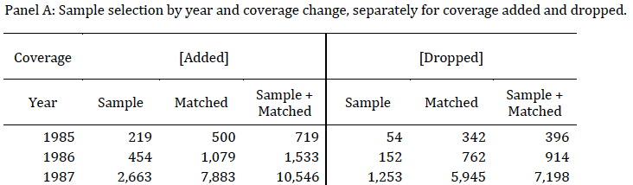

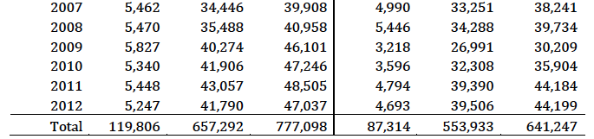
Table 1 : Sample selection and descriptive statistics
15%
85%
14%
86%

Slide 19
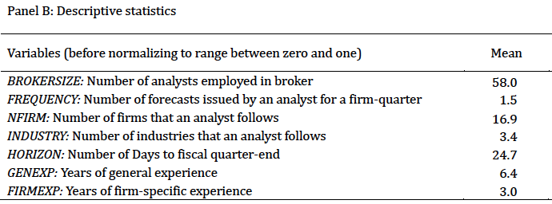
Table 1 : Sample selection and descriptive statistics

Slide 20
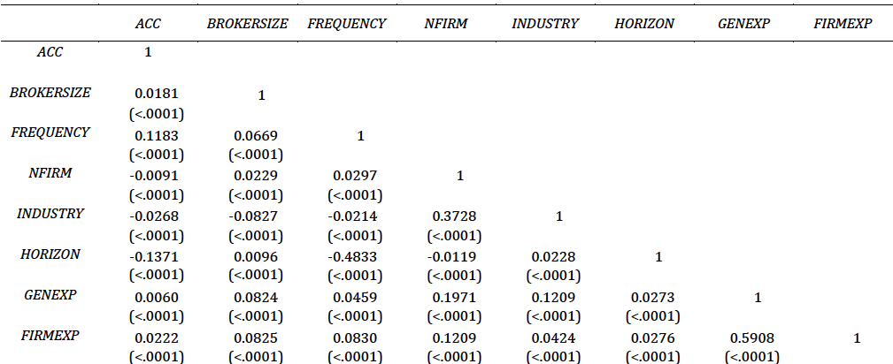
Table 2: Pearson correlation among forecasts and analyst characteristics

Slide 21
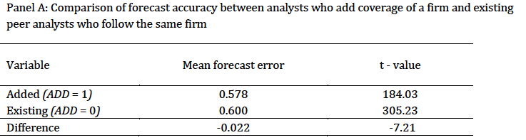
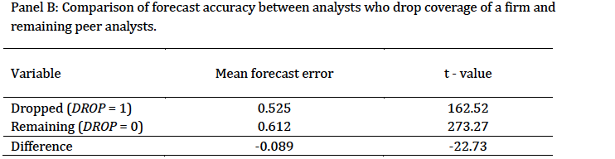
Table 3: Mean forecast accuracy
Analysts who add/drop coverage of a firm attain lower forecast accuracy than her peers.
Mean forecast accuracy
Mean forecast accuracy

Slide 22
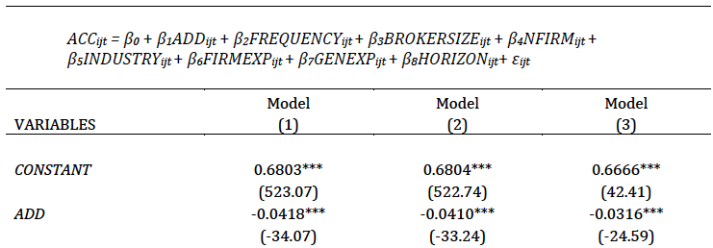

Table 4: Regression of forecast accuracy of analysts who add coverage of a firm on analysts’ characteristics
The average effect of analysts who add coverage of a firm on forecast accuracy

Slide 23
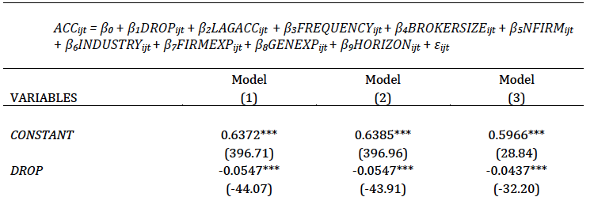

Table 6: Regression of forecast accuracy of analysts who drop coverage of a firm on analysts’ characteristics
The average effect of analysts who drop coverage of
a firm on forecast accuracy

Slide 24

Further analyses
Rookie analysts & add
Retiring analysts & drop
Non-primary industries & add

Slide 25
Conclusion
We examine the relationship between analysts’ relative EPS forecast accuracy and coverage changes.
We find that the accuracy of analysts' first forecast for a firm (newly added coverage) is lower than their peers. In addition, the accuracy of their last forecast (just before coverage is dropped) is also lower than their peers.
Further analysis shows that our results are not driven by the rookie or retiring analysts.

Slide 26
Thank you
Questions/Comments?
fscheong@nyu.edu

