Slide 1





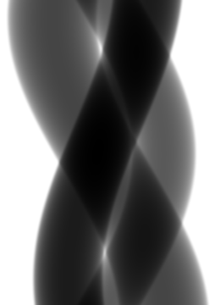
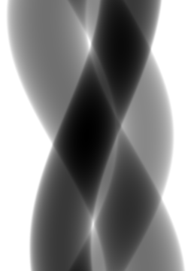
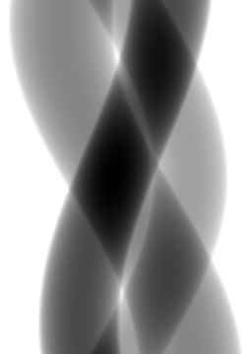
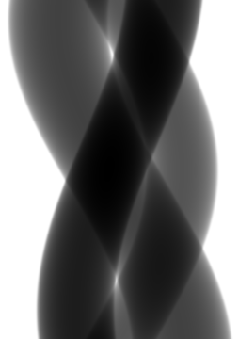
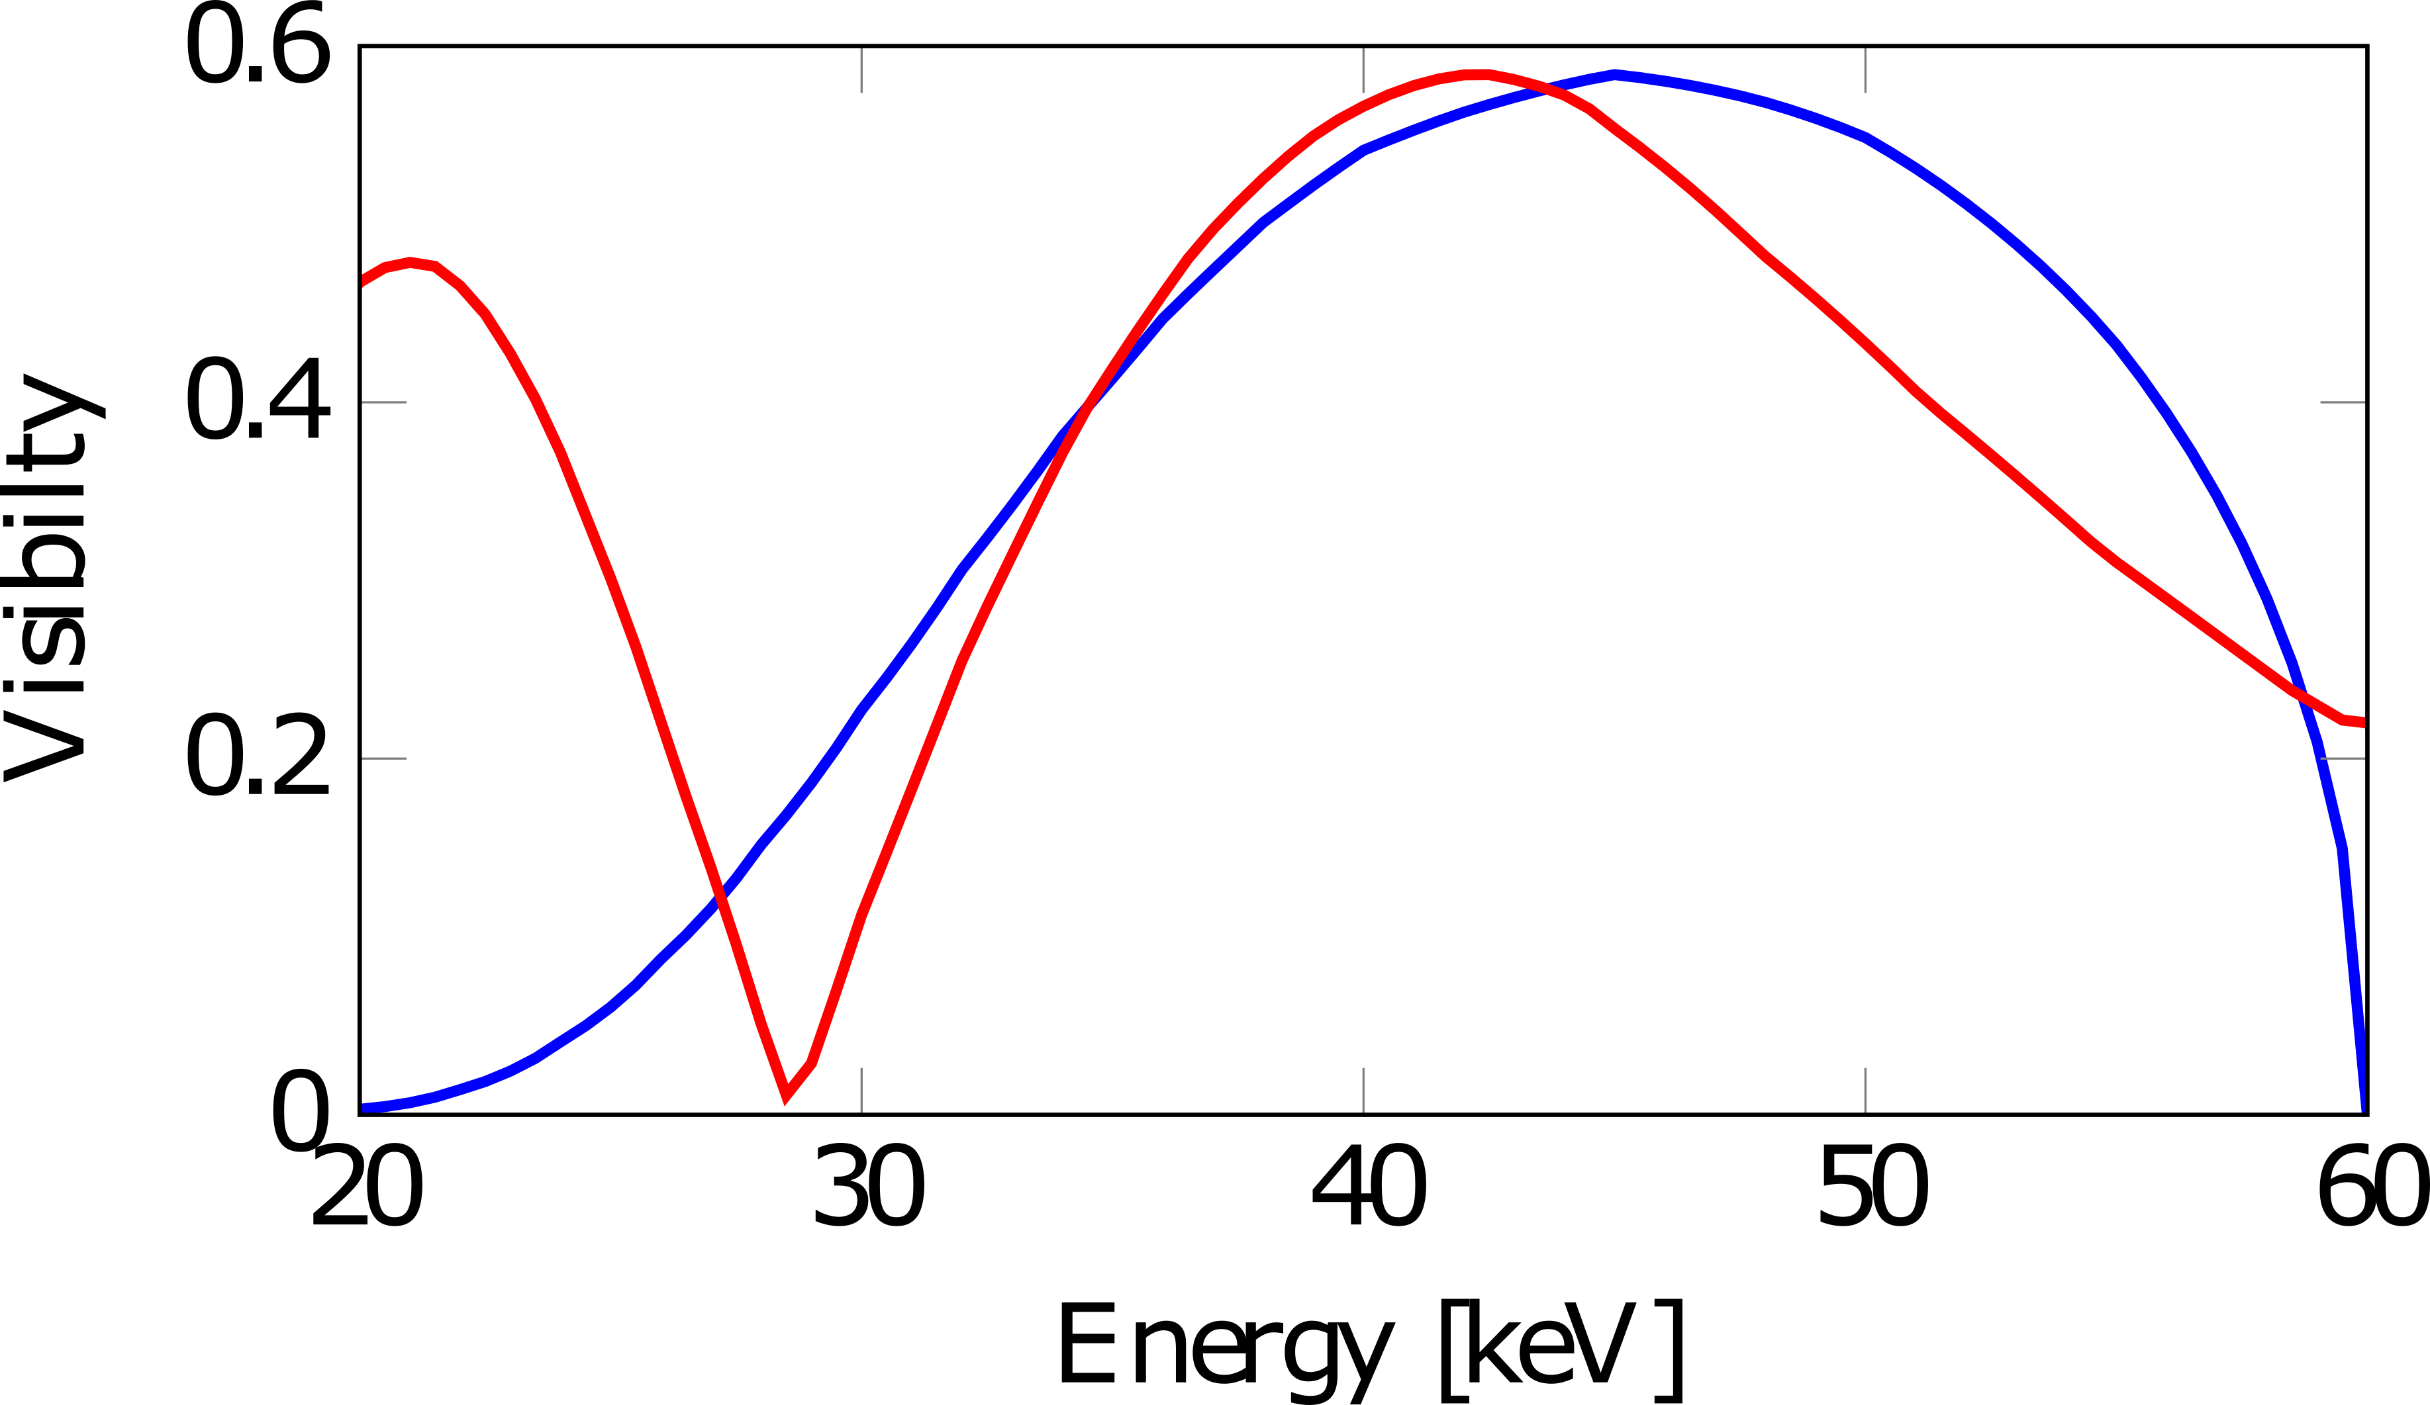
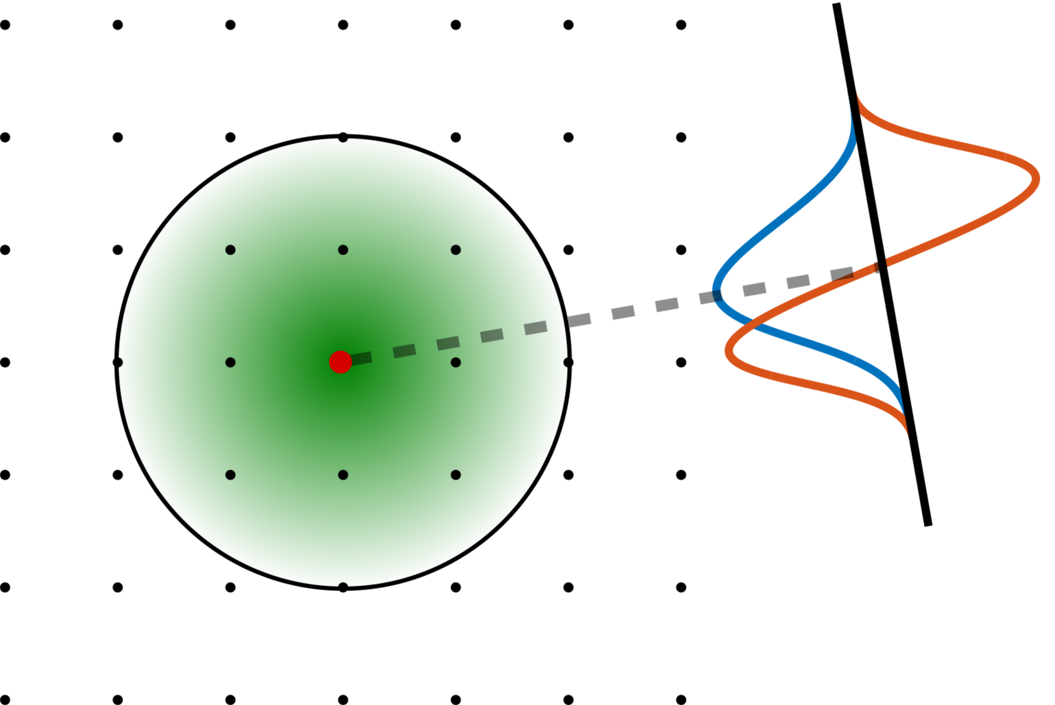
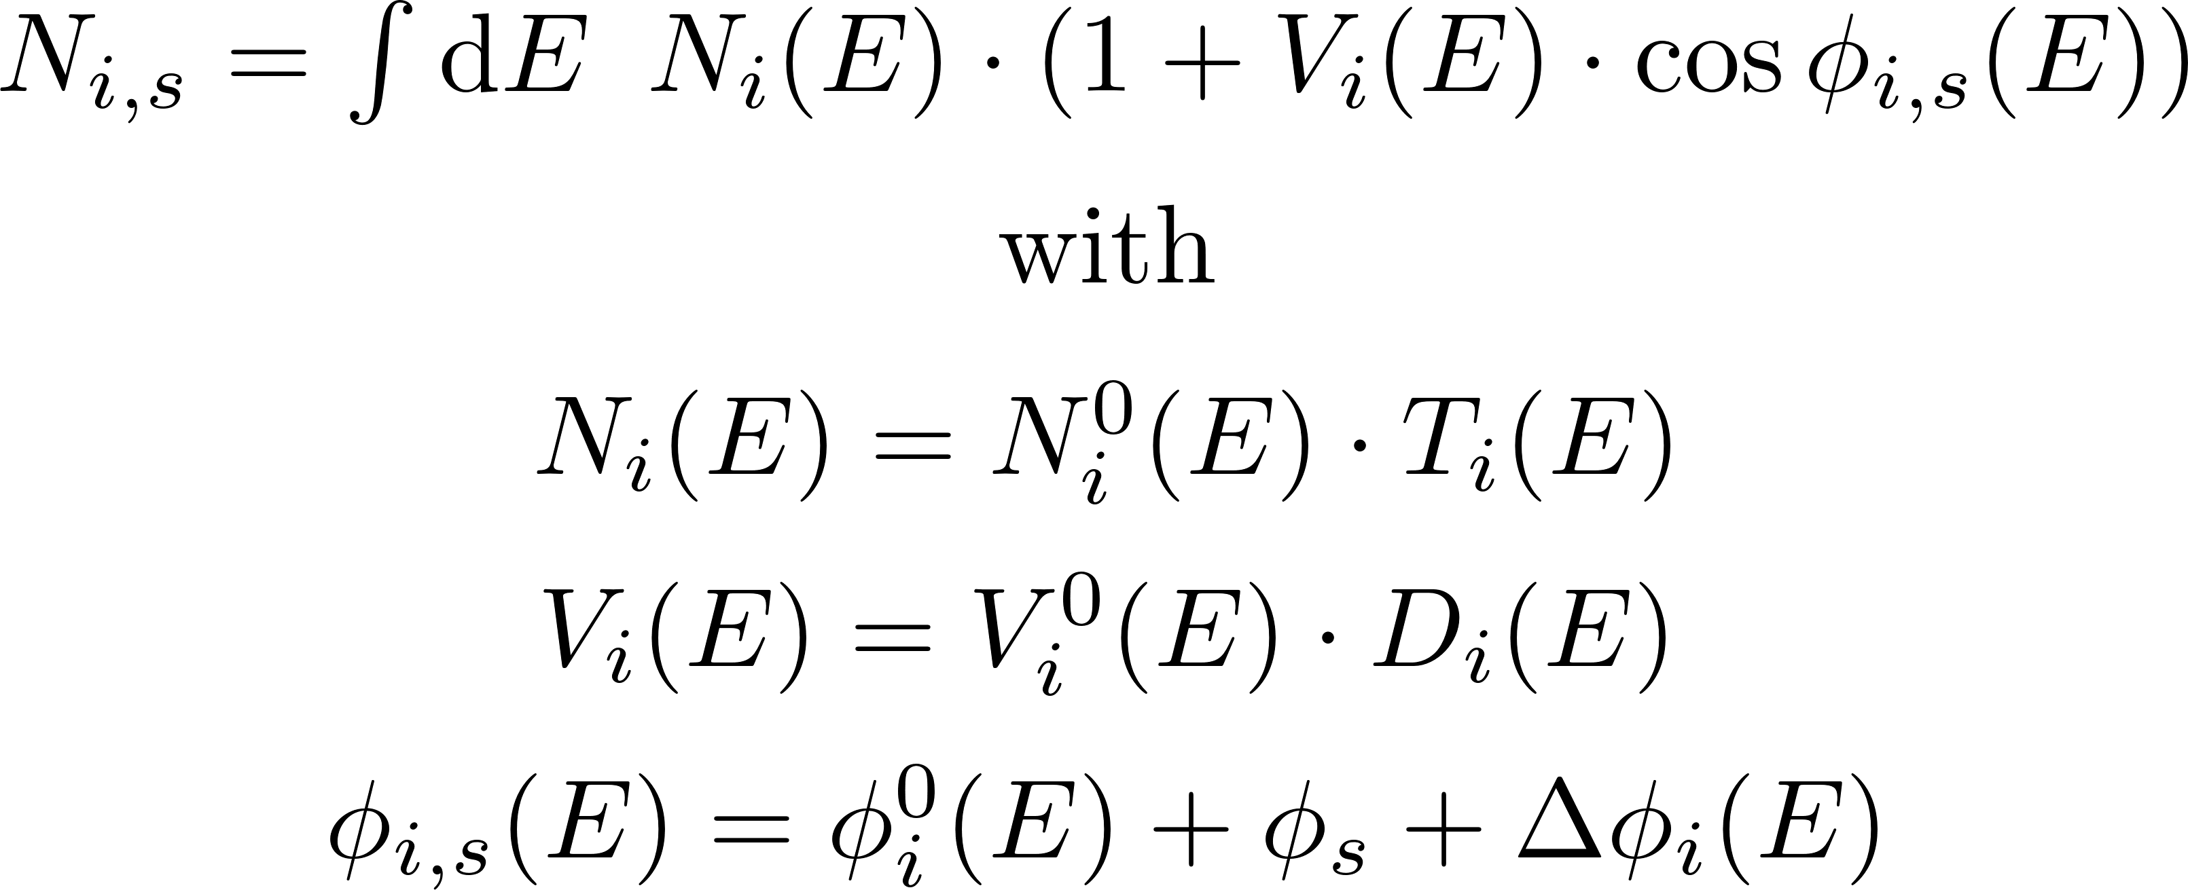



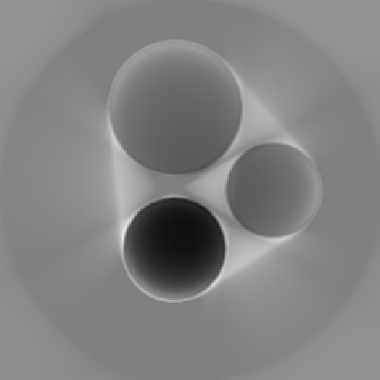
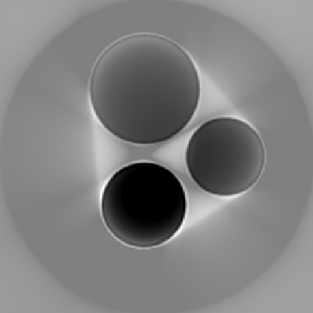
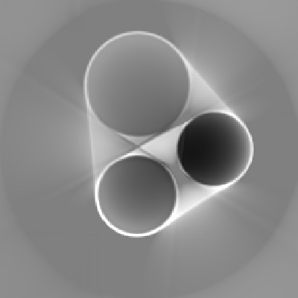
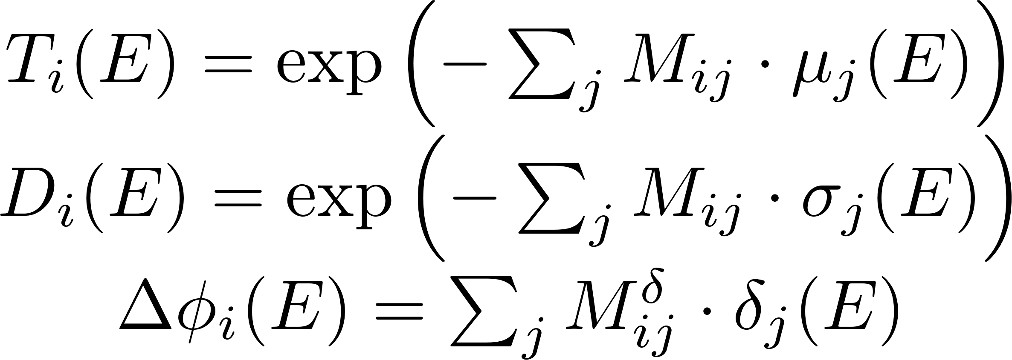
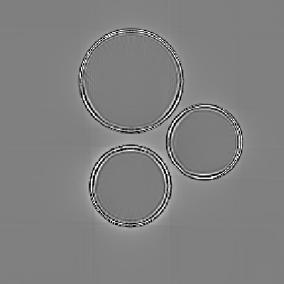
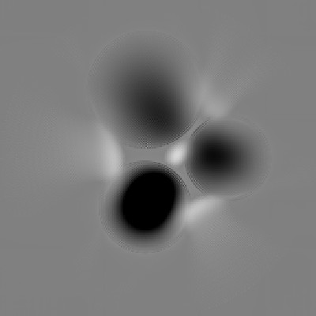
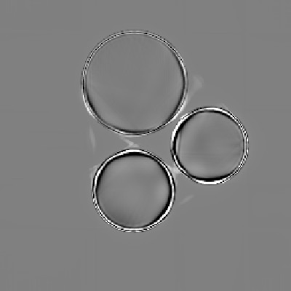
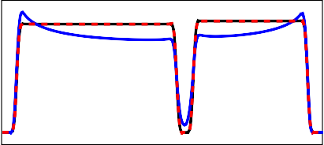
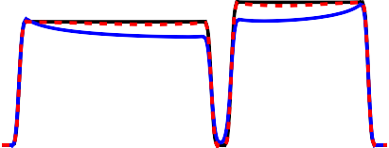
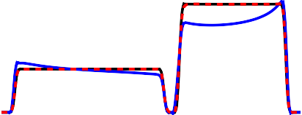
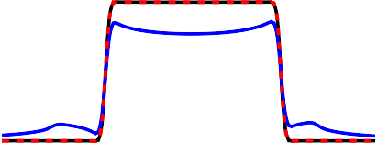
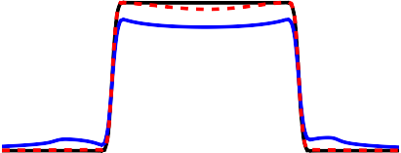
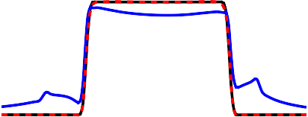
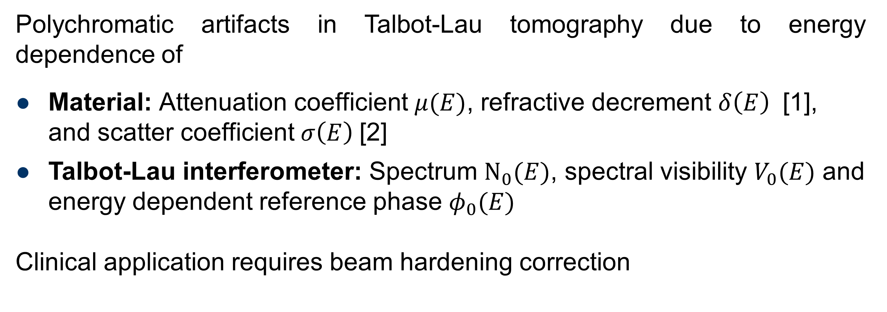
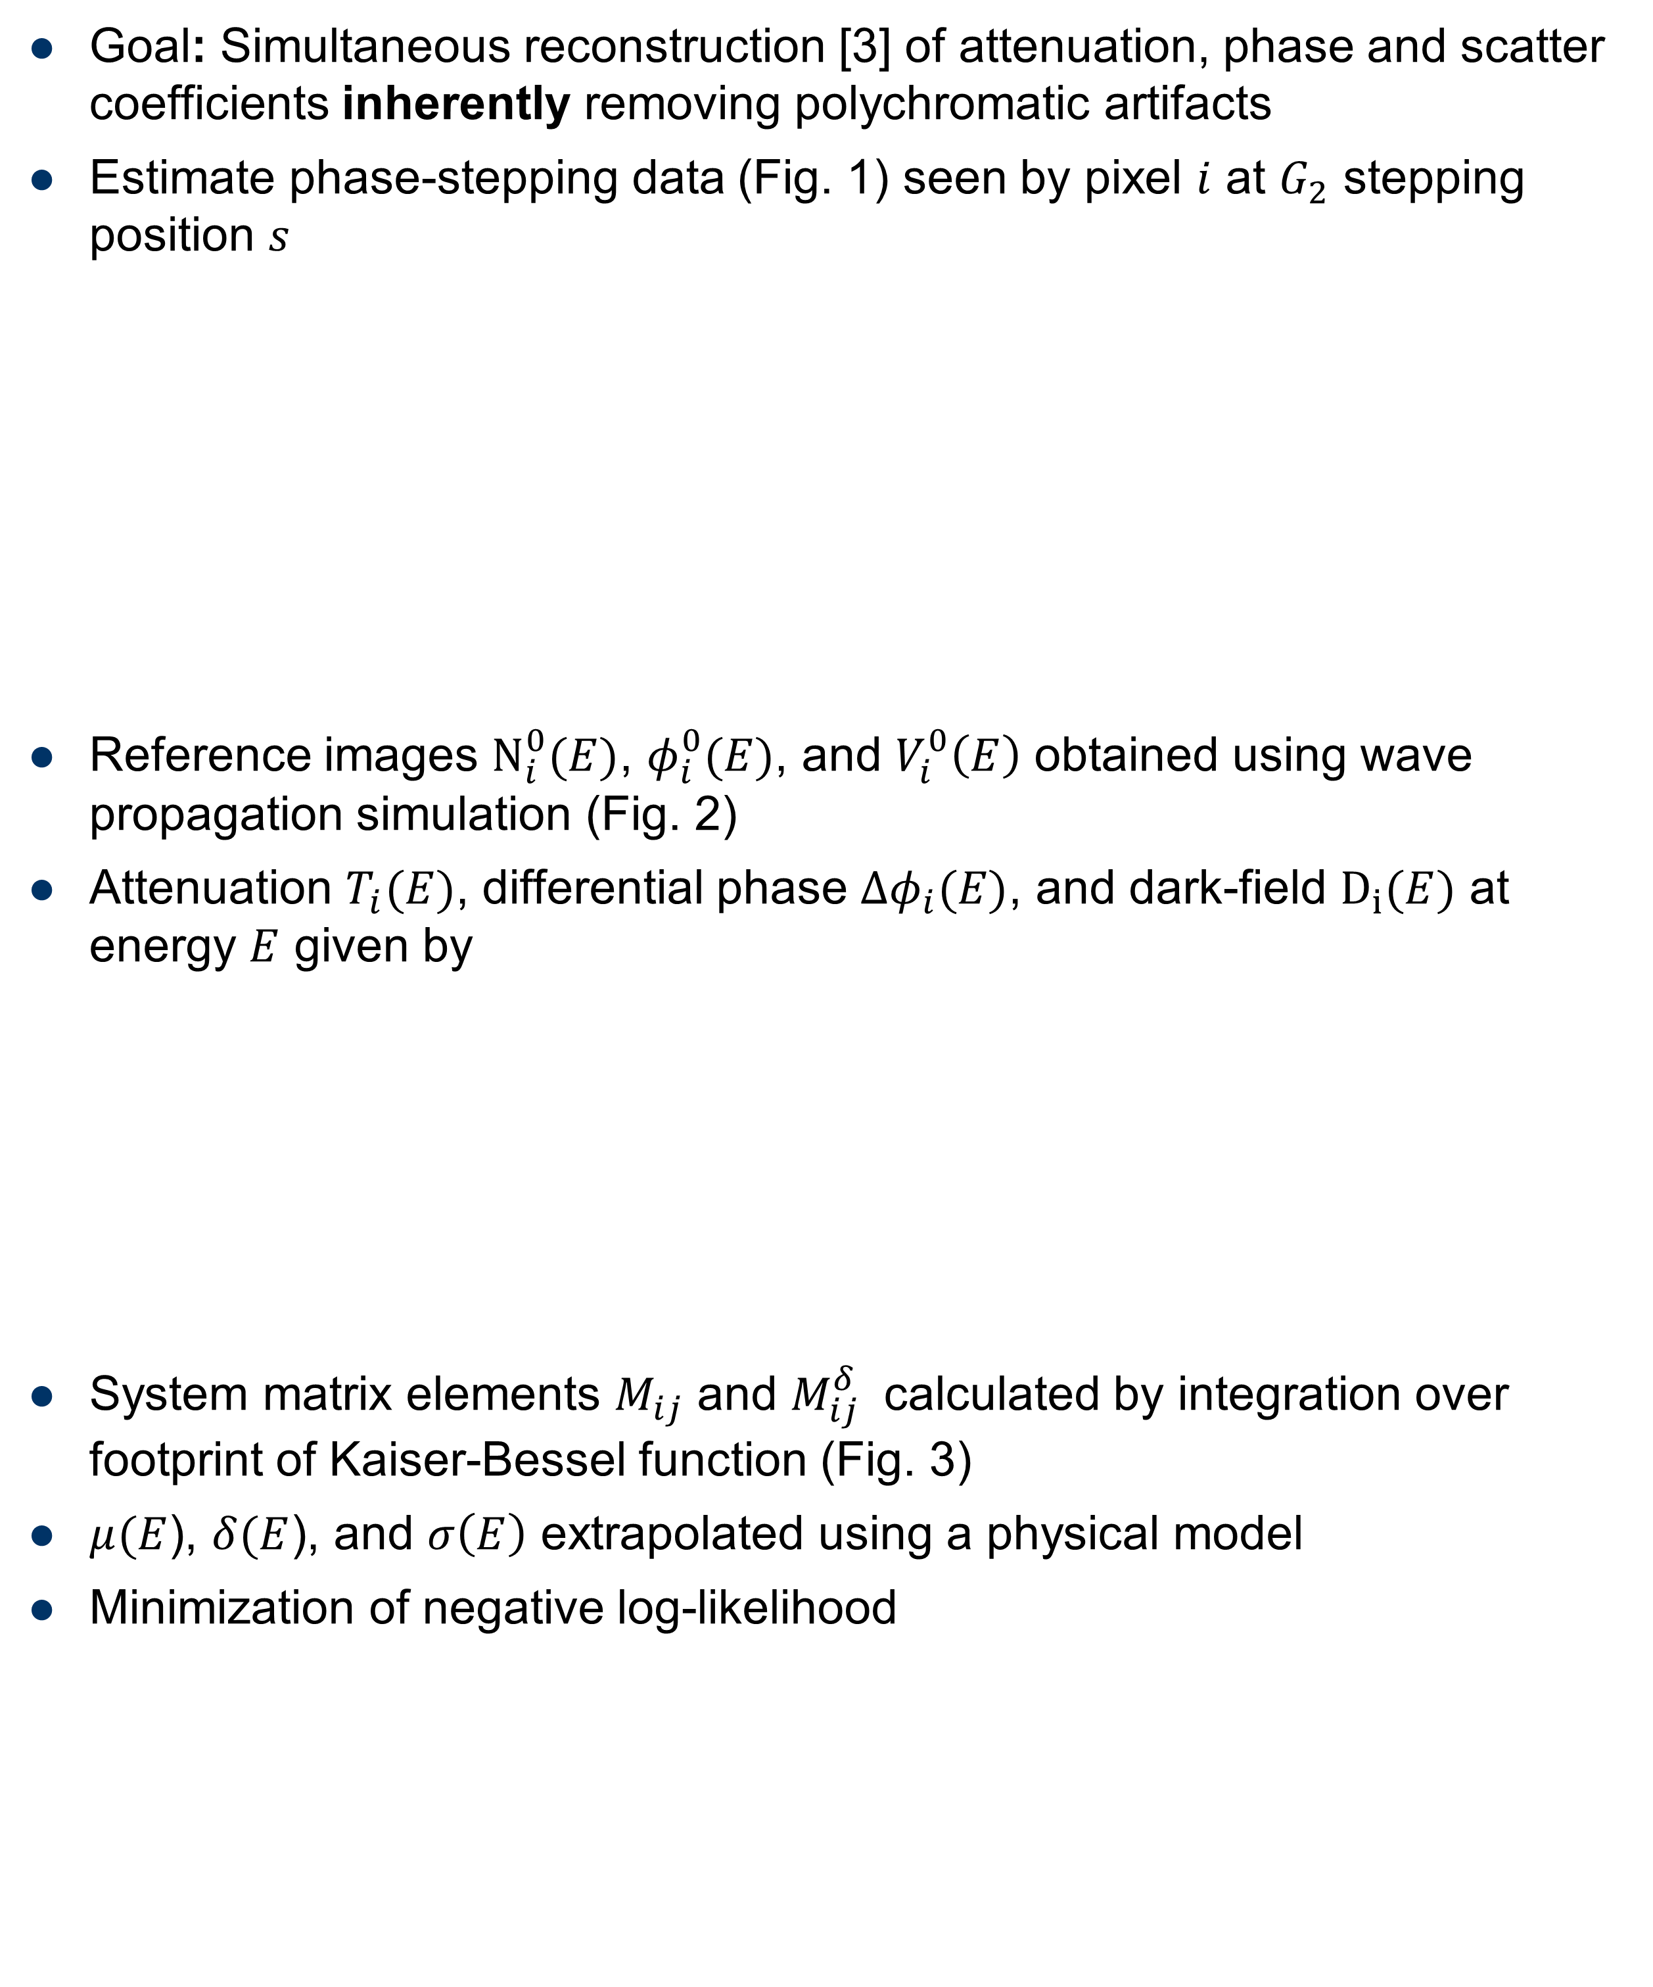
Polychromatic Maximum Likelihood Reconstruction for Talbot-Lau X-ray Tomography
Florian Schiffers^{1,2} , Sebastian Käppler¹, Shiyang Hu¹, Jens Rieger², Georg Pelzer², Andreas Wolf²,
Andreas Maier¹, Thilo Michel², Christian Riess¹, Gisela Anton²
¹ Pattern Recognition Lab, Department of Computer Science, Friedrich-Alexander University Erlangen-Nuremberg, Erlangen, Germany ² Erlangen Centre for Astroparticle Physics, Department of Physics, Friedrich-Alexander University Erlangen-Nuremberg, Erlangen, Germany
Introduction
15 keV
30 keV
45 keV
60 keV
Polychromatic
Polychromatic artifacts in Talbot-Lau tomography due to energy dependence of
Material: Attenuation coefficient $μ(E)$, refractive decrement $δ\left(E\right)$ [1], and scatter coefficient $σ\left(E\right)$[2]
Talbot-Lau interferometer: Spectrum $N_{0}(E)$, spectral visibility $V_{0}(E)$ and energy dependent reference phase $φ_{0}(E)$
Clinical application requires beam hardening correction
Figure 1: Superposition of mutually independent forward projections for phase-stepping data (here shown for phase step 0) at different energies result in the expected phase-stepping data in a polychromatic setup.
Materials and Methods
Goal: Simultaneous reconstruction [3] of attenuation, phase and scatter coefficients inherently removing polychromatic artifacts
Estimate phase-stepping data (Fig. 1) seen by pixel $i$ at $G_{2}$ stepping position $s$
Reference images $N_{i}^{0}(E)$, $φ_{i}^{0}(E)$, and $V_{i}^{0}\left(E\right)$ obtained using wave propagation simulation (Fig. 2)
Attenuation $T_{i}(E)$, differential phase $Δφ_{i}(E)$, and dark-field $D_{i}(E)$ at energy $E$ given by
System matrix elements $M_{ij}$ and $M_{ij}^{δ}$ calculated by integration over footprint of Kaiser-Bessel function (Fig. 3)
$μ(E$), $δ(E$), and $σ\left(E\right)$ extrapolated using a physical model
Minimization of negative log-likelihood
Figure 2: Spectral visibility and X-ray spectrum for the interferometer used in the evaluation.
Figure 3: (Differential) footprint of Kaiser-Bessel function.
Ground Truth
Attenuation
Refractive decrement
Scatter
H₂O
PMMA
60
60
20
40
40
15
PTFE
20
20
10
0
0
5
FBP
10
4
0
4
2
2
0
0
0
-10
-2
-4
1
-2
-4
0.4
Iterative Rec.
0.2
0.1
0.5
0.2
0
0
0
-0.1
-0.5
-0.2
-0.2
-1
-0.4
Figure 4: First row: ground truth data. Second row: reconstruction error using filtered backprojection. Third row: reconstruction error with proposed iterative method and polychromatic forward model.
Results and Discussion
Synthetic CT data affected by polychromatic effects generated from well-defined phantom using proposed forward model (Fig. 4)
Reconstruction removes polychromatic artifacts (Fig. 5)
Slow convergence of phase-image
(a) Attenuation
(b) Refractive decrement
(c) Scatter
Conclusions
Figure 5: Two cross-sections through the reconstructed data as visualized in Fig. 4. Black: Phantom ground truth, Blue: Filtered Backprojection, Red (dashed): Proposed reconstruction method. For all images, the iteratively reconstruction and ground truth are in high agreement.
Reconstruction method for Polychromatic Talbot-Lau imaging
Experiments with synthetic phantom show strong artifact reduction
Efficient optimization method for phase-image required
Further experiments with real data in progress
References
[1] N. Bevins et al.: “Beam hardening in x-ray differential phase contrast computed tomography,” in Medical Imaging, March 2011.
[2] G. Pelzer et al.: “A beam hardening and dispersion correction for x-ray dark-field radiography,” Medical Physics, vol. 43, May 2016.
[3] A. Ritter et al.: “Simultaneous maximum-likelihood reconstruction for x-ray grating based phasecontrast tomography avoiding intermediate phase retrieval,” arXiv:1307.7912, Jul. 2013.
Contact
 Florian.Schiffers@fau.de, Sebastian.Kaeppler@fau.de

