Slide 1
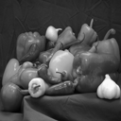
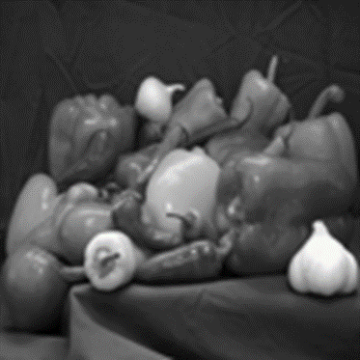

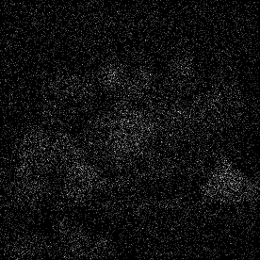
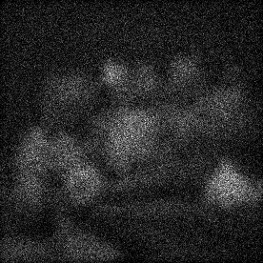
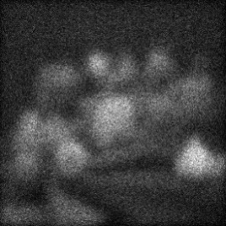
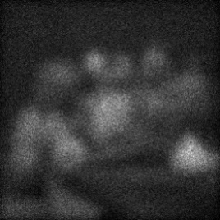
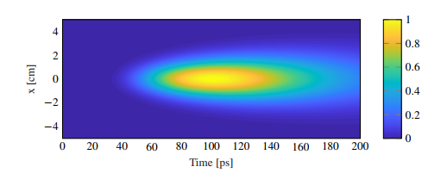

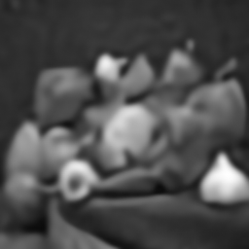
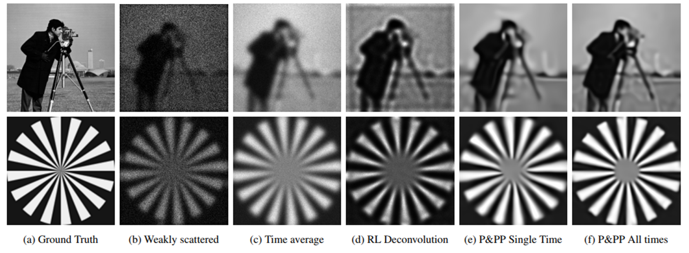
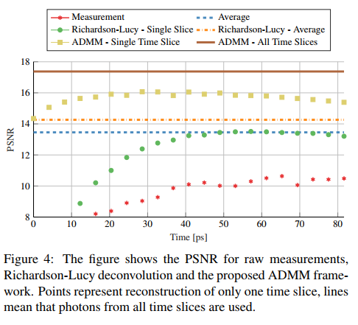
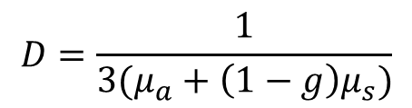




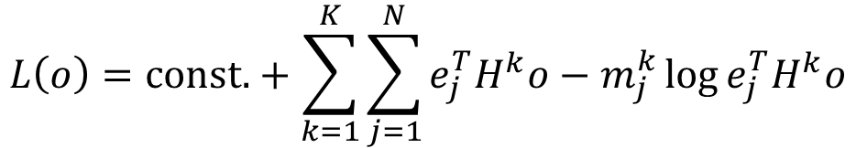

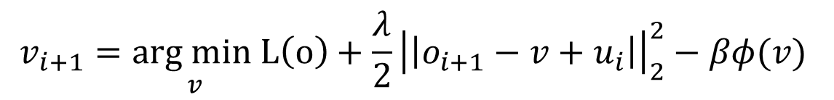

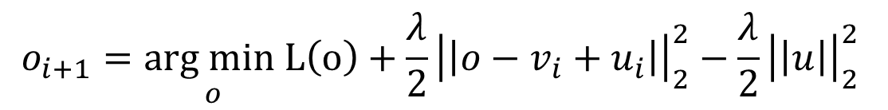

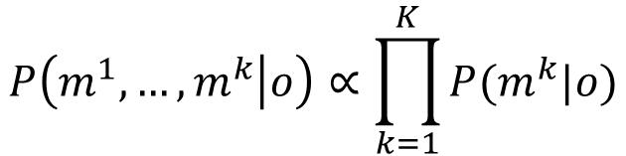

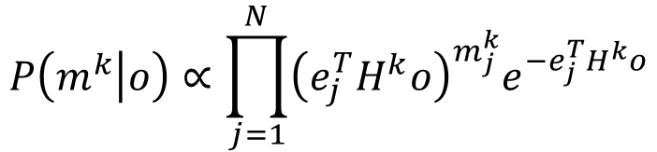
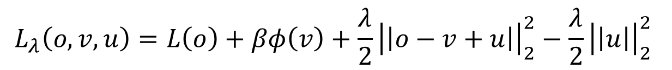


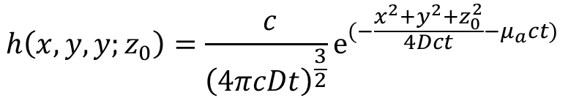

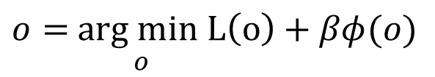


All-Photon Imaging through Scattering Media with a Learning Based Prior
Florian Schiffers¹, Lionel Fiske¹, Pablo Ruiz², Aggelos K. Katsaggelos², Oliver Cossairt¹
¹ Computational Photography Lab, Department of Computer Science, Northwestern University | ² Image and Video Processing Lab, Electrical and Computer Engineering, Northwestern University,
Introduction
Imaging through scattering media finds applications in diverse fields from biomedicine to autonomous driving. However, interpreting the resulting images is difficult due to blur caused by the scattering of photons within the medium. Transient information, captured with fast temporal sensors, can be used to significantly improve the quality of images acquired in scattering conditions. Photon scattering, within a highly scattering media, is well modeled by the diffusion approximation of the Radiative Transport Equation (RTE). Its solution is easily derived which can be interpreted as a Spatio-Temporal Point Spread Function (STPSF). In this paper, we first discuss the properties of the ST-PSF and subsequently use this knowledge to simulate transient imaging through highly scattering media. We then propose a framework to invert the forward model, which assumes Poisson noise, to recover a noise-free, unblurred image by solving an optimization problem.
Ultrashort
Laser
SPAD
Camera
Observations
Diffusive Object
40 ps
…
60 ps
Computing the Point Spread Function
An ultrafast pulsed laser source illuminates a transmissive object which is placed directly in front of a highly scattering medium. A streak camera is able to resolve the arriving photons in time. Ballistic and scattered photons arrive at different times since scattered photons travel a longer path. The spatio-temporal imaging system is modeled with a time-dependent point spread function computed from the RTE. Inversion of this model allows reconstruction of a noise free, deconvolved image.
$$Radiative Transport Equation (RTE):$$
120 ps
80 ps
$$\frac{1}{c}\frac{∂u(r,t)}{∂t}=D∇^{2}u−μ_{a}u+S$$
$$and$$
$$u\left(r,0\right)=f\left(r\right)$$
$$and$$
$$D=\frac{1}{3(μ_{a}+\left(1−g\right)μ_{s})}$$
The energy and width of the ST-PSF grow in time. Initial time slices have little blurring, but low energy. Later time slices have more energy, but significant blurring. The ST-PSF was created with ms = 5cm-1, ma = 1cm-1, g = 0:99 and a scattering volume with depth 3cm.
$$Solution of RTE:$$
Reconstruction
$$h\left(x,y,y;z_{0}\right)=\frac{ c}{{\left(4πcDt\right)}^{\frac{3}{2}}}e^{(−\frac{x^{2}+y^{2}+z_{0}^{2}}{4Dct}−μ_{a}ct) }⁡$$
Plug-and-Play Prior Based Deconvolution
$$Cost−Function with regularizer φ:$$
$o=$ $\underset{o}{arg min}L\left(o\right)+βφ(o)$
Poisson Likelihood
$${Construct Augmented Laugrangian: L}_{λ}$$
$$Image formation mode:$$
$$I\left(x,y;t\right)=∫o\left(x−x^{′},y−y^{′}\right)⋅h\left(x^{′},y^{′},t;z_{0}\right)dx^{′}dy′$$
$$L_{λ}\left(o,v,u\right)=L\left(o\right)+βφ\left(v\right)+\frac{λ}{2}{\left|\left|o−v+u\right|\right|}_{2}^{2}−\frac{λ}{2}{\left|\left|u\right|\right|}_{2}^{2}$$
$$Likelihood for image at time k:$$
$$P\left(m^{k} | o\right)∝\prod_{j=1}^{N}{{\left(e_{j}^{T}H^{k}o\right)}^{m_{j}^{k}}e^{−e_{j}^{T}H^{k}o}}$$
$$o_{i+1}=\underset{o}{arg min}L\left(o\right)+\frac{λ}{2}{\left|\left|o−v_{i}+u_{i}\right|\right|}_{2}^{2}−\frac{λ}{2}{\left|\left|u\right|\right|}_{2}^{2}$$
$$P\left(m^{1},…,m^{k} | o\right)∝\prod_{k=1}^{K}{P(m^{k}|o)}$$
$$v_{i+1}=\underset{v}{arg min}L\left(o\right)+\frac{λ}{2}{\left|\left|o_{i+1}−v+u_{i}\right|\right|}_{2}^{2}−βφ(v)$$
$$Poisson Likehood for all images:$$
$$L\left(o\right)=\text{const}\text{.}+\sum_{k=1}^{K}{\sum_{j=1}^{N}{e_{j}^{T}H^{k}o−m_{j}^{k}\log{e_{j}^{T}H^{k}o}}}$$
$$Replace with Deep Denoiser [5]:$$
$$v_{i+1}=FFDNET_{σ}(o_{i+1}+u_{i})$$
$$Log−Likelihood$$
$$u_{i+1}=u_{i}+(o_{i+1}−v_{i+1})$$
Results
Visual evaluation of the proposed reconstruction algorithm for two simulated images. Weakly scattered images are subject to heavy noise (b), while later times are heavily blurred with better photon statistics (c). Images (d) show deconvolution with Richardson-Lucy. The proposed algorithm was applied for a single image of an early time, see (e), and for a reconstruction considering the full temporal image stack, see Images (f). Reconstruction with the temporally resolved images shows the best reconstruction result.
The figure shows the PSNR for raw measurements, Richardson-Lucy deconvolution and the proposed ADMM framework. Points represent reconstruction of only one time slice, lines mean that photons from all time slices are used
References
[1] G. Satat, M. Tancik, and R. Raskar, “Imaging through volumetric scattering with a single photon sensitive camera,” in Mathematics in Imaging. Optical Society of America, 2018.
[2] A. Boccolini, F. Tonolini, J. Leach, R. Henderson, and D. Faccio, “Imaging inside highly diffusive media with a space and time-resolving single-photon sensor,” in Imaging Systems and Applications. Optical Society of America, 2017
[3] S. V. Venkatakrishnan, C. A. Bouman, and B. Wohlberg, “Plug-and-play priors for model based reconstruction,” in 2013 IEEE Global Conference on Signal and Information Processing. 2013, IEEE.
[4] A. Rond, R. Giryes, and M. Elad, “Poisson inverse problems by the plug-and-play scheme,” Journal of Visual Communication and Image Representation, vol. 41, pp. 96–108, 2016.
[5] K. Zhang, W. Zuo, and L. Zhang, “FFDNet: Toward a fast and flexible solution for CNN-based image denoising,” IEEE Transactions on Image Processing, vol. 27, no. 9, pp. 4608–4622, 2018.
Contact:  florian.schiffers@northwestern .edu ☒ https://compphotolab.northwestern.edu/
Computational Photography Lab, CS Department, Northwestern University | https://compphotolab.northwestern.edu/

