Slide 2
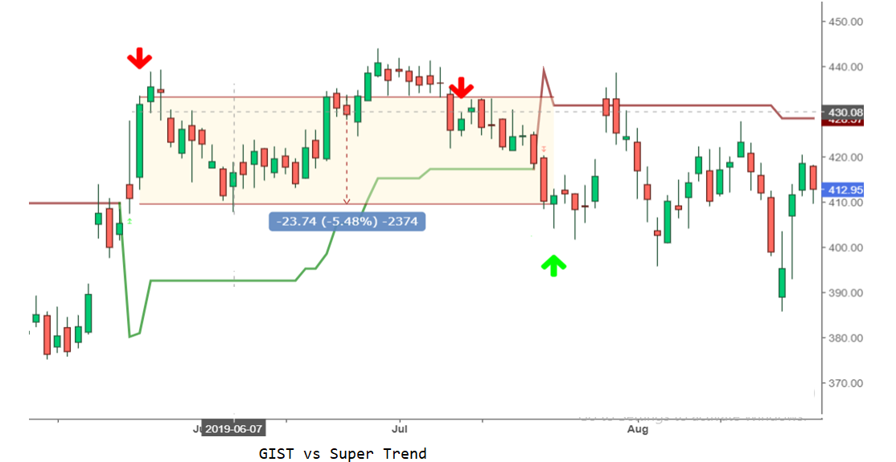
ICICI Bank 2019 May – June , Short Trading
Comparison with Super Trend

Slide 3
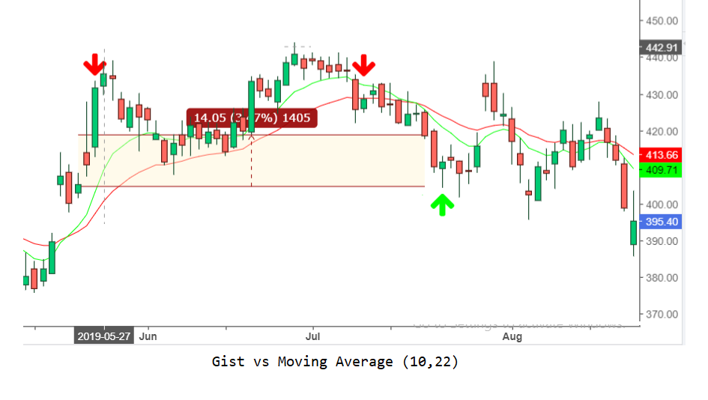
ICICI Bank 2019 May – June , Short Trading
Comparison with Moving Average

Slide 4
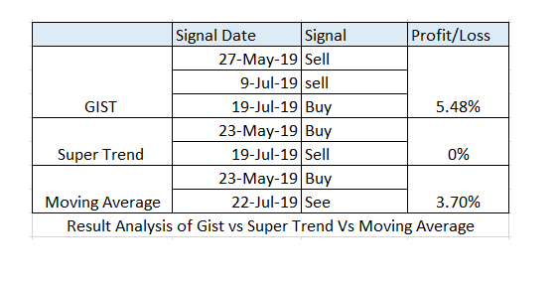
Continue…
Result Analysis

Slide 5
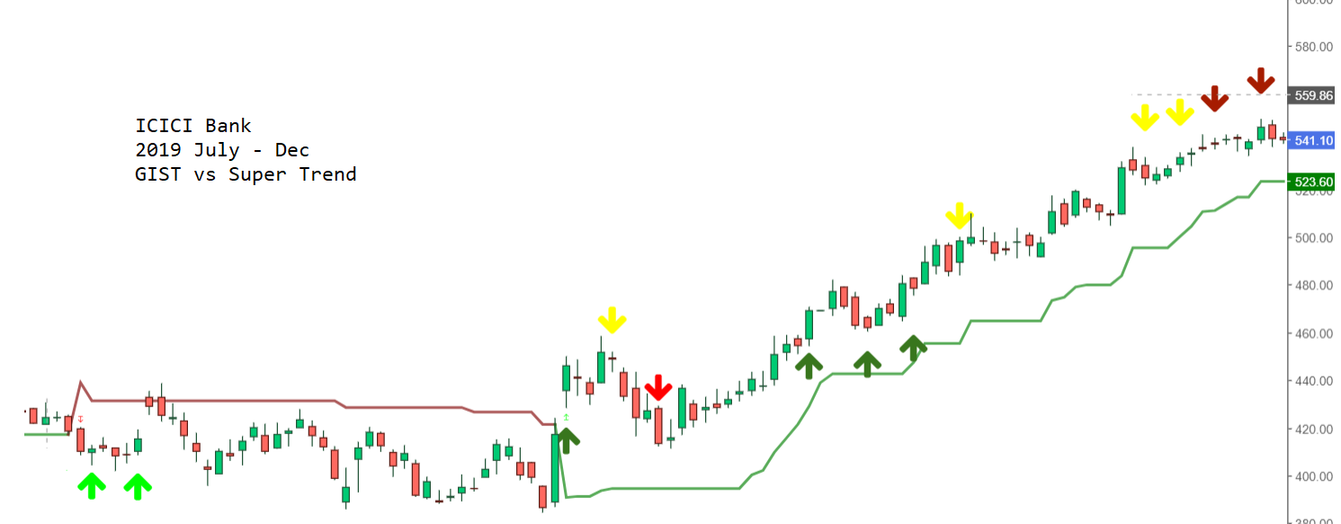
ICICI Bank – July 2019 to Dec 2019 , GIST vs Super Trend Comparative Analysis

Slide 6
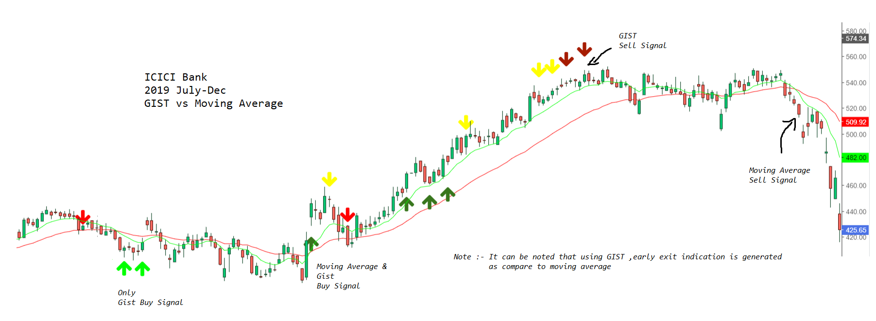
ICICI Bank – July 2019 to Dec 2019 , GIST vs Moving Average Comparative Analysis

Slide 7
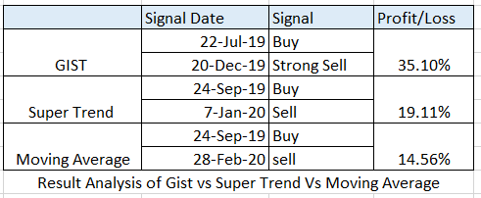
Continue…
Result Analysis

Slide 8
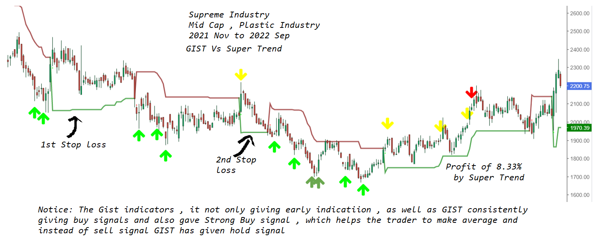
Supreme Industry (during sideways market) , Nov 2021 to Sep 2022

Slide 9
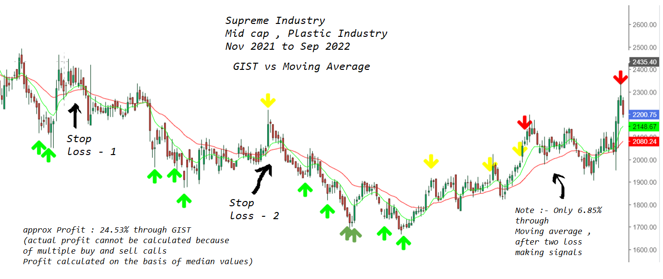
Supreme Industry (during sideways market) , Nov 2021 to Sep 2022

Slide 10
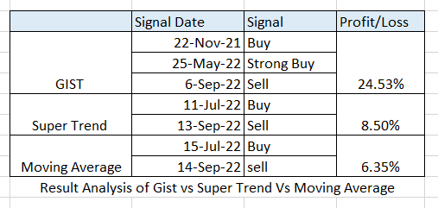
Continue…
Result Analysis

