Slide 1

Java Script
Building Event Based Web Applications.

Slide 2
Course Objective
Understanding Java Script.
Java Script Programming approach.
Data types.
Objects and Functions.
Understanding classes.
Understanding error handling.

Slide 3
Requirement
Adding presentation logic.
Triggering action on specific event.
Creating Rich Internet Applications (RIA).

Slide 4
Java Script
Java script easily embedded into HTML.
Java Script gives HTML designer a programming tool.
It can react on events.
It can read HTML data.

Slide 5
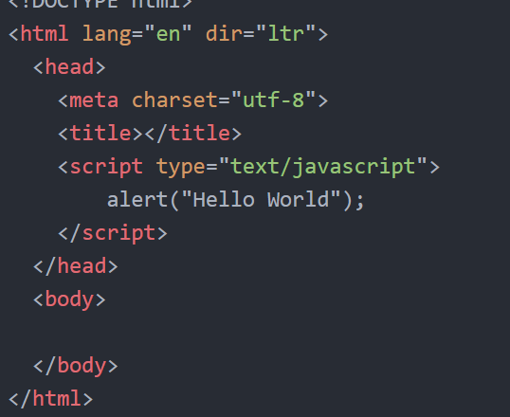
Java Script Hello World

Slide 6
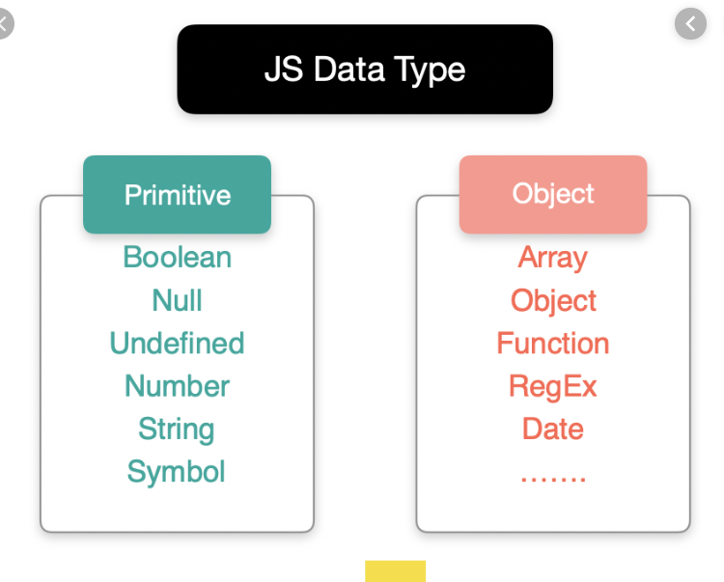
Java Script Data Type

Slide 7
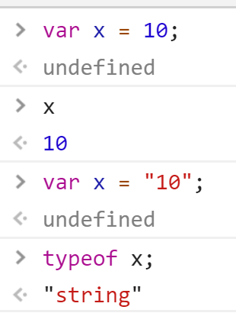
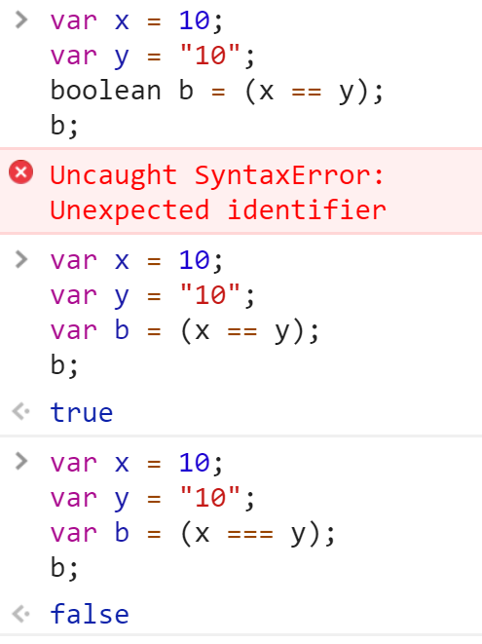
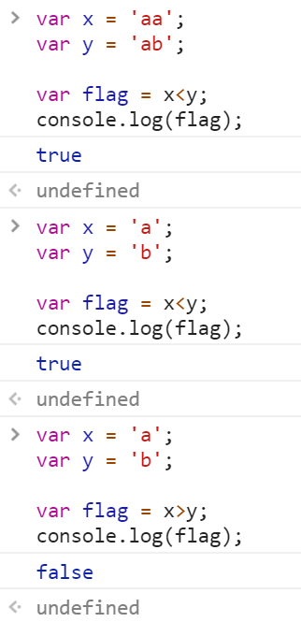
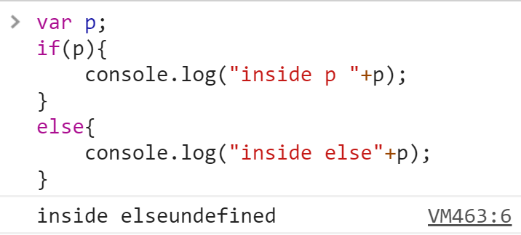
Continue

Slide 8
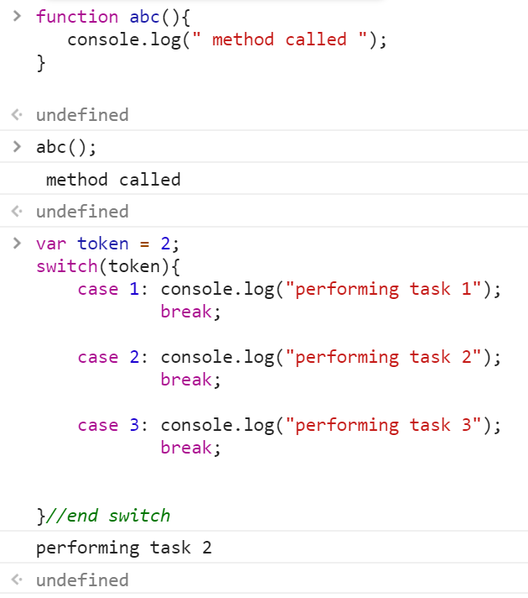
Programming Control logic
Java script contains all programming contraints like
1) loops
2) if else
3) switch case.
4) operators (=== unique in java script)

Slide 9
END of Java Script

