Slide 1








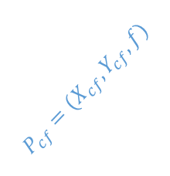


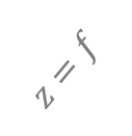

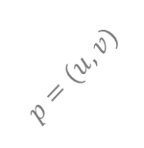
$$P_{w}=\left(X_{w}, Y_{w}, Z_{w}\right)⇒ P_{c}= (X_{c}, Y_{c}, Z_{c})$$
$$u$$
$$A_{c}$$
$$P_{cf}=(X_{cf}, Y_{cf}, f)$$
$$z_{c}$$
$$p=(u, v)$$
$$A_{cf}$$
optical axis
$$o_{c}^{′}=(c_{x}, c_{y})$$
$$O_{cf}$$
$$Z$$
$$X$$
$$z=f$$
$$O_{c}$$
$$v$$
Y
针孔相机模型示意图

