Slide 1

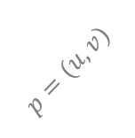







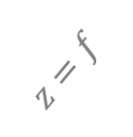



$$P_{w}=\left(X_{w}, Y_{w}, Z_{w}\right)⇒ P_{c}= (X_{c}, Y_{c}, Z_{c})$$
$$u$$
$$p=(u, v)$$
$$x$$
$$z$$
optical axis
$$o_{c}^{′}=(c_{x}, c_{y})$$
$$Z_{c}$$
$$X_{c}$$
$$z=f$$
$$O_{c}$$
$$y$$
$$v$$
$$Y_{c}$$
针孔相机模型示意图

