Slide 1








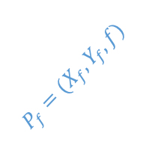


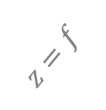

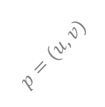
$$P_{w}=\left(X_{w}, Y_{w}, Z_{w}\right)⇒ P_{c}= (X_{c}, Y_{c}, Z_{c})$$
$$u$$
$$A_{c}$$
$$P_{f}=(X_{f}, Y_{f}, f)$$
$$O_{c}$$
$$p=(u, v)$$
$$A_{f}$$
optical axis
$$o^{′}=(c_{x}, c_{y})$$
$$O_{f}$$
$$Z$$
$$X$$
$$z=f$$
$$O$$
$$v$$
Y
针孔相机模型示意图

